Slide 1

Research Question – Presentation for Feedback Date:
Group Name: A315 Name of Student Presenting: Mohammed Umar Shaik

Slide 2
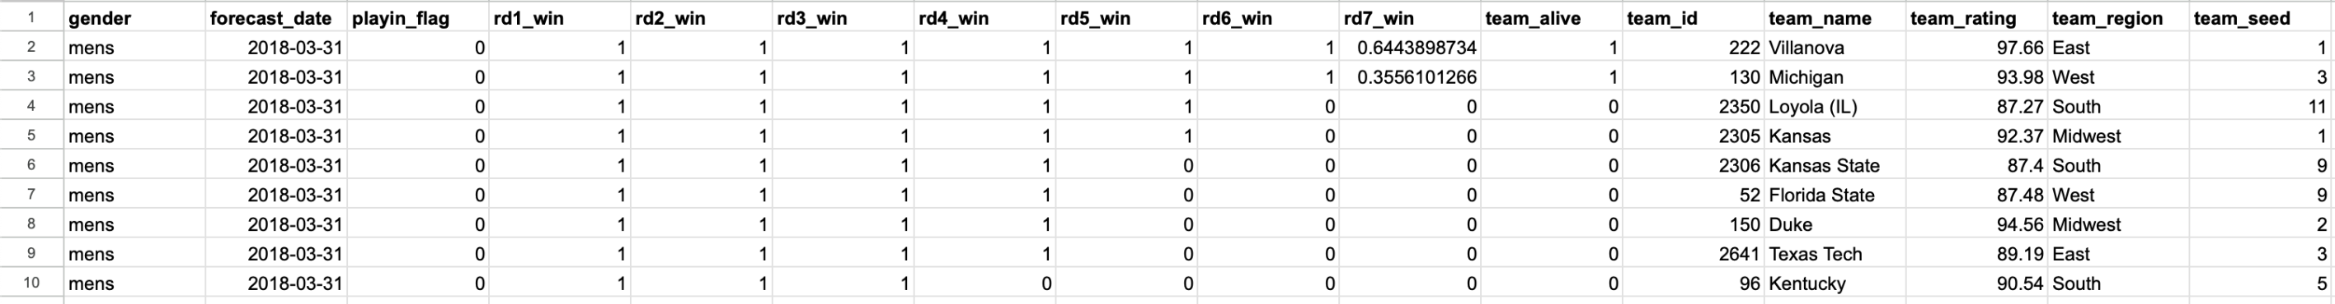
The columns/variables we are using are team_rating, team_region.
Total rows of dataset = 1456
Dataset Snippet:

Slide 3
This dataset is interesting to us because : it provides insights into the performance metrics, probabilities, and regional comparisons of NCAA basketball teams, allowing us to analyze factors influencing tournament outcomes. Our Independent variable is: Region This Independent variable datatype is (select one): Nominal/Categorial Our Dependent variable is: TeamRating This Dependent variable datatype is (select one): Interval/Measurement data
Dataset ID: (DS307 NCAA Men 538 team ratings)
Notes:
Before specifying your Research Question you must define the type of data you are analysing. Are the variables you select interval data (measurement data you can divide, multiple, etc), OR are they ordinal (there is a definite order but the intervals between each variable are not necessarily equal, or the terms might be subjective like in a likert scale); OR are they just categorical/nominal (Items such as film names, cities, etc., that you can count numbers of occurrences? You also need to understand whether the variable is either dependent or independent and this will vary according to the context. Independent variables may cause an effect, whereas the dependent variable might be effected by the independent variable. Check the lecture notes on the RQ for more information and examples.
You will get only one opportunity to present your Research Question ahead of the submission date. Have your questions ready, and be ready to take notes on feedback.

Slide 4
Template 2: Interval/Ordinal vs Nominal : Is there a difference in the means of team ratings between teams from the East region and teams from the South region? Hypothesis: 1. Null hypothesis (H0): There is no difference in the means of team ratings between teams from the East region and teams from the South region. 2. Alternative hypothesis (H1): There is a difference in the means of team ratings between teams from the East region and teams from the South region.
Our Research Question is

Slide 5
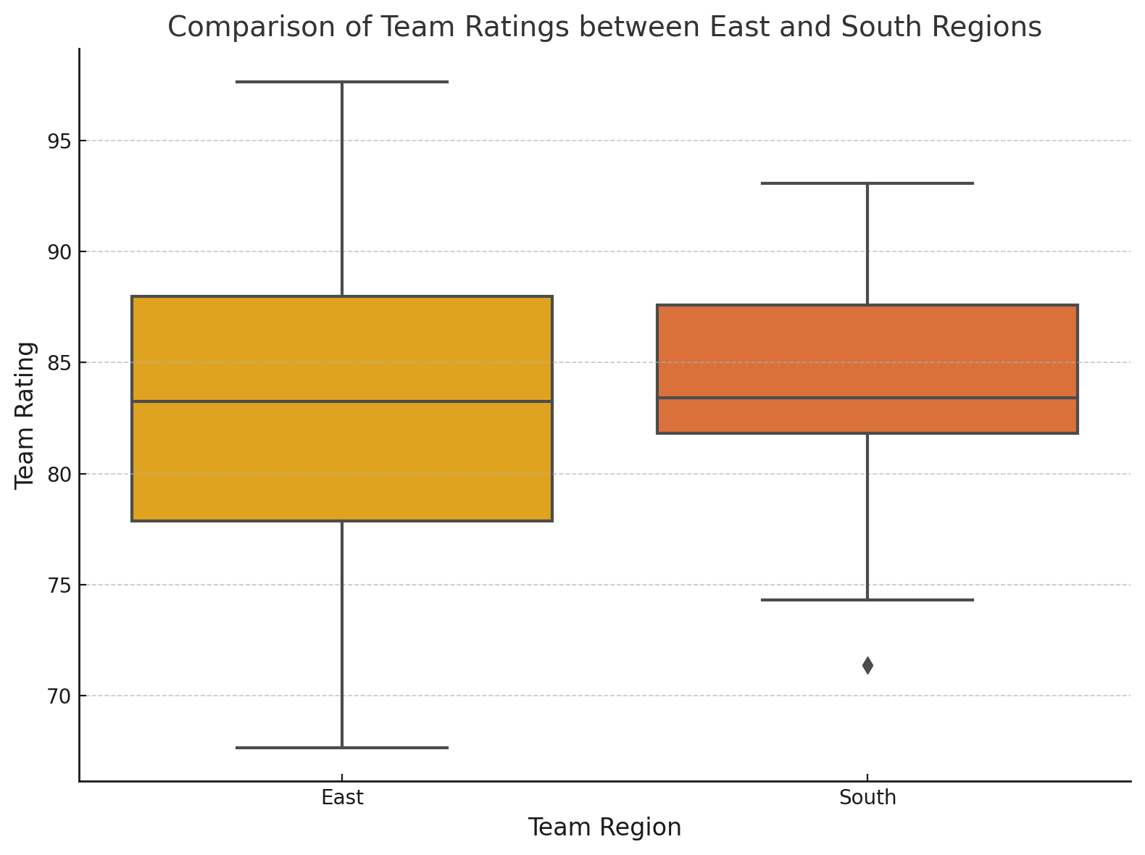
Sample sizes:
East region: 216 teams
South region: 192 teams
p-value: 0.0126
"We reject the null hypothesis"

