Slide 1
Sykes Seafood | Company Overview
Independent seafood processor and distributor serving UK and European retail, foodservice and manufacturing customers
Business Overview (inc. channels, RTM and ownership)
Select Product Overview
Founded in Manchester in 1862. Now headquartered in Warrington, with a particular focus on warm-water and cold-water prawns [1]
Privately controlled by Alan Dale through ADRD Investments. The group includes Sykes Seafood and Dutch shrimp processor Klaas Puul [2]
Over 600 products across 110 species. Supplies branded and customer own-label seafood to retailers, wholesalers, foodservice operators and manufacturers [1]
Liverpool processing site handles c.350 tonnes per week. Klaas Puul adds processing in Edam / Volendam and shrimp peeling in Morocco [3]
Arctic Royal is the premium flagship brand, complemented by Clear Seas. Both serve retail and foodservice alongside own-label supply [1]
Cold-water prawns
Warm-water prawns
Cooked and peeled prawns
King prawns in multiple sizes / formats
Argentinian prawns
Whitefish
Recent Developments and M&A Activity
2020–23: added Klaas Puul, Ruskim Seafoods and the trading assets of The Big Prawn Co., expanding European shrimp and UK distribution capabilities [4]
2023: opened the 167,000 sq ft Warrington head office / distribution centre and consolidated Big Prawn production into Liverpool [2,3]
FY25: operating profit recovered to £12.9m on broadly flat revenue after acquisition integration [2]
Wild red prawns, whole or peeled
Cod, haddock, pollock, basa and hake
Key Financial Information
Added-value prawns
Squid & octopus
ADRD Investments consolidated group (£m)
 | FY24 | FY25
Revenue | 349.9 | 347.4
Operating profit | 4.6 | 12.9
Operating margin | 1.3% | 3.7%
Profit before tax | (0.9) | 8.5
Marinated, breaded, battered and tempura
Frozen cephalopod range
Years ended 30 Mar 2024 / 29 Mar 2025. FY25 revenue −0.7%.
UK Sykes Seafood Ltd alone: £241.7m revenue / £3.8m PBT [2,5]
1
Sources: company information, statutory filings and trade press. Full claim-by-claim references in slide notes.
31 October 2026
Notes:
Research cut-off: 31 October 2026. All financial amounts are actuals unless stated.
[1] Sykes, Who we are: https://www.sykesseafood.com/who-we-are (accessed 31 October 2026). Supports foundation in 1862, 600+ products / 110 species, channels, brands and own-label offer. Head office address also shown on company website. Product details / photographs: https://www.sykesseafood.com/ (accessed 31 October 2026), product sections Coldwater Prawns, Warm Water Prawns, Wild Argentinian Prawns, Whitefish, Added Value King Prawns, Squid & Octopus. These are category illustrations from the company's website, not a claim that every item is sold in the depicted packaging.
[2] ADRD Investments Ltd, accounts to 29 March 2025, filed 17 February 2026, Companies House company 11424167: https://find-and-update.company-information.service.gov.uk/company/11424167/filing-history/MzUwNTE1MTQwMGFkaXF6a2N4/document?format=pdf&download=1 . Consolidated revenue £347.363m vs £349.892m, operating profit £12.919m vs £4.556m, PBT £8.507m vs loss £0.928m. Cross-check: https://theaccounts.uk/company/11424167/adrd-investments-limited/ . Margins calculated as operating profit / revenue. Revenue growth = 347.363 / 349.892 − 1 = −0.72%. These are the consolidated parent figures, including Klaas Puul, not just the UK trading company. Group notes and strategic report support 2023 Warrington opening / operational consolidation and Norfolk-to-Liverpool production migration on 14 November 2023. Attribution of profit recovery to integration is context, not a quantified causal bridge.
Ownership: ADRD PSC register shows Alan David Dale with 75–100% of shares and voting rights: https://find-and-update.company-information.service.gov.uk/company/11424167/persons-with-significant-control . ADRD group notes list Sykes companies (94.99% effective group interest) and Klaas Puul subsidiaries.
[3] Sykes, Our Facilities: https://www.sykesseafood.com/our-facilities . Supports 350 tonnes weekly in Liverpool, 167,000 sq ft Warrington, Edam, Volendam and Morocco operations. Website also retains stale references to Norfolk; the later FY25 accounts' closure / consolidation disclosure takes precedence.
[4] The Grocer, 30 January 2023: https://www.thegrocer.co.uk/news/sykes-seafood-saves-120-jobs-in-big-prawn-co-pre-pack-administration-deal/675912.article . Dates Klaas Puul completion to 2020 and Ruskim to 2021. Sykes announcement, 30 January 2023: https://backend.sykesseafood.com/press_release/sykes-purchases-big-prawn-assets/ . Acquisition was of trading assets, not shares. Ruskim company announcement: https://backend.sykesseafood.com/press_release/ruskim/ .
[5] Sykes Seafood Ltd, accounts to 29 March 2025, company 02289318, filed 18 February 2026: https://find-and-update.company-information.service.gov.uk/company/02289318/filing-history . Financial transcription: https://www.192.com/atoz/financial/business/02289318/ . UK trading company revenue £241.735m / PBT £3.808m, distinct from ADRD group.
Image / logo sources: company website. Exact image URLs are recorded below.
EXACT PRODUCT IMAGE SOURCES
Cold-water prawns: https://backend.sykesseafood.com/wp-content/uploads/shutterstock_1174700956-1.webp
Warm-water prawns: https://backend.sykesseafood.com/wp-content/uploads/prawns-on-slate.webp
Argentinian prawns: https://backend.sykesseafood.com/wp-content/uploads/wild-argentinian-prawns.webp
Whitefish: https://backend.sykesseafood.com/wp-content/uploads/shutterstock_2143659651.webp
Added-value prawns: https://backend.sykesseafood.com/wp-content/uploads/shutterstock_1092323240-1.webp
Squid & octopus: https://backend.sykesseafood.com/wp-content/uploads/squid.webp
Logo(s): https://www.sykesseafood.com/sykes-brand-logo-white.svg

Slide 2


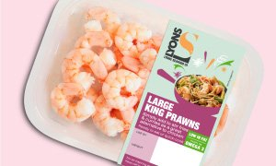
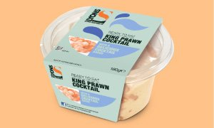
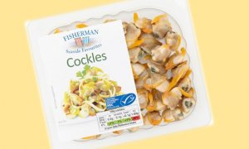
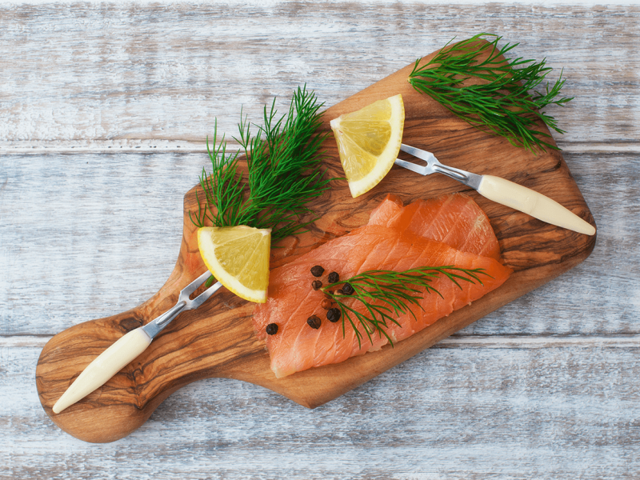
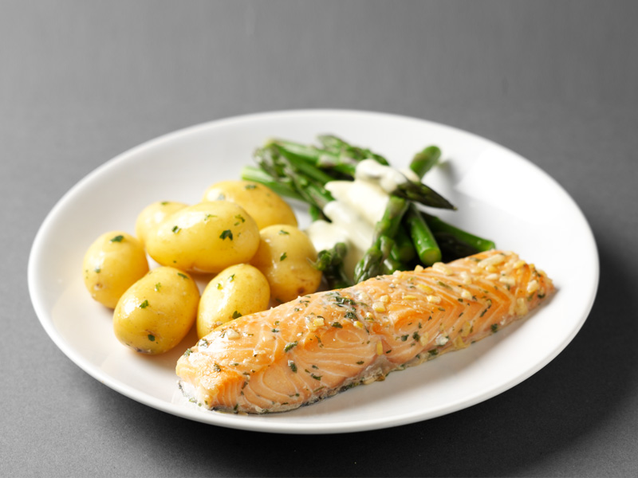
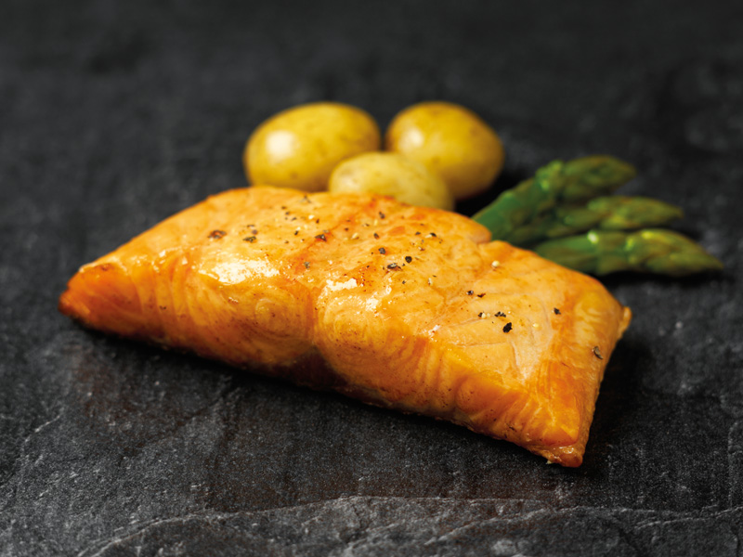
Lyons & Farne | Company Overview
Labeyrie’s UK seafood businesses supplying prawns, speciality shellfish and salmon, primarily through retailer own labels
Business Overview (inc. channels, RTM and ownership)
Select Product Overview
Two UK operating companies within Labeyrie Fine Foods: Lyons Seafoods in Warminster, Wiltshire, and Farne Salmon & Trout in Duns, Scotland [1]
Labeyrie ownership: PAI Partners 46%, agricultural cooperative Lur Berri 46%, with employees holding the balance. Both UK businesses joined the group in 2004 [1,2]
Lyons supplies prawns and speciality seafood to UK retail, catering and manufacturing customers. Its offer includes warm-water / cold-water prawns and other shellfish [3]
Farne processes fresh and smoked salmon, including cold-smoked, hot-smoked, ready-to-eat and natural / ready-to-cook products [4]
Major-retailer own-label supply is central to the UK offer. The Real Seafood Co. brand also grew with retail customers in FY25 [1,3]
Lyons: prawns & shellfish
Lyons: seafood cocktails
Essential ingredients for home cooking
Prepared prawn cocktail ranges
Lyons: seaside favourites
Farne: cold-smoked salmon
Recent Developments and M&A Activity
Oct 2025: Houlihan Lokey reportedly marketed both businesses together, citing c.£30m EBITDA and £240–300m asking value [5]
FY25: Lyons revenue rose 8.3% and Farne revenue fell 1.0%. Both increased operating profit, taking combined EBIT to £23.2m [6]
Aug / Sep 2026: press reported plans for a wider Labeyrie sale by July 2027, separate from the UK disposal process [7]
Convenient prepared seafood
Mild oak, hickory and organic options
Key Financial Information
Farne: hot-smoked salmon
Farne: natural salmon
Standalone entities, years ended 30 June (£m)
 | FY24 | FY25
Lyons revenue / EBIT | 120.3 / 8.6 | 130.3 / 11.8
Farne revenue / EBIT | 119.0 / 9.4 | 117.9 / 11.4
Combined revenue¹ | 239.3 | 248.2
Combined EBIT¹ / margin | 18.0 / 7.5% | 23.2 / 9.3%
Lemon & parsley and flavoured fillets
Ready-to-cook salmon products
¹ Simple sum before any intercompany eliminations / carve-out costs.
FY25 PBT: Lyons £13.4m / Farne £11.9m [6]
2
Sources: company information, statutory filings and trade press. Full claim-by-claim references in slide notes.
31 October 2026
Notes:
Research cut-off: 31 October 2026. This profile covers the two UK companies, not the whole Labeyrie Fine Foods group.
[1] Labeyrie Fine Foods UK, Modern Slavery Statement 2021: https://lyons-seafoods.com/downloads/test20230327.pdf . Identifies both UK operating companies, their private-label focus, species and 2004 acquisition. Current UK tax policy: https://www.lyons-seafoods.com/downloads/labeyrie-fine-foods-group-uk-tax-policy-june-2024.pdf . Confirms the two entities manufacture and supply major retailers in UK / abroad. Locations: Lyons contact https://lyons-seafoods.com/get-in-touch/ ; Farne https://farnesalmon.com/about-us/ and company registry.
[2] Labeyrie Fine Foods, strategic plan press release, 12 June 2025: https://www.labeyrie-fine-foods.com/media/1870/download/LabeyrieFineFoods_plan_strategique_juin25.pdf?v=1 . PAI and Lur Berri hold 46% each, remainder employees. Cross-check current shareholder page: https://www.lurberri.fr/fr/poles-dactivites/pole-agroalimentaire/labeyrie-fine-foods/ . Avoid describing PAI as sole owner.
[3] Lyons Seafoods Ltd, FY25 annual accounts, strategic report printed p.2 and income statement, filed 27 March 2026: https://find-and-update.company-information.service.gov.uk/company/02987743/filing-history/MzUxMTY3NDY3MGFkaXF6a2N4/document?format=pdf&download=1 . Principal activity is sale of prawns and speciality seafood to UK retail, catering and manufacturing. Strategic report states The Real Seafood brand continued growth with main retail customers and notes a challenged cold-water prawn market. Species / history: https://www.lyons-seafoods.com/downloads/statement-welfare-2025.pdf .
[4] Farne products: https://farnesalmon.com/our-products/ . Supports production categories. Detailed ranges and images: https://farnesalmon.com/cold-smoked-salmon/ ; https://farnesalmon.com/hot-smoked-salmon/ ; https://farnesalmon.com/natural-salmon/ .
[5] Fish Farming Expert, 14 October 2025, reporting Undercurrent sources: https://www.fishfarmingexpert.com/farne-salmon-trout-houlihan-lokey-labeyrie-fine-foods/scottish-borders-salmon-factory-reported-to-be-up-for-sale/2007487 . Reports HL marketing both UK assets as a package, c.£30m EBITDA / c.£240m revenue in sales documents and an 8–10x EBITDA aspiration (£240–300m). These are reported process figures, with undisclosed period / adjustments, not audited FY25 EBITDA or a completed valuation. No completed UK sale is established by the cited material.
[6] FY25 / FY24 financial data: Lyons accounts above; Farne Salmon & Trout Ltd, filed 24 March 2026: https://find-and-update.company-information.service.gov.uk/company/SC076613/filing-history/MzUxMTY3NDY3MWFkaXF6a2N4/document?format=pdf&download=1 . Corroborating transcriptions: https://theaccounts.uk/company/02987743/lyons-seafoods-limited/ and https://theaccounts.uk/company/SC076613/farne-salmon-trout-limited/ . Lyons revenue £130.312m / £120.314m; EBIT £11.792m / £8.555m; PBT £13.419m / £10.064m. Farne revenue £117.866m / £119.016m; EBIT £11.403m / £9.399m; PBT £11.885m / £9.966m. Combined revenue £248.178m / £239.330m; EBIT £23.195m / £17.954m. Simple sum, no intercompany eliminations, separation costs, standalone central costs or pro forma adjustments. Combined EBIT margins calculated as summed EBIT / summed revenue. Revenue growth Lyons +8.31%, Farne −0.97%. EBIT is operating profit, not EBITDA.
[7] L’Informé, 31 August 2026, updated 3 September: https://www.linforme.com/grande-conso/article/pressee-par-ses-creanciers-lur-berri-planche-sur-la-vente-de-labeyrie_6665.html . Reports banks pressing Lur Berri for disposal of Labeyrie before 31 July 2027. Reported parent-level plans only, not an announced completed sale of these two divisions.
Product photos / labels: https://lyons-seafoods.com/products/ and the Farne pages in [4]. Photos are examples on company websites and may show historic packaging, not confirmation of current retailer contracts. Natural-salmon image is the lightly smoked ready-to-cook fillet shown on Farne's natural-salmon page. Logos: respective company websites. Exact asset URLs below.
EXACT PRODUCT IMAGE SOURCES
Lyons: prawns & shellfish: https://lyons-seafoods.com/uploads/collections/essential_ingredients20130422_thumb.jpg
Lyons: seafood cocktails: https://lyons-seafoods.com/uploads/collections/cocktails20130422_thumb.jpg
Lyons: seaside favourites: https://lyons-seafoods.com/uploads/collections/seaside_favourites20160907_thumb.jpg
Farne: cold-smoked salmon: https://farnesalmon.com/wp-content/uploads/2018/03/farne-home-salmon-new-1-800x600.png
Farne: hot-smoked salmon: https://farnesalmon.com/wp-content/uploads/2016/08/Co-op-plain-hot-smoked-salmon-800x600-1.jpg
Farne: natural salmon: https://farnesalmon.com/wp-content/uploads/2016/08/Lightly-Smoked-Salmon-Fillet-800x600.jpg
Logo(s): https://lyons-seafoods.com/img/logo.png ; https://farnesalmon.com/wp-content/themes/farne/images/farne-logo.png

Slide 3
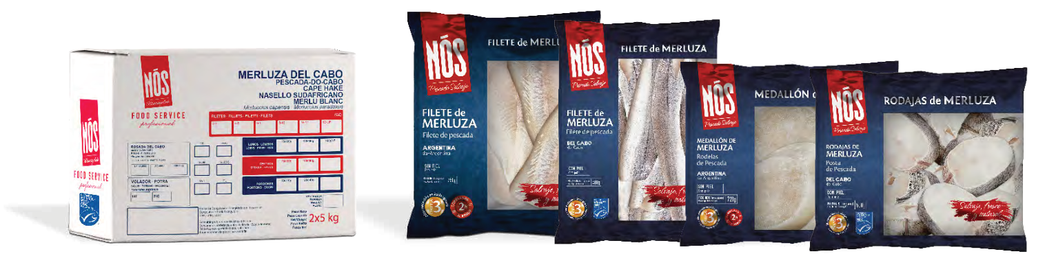
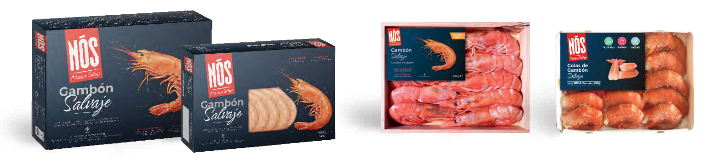
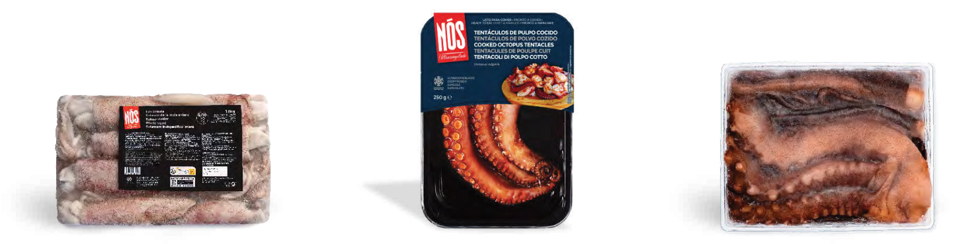
Iberconsa | Company Overview
Platinum Equity-owned, vertically integrated frozen seafood group with fishing operations in Argentina and Southern Africa
Business Overview (inc. channels, RTM and ownership)
Select Product Overview
Founded in 1981 and headquartered in Vigo, Spain. Activities span wild catch, processing, cold storage, distribution and commercialisation [1]
Platinum Equity acquired the business in June 2019 from Portobello Capital and founding-family shareholders. It remains an active portfolio company [2]
Owner-reported footprint: 40 vessels, five processing plants and four cold-storage distribution facilities, selling into more than 60 countries [2]
Fleet operates primarily in Argentina, Namibia and South Africa. Approximately 90% of sales volumes are produced in-house, supporting control of supply [2,3]
Sales channels include trading, retail and foodservice in Europe and Asia-Pacific. Core products are hake, wild red shrimp and squid [1,3]
Hake
Frozen fillets, medallions and steaks in retail bags / boxes
Argentine red shrimp
Recent Developments and M&A Activity
2024: established Iberconsa (Shanghai) Trading, adding a local commercial presence in China [1]
May 2026: trade press reported Platinum retaining the business and a renewed focus on growth / acquisitions [4]
Sep 2026: trade press reported completion of corporate debt refinancing. Earlier 2027 maturity warnings pre-date this development [5]
Wild shrimp in display boxes and retail trays
Key Financial Information
Cephalopods
FY25 public financial disclosures (€m)
Metric / reporting scope | FY24 | FY25
Revenue: Grupo Ibérica¹ | 419.3 | 398.1
S&P-adjusted EBITDA² | 69.0 | 75.4
Fitch-adjusted EBITDA² | — | 82.0
Fitch EBITDA margin² | — | 18.2%
Squid and octopus ranges, including block and skin-pack formats
¹ Spanish reporting entity. ² Bering / rating-group scope and adjustments.
These measures are not directly comparable. See notes [3,6,7]
3
Sources: company information, statutory filings and trade press. Full claim-by-claim references in slide notes.
31 October 2026
Notes:
Research cut-off: 31 October 2026. Currency EUR. Financial scopes and definitions differ and must not be blended into a single unqualified group margin.
[1] Iberconsa, The Group: https://www.iberconsa.com/the-group . Supports 1981 foundation, countries of operation, integrated activities and 2024 Shanghai entity. Products: https://www.iberconsa.com/products . Supports species and formats: hake, Argentine shrimp, Illex / Patagonian / South African / Indian squid; Cape hake filleted / frozen on-board and portioned at Walvis Bay. Product text / images are company-sourced.
[2] Platinum Equity, active portfolio profile: https://www.platinumequity.com/our-company/iberconsa/ . Supports acquisition in June 2019 from Portobello and founding-family affiliates, full value chain, 40 vessels, five plants, four distribution cold stores and 60+ countries. These are owner-published footprint indicators rather than independently verified FY26 counts.
[3] Fitch rating commentary reproduced in Troubled Company Reporter Europe, 7 May 2026: https://www.bankrupt.com/TCREUR_Public/260507.mbx , section BERING III. Reports FY25 adjusted EBITDA €82m and 18.2% margin, 90% sales volumes produced in-house, Europe / APAC trading, retail and foodservice channels. Fitch's adjustment scope differs from Spanish operating-company accounts and S&P. The original May downgrade / 2027 maturity warning is historical, with subsequent refinancing reported in September. Company mix cited by Fitch was hake 41%, wild shrimp 31%, cephalopods 16% of 2025 sales; not used to infer volumes or apply to the Spanish entity's revenue.
[4] Alimarket, 13 May 2026: https://www.alimarket.es/alimentacion/noticia_amp/425793/iberconsa-da-un-golpe-de-timon--buscara-doblar-su-tamano-con-alguna-compra-y-dilatara-la-salida-de-platinum ; Undercurrent News, 14 May 2026: https://www.undercurrentnews.com/2026/05/14/platinum-equity-holds-on-to-iberconsa-as-group-nears-e500m-sales-mark/ . Both headlines indicate delayed Platinum exit / renewed growth focus. No unverified acquisition size or sales forecast has been treated as actual.
[5] Undercurrent News, 4 September 2026: https://www.undercurrentnews.com/2026/09/04/spains-iberconsa-completes-debt-refinancing-sets-sights-on-further-growth/ . Public headline establishes reported refinancing completion, but detailed terms are subscription-only. No new financing amount, coupon or maturity is asserted.
[6] Spanish reporting entity Grupo Ibérica de Congelados, as reported by Economía Digital, August 2026: https://www.economiadigital.es/galicia/empresas/iberconsa-profand-nueva-pescanova-wofco.html and Xornal Económico: https://xornaleconomico.com/actualidad/iberconsa-cierra-2025-con-ventas-de-398-millones-un-5-menos-y-dispara-su-deuda-un-34/ . Revenue €398.1m FY25, down c.5%; FY24 €419.31m corroborated by https://www.ttrdata.com/en/radar/aggregated/Blackstone-KKR-BC-Partners-Ardian-and-CVC-Capital-Partners-Global-interested-in-acquiring-55-of/260357/ . These are the Spanish reporting-entity figures, not represented as Bering rating-group consolidated revenue.
[7] S&P commentary reproduced in TCR Europe, 9 June 2026: https://www.bankrupt.com/TCREUR_Public/260609.mbx , BERING III section. S&P-adjusted EBITDA €75.4m in 2025 vs c.€69m in 2024 and reported rating-group revenue decline of 5.6%. Notes shorter shrimp season and higher margins from FX, mix and efficiency. EBITDA €75.4m and Fitch €82m are alternative agency-adjusted measures, not interchangeable statutory EBITDA. No margin is calculated using these figures and the Spanish entity's €398.1m revenue.
Image sources: Iberconsa products page; logo: company website. Exact URLs below.
Product pack photographs and format descriptions: Iberconsa General Catalogue, currently linked on company products page, https://www.iberconsa.com/wp-content/uploads/2026/04/catalogo2026.pdf , PDF pages 82, 84, 86 (printed pp.80, 82, 84). Images are cropped from catalogue pages. Catalogue file path date does not establish an audited financial reporting date.
EXACT PRODUCT IMAGE SOURCES
Hake: https://www.iberconsa.com/wp-content/uploads/2026/04/catalogo2026.pdf (PDF page 82)
Argentine red shrimp: https://www.iberconsa.com/wp-content/uploads/2026/04/catalogo2026.pdf (PDF page 84)
Cephalopods: https://www.iberconsa.com/wp-content/uploads/2026/04/catalogo2026.pdf (PDF page 86)
Logo(s): https://www.iberconsa.com/wp-content/uploads/2024/09/iberconsa-2024-09-03.svg

