Slide 1
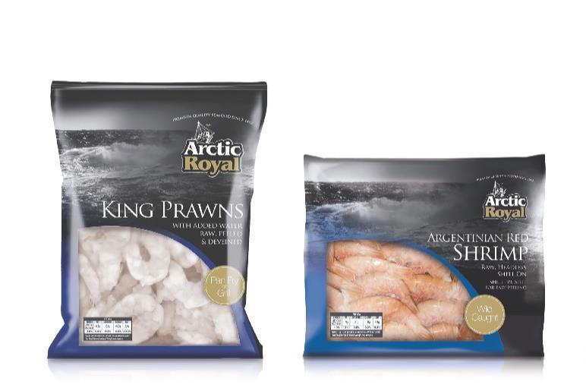
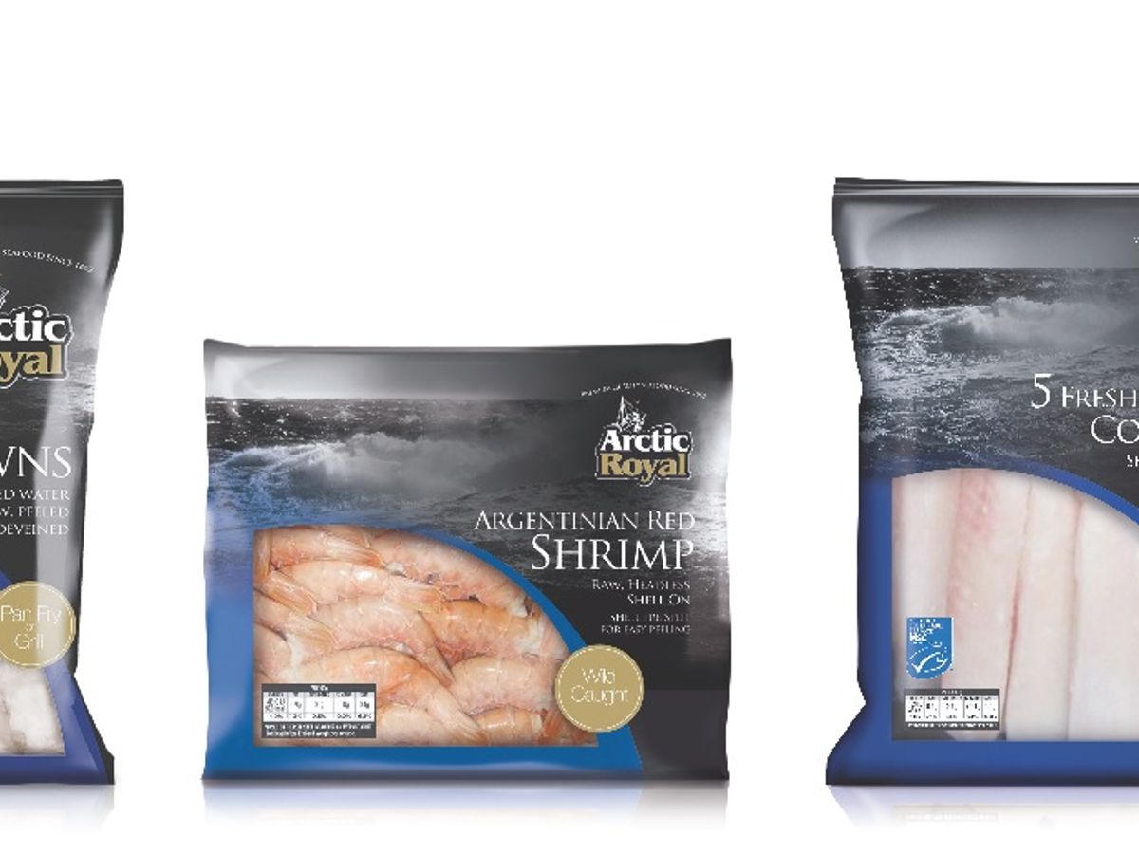
Sykes Seafood | Company Overview
Logo
Leading independent UK frozen seafood supplier with 160+ years of expertise, specializing in prawns and whitefish via vertical integration from global sourcing to UK processing and national distribution.
Business Overview (inc. distribution channels, RTM and ownership)
Select Product Overview
Founded in 1862 by Joseph Sykes in Manchester (Old Smithfield Market); now one of the UK’s leading independent frozen seafood suppliers.
Vertical supply chain: global sourcing of raw materials, processing/packing in UK facilities (Sefton, Liverpool BRC AA+ ~350t/week; Norfolk; Morocco hand-peeling via Klaas Puul), distribution from Warrington coldstore (new hub operational 2023).
Over 600 products across 110 species, specializing in warm- and cold-water prawns; brands include Arctic Royal (premium, 200+ SKUs), Clear Seas (value), Ocean Classic, Glenmyr. Also own-label for major retailers.
Channels: Foodservice (restaurants, hospitals, caterers), Wholesale, Retail (branded & private label), Manufacturers. National UK mixed/full pallet delivery; pan-European via Klaas Puul.
Ownership: Privately owned via ADRD Investments / Sykes Seafood Holdings. Key acquisitions: Klaas Puul (2019), Ruskim Seafoods (2021 – added meat/dry goods), Big Prawn Co. (2023).
Facilities span UK, Netherlands, Morocco; ~400+ employees; strong focus on sustainability (MSC, responsible sourcing).
Classic Prawns
Wild / Specialty
Arctic Royal
King Prawns
Argentinian Red
Shrimp
Whitefish &
Salmon
Value-Added
Frozen-at-sea cod,
haddock, fillets,
IQF portions
Tempura, breaded,
filo, marinated,
ready meals
Recent Developments and M&A Activity
• 2021: Acquired Ruskim Seafoods to expand range beyond seafood.
• 2023: Acquired Big Prawn Co.; new Warrington distribution centre operational (20-year lease); full group consolidation of Sykes/Ruskim/Big Prawn.
• Parent ADRD: FY2023 sales £347.7m (+42%), underlying EBITDA £23.9m, PBT £1.7m (impacted by inflation, FX, interest rates). Continued organic growth and capacity investments.
Foodservice & Own-Label
Clear Seas everyday range • Arctic Royal premium for retail/foodservice • Own-label packing for major UK retailers • Mixed pallets for wholesale • 600+ SKUs across prawns, whitefish, shellfish, value-added.
Key Financial Information
Group (ADRD) sales ~£348m (FY2023); Sykes Seafood Ltd turnover ~£242m (YE Mar 2025). ~400+ employees. Combined with affiliates creates ~$550m pan-European shrimp-focused business (historical). Sources: Company filings, SeafoodSource, Undercurrent News.
Sources: Company website (sykesseafood.com), SeafoodSource, Undercurrent News, Companies House / Pomanda filings, LinkedIn. Notes: (1) Group figures via ADRD Investments parent.
Notes:
Sources for Sykes Seafood:
- sykesseafood.com (Who we are, facilities, products, history, brands)
- SeafoodSource (ADRD FY2023 financials: £347.7m sales, EBITDA £23.9m, PBT £1.7m)
- Undercurrent News (distribution overhaul, Warrington DC)
- Companies House / Pomanda (Sykes Seafood Ltd turnover ~£242m YE Mar 2025)
- LinkedIn / company announcements (acquisitions of Klaas Puul 2019, Ruskim 2021, Big Prawn 2023)
- Birchall Foodservice and other trade sources for product range and processing volumes (~350t/week Sefton)
All figures as of latest available public data (2023-2026).

Slide 2
Lyons Seafoods & Farne Salmon | Labeyrie UK Seafood Divisions
Logo
UK leading specialty private-label seafood business within Labeyrie Fine Foods (PAI Partners / Lur Berri); focused on smoked salmon (Farne) and cooked prawns/shellfish (Lyons), serving major retailers.
Business Overview (inc. distribution channels, RTM and ownership)
Select Product Overview
Farne Salmon & Trout (Duns, Scottish Borders, founded 1982): One of Europe’s largest smoked salmon facilities; largest private employer in Borders (~500-700 staff). Produces cold/hot smoked, ready-to-eat, natural salmon, mackerel.
Lyons Seafoods (Warminster, Wiltshire, founded 1958): Leading UK supplier of freshly cooked prawns, shellfish (tropical/wild northern prawns, mussels, scallops, squid, crayfish). ~250-300+ employees.
Combined: Acquired by Labeyrie Fine Foods Group in 2004. Joint turnover >£240-260m; produces ~16,000 tonnes finished product. Primarily private label for major UK retailers (Tesco, Sainsbury’s, Asda etc.), plus brand The Real Seafood Company (launched ~2022).
Channels: Retail (core), foodservice, manufacturing. Global sourcing (Scotland/Ireland/Norway salmon; farmed/wild prawns), UK processing, distribution to retail/foodservice.
Ownership: Part of Labeyrie Fine Foods (France), jointly owned by private equity PAI Partners and Groupe Coopératif Lur Berri. Group is #1 in smoked salmon and shrimp in Europe (various markets).
Strong focus on responsible sourcing, welfare (decapod), GFSI certifications, modern slavery compliance.
Smoked Salmon
(Farne)
Cooked Prawns &
Shellfish (Lyons)
Cold & hot smoked
Ready-to-eat
Natural salmon
Flavored ranges
(Tesco Finest etc.)
Mackerel
Tropical & wild
northern prawns
Mussels, scallops
Squid, crayfish
Ready-to-eat packs
The Real Seafood Company Brand
Consumer brand launched ~2022. High-quality responsibly sourced seafood at accessible prices. Range includes smoked salmon, king prawns, crayfish, scallops. Available in Tesco, Sainsbury’s, Asda and growing. Private label remains core business (~100% UK activity historically private label).
Recent Developments and M&A Activity
• 2025: Reported potential sale process for UK assets (Farne + Lyons) via Houlihan Lokey; package valued at £240-300m (8-10x EBITDA of ~£30m, revenue ~£240m). No confirmed exit as of latest reports.
• The Real Seafood Co. brand growth with major retailers (Tesco Finest expansions, Sainsbury’s, Asda). Lyons FY2025 (YE Jun): turnover £130.3m (+8%), PBT £13.4m.
• Continued investment in product innovation (e.g., flavored smoked salmon ranges) and sustainability.
Private Label Leadership
Major UK retailer own-label programs for smoked salmon and cooked prawns/shellfish. Expertise in fresh and chilled formats, innovation in flavors and convenience.
Key Financial Information
Combined UK seafood: ~£240-260m revenue, ~£30m EBITDA (sale process docs). Lyons alone: £130m+ turnover, strong profits. Farne: largest UK salmon processor. Group Labeyrie ~€900m sales. ~900-1,000 UK employees across sites.
Sources: Labeyrie group site, Farne/Lyons sites, Fish Farming Expert / Undercurrent (sale process), Insider Media (Lyons FY2025), Modern Slavery statements, World Benchmarking Alliance.
Notes:
Sources for Lyons & Farne (Labeyrie UK):
- farnesalmon.com, lyons-seafoods.com, labeyrie-fine-foods.com (group overview, brands including The Real Seafood Company)
- Fish Farming Expert / Salmonexpert / Undercurrent News reports on potential sale process (2025): combined revenue ~£240m, EBITDA ~£30m, valuation £240-300m
- Insider Media: Lyons Seafoods YE Jun 2025 turnover £130.3m, PBT £13.4m, ~313 employees
- Modern Slavery Act statements (joint ~£260m turnover, 16,000t production, ~965 employees)
- World Benchmarking Alliance Seafood Stewardship Index (Labeyrie profile)
- Northumberland Gazette (Tesco Finest expansion)
All as of latest public information (2024-2026).

Slide 3
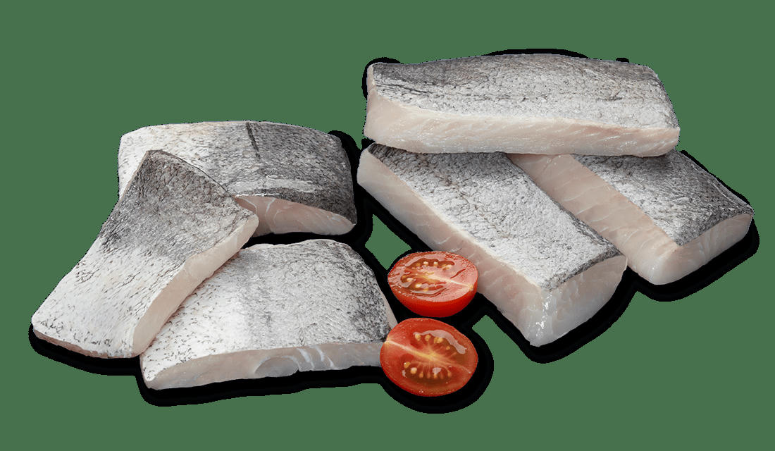
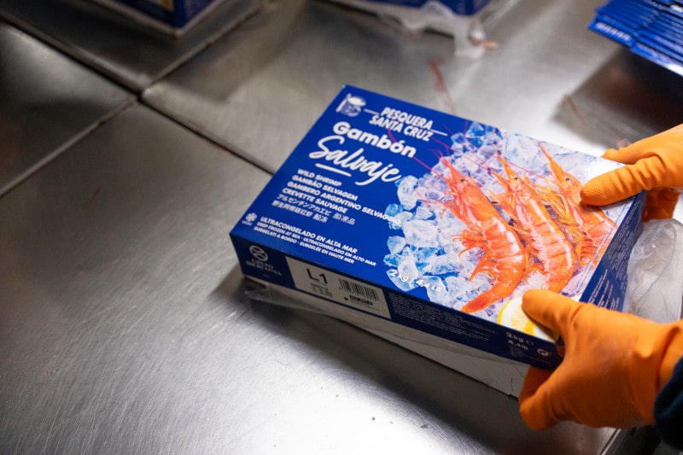
Iberconsa | Company Overview (Platinum Equity)
Logo
Vertically integrated global frozen seafood leader specializing in wild hake, Argentine red shrimp, and squid; owned by Platinum Equity (majority) with Portobello Capital minority stake.
Business Overview (inc. distribution channels, RTM and ownership)
Select Product Overview
Founded 1981 in Vigo, Spain by Galician partners. Fully vertically integrated: wild catch (own fleet), processing, commercialization, and distribution.
Fleet of ~40 vessels (freezer trawlers, shrimp trawlers/tangoneros, squid jiggers) operating primarily in Argentina, Namibia, and South Africa. Significant quotas for Cape/Argentine hake, Argentine shrimp, Illex squid.
Processing: 4-5 plants (Argentina: Rawson/Iberpesca, Puerto Deseado; Namibia: Walvis Bay/Embwinda JV; Spain: Vigo). Own cold storage network. Annual net production ~88-90,000 tons.
Products: Hake (~41% of revenue), wild Argentine red shrimp (~31%), Illex squid (~17%), other (monkfish, kingklip, etc.). Sold in 50-60+ countries via trading, retail, foodservice, manufacturers.
Ownership: Platinum Equity acquired majority stake in June 2019 from Portobello Capital and founding families (~€500-550m deal). Portobello retains minority. HQ Vigo; ~4,000+ employees group-wide.
Leader in frozen wild hake and Argentine shrimp globally; #3 in Spain across fish species. Strong in Europe and APAC.
Hake
Argentine Red
Shrimp
~41% revenue
Cape & Argentine
~31% revenue
Wild, frozen
Illex Squid &
Cephalopods
Other Species
~17% revenue
Jiggers fleet
Other squid
Monkfish
Kingklip
South African
squid etc.
Recent Developments and M&A Activity
• 2019: Platinum Equity majority acquisition.
• 2026: Refinancing/recapitalization with Banco Santander & Bank of America; Platinum (and Portobello) injected ~€134m (preferential shares / debt conversion). Debt reduced; structure enables future sale or IPO. S&P/Fitch notes on liquidity.
• Fleet investments and modernizations (e.g., API V, Santa Princesa). Navigating Argentine shrimp season challenges and inflation.
• Targeting >€500m revenue in 2026.
Vertical Integration Advantage
Own fleet (catch) → Onboard/processing plants → Cold stores → Global commercialization (trading, retail, foodservice). ~90% volumes produced in-house. Formats tailored for customers worldwide.
Key Financial Information
Revenue ~€450-480m (2024/25; some reports ~€398-454m depending on consolidation/year). EBITDA ~€75-80m+ (S&P/Fitch ~€75m adjusted 2025). Production ~90kt. Strong vertical integration supports margins above industry average. Platinum holding period extended beyond typical.
Sources: Platinum Equity, Iberconsa.com, S&P/Fitch ratings, elEconomista, Faro de Vigo, La Voz de Galicia, company history. Figures vary by year/source (2024-2026).
Notes:
Sources for Iberconsa:
- platinumequity.com/our-company/iberconsa (overview, fleet 40 vessels, 5 plants, 88k tons, acquisition 2019)
- iberconsa.com (integration, products, history since 1981, production ~90kt, sales ~€450m 2024)
- S&P Global Ratings (revenue €454m 2025e, EBITDA €75m adjusted; hake 41%, shrimp 31%, squid 17%)
- Fitch Ratings (similar; leading global frozen hake/shrimp)
- elEconomista.es, Faro de Vigo, La Voz de Galicia, El Confidencial (2026 refinancing ~€200m+, Platinum capital injection ~€134m, revenue targeting >€500m, 2025 ~€450m+)
- Mergr / CB Insights (ownership)
All figures as reported in public sources; note variations across years and consolidations.

