Slide 1
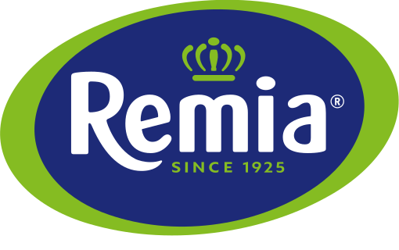
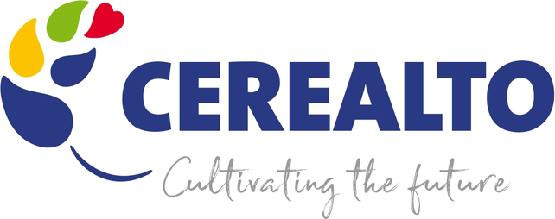
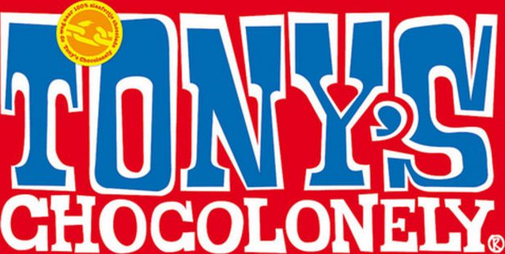


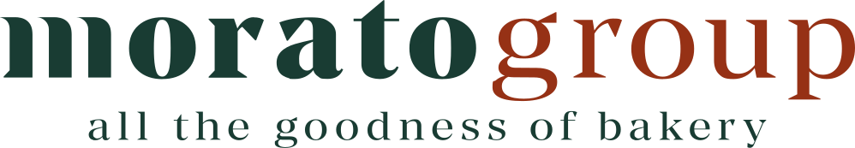





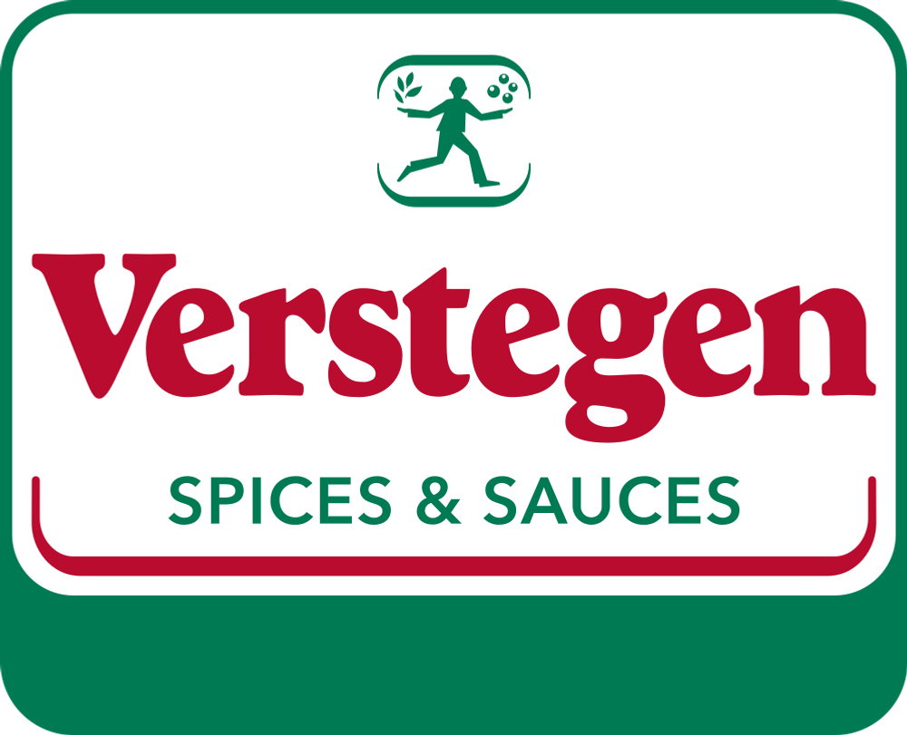




Consumer – Opportunities Pipeline (Benelux & Bakery)
Benelux
Bakery
Tony's Chocolonely
Verlinvest (Feb-20)
FY25 Revenue: c.€240m
Remia
Family-Owned (de Rooij)
Revenue: c.$169m (est.)⁽²⁾
Baker & Baker
Rhône Capital (Mar-13)
FY24 Revenue: €624m
Cerealto
Davidson Kempner & Afendis (Jul-22)
FY24 Revenue: €525m
Finsbury Food
DBAY Advisors (Sep-23)⁽⁴⁾
FY25 Revenue: £445m
Morato Pane
Aliante Partners (Oct-06)
PF Revenue: >€500m⁽⁵⁾
Cosucra
Family / Sofiprotéol, WE, SFPIM (2023)
FY26 Revenue: c.€150m⁽³⁾
Skins Cosmetics
Vendis Capital (Jan-24)
FY23 Revenue: >€40m
PE-Owned / Family-Owned
Increasing LFY Revenue
Country Style Foods
Family-Owned (Wood)
FY25 Revenue: £325m
Resch&Frisch
Family-Owned (Resch)
FY25 Revenue: €155m
PF Concept
Charlesbank & Partners Grp (Aug-16)⁽¹⁾
Revenue: n.a.
Verstegen
Family-Owned (Driessen)
Revenue: n.a.
Atrian Bakers
Grupo Lasem / Banc Sabadell (Jan-18)
FY24 Revenue: c.€65m
Prinsen Berning
Bencis (Jun-16)
FY24E Revenue: c.€200m
Hung
Euro Caps
Freshstream (Jun-17)
FY23 Revenue: c.$152m
Hung
Gisou
Eurazeo (Apr-22)
Revenue: n.a.
Delayed
No stalled / delayed processes flagged
Stalled / Delayed
Source: Company information, filed accounts, owner / investor announcements, select press (see source list). Revenue shown is latest available full year; logos ordered by revenue (highest top-left), n.a. last. GBP / USD converted at c.€1.17/£ and c.€0.86/$ for ordering only.
Notes: (1) Held via parent Polyconcept; standalone revenue not disclosed. (2) Data-provider estimate (ZoomInfo), not company-reported. (3) Statutory entity Cosucra – Groupe Warcoing SA, FYE Mar-26. (4) Date of recommended take-private offer. Euro Caps and Gisou stakes are minority (founders / management retain majority). (5) Pro forma for Jaus Bakery acquisition (Oct-26).
Notes:
Logo placeholders: company names are shown as wordmark stand-ins – paste each company logo over its name. Revenue sources listed in accompanying chat.
Logo source – cosucra: https://www.cosucra.com/app/uploads/2023/09/logo-cosucra.svg
Logo source – skins: https://www.skins.nl/bundles/skinstheme/assets/logos/skins_wordmark.svg
Logo source – verstegen: https://verstegen.nl/cdn/shop/files/Verstegen_Logo.svg
Logo source – baker: https://greenlifeksa.com/collections/baker-baker
Logo source – morato: https://www.moratogroup.com/wp-content/uploads/2025/09/Logo-Green-Red.svg
Logo source – country: https://www.countrystyle.co.uk/wp-content/uploads/2019/04/1553856640036.png
Logo source – atrian: https://atrianbakers.com/wp-content/uploads/2025/07/Logos-clientes-web-6-e1753967116447.png
Logo source – prinsen: https://prinsenberning.com/wp-content/uploads/2024/09/logo-prinsen-berning-2026.svg
Logo source – euro: https://eurocaps.nl/images/logo.png
Logo source – gisou: https://gisou.com/cdn/shop/files/logo.svg
Logo source – pf: https://images.squarespace-cdn.com/content/v1/6174147261b4dd0e9df4a4d4/1ff1e7df-cef8-41e0-8ece-d18223f79461/pf-concept.png
Logo source – cerealto: https://pbs.twimg.com/media/FpFEX-lXsAAq1t8?format=jpg&name=large
Logo source – tonys: https://images.ctfassets.net/3m6f3dx67i1j/a7R3rzoVYvsY5RrxfxDTB/bacfbcdc1a698e6b292203a7f23882af/tonywebsite2.jpeg?fit=fill&fm=jpg&q=80&w=882
Logo source – resch: https://gentechnikfrei.at/wp-content/uploads/2021/05/2021-05-19_60a4d253377f2_ReschFrisch_Logo-5cm_4c.png
Logo source – finsbury: https://finsburyfoods.co.uk
Logo source – remia: https://www.remia.com

