Slide 1

BUSINESS
PLAN

Slide 2
TEAM ORGANISATIONAL CHART
[LEKAN] President, CEO
[RITA] Vice President
[JOKE] Vice President
[ADAORA] Manager
[CHRISTIAN] Manager
[LUKMAN] Manager
[REBECCA] Manager
[KUNLE]
(manager)

Slide 3

Underemployment
Unemployment
Lack of relatively cheap and timely services.
Gap between service providers and service users.
Lack of vocational skills among youths.
PROBLEM STATEMENT

Slide 4


SOLUTION
Bridge gaps between the service providers and customers who want timely and affordable services.
Provide platforms for skill acquisition.
Create employment
Provide platform for business expansion for SMEs.

Slide 5

Creating a platform for connecting service providers with clients who need prompt, verified and excellent services at their preferred places and convenience.
MISSION
Connecting all businesses and customers across Nigeria.

Slide 6



COMPETITORS

Slide 7
OUR TARGET MARKET
Small and Medium scale Enterprises
Customers who need timely and affordable services
Unskilled and under-skilled youths

Slide 8

Market
Make-up Artists and Users
Painters and Users
Mechanics and Users
Fashion Designer and Users
Caterers and users
Carpenters and Users
Hair-dressers and Users
Photo-graphers and Users
Plumbers and Users
Electrician and Users

Slide 9

CLIENT - PROFFESIONAL BRIDGE
PROMPT SERVICES
AFFORDABLE SERVICES
VERIFIABLE SERVICES
SKILL ACQUISITION
PLATFORM FOR ADVERTS AND BUSINESS EXPANSIONS
Value proposition

Slide 10

SMS
e-mails
Phone calls
Social media adverts.
Billboard Ads.
MARKETING
CHANNELS

Slide 11

Customer care representative
Routine calls
Business management and marketing trainings
CUSTOMER
RELATIONSHIP

Slide 12
Business owners
NGOs
PARTNERS

Slide 13

Sign-up fees for business owners and service providers
Third party advertisements on website
Sponsorships
REVENUE
GENERATION

Slide 14
Item | Qty | Unit Cost | Total cost
Start-up Capital
Website Hosting | 1year | 10000 | 10,000.00
Computers | 2 | 125000 | 250,000.00
Advertisements | 1year |  | 900,000.00
Rent & Utilities | 1year |  | 500,000.00
Salaries | 1year | 300000 | 3,600,000.00
Revenues
Sign up price (per annum)
Bronze package | 40Subscribers | 5000 | 2,400,000.00
Silver Package | 20subscribers | 10000 | 2,400,000.00
Gold package | 10subscribers | 15000 | 1,800,000.00
Adverts price |  |  | 2,000,000.00
Total cost summary
Total Expenditure |  |  | 5,260,000.00
Total Revenue |  |  | 8,600,000.00
Net Profit |  |  | 3,340,000.00

Slide 15

OUR PROCESS IS EASY
REGISTER
SEARCH
CONNECT

Slide 16
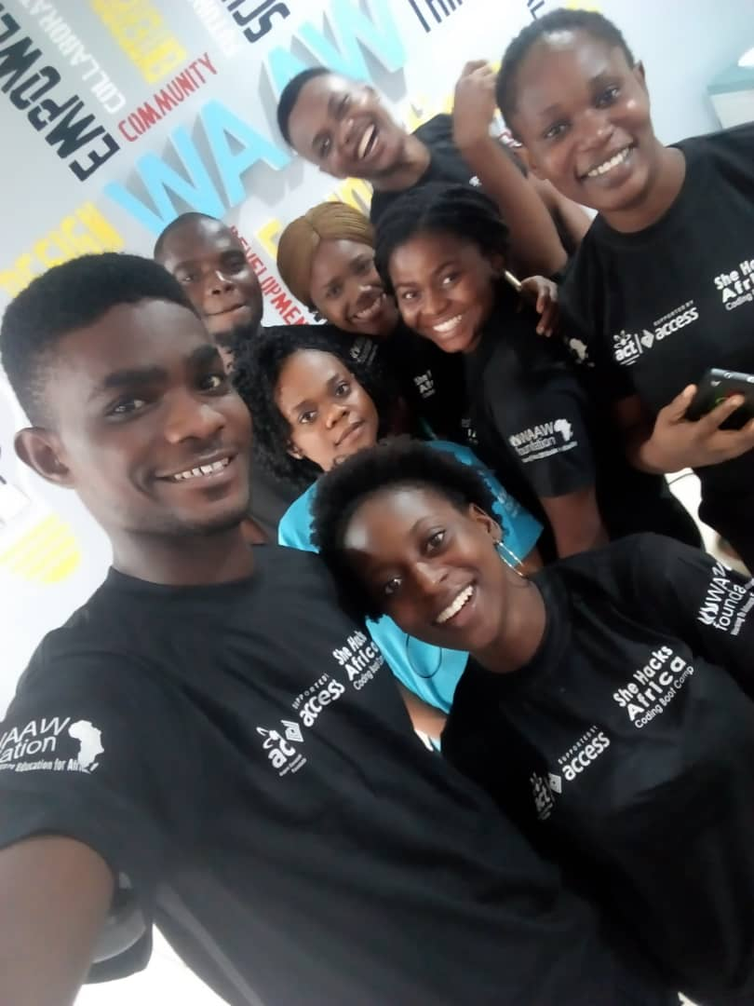

THANKS!

