Slide 1

World-Cities, Pop, Lang, Rank
Data Analysis Report
Prepared by
Ibukunoluwa Aransiola
July 25th,2024

Slide 2
Contents
Overview of Database
Goal of the Analysis
Database Structure
ER Diagram
Analysis on Population
Analysis on Language
Analysis on life expectancy
Other relevant Analysis
Conclusion

Slide 3
Overview Of Database: Brief Description of the Database
The database is designed to store and manage information about countries, cities, and languages around the world. It includes demographic, geographic, and linguistic data, providing a comprehensive overview of global regions.
SQL queries: https://github.com/Ibk14/SQL-PROJECT-/blob/main/World-Project.sql
Data source: Kaggle.com
Tools used: Postgre SQL (PgAdmin 4)

Slide 4
Goal of the Analysis
The primary goal of the analysis is to uncover insights related to population distribution, linguistic diversity, life expectancy and urbanization trends, GDP etc.
The aim is to draw meaningful conclusions about global demographics and other relevant areas.

Slide 5
Database Structure
Mention of the Three Tables
Country Table: Contains details about each country, such as its name, continent, population, government form, and economic indicators.
City Table: Includes information on various cities, their populations, and the districts they belong to.
CountryLanguage Table: Stores data on the languages spoken in each country, indicating whether they are official and their prevalence.

Slide 6
Database Structure contd.
Primary Key
The countrycode column in the Country table serves as its primary key, uniquely identifying each country.
Foreign Key
In our database, the countrycode column in both the City and CountryLanguage tables is a foreign key, linking each record to the corresponding country in the Country table.

Slide 7
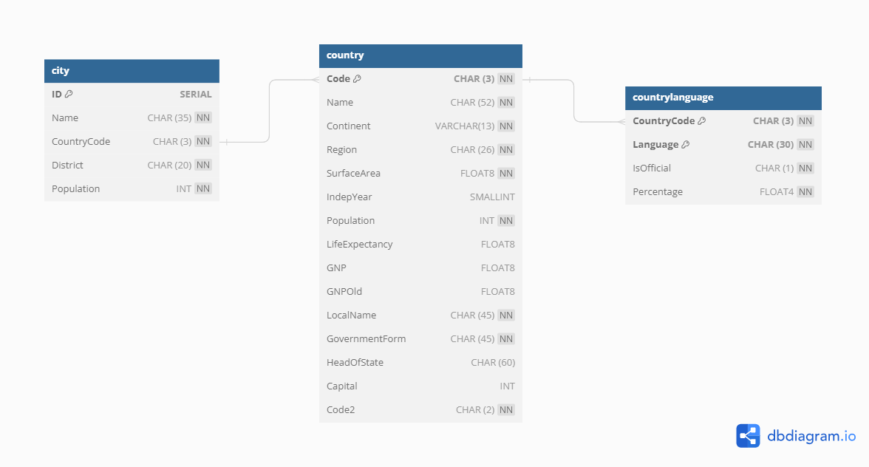
ER DIAGRAM

Slide 8
ANALYSIS ON POPULATION

Slide 9
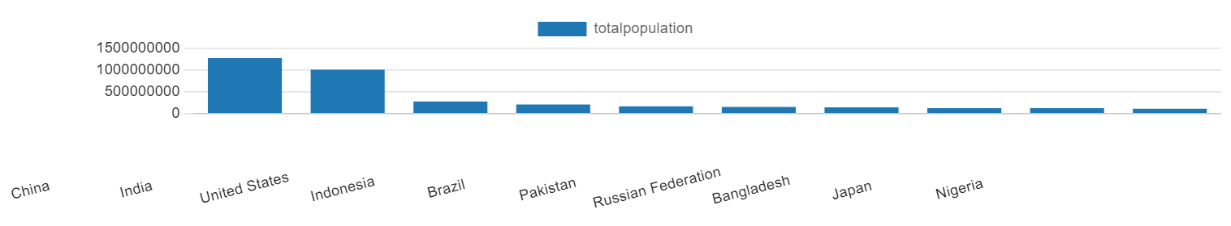
Countries with the Highest and Lowest Populations
Top populated countries include China, India, and the United States.
Least populated countries include small island nations and territories.

Slide 10
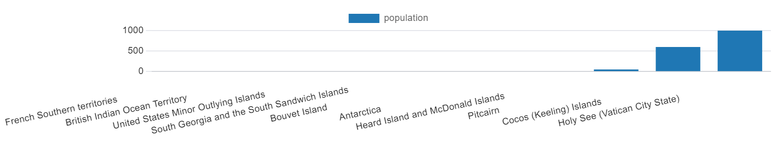
Bottom 10 countries with the lowest populations are shown in the chart below

Slide 11
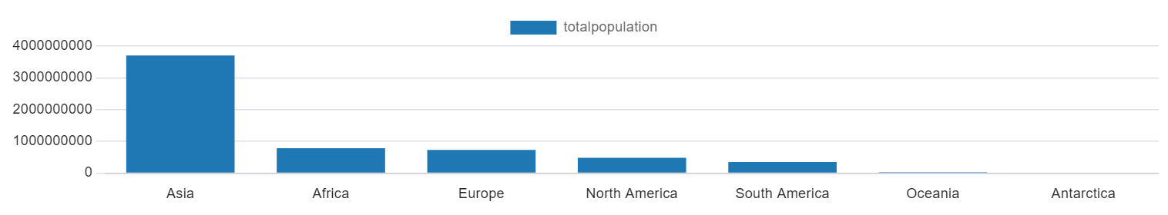
Continents like Asia and Africa have countries with the highest total populations.

Slide 12
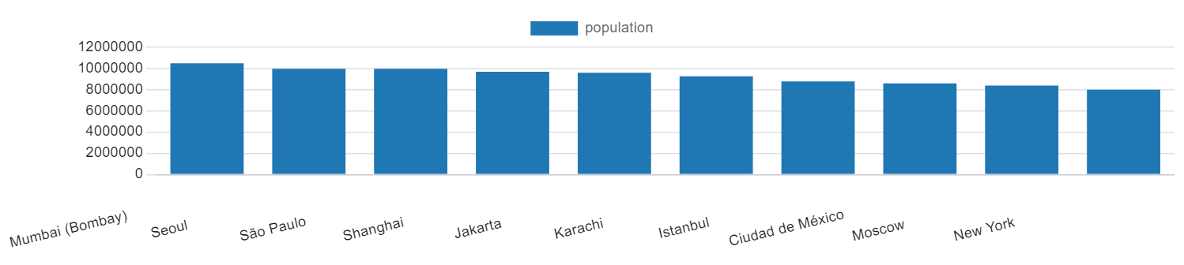
Identify countries like India, South Korea, Brazil etc. with large urban populations, based on cities.

Slide 13
ANALYSIS ON LANGUAGE DIVERSITY

Slide 14
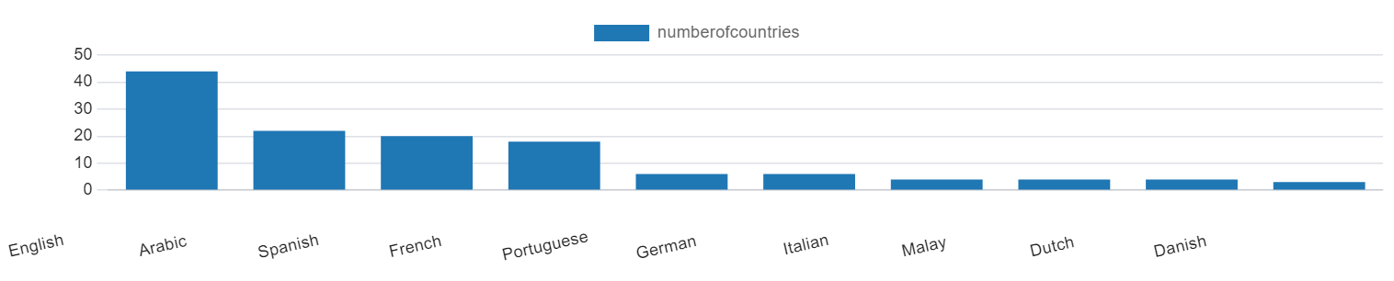
Distribution of Official Languages
Languages like English, Arabic, and Spanish holds the top 3 highest official languages in as many countries. With English language as official language in 44 countries, Arabic in 22 countries and Spanish in 20 countries

Slide 15
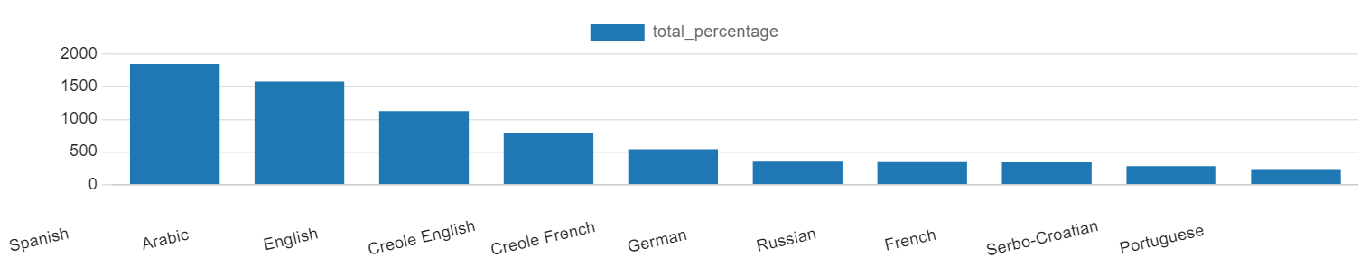
Most and Least Spoken Official Languages
Identify languages like Spanish, Arabic and English as widely spoken with large percentages; and languages like Futuna, Wallis, Nahua etc. that are spoken at percentages of 0.0%

Slide 16
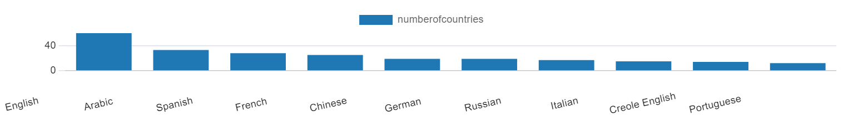
Top 10 Languages by Number of Countries Spoken
This query identifies the top languages spoken in the most countries, with the chart below

Slide 17
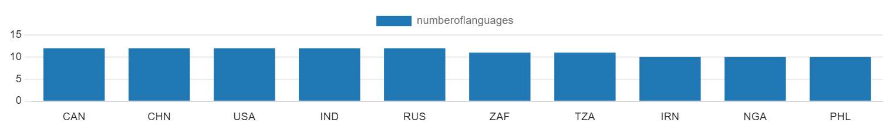
Countries with the Most Languages Spoken
The top 10 countries with the highest number of languages being spoken as shown in the chart below
Canada, China, USA, India and Russia are joint top with 12 languages spoken in these countries; south Africa and Tanzania with 11 languages, while Iran, Nigeria and Phillipines with 10 languages.

Slide 18
ANALYSIS ON LIFE EXPECTANCY

Slide 19
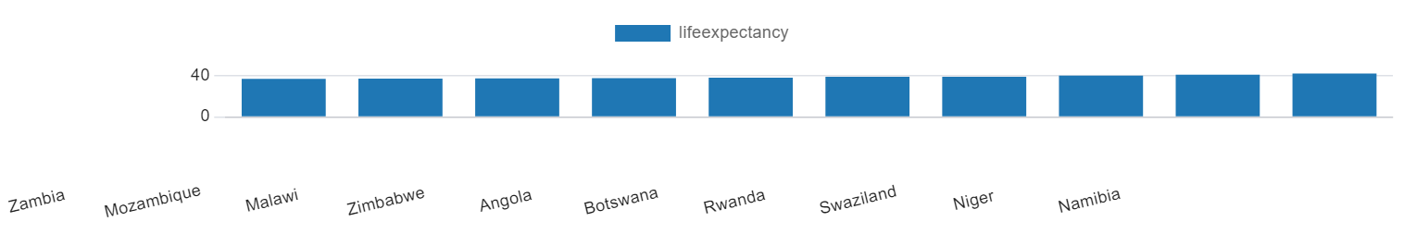
Countries with the Lowest Life Expectancy
This query identifies countries with the lowest life expectancy ranging from 37.2 years of age to 42.5 amongst the bottom 10 countries in this category

Slide 20
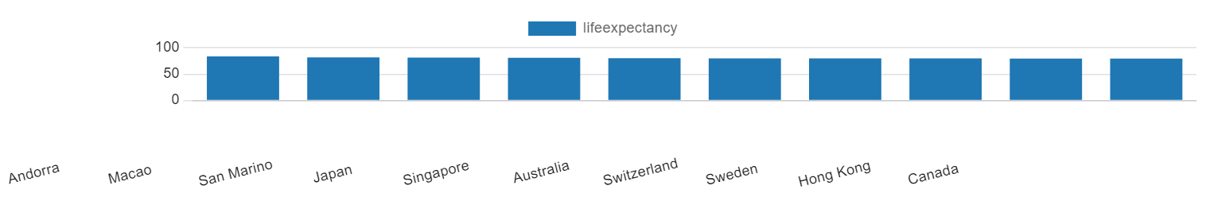
Countries with high Life Expectancy
This query identifies countries with high life expectancy ranging from 83.5 to 79.4 years of age amongst the top 10 countries in this category

Slide 21
OTHER RELEVANT ANALYSIS FROM THE DATABASE

Slide 22
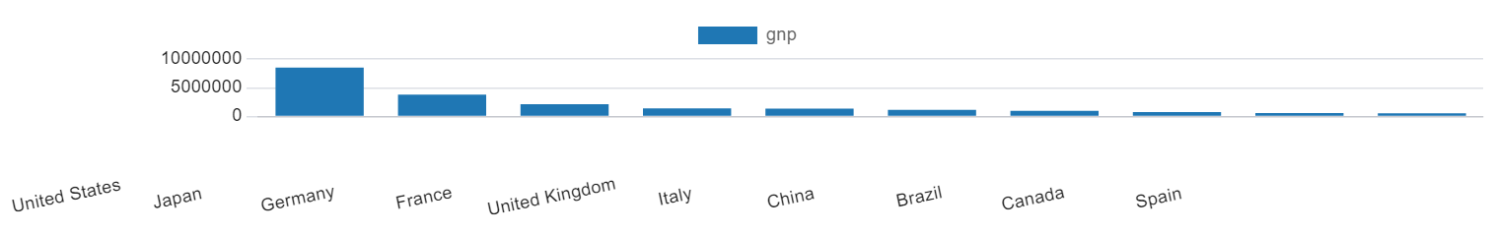
GDP Analysis
Highlights Countries with the Highest GDP with a query that identifies the top 10 highest Gross National Product (GNP), with a chart below

Slide 23
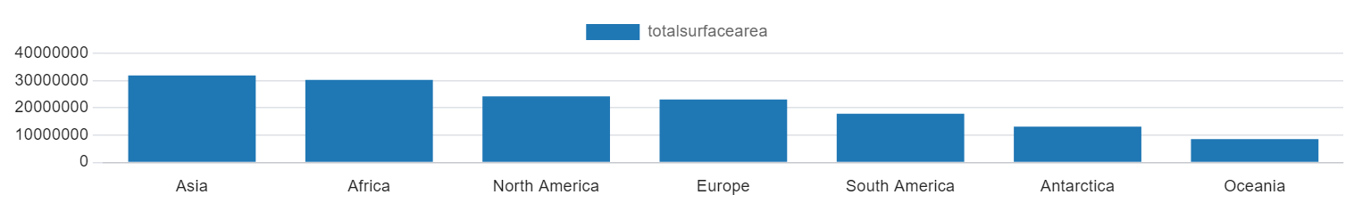
Total Surface by continent Analysis
Ran a query that shows the total Surface Area by Continent. This query sums up the total surface area of countries in each continent.

Slide 24
Conclusions & Findings
Population Distribution
Countries with the highest and lowest populations helps to highlight the regions where most people live and where there may be less density, affecting infrastructure, healthcare, and other societal needs.
Linguistic Diversity
Countries with multiple official languages reflect cultural diversity, while the prevalence of certain languages suggests cultural dominance.
Countries with multiple official languages often reflect a multicultural society, which can influence any decision making.
Less prevalent languages highlights the need for language preservation efforts.

Slide 25
Life Expectancy
Life Expectancy analysis shows countries with higher life expectancies tend to have better healthcare systems, economic stability, good environmental factors, higher standards of living, and more effective public health policies and vice versa.
Urbanization Trends
Cities with the highest populations are often economic hubs, attracting people for job opportunities, education, and better living conditions.
Understanding the distribution between urban and rural populations helps in planning infrastructure, services, and policies to address the needs of both areas.

Slide 26
THE END

