Slide 1
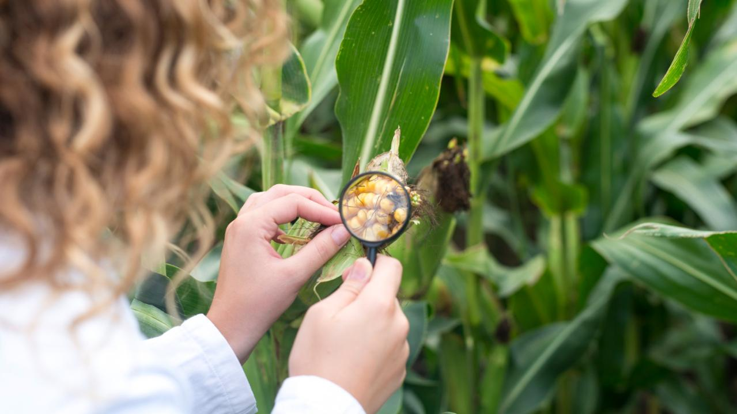

ANALYSIS ON Climate Change Impact on Agriculture
BY
GROUP 4

Slide 2
CONTENT
Introduction
Problem Statements
Why this Analysis Matters
Methodology
Key Findings
Limitations
Improvements
Recommendations
Conclusion
Dashboard
Agricultural

Slide 3
INTRODUCTION
This analysis on ‘Climate Change impact on Agriculture’ explores how evolving climate conditions are influencing crop yields and agricultural sustainability.
We will take a data-driven journey through historical trends, regional variations, and key correlations to reveal actionable insights that can help shape future strategies in agriculture.
Agricultural

Slide 4
PROBLEM STATEMENTS
To figure out insight on how climate change impact crop production.
To reveal the factors influencing agricultural productivity
To identify which variables most strongly drive high yields and economic returns.
Agricultural

Slide 5
WHY THIS ANALYSIS MATTERS
To understand what drives successful crop production.
To pinpoint effective strategies and identify vulnerabilities.
To help stakeholders make informed decisions that support resilient and sustainable agriculture.
To promoting sustainable resource management amid climate change
Agricultural

Slide 6
OBJECTIVES
To examine crop yields in relation to climate change
To uncover the key factors behind agricultural productivity
To figure out operational practices related to economic factors.
Agricultural

Slide 7
METHODOLOGY
DATA
UNDERSTANDING
UNCOVER
INSIGHTS
DATA
CLEANING
METHODOLOGY
DATA
ANALYSIS
DATA
MODELING
Agricultural

Slide 8
DATA SUMMARY
Total Number Countries
Crop Types
Adaptation Strategies
10
10
5
Nigeria
China
USA
India
Australia
Argentina
Canada
France
Russia
Brazil
Barley
Coffee
Corn
Cotton
Fruit
Rice
Soyabeans
Sugarcane
Vegetable
Wheat
Water Management
Drought Resistance
Crop Rotation
Organic Farming
No Adaptation

Slide 9
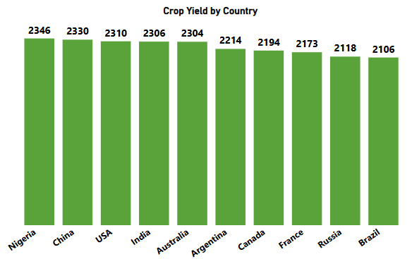
KEY FINDINGS
Crop yield ( In Metric Tons) by Country
This Bar chart shows the ranking of countries by crop yield.
From the result, Nigeria leads, followed by China, USA, India, and others.

Slide 10
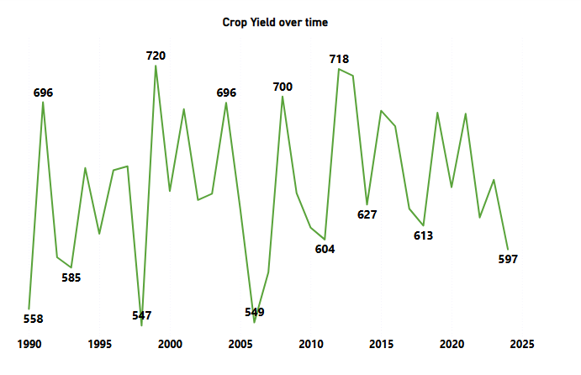
KEY FINDINGS
Crop yield (in Metric Tons) over time

Slide 11
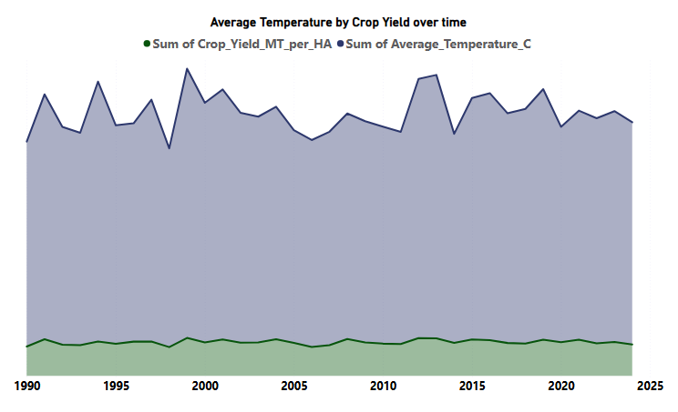
KEY FINDINGS

Slide 12
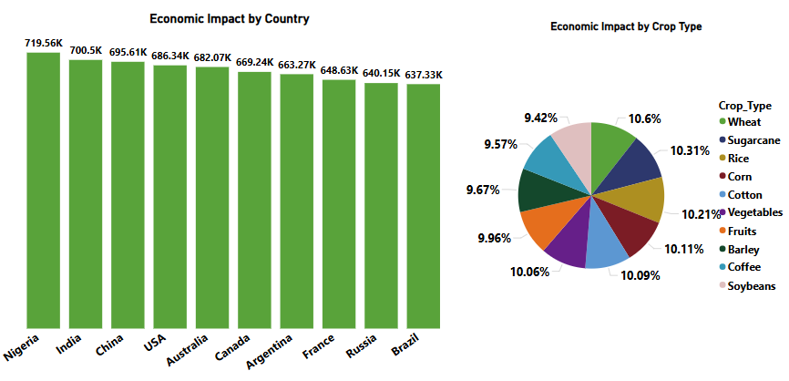
KEY FINDINGS
Economic impact (in USD) by country

Slide 13
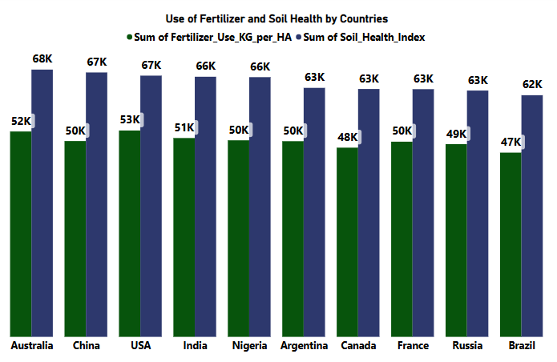
KEY FINDINGS

Slide 14
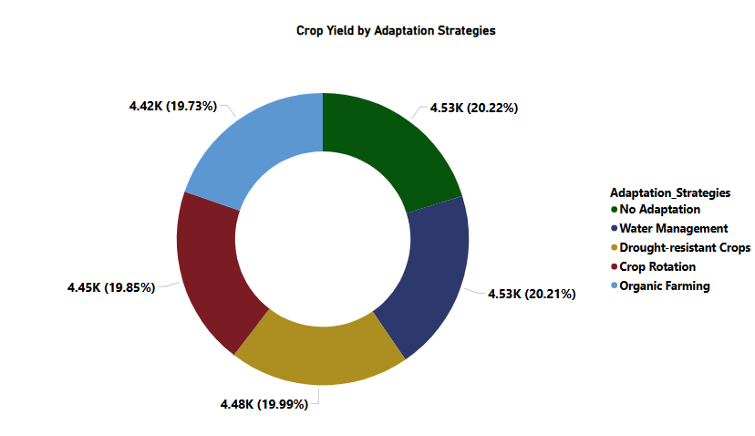
KEY FINDINGS

Slide 15
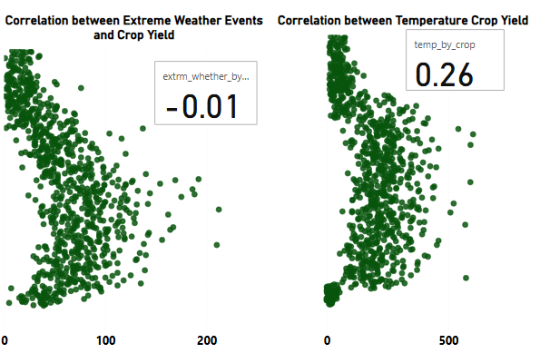
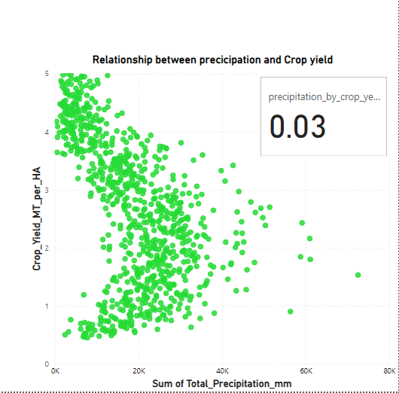
KEY FINDINGS
Correlation between Precipitation and crop Yield

Slide 16
Limitation
The dataset is missing crucial regional and seasonal factors.
Due to the limited and aggregated nature of the data, the model’s conclusions may not apply broadly to all contexts.
The analysis overlook other influential factors, reducing the overall comprehensiveness of the insights.

Slide 17
IMPROVEMENT
Expand Data Collection: We would gather a larger dataset, including regional and seasonal data, to capture a full picture of agricultural performance across different geographies.
Enhance Data Quality and Consistency: We would implement standardized data collection procedures and conduct rigorous quality checks.
Integrate Additional Variables: Adding other relevant factors such as soil types, local climate trends, and socioeconomic indicators would create a more robust model.
Utilize Advanced Analytical Methods: With more time and expertise, advanced statistical and machine learning techniques could be employed to uncover non-linear relationships and interactions among variables for deeper insights.

Slide 18
Recommendations
Invest in High-Yield Markets
Enhance Water Management Infrastructure
Optimize Crop Mix and Economic Portfolios
Embrace Technological Innovations
Adopt a Diversified Adaptation Strategy

Slide 19
Conclusion
This analysis clearly demonstrates that climate change—through rising temperatures and irregular precipitation, significantly impacts agricultural productivity, leading to lower crop yields in many regions. While some areas exhibit resilience thanks to effective farming practices and adaptive measures, others remain highly vulnerable, underscoring the urgent need for tailored, data-driven interventions to safeguard food security and ensure sustainable agricultural practices in the face of ongoing climate challenges.

Slide 20
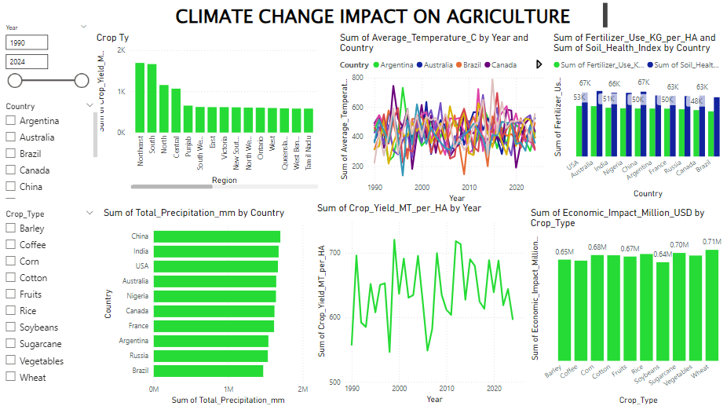
DASHBOARD

Slide 21
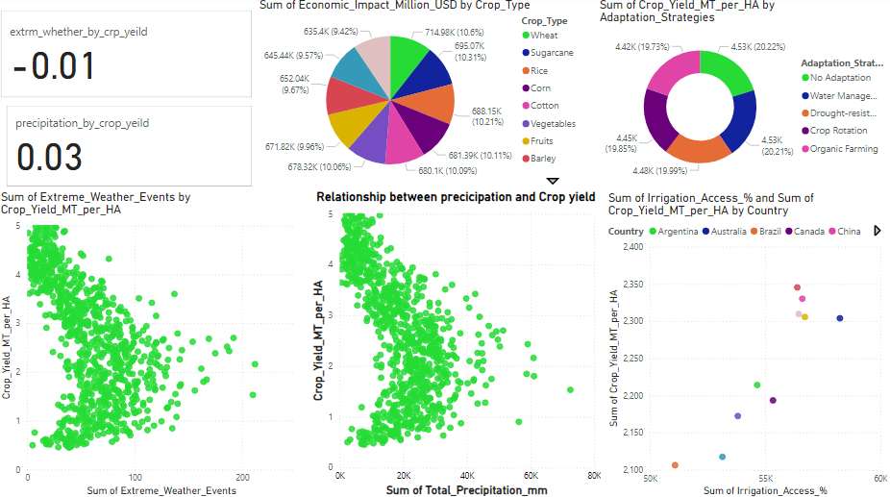

Slide 22

Thank You!

