Slide 1

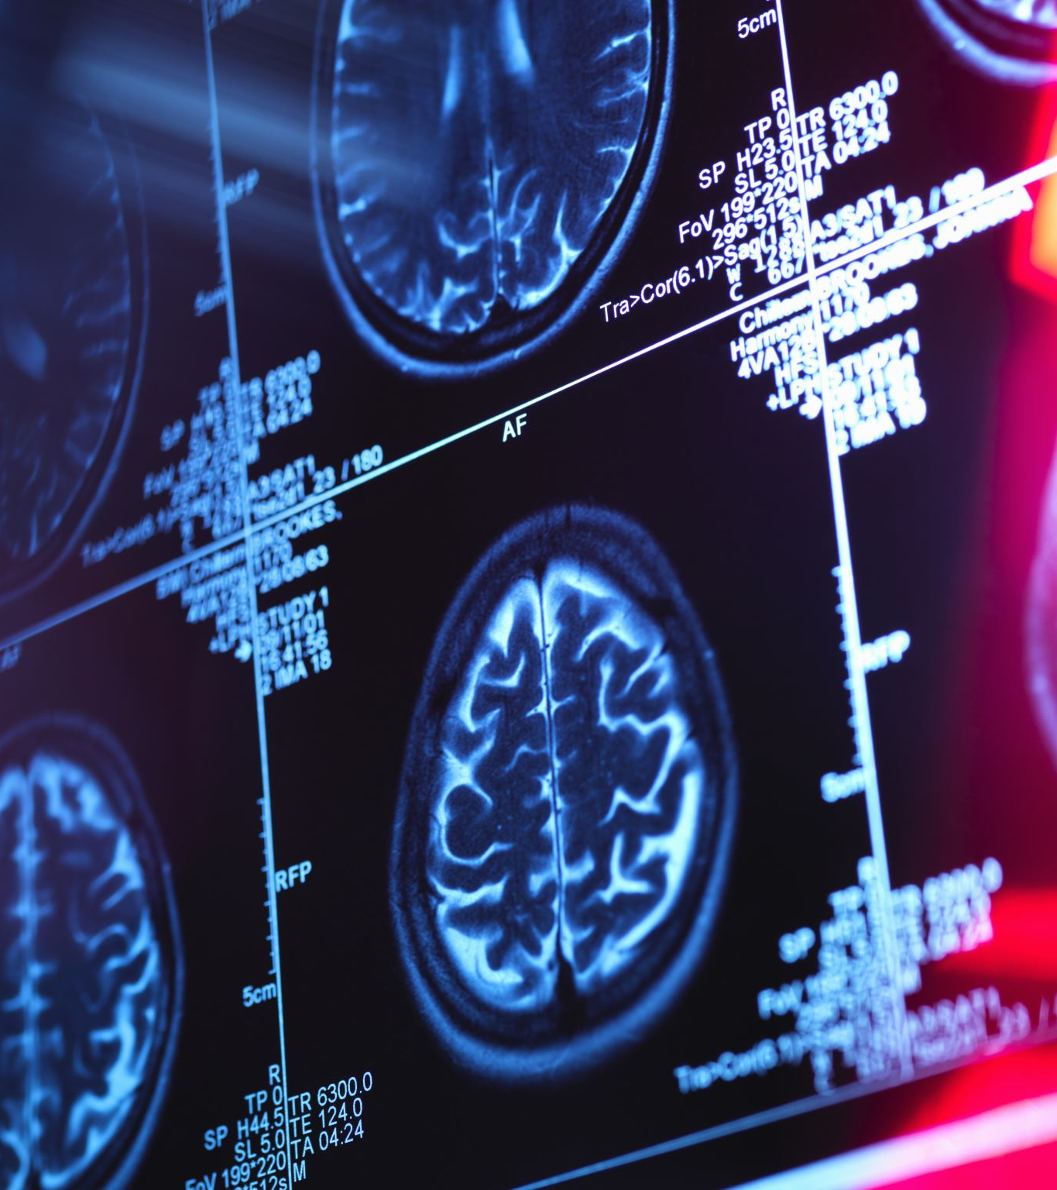

Project Overview:
Objective: Build an automatic brain cancer detection script using deep learning.
Approach:
Leverage VGG16 for feature extraction.
Enhance edges using the Sobel operator.
Perform binary classification for Cancer vs. Non-Cancer.
Why is VGG Special?
It stacks many simple layers to become “really smart”.
It can recognize thousands of objects in images.
It's used in things like self-driving cars, security cameras, and medical image analysis.

Slide 2
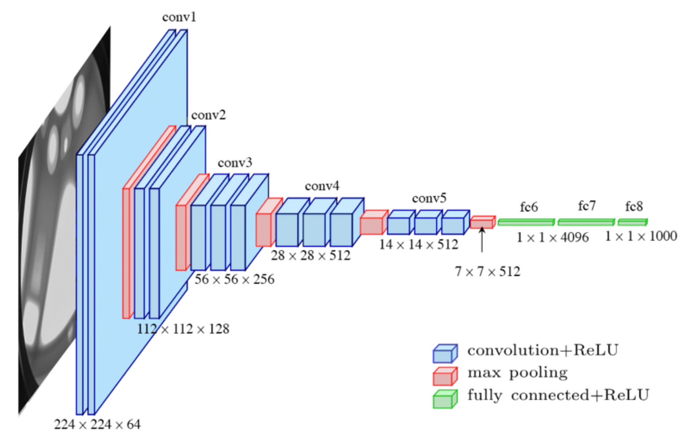
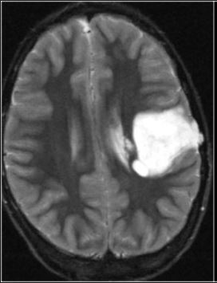
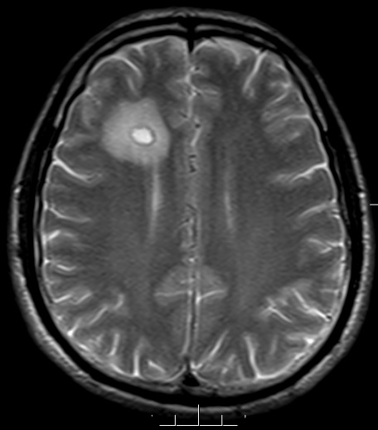
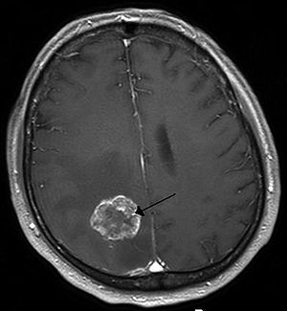
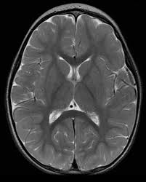
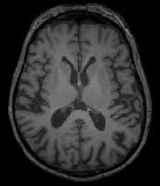
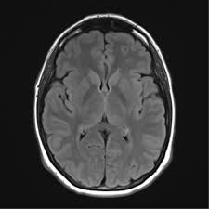
Cancer
Non-Cancer
What is VGG?
VGG is a computer program that looks at pictures and figures out what’s in them—like a smart camera that can tell whether it's seeing a cat, dog, or airplane.
How Does It Work? Think of it like making a sandwich:
First Layer (Bread - Input Image) → The network starts with a picture (like a 224x224 image).
Middle Layers (Fillings - Convolution & Pooling Layers) → These are like different layers of cheese, lettuce, and tomatoes in a sandwich. Each layer helps the network learn features from the image—like edges, shapes, and textures.
Small filters (3x3) act like a magnifying glass looking for small details.
Pooling layers help shrink the size of the image while keeping the important parts.
Final Layers (Bread - Fully Connected & Output) → The last few layers are like a decision-maker. It takes all the learned details and figures out what the image is or what you’re looking for.

Slide 3
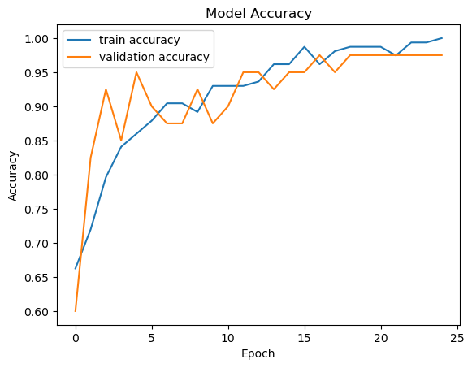
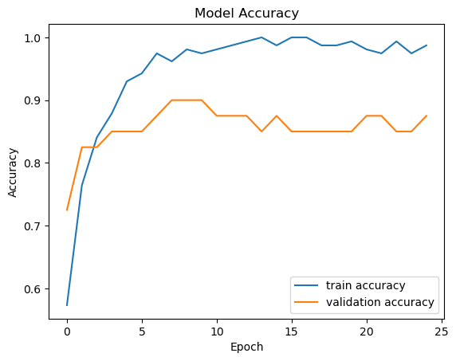
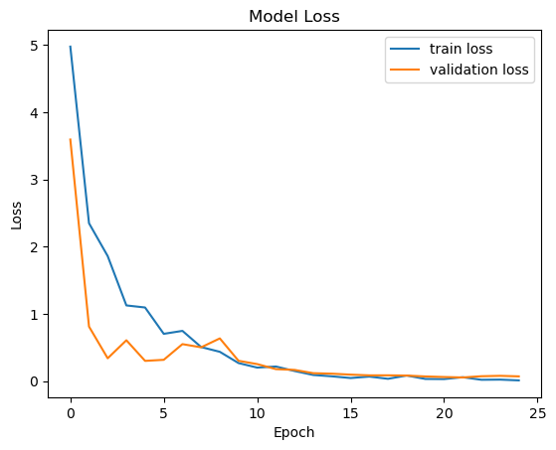
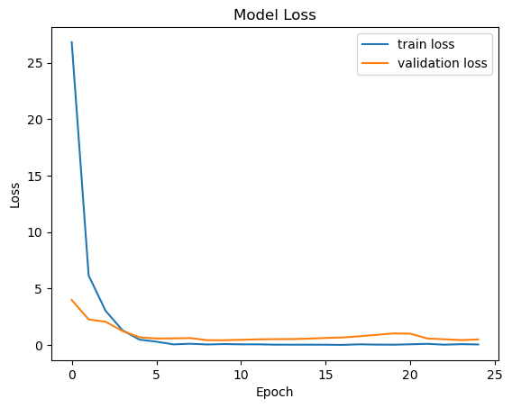
VGG16
VGG16 with Sobel Enhance
accuracy: 0.9729 - loss: 0.0749 Test Accuracy: 97.50%
accuracy: 0.8750 - loss: 0.5048 Test Accuracy: 87.50%
Accuracy: Means that on the training dataset, the model correctly predicted the class (Cancer or Non-Cancer) 97.29% of the time.
Loss: Loss is a measure of how well the model is performing with respect to its predictions compared to the true label. A lower loss indicates that the model's predictions are closer to the actual values. A loss of 0.0749 is quite low, meaning the model's predictions are close to the true labels. This loss value reflects how well the model is fitting the training data. The close you are to 0 the better the model if fitting to the dataset.
Test Accuracy: This metric is calculated on a separate test dataset that the model has not seen during training. It gives an indication of how well the model generalizes to unseen data. The test accuracy (97.50%) being close to the training accuracy suggests that the model is not overfitting to the training data.

Slide 4


