Slide 1


Library Management System
An overview of the project
Project source

Slide 2
Introduction
Welcome to the Library Management System presentation. This system is designed to manage books, users, and registrations in a library setting.

Slide 3
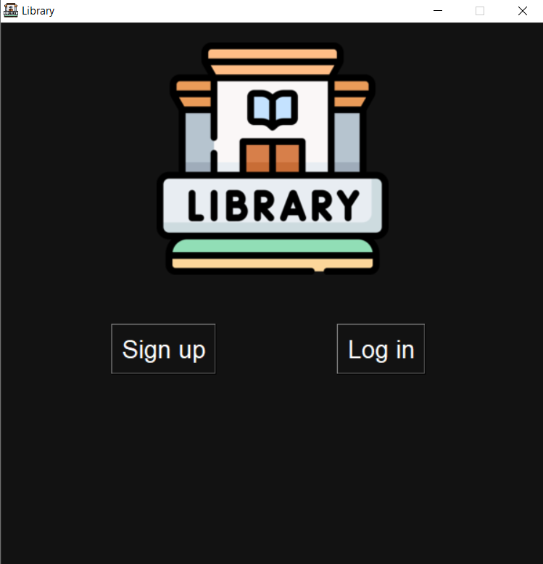
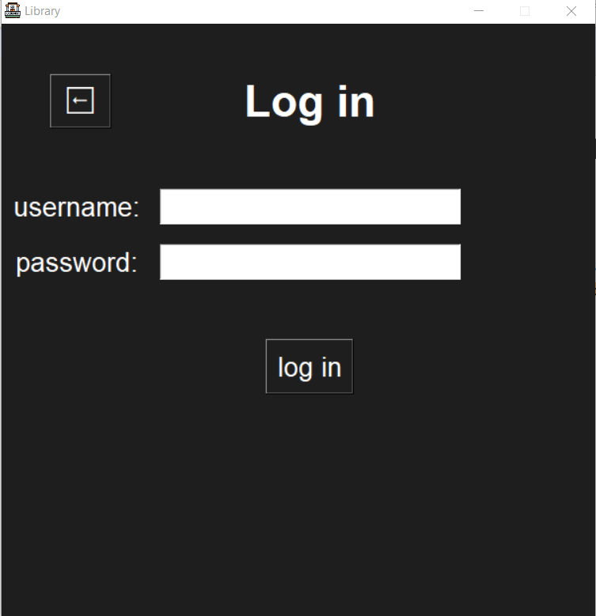
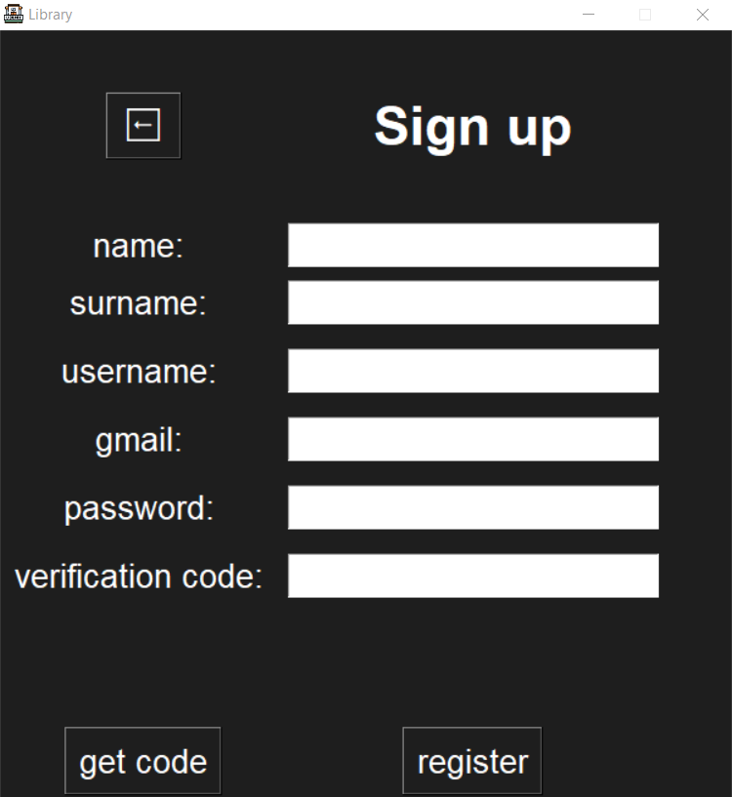
Project Overview
The Library Management System facilitates the efficient management of library resources. It includes features for adding and viewing books, registering users, and more.

Slide 4
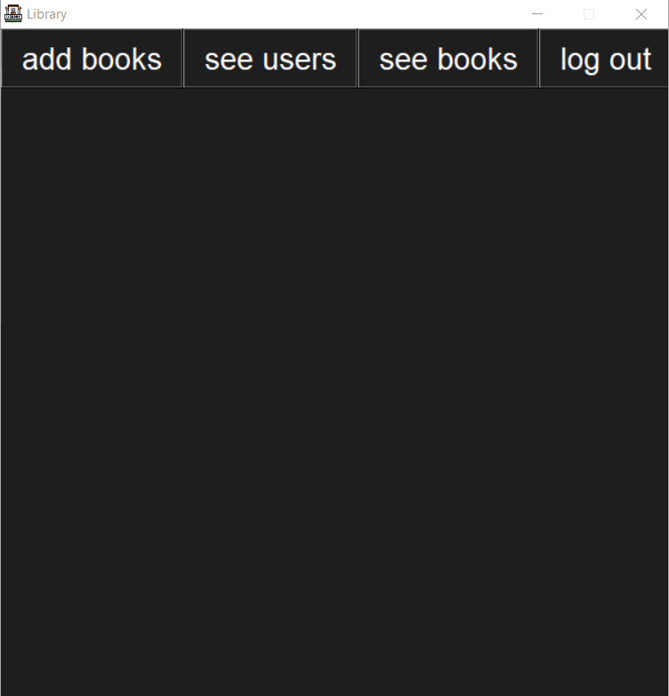
Key Features
1. Add and view books 2. Register and manage users 3. View registered books for users 4. Edit and delete books 5. User-friendly interface

Slide 5
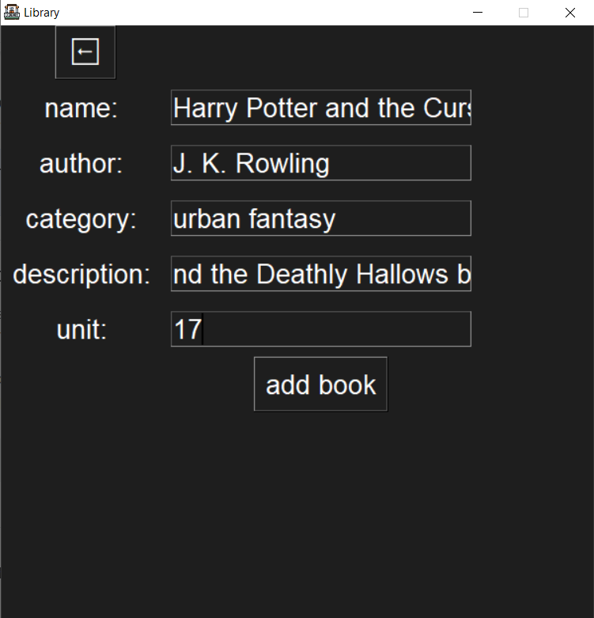
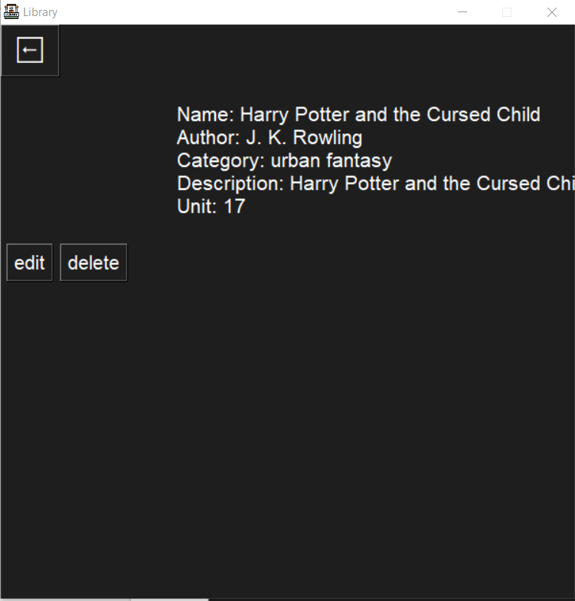
AddBook Class
The AddBook class allows the addition of new books to the library. It provides a user-friendly interface with fields such as name, author, category, description, and unit.

Slide 6
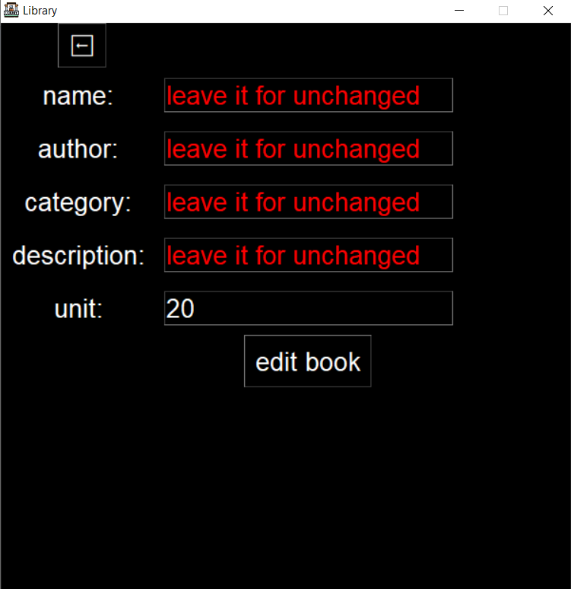
EditBook Class
The EditBook class enables the editing of existing book details. Users can modify the name, author, category, description, and unit of a book.

Slide 7
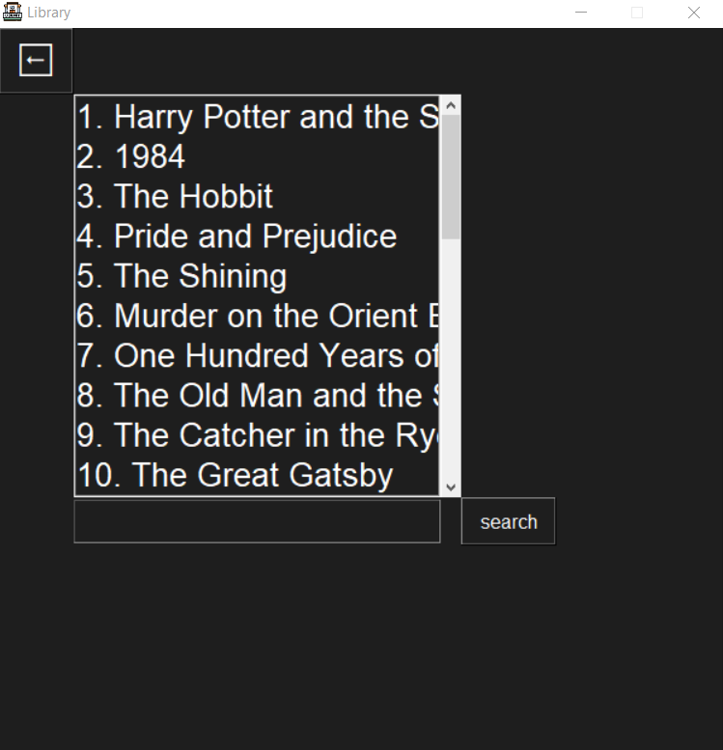
SeeBooks Class
The SeeBooks class displays all books in the library. Users can search for specific books using keywords and perform actions such as double-clicking to view details.

Slide 8
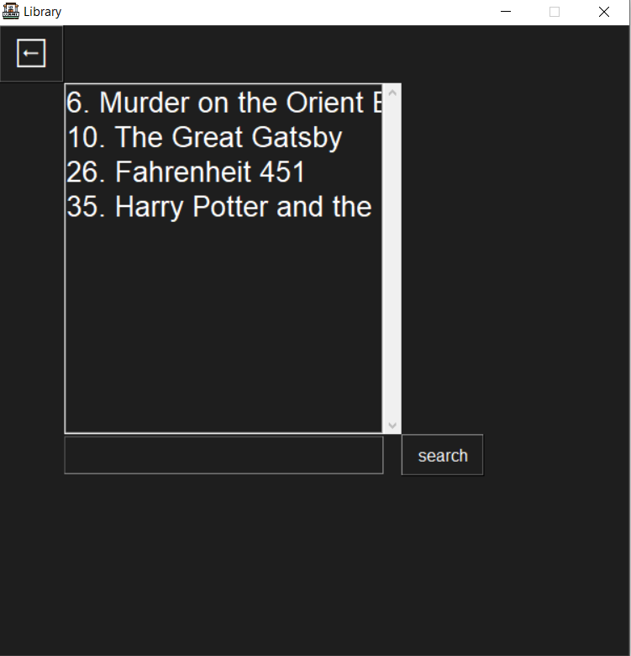
RegisteredBooks Class
The RegisteredBooks class shows books registered by a specific user. Users can search for registered books and navigate through the list.

Slide 9
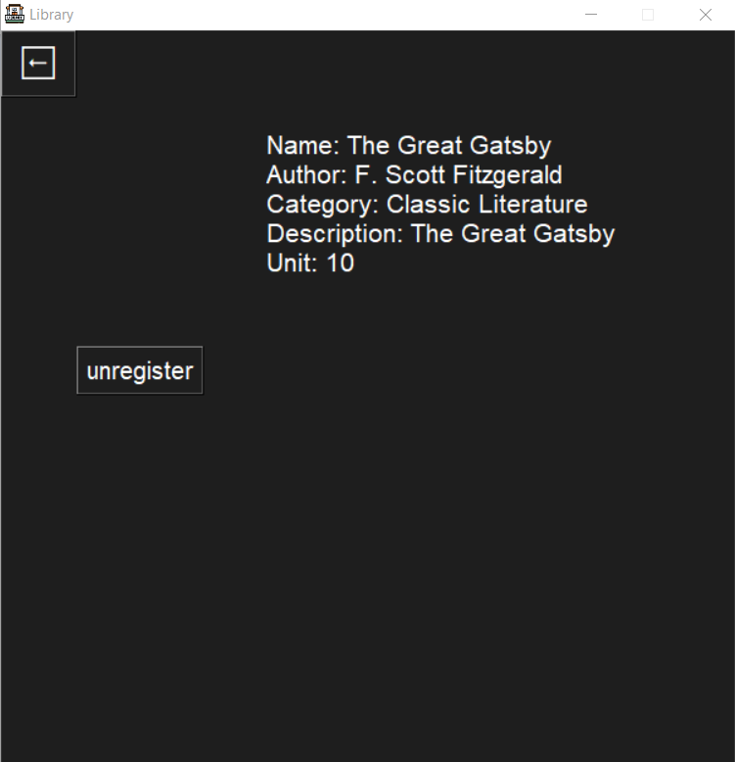
SpecificBook Class
The SpecificBook class provides details about a specific book. Users can view information such as name, author, category, description, and unit. Superusers can edit or delete the book, while regular users can register or unregister it.

Slide 10
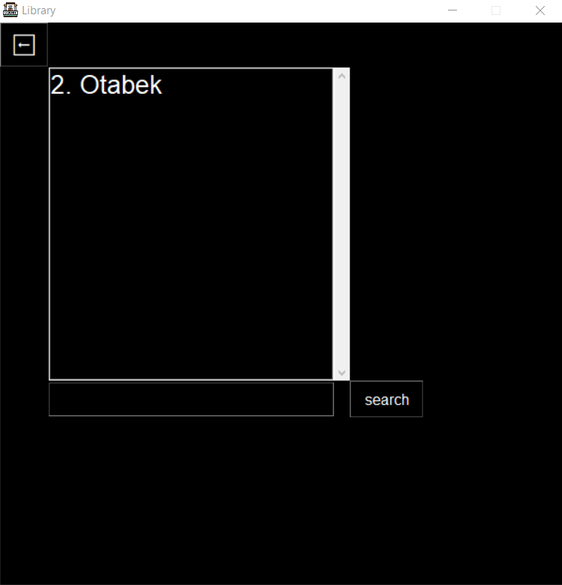
SeeUsers Class
The SeeUsers class displays all users in the system. It provides a search functionality to find specific users and allows administrators to view user details.

Slide 11
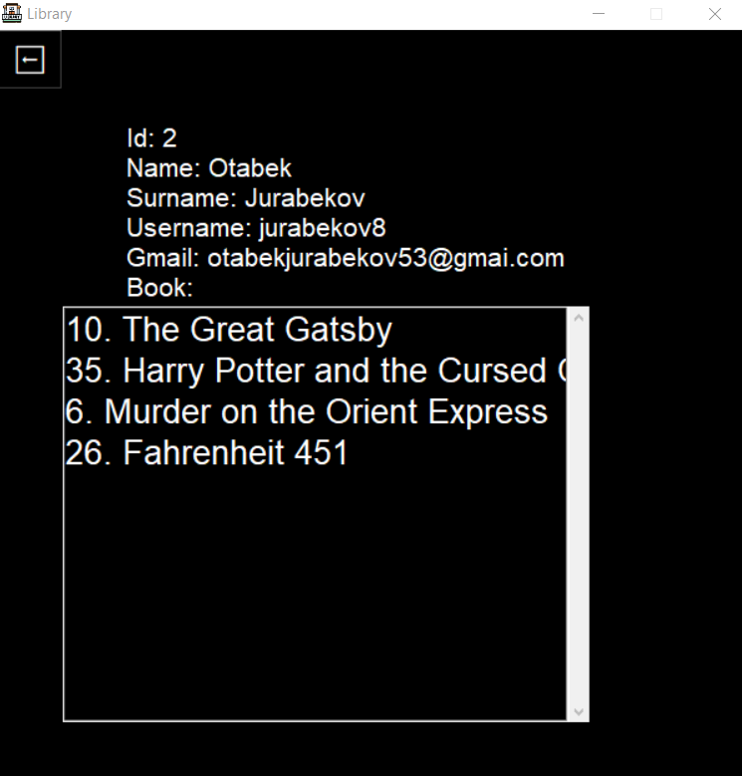
SpecificUser Class
The SpecificUser class provides details about a specific user. It displays the user's ID, name, surname, username, Gmail, and the list of books registered by the user.

Slide 12
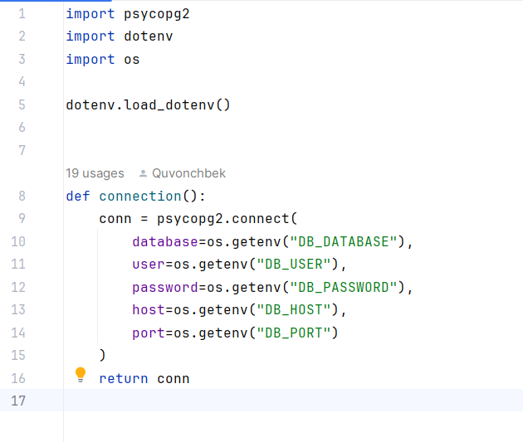
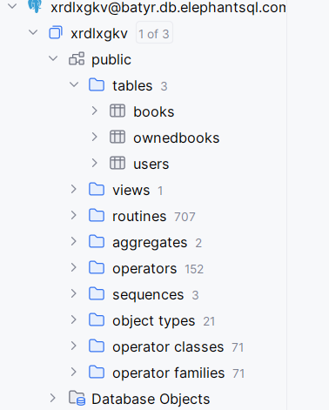
Database Connection
The project is connected to a PostgreSQL database to store information about books, users, and registrations. The database ensures data persistence and integrity.

Slide 13
Future Enhancements
Potential future enhancements include: - Implementing user authentication - Adding graphical charts for library statistics - Enhancing the user interface for better user experience

Slide 14
Conclusion
In conclusion, the Library Management System provides a comprehensive solution for managing library resources. It is designed to be user-friendly, efficient, and easily expandable.

Slide 15
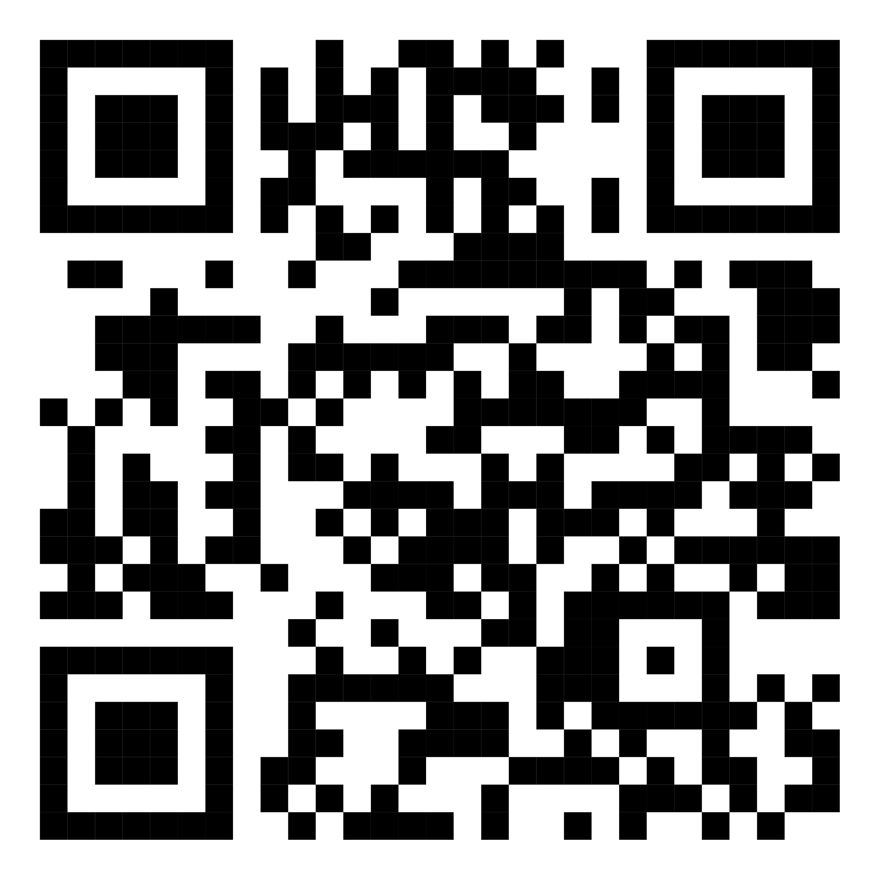
Thank You
Thank you for your attention! If you have any questions or suggestions, feel free to ask.

