Slide 1
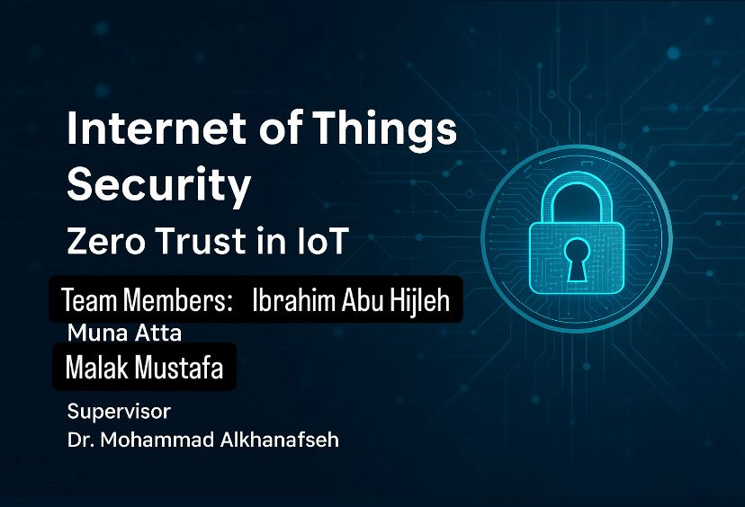
Team Members:
Supervisor:

Slide 2
Traditional Security Model: An Overview
In the traditional security model, a perimeter is defined to protect the internal network . However, this approach fails to consider internal threats and the possibility of breaches through external devices.

Slide 3
The Limitations of Traditional Security
The traditional security model assumes that inner network traffic is secure by default, which is no longer valid in today’s threat landscape. Attackers can exploit vulnerabilities, bypass traditional security measures, and gain unauthorized access.

Slide 4
The Zero Trust Model: A Paradigm Shift in Security
The Zero Trust model is a proactive security approach that assumes no user or device within or outside the network should be trusted by default. Every access request is verified and authenticated before granting access, significantly reducing the attack surface.

Slide 5
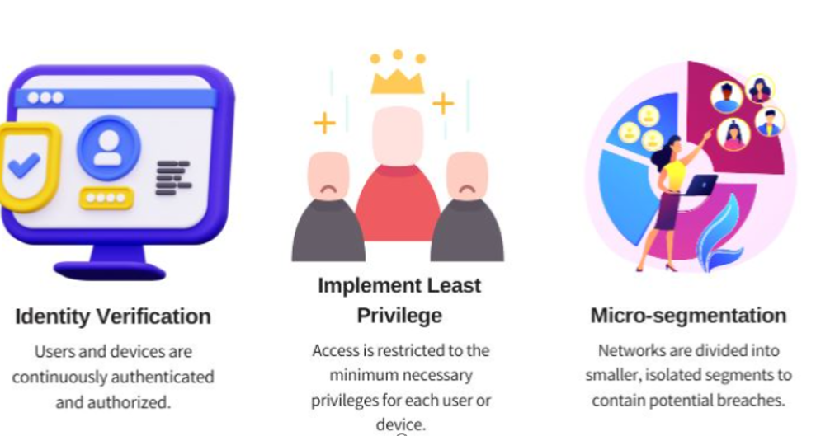
Key Principles of the Zero Trust Model

Slide 6
Zero Trust Architecture in IoT
Advantages of Zero Trust in IoT:
Enhances overall security by removing implicit trust.
Limits attack spread through micro-segmentation.
Granular access control using the least privilege principle.
Continuous monitoring enables fast anomaly detection.
Adaptable to dynamic and distributed IoT environments.

Slide 7
Disadvantages of Zero Trust in IoT
Complex to implement and requires detailed network mapping.
High processing overhead may burden resource-limited IoT devices.
Implementation and maintenance costs can be high.
May introduce latency due to frequent authentication.
Legacy IoT systems may require major security upgrades.

Slide 8
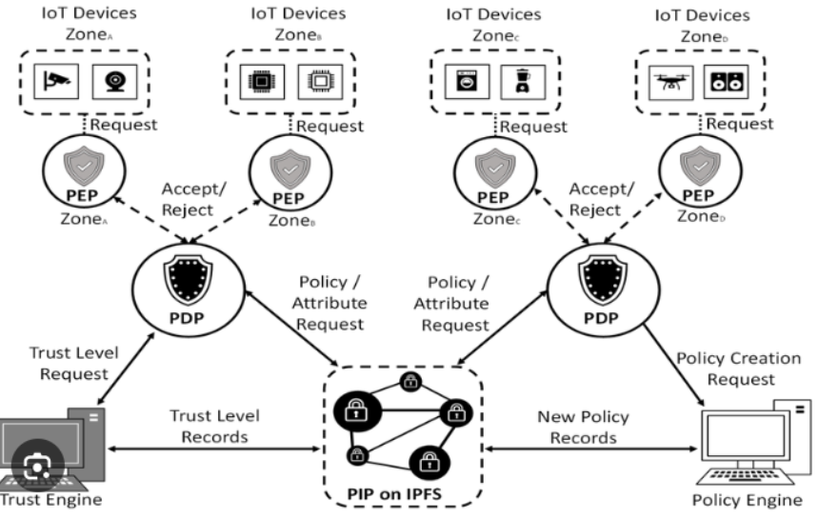
How Zero Trust work:

Slide 9
Potential Attacks in Zero Trust IoT:
• Identity Spoofing Description: Attacker mimics a trusted device's identity.
-Example: Using forged digital certificate to access through PEP.
-Risk: Access granted to malicious actor if identity checks are weak.
• Replay Attacks Description: Reusing intercepted valid access requests.
-Example: Replaying old access token to gain entry.
-Risk: Allows unauthorized access without detection.
• Data Injection Attacks Description: Injecting malicious data into system communication.
-Example: Sending fake policy updates to PDP.
-Risk: Can change system behavior or bypass restrictions.

Slide 10
• Insider Attacks Description: Malicious activity by trusted devices or users.
-Example: Authenticated IoT device spreading malware internally.
-Risk: Difficult to detect; exploits trust-based systems.
• Denial of Service (DoS/DDoS) Description: Overloading components with excessive requests.
-Example: Flooding PDP with requests to crash service.
-Risk: Disrupts decision-making and system availability.
• Man-in-the-Middle (MitM) Description: Intercepting or modifying data in transit.
-Example: Tampering with trust level queries from PDP to Trust Engine.
-Risk: Leads to data leaks or false trust assignments.

Slide 11
• Policy Tampering Description: Modifying or injecting fake security policies.
-Example: Attacker updates PIP with permissive rules.
-Risk: Undermines enforcement of Zero Trust policies.
• Trust Manipulation Description: Tricking the system to assign a high trust score.
-Example: Acting benignly until trusted, then launching an attack.
-Risk: Allows attackers to pass security checks and strike later

Slide 12

Thank You for Your Attention!
Is there any question?
Team Members:
Ibrahim Abu Hijleh
Muna Atta
Malak Mustafa

