Slide 1
📚
BOON ACADEMY
Intervention Command Center
Turning Day-14 risk data into a facilitator's daily action queue — and proving the intervention actually happened.
// SYSTEM WALKTHROUGH

Slide 2
THE PROBLEM
Day 14. Six days until Quiz 2.
› Facilitators can already see who is struggling — that was never the gap.
› The hard part is deciding who needs help first, what kind of help fits, and whether
› the planned help actually happened, before the next quiz arrives.
6
days until Quiz 2
200
students · 8 facilitators
~30%
current intervention coverage
BOON ACADEMY
02

Slide 3
REAL DATA, NOT ASSUMPTIONS
What the numbers actually show
200
5
8
students
campuses
facilitators
199
13.5%
57%
below target (99.5%)
have documented
post-quiz contact
of notes had an
ownership mismatch
Every number in this deck is calculated from the actual dataset — nothing is hardcoded or hypothetical.
BOON ACADEMY
03

Slide 4
THE CORE WORKFLOW
From raw data to a daily action
DATA
→
DETECT
→
PRIORITIZE
→
RECOMMEND
→
FACILITATOR
ACTS
→
RECORD
OUTCOME
→
MEASURE
COVERAGE
› Rules handle calculation and prioritization — fully explainable, fully testable.
› The LLM handles language understanding and personalized communication — never the numbers.
› Every action is tracked to a real outcome, so coverage is measured, not assumed.
BOON ACADEMY
04

Slide 5
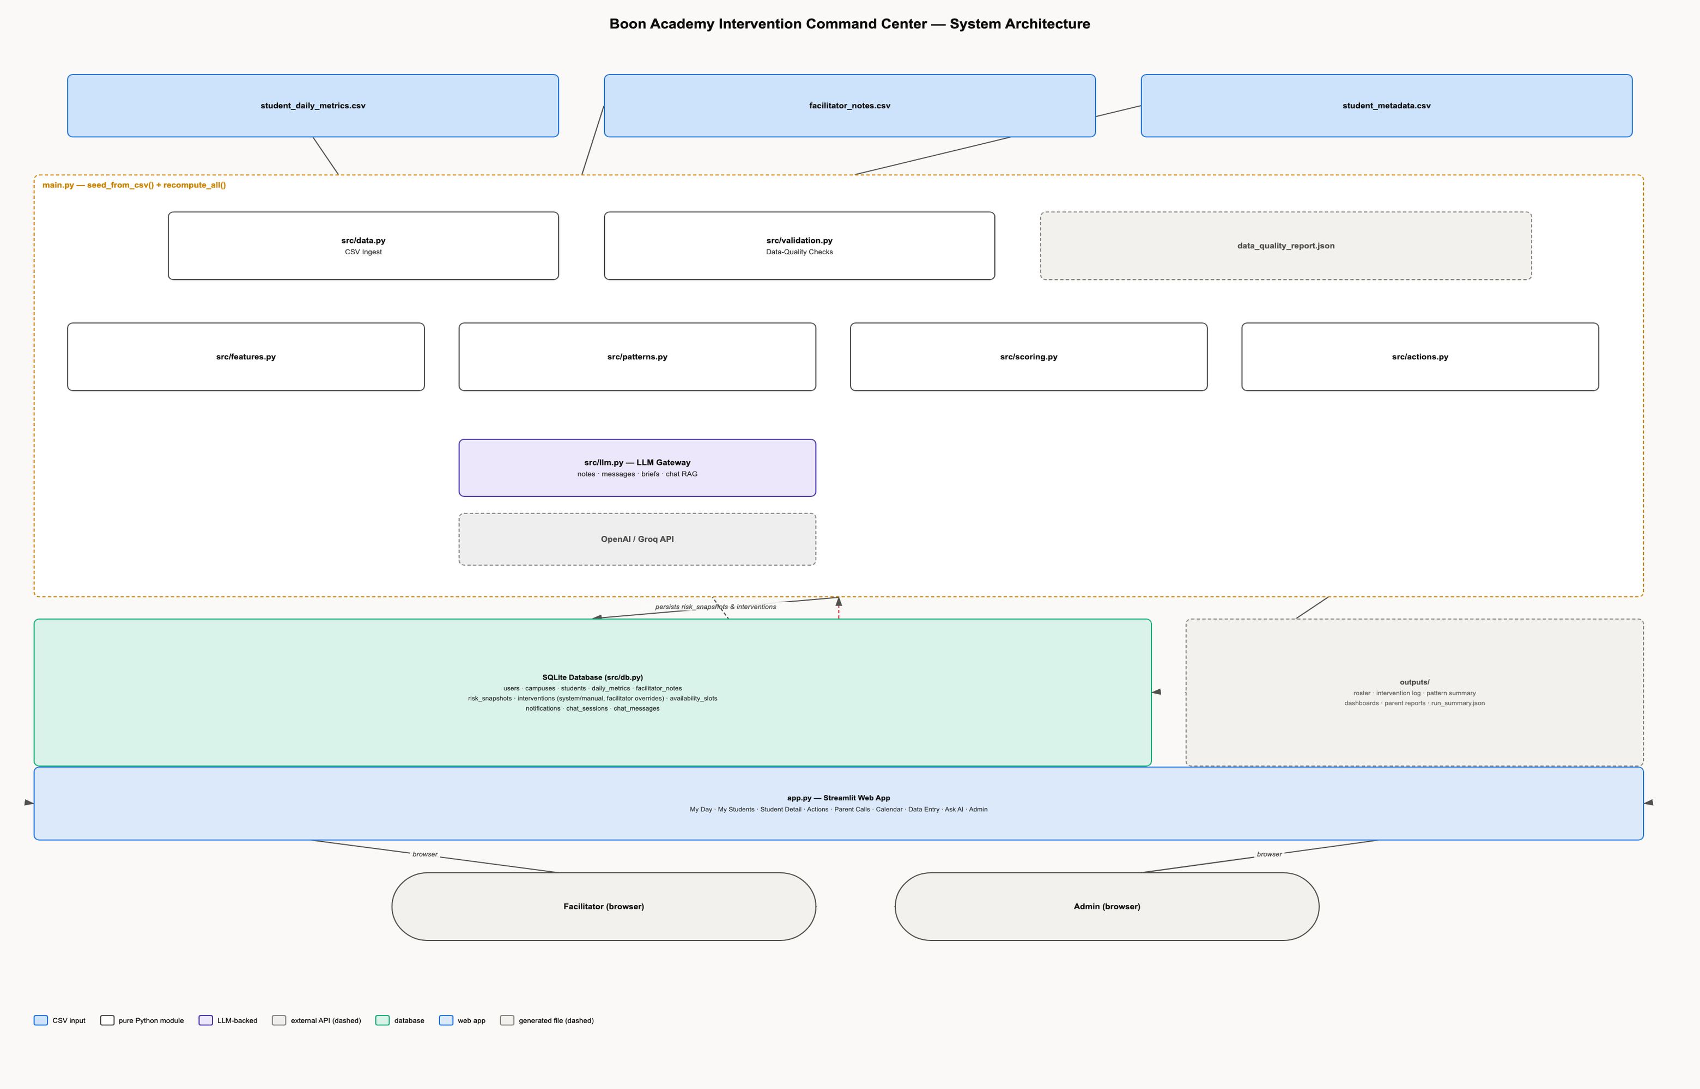
SYSTEM ARCHITECTURE
One Python application, two entry points
BOON ACADEMY
05

Slide 6
TECH STACK
Simple by choice, not by accident
USED
DELIBERATELY NOT USED
› Python 3.12
› Streamlit (UI)
› SQLite + SQLAlchemy (data)
› pandas / numpy (features)
› Plotly (charts)
› OpenAI SDK — works with OpenAI or Groq
› python-dotenv (config)
› pytest (tests)
› A trained ML model — no Quiz 2 outcomes exist yet to train on
› React / a separate frontend
› Postgres, Kafka, Airflow, microservices
› A vector database
BOON ACADEMY
06

Slide 7
RISK & PRIORITY
Deterministic scoring, not a black box
Performance
25 pts
Gap between Quiz 1 score and target
Engagement
25 pts
Recent attendance & practice vs. healthy levels
Trajectory
25 pts
Is behavior getting better, worse, or steady?
Trusted Note
15 pts
Severity found in verified facilitator notes
Intervention Gap
10 pts
Any documented help since Quiz 1?
risk_score = sum of components (0-100) • priority_score = 0.8×risk + 0.2×urgency
Critical 70-100
High 50-69
Medium 30-49
Low 0-29
BOON ACADEMY
07

Slide 8
BEHAVIORAL PATTERNS
13 deterministic rules, zero LLM involvement
ACUTE_ATTENDANCE_DROP
CHRONIC_LOW_ATTENDANCE
ATTENDING_BUT_NOT_PRACTICING
ZERO_PRACTICE_STREAK
PRACTICE_COLLAPSE
CRAMMING_PATTERN
RECOVERY_TRAJECTORY
STABLE_HEALTHY_BEHAVIOR
LARGE_TARGET_GAP
POSSIBLE_MISSED_ASSESSMENT
NO_POST_QUIZ_INTERVENTION
UNRESOLVED_FOLLOW_UP
DATA_QUALITY_RISK
Each pattern returns a plain-language explanation and the real evidence numbers behind it — never just a label.
BOON ACADEMY
08

Slide 9
RECOMMENDATIONS
One recommended action per student
› Patterns + risk level map to exactly one action — PARENT_CALL, STUDENT_CHECK_IN, MOTIVATIONAL_MESSAGE, PRACTICE_PLAN, ONE_TO_ONE_TUTORING, STUDY_PLANNING,
› ATTENDANCE_FOLLOW_UP, DATA_REVIEW, MONITOR_ONLY, POSITIVE_REINFORCEMENT.
› Parent calls are gated to genuinely severe cases— not every below-target student, or the queue becomes meaningless.
› Each action carries an SLA, an effort estimate, and a plain-language brief.
BOON ACADEMY
09

Slide 10
WHERE AI FITS — AND WHERE IT DOESN'T
Language tasks only, never the numbers
AI IS USED FOR
NEVER USED FOR
› Understanding facilitator notes (barrier, severity, follow-up)
› Writing personalized motivational messages
› Drafting parent call briefs
› Writing parent report summaries
› Risk scoring
› Attendance calculation
› Priority ordering
› Data validation
› Intervention status
Swappable provider: OpenAI or Groq via one config value · cache → call → one retry → deterministic fallback · note text is always treated as data, never instructions
BOON ACADEMY
10

Slide 11
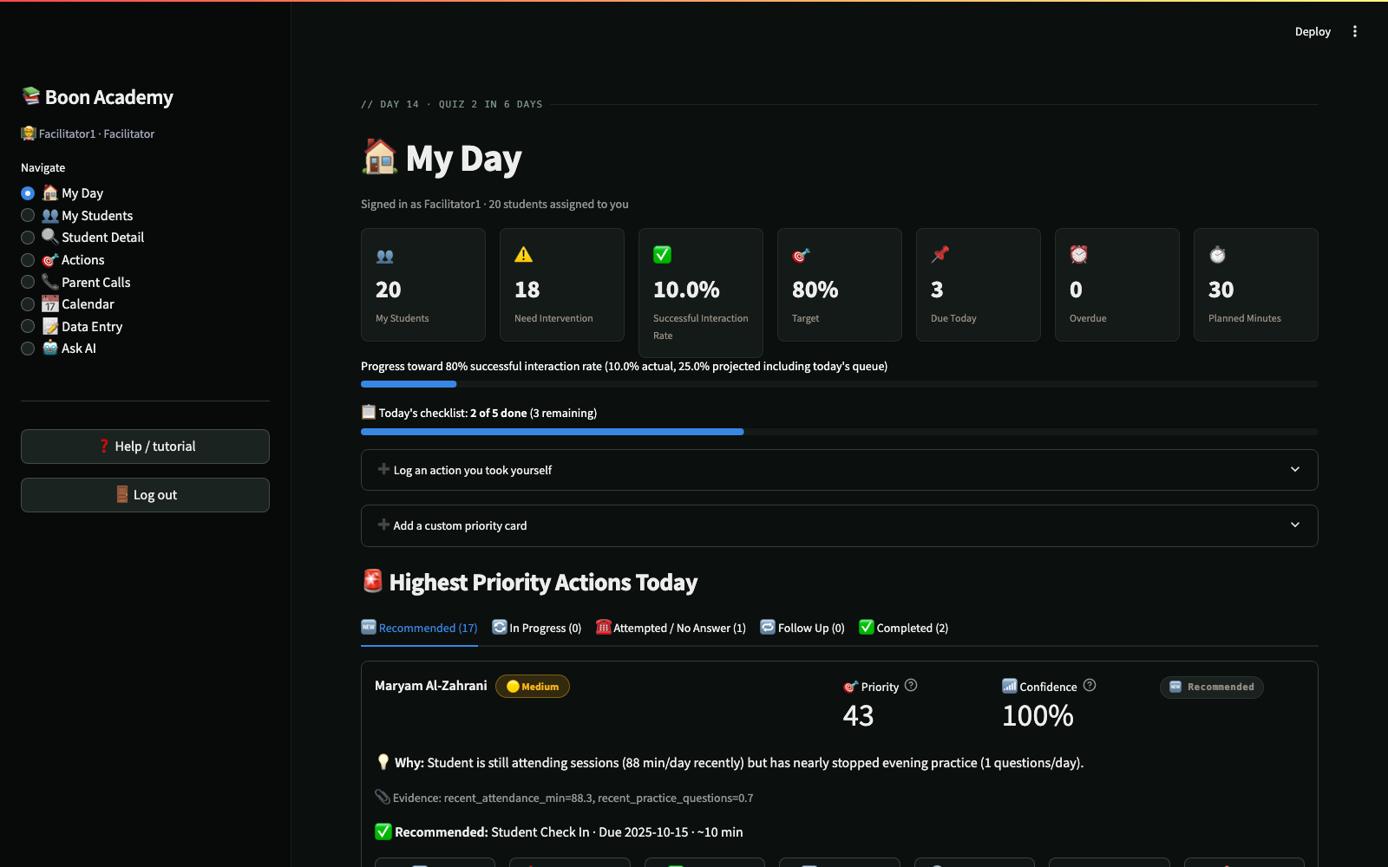
THE FACILITATOR'S DAY
"My Day" — the primary product surface
› KPIs: students, need-intervention, interaction rate, due today, overdue
› Students grouped into status tabs — not one long list
› Every card: why, evidence, recommended action, one-click buttons
› A confirmation message on every action taken
BOON ACADEMY
11

Slide 12
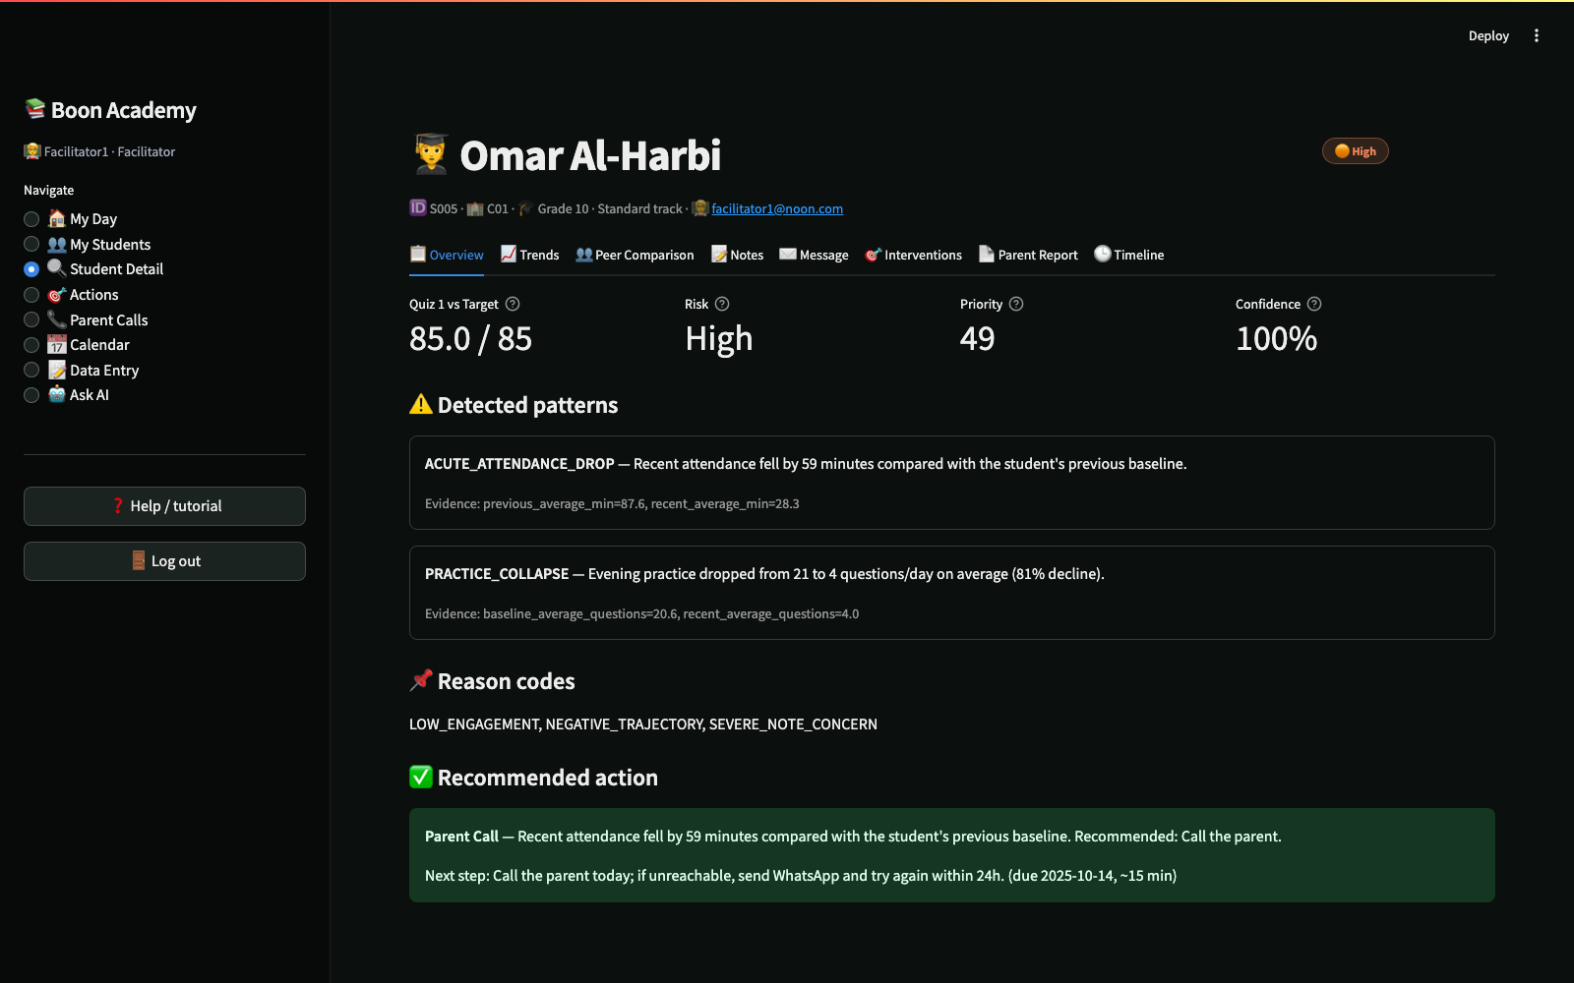
STUDENT DEEP DIVE
Eight tabs, one full picture
› Overview · Trends · Peer Comparison
› Notes (AI-analyzed, trust-checked)
› Message (generate / edit / send)
› Interventions · Parent Report · Timeline
BOON ACADEMY
12

Slide 13
MEASURING WHAT ACTUALLY HAPPENED
A recommendation is not an intervention
Recommendation coverage
100%
Contact attempt rate
0%
Successful interaction rate
0%
Target
80%
› A generated recommendation, or a no-answer call, never counts as success.
› Only a completed, sent, or booked interaction moves the needle.
› This is the honest baseline on Day 14 — the app exists to move it toward 80%.
BOON ACADEMY
13

Slide 14
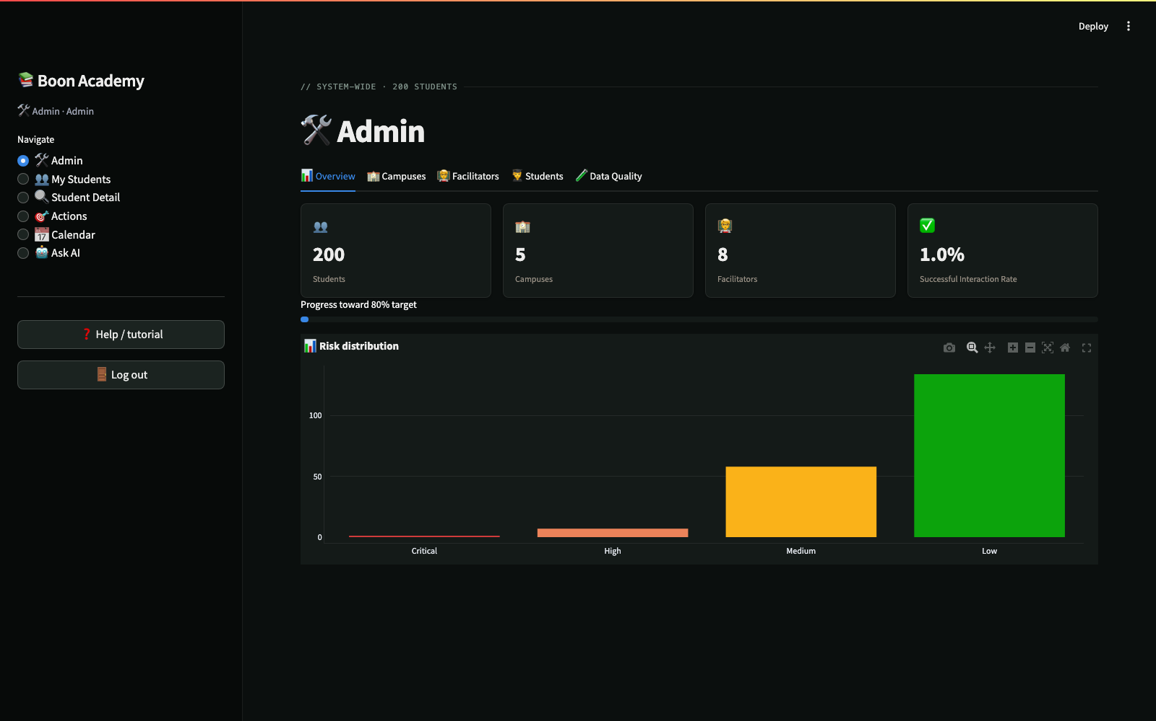
SYSTEM OVERSIGHT
The Admin view
› System-wide KPIs & risk distribution
› Campuses, facilitators, workload
› Every student, add/edit in place
› Full data-quality visibility — nothing hidden
BOON ACADEMY
14

Slide 15
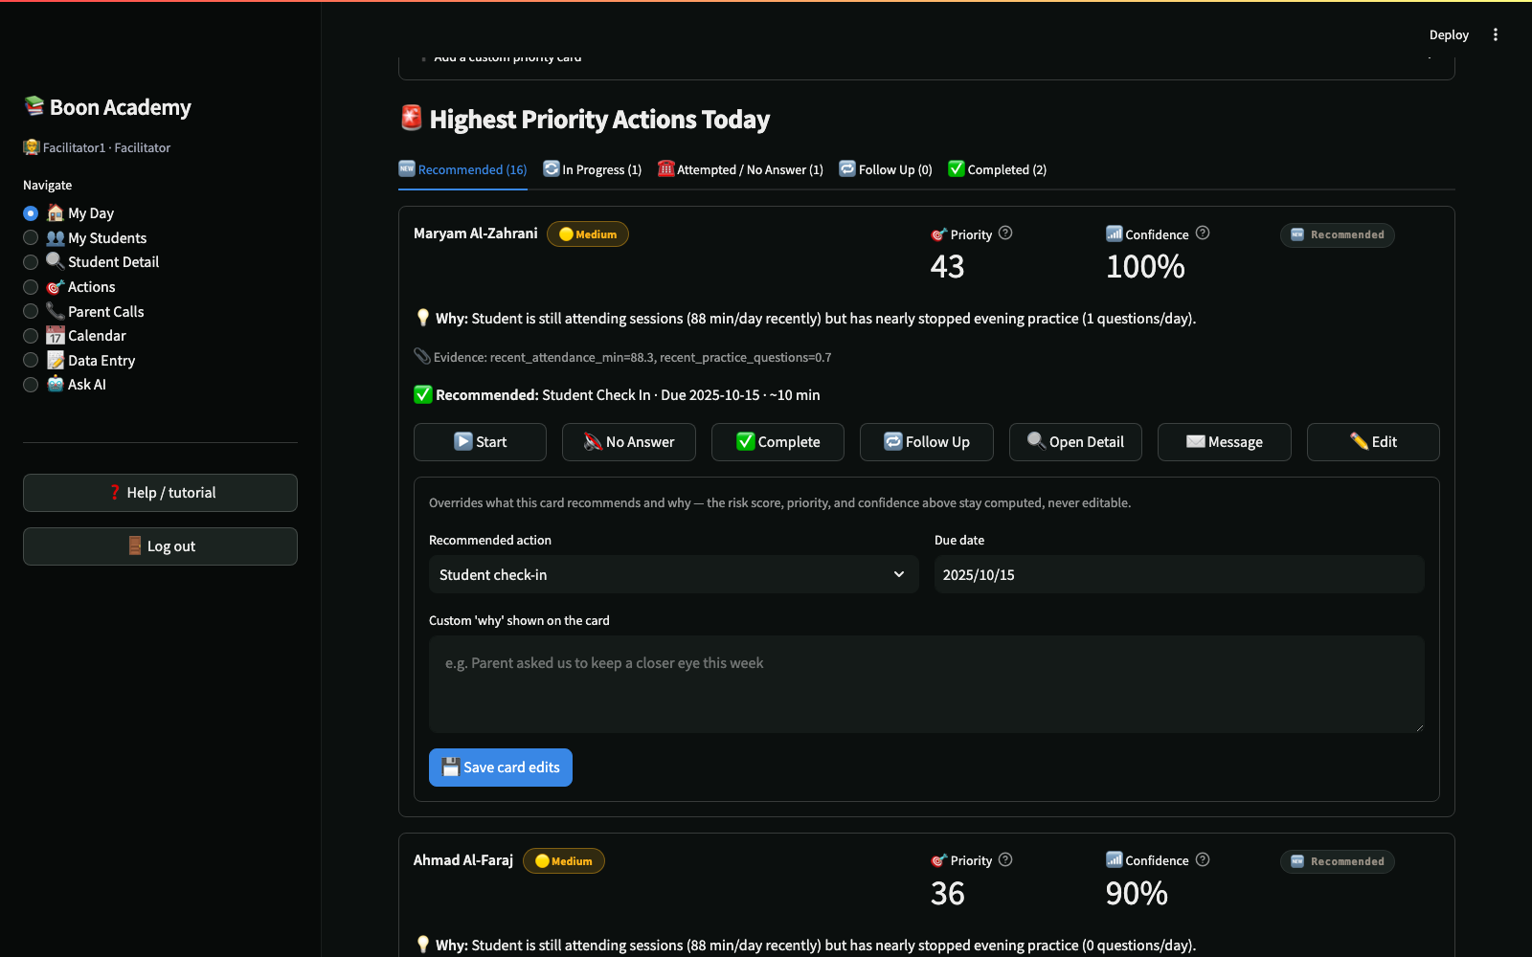
SELF-SERVICE, NOT JUST AUTOMATION
Taking Action, Your Way
› Every priority card has an ✉️ Edit button — override the recommended action, due date, and why, without ever touching the risk score itself.
› ➕ Add a custom priority card puts any student on today's list with your own reason — even one the system hasn't flagged.
› ➕ Log an action you took yourself records anything done outside the system's queue — an extra call, a booked session, tomorrow's work pulled forward.
› Every action can be edited or deleted afterward — nothing the system recommends is locked in.
BOON ACADEMY
15

Slide 16
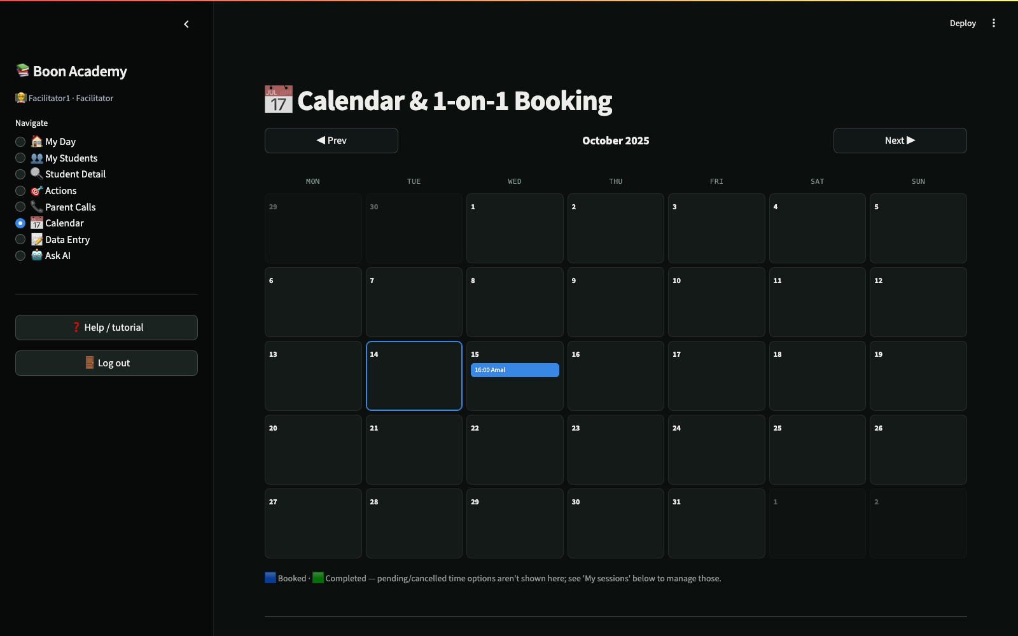
BOOKING & SCHEDULING
A Calendar, Built Like One
› A real month grid — Prev/Next navigation, today highlighted, laid out like a familiar calendar app.
› Shows only approved sessions: booked and completed — pending time options never clutter the view.
› Proposing time options creates a tracked intervention immediately, before a student even confirms one.
› Mark a session done, reschedule it, or cancel it — all from the same page.
BOON ACADEMY
16

Slide 17
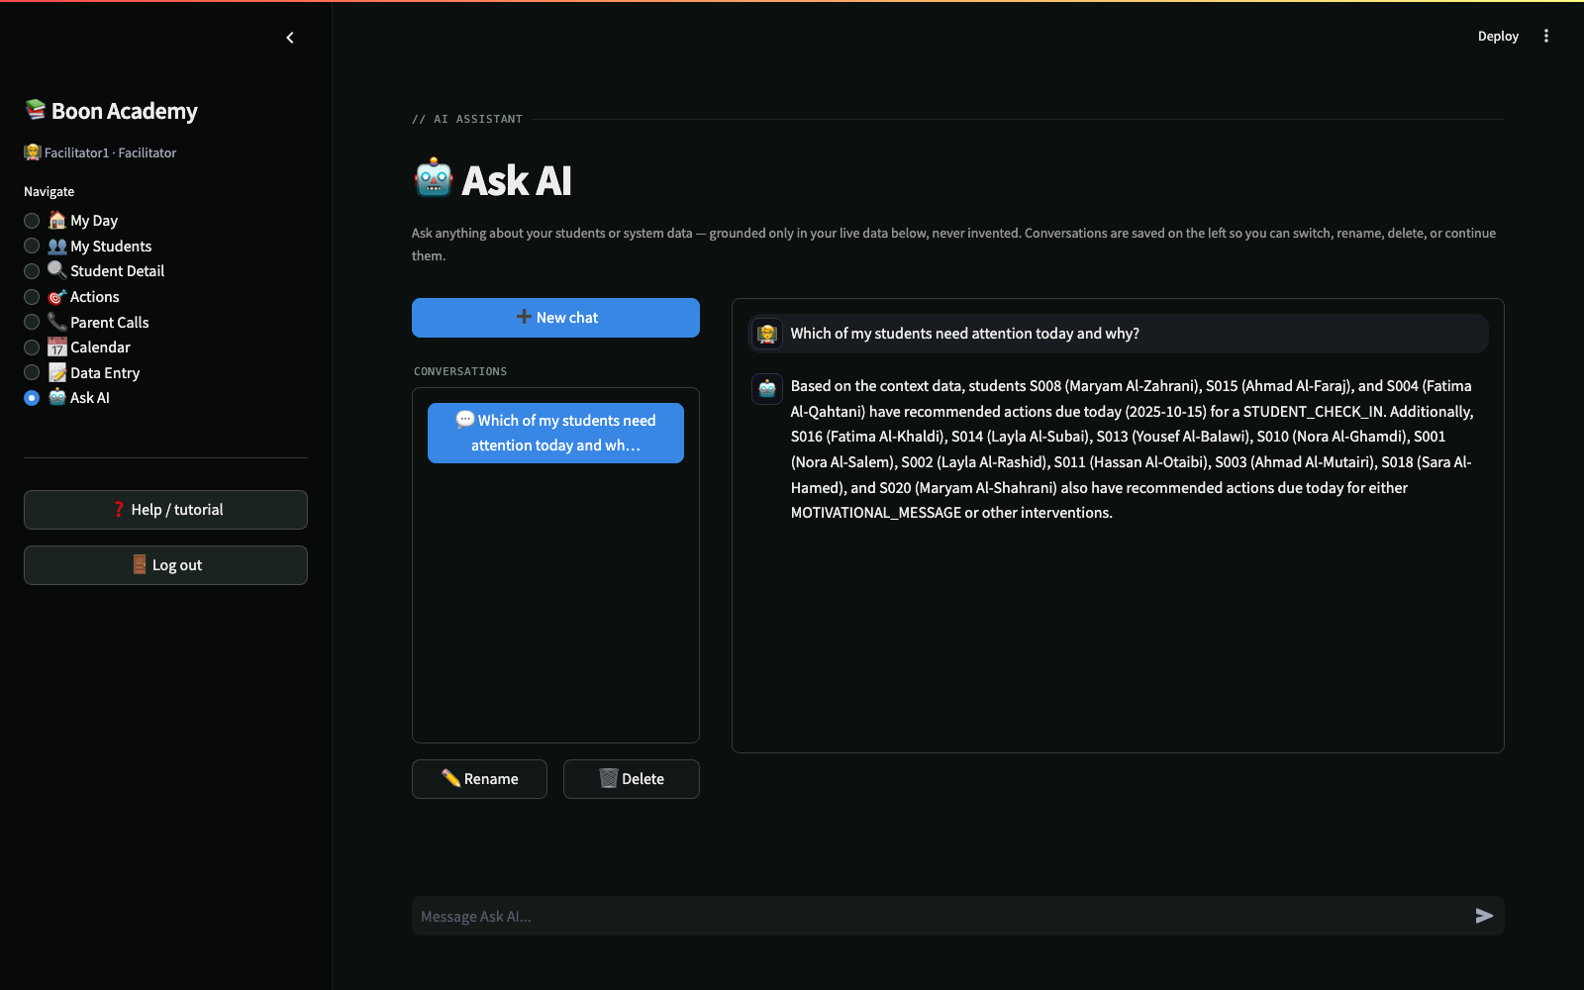
A CHAT ASSISTANT, GROUNDED IN YOUR DATA
Ask AI
› Ask about risk levels, coverage, overdue actions, or a specific student, in plain language.
› Every answer is built from a live digest of your own roster and intervention data — never a generic knowledge base with no connection to your students.
› Naming a student pulls in their full record automatically; asking about something the data doesn't cover gets an honest “I don't know,” never a guess.
› Conversations are saved, renameable, and switchable — pick up where you left off.
BOON ACADEMY
17

Slide 18
DESIGN SYSTEM
Analyzed, adapted, not copied
› Real computed styles extracted from motion.dev— colors, fonts, spacing, not guesswork.
› Warm near-black charcoal base, monospace technical labels, hairline dividers, accent-square section markers.
› Kept our own validated blue accent— reusing their signature yellow would collide with our own "Medium risk = yellow" status color.
› One shared token set (src/config.py) — the live app, the exported reports, and this deck all draw from it.
Critical
High
Medium
Low
Brand
BOON ACADEMY
18

Slide 19
RELIABILITY
32 tests, all passing in under a second
› Validation— missing attendance stays missing, ownership mismatches are flagged not dropped.
› Patterns— each rule fires (and doesn't false-fire) against hand-built scenarios.
› Risk— a severe dropout always outranks a stable student; score always stays in [0,100].
› Coverage math— a recommendation or a no-answer call never counts as success.
› LLM— mocked end-to-end: valid response, retry-then-succeed, fallback-after-two-failures.
› Access control— a facilitator's query never returns another facilitator's students.
BOON ACADEMY
19

Slide 20
WHAT WE DELIBERATELY CUT
And why
1. No trained ML model
Quiz 2 outcome labels don't exist yet — nothing to validate a model against. An auditable rule set is more trustworthy for a facilitator acting on it today.
2. No uncontrolled automatic parent communication
57% of sample notes carried an unverified facilitator/student pairing — identity and contact data need human validation first. Every send is a facilitator-reviewed dry run.
BOON ACADEMY
20

Slide 21
WHAT'S NEXT
Closing the loop
Recommended
intervention
→
Completed
intervention
→
Outcome
→
Behavior
change
→
Next quiz
result
› Today, the system measures whether an action was completed — not yet whether it worked.
› Once Quiz 2 results land, each completed intervention becomes a labeled example.
› That's exactly the training data a real predictive model would need— and only then would training one be justified.
BOON ACADEMY
21

Slide 22
Thank you.
Boon Academy Intervention Command Center

