Slide 1
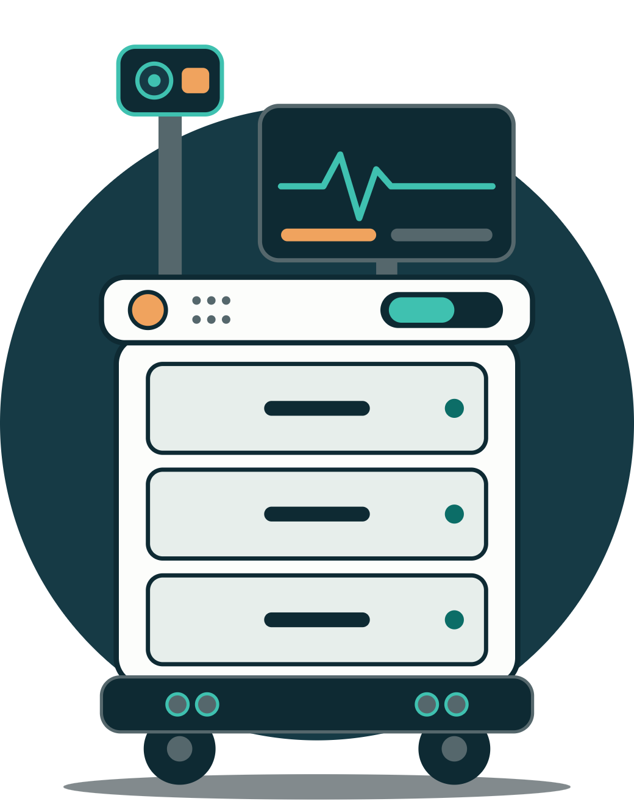
IsoCare
DATA ACQUISITIONS · PROJECT PROPOSAL
An autonomous medication and vitals robot for isolation wards
Youssef Eslam · Ibrahim Tamer · Youssef Hesham · Belal Tamer
Supervised by Dr. Essam Seddik · Monday, October 19, 2026
Notes:
Introduce the team and the idea in one sentence: IsoCare is a robot that does the routine rounds in an isolation ward. It measures vitals and hands out the doctor’s medication, so nurses only go in when they’re really needed.

Slide 2

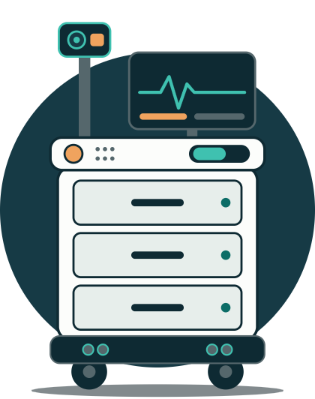
The problem and our solution
INTRODUCTION
THE PROBLEM
OUR SOLUTION · ISOCARE
Every time a nurse enters an isolation room, they must put on and take off protective gear. It’s slow, tiring and risky.
A mobile medicine cabinet that does the routine rounds by itself.
Drives itself to each bed
14–23
12.7%
Confirms the patient’s identity
Measures heart rate, SpO2 and temperature
minutes to take the gear off, each time
error rate when taking it off, in a COVID-19 ward
Gives the doctor’s drugs only when it’s safe
Nurses rate robots most useful for measurements and deliveries, exactly the routine work IsoCare takes over.
It never prescribes and doesn’t replace nurses: doctors set the rules, nurses load the drawers.
Sources: Isr. J. Health Policy Res. 2021; COVID-19 isolation-ward study 2020; Nursing Open 2024
02
Notes:
Every time a nurse enters an isolation room, they have to put on and take off protective gear. Taking it off alone is reported to take 14 to 23 minutes, and it’s where most mistakes happen: one COVID-19 ward study found a 12.7% error rate. A 2024 survey found nurses think robots help most with measurements and deliveries. That’s IsoCare: a mobile medicine cabinet that drives to each bed, confirms the patient, measures heart rate, oxygen and temperature, and gives the doctor’s prescribed drugs only when it’s safe. It never prescribes and doesn’t replace nurses. Sources: Israel Journal of Health Policy Research 2021, doi 10.1186/s13584-021-00477-7; PubMed Central PMC7468685 (2020); Lee et al., Nursing Open 2024, doi 10.1002/nop2.2175.

Slide 3
One round, and who presents what
INTRODUCTION
One round at each bed
01
02
03
04
05
06
Load
Navigate
Identify
Measure
Decide
Act
Nurse fills the drawers
Drives to the bed
Wristband and face
HR, SpO2, temp
Checks the doctor’s rules
Dispense, or alert the nurse
Four parts, four presenters
1 · Hardware
2 · ROS 2
3 · AI
4 · Software
Belal Tamer
Ibrahim Tamer
Youssef Hesham
Youssef Eslam
Sensors, motors, power and data acquisition
How the parts talk, and navigation
What it sees and hears, and dose decisions
Doctor app, touchscreen, data and alerts
We go bottom-up: from the sensors to the doctor’s phone
03
Notes:
Quickly walk through one round: the nurse loads the drawers, the robot drives to the bed, confirms the patient, measures the vitals, checks the doctor’s rules, and then either dispenses or alerts the nurse. Then hand over: we present the robot bottom-up, starting with the hardware, then ROS 2, then the AI, and finally the software and the doctor’s app.

Slide 4
Sensors and motors
PART 1 · HARDWARE · BELAL TAMER
Vitals
Navigation
Other sensors
Motors
MAX30102
HC-SR04 ×2
Limit switch ×4
2× 12 V gear motor
Heart rate and SpO2, in a dark finger chamber
Ultrasonic, front-left and front-right
Confirms each drawer was opened
37 mm, ~100 RPM, 10 kg·cm or more
MLX90614
VL53L0X ×2
INA219
2× DRV8871
Forehead temperature, no touching
Laser distance, side and low obstacles
Battery level and motor-stall detection
Motor driver, one per motor, 3.6 A peak
MAX30205
MPU6050
USB webcam
4× MG90S servo
Contact temperature to cross-check the IR
IMU: heading between bed markers
1080p wide-angle: beds, markers, QR codes
3 drawer locks and the finger-slot lid
Hall encoders ×2
Wheels
Wheel speed and distance
85–100 mm rubber, plus 2 ball casters
The ESP32 reads every sensor except the webcam, which plugs into the Pi
04
Notes:
These are the sensors and motors from our bill of materials. Vitals: the MAX30102 measures heart rate and oxygen in a dark finger chamber, the MLX90614 reads forehead temperature without touching, and the MAX30205 contact sensor cross-checks it. Navigation: two ultrasonic sensors at the front, two laser time-of-flight sensors for the sides and low obstacles, an IMU for heading, and the Hall encoders built into the motors for wheel speed. Other sensors: limit switches confirm each drawer was opened, the INA219 monitors the battery and spots a stalled motor from a current spike, and a USB webcam feeds the AI. Motors: two 12 V geared motors with encoders, each with its own DRV8871 driver, and four metal-gear MG90S servos for the three drawer locks and the finger-slot lid. We chose metal-gear servos because cheap plastic ones are too weak for locks. That is well beyond the course minimum of three sensors, motors, a microcontroller and a camera. If asked how the data is read: most sensors share the ESP32’s I2C bus; the two laser sensors start with the same address, so their XSHUT pins give each a new one at start-up; the ultrasonic sensors fire one at a time so they don’t hear each other; and the heart-rate signal is sampled at 100 Hz, filtered, and its peaks counted.

Slide 5


ROS 2 ties every part together
PART 2 · ROS 2 · IBRAHIM TAMER
Key topics
Raspberry Pi 5 · ROS 2 Jazzy
Topic | Message | From → To
/go_to_bed | std_msgs/UInt8 | mission → planner
/route | Route (custom) | planner → navigator
/marker_pose | MarkerPose (custom) | detector → navigator
/cmd_vel | geometry_msgs/Twist | navigator → bridge
/sensor_data | SensorData (custom) | bridge → odometry
/odom | nav_msgs/Odometry | odometry → navigator
/detections | Detection2DArray | yolo → navigator
/vitals | Vitals (custom) | bridge → decision
/drawer/unlock | Service (custom) | decision → bridge
camera
marker_detector
yolo_detector
route_planner
navigator
odometry
serial_bridge
mission_manager
patient_id
decision_engine
app_bridge
framed serial link over USB
ESP32 firmware · not a ROS node
motors
encoders
imu
range ×4
vitals
drawer_locks
safety_stop
ESP32 safety: stops the motors if /cmd_vel goes quiet for 0.5 s, and slows at 40 cm and stops at 15 cm with no help from the Pi
05
Notes:
ROS 2 is the middleware that connects everything. Each job is a small program called a node, and nodes talk by publishing and subscribing to named topics with standard message types. That means each team member’s code is its own node, and they plug together through agreed topics. The Raspberry Pi runs ROS 2 Jazzy, the long-term-support release. The ESP32 is not a ROS node: it runs our own firmware, and a serial_bridge node on the Pi talks to it over USB using a framed serial protocol we defined. Walk through the table: the navigator sends speed commands to serial_bridge, which forwards them to the ESP32. The ESP32 sends back raw wheel ticks, gyro, distances and vitals, which serial_bridge publishes, and the odometry node turns the sensor data into a position. The decision engine calls a service to unlock a drawer. Safety point: the ESP32 protects itself. If speed commands stop arriving for half a second it stops the motors, and it slows at 40 centimetres and stops at 15 centimetres on its own, without the Pi.

Slide 6


Driving to the bed with markers
PART 2 · ROS 2 · IBRAHIM TAMER
01
02
03
04
Marker map
Localize
Plan and drive
Park and stop
Markers are graph nodes with distances. Each position is tape-measured.
Wheel ticks and gyro give position and heading. Each marker sighting resets both.
Dijkstra picks the route. The navigator steers and sends /cmd_vel.
At the bed it aligns on the marker, and YOLO confirms the bed. The ESP32 stops for obstacles.
RViz2: shows the robot’s pose, the markers it sees and live sensor data while we test.
rosbag2: records every sensor topic with timestamps, so we can replay runs and plot the data.
No LiDAR needed: wheel odometry and the IMU, corrected by the bed markers
06
Notes:
We do not use a full navigation stack. First, we draw the ward as a graph: each marker is a node, the distance between neighbouring markers is an edge, and we measure each marker’s position with a tape. Second, the Pi estimates where the robot is from the wheel ticks and the gyro; that estimate drifts, so every time the camera sees a marker we reset the position and heading. Third, Dijkstra’s shortest-path algorithm picks the list of markers to visit, and the navigator drives one leg at a time, steering on the marker when it can see it and dead reckoning when it cannot, at 0.3 metres per second or less, sending speed commands. Fourth, at the bed the robot lines up on the marker, YOLO confirms the bed or person, and the distance sensors set the stopping distance. The ESP32 handles obstacles itself. If the path is blocked, the robot waits, retries, then calls the nurse. If it loses every marker, it stops and alerts. Mention the data acquisition link: rosbag2 records every sensor topic with timestamps, which we use for testing and for the graphs in our report.

Slide 7




What the robot sees and hears
PART 3 · AI · YOUSSEF HESHAM
Obstacles and people
Bed markers
Finds beds and people in the camera frame and confirms the bed before the robot parks. Pretrained on COCO, fine-tuned on our own photos.
Reads each bed’s printed marker to get the bed number, distance and angle, so the robot parks in the right spot.
OpenCV ArUco
YOLOv8n
Patient check
Voice keywords
Reads the wristband QR code, then checks the face matches the patient the nurse registered, before any drawer opens.
Listens only for “call nurse”, “pain” and “repeat”. It runs on the robot, so no audio leaves the room.
QR + face recognition
Offline keyword model
All models run on the Raspberry Pi; results go out as ROS 2 topics
07
Notes:
The AI has two jobs: perception, on this slide, and decisions, on the next. YOLOv8n is the smallest YOLOv8 model, chosen so it runs on the Raspberry Pi. It comes pretrained on the COCO dataset, which already includes people, beds and chairs, and we fine-tune it on our own photos to add things like medicine carts. Bed markers are read with OpenCV’s ArUco module, which gives the bed number plus distance and angle. The patient check uses two factors: the wristband QR code and a face match. The voice model only listens for a few keywords and runs offline. Everything stays on the robot, and the results are published as ROS 2 topics for navigation and the decision engine.

Slide 8
Is it safe to give this dose now?
PART 3 · AI · YOUSSEF HESHAM
What the robot finds | What it decides
Vitals normal, scheduled dose due | Unlock the drawer, dispense, log it
Doctor’s condition met (e.g., fever) | Ask the doctor to approve in the app, then dispense and notify the nurse
Vitals abnormal (low SpO2, very high heart rate) | URGENT: hold all drugs, alert the nurse now, stay with the patient
Reading unreliable (finger moved, weak signal) | Re-measure; if it fails again, call the nurse
DOCTOR’S RULE · EXAMPLE
Paracetamol: only if temperature is above 38 °C, at most once every 6 hours
The AI can never act outside the doctor’s limits.
Alert levels follow a simplified NEWS2 early-warning score, plus each patient’s own trend over time.
The AI decides whether to give the doctor’s prescribed drugs; it never chooses new ones
08
Notes:
This is the core of the project and the answer to “isn’t it dangerous for an AI to give drugs?”. The AI never chooses a drug. The doctor prescribes and sets the conditions, exactly like the as-needed orders hospitals already use. The robot measures the vitals and decides whether the condition is met, whether it’s safe, or whether to stop and call a human. NEWS2 is a real clinical early-warning score; we use a simplified version with the three vitals we measure, and compare each reading with that patient’s own previous readings to spot deterioration.

Slide 9


The doctor’s app
PART 4 · SOFTWARE · YOUSSEF ESLAM
01
Send the robot to a patient
Bed 3
LIVE
Pick a bed; the robot drives there and starts a check.
02
See and talk to the patient
Live two-way video through the robot’s camera, screen, mic and speaker.
Robot camera
03
Watch the vitals
Latest readings, trends over time, and an alert whenever a dose is held.
HR
SpO2
Temp
04
Approve doses
82
96%
38.6
When a doctor’s rule is met, the doctor taps Approve or Hold.
Fever rule met. Give paracetamol?
Privacy: the robot says who is joining and lights an LED while the camera is live. Only logged-in doctors can connect, and calls aren’t recorded by default.
Approve
Hold
App mockup; the readings shown are example values
09
Notes:
The doctor’s app lets a doctor check on a patient without entering the isolation room. The doctor picks a bed, the robot drives there, and the doctor sees and talks to the patient through the robot’s camera, screen, mic and speaker. The app shows the latest vitals and their trend. When one of the doctor’s rules is met, like a fever above 38 °C, the robot asks for approval, and the doctor taps Approve or Hold, so a human stays in charge of every as-needed dose. Mention privacy: the robot announces the doctor and lights an LED whenever the camera is live, only logged-in doctors can connect, and calls are not recorded by default.

Slide 10




From the robot to the doctor’s phone
PART 4 · SOFTWARE · YOUSSEF ESLAM
ROS 2 topics
app_bridge
Firebase
Doctor app
Vitals, decisions and alerts from the robot
Our Python node linking ROS 2 to the cloud
Syncs the data and sends push alerts
Flutter: one code base for Android and iPhone
Nurse touchscreen
Patient voice and screen
Data and logs
A web page served by the Pi. The nurse assigns drawers to beds and enters the doctor’s rules.
Spoken step-by-step guidance in the patient’s language, with readings shown on screen.
Every visit is saved on the robot in SQLite and synced, with CSV export for doctors and our report.
Live video uses WebRTC, straight from the robot to the doctor’s phone
10
Notes:
This slide shows how data gets from the robot to people. The robot’s nodes publish vitals, decisions and alerts as ROS 2 topics. Our app_bridge node, written in Python, listens to those topics and syncs them to Firebase, which stores the data and sends push notifications to the doctor’s phone. The app is built in Flutter, so one code base runs on both Android and iPhone. Live video doesn’t go through Firebase; it uses WebRTC, straight from the robot to the phone. The other screens: the nurse uses a touchscreen page served by the Pi to set up each round, and the patient hears spoken guidance and sees their readings. Every visit is saved on the robot in a SQLite database and can be exported as CSV, which also gives us the data for our report.

Slide 11


Plan, testing and product
WRAP-UP
Week 5
Week 6
Week 7
Week 8
Week 9
Week 10
Week 11
Week 12
Design
Build
Build
Build
Integrate
Integrate
Test
Demo
Oct 19
Oct 26
Nov 2
Nov 9
Nov 16
Nov 23
Nov 30
Dec 7
Final design
Chassis and drive motors
Obstacle stop working
Drawers and locks
All parts linked over ROS 2
Milestone: full bed visit, no help
Vitals accuracy tests
Final demo
Order parts
Report
Agree ROS 2 topics
Vitals sensors on the ESP32
YOLOv8 and ArUco on the Pi
Decision engine and app
App connected to the robot
Navigation and safety tests
Rounds across all beds
Testing
Product
Vitals vs. commercial devices: ±5 bpm, ±2%, ±0.5 °C
Reaches the right bed in 19 of 20 runs
Safety tests must pass every time
For isolation wards, quarantine sites and care homes
COVID-era robots like Nepal’s SISTER were driven remotely
IsoCare drives itself, measures and decides safely
Dates are each week’s Monday · SISTER: UNDP Nepal, “Robots for Recovery,” 2020
11
Notes:
A quick wrap-up before questions. Our plan runs week by week from week 5, starting Monday October 19, to week 12. Week 5: we finish the design, order the parts and agree the ROS 2 topics. Weeks 6 to 8 we build: first the chassis, drive motors and vitals sensors, then the obstacle stop and the vision models, then the drawers, the decision engine and the app. Week 9 we link everything over ROS 2. Our key milestone is in week 10: one full bed visit with no human help. Week 11 is testing, and week 12 is the final demo and report. Testing: we compare our vitals with commercial devices and test navigation; the safety tests must pass every time. Product: hospitals already used robots in isolation wards during COVID-19, like the remotely driven SISTER robot in Nepal; IsoCare goes further by driving itself, measuring vitals and deciding safely.

Slide 12
Thank you
ISOCARE
Questions?
IsoCare does the routine rounds, so nurses enter isolation rooms only when they’re really needed.
Youssef Eslam · Ibrahim Tamer · Youssef Hesham · Belal Tamer
Notes:
Close with the one-sentence summary and open the floor. Likely questions: what happens if the robot gets it wrong (the doctor’s limits, the patient check and the alerts), how it handles doors (it stays inside one ward), and why not just use a camera for temperature (accuracy and cost).

