Slide 1
ENGI 301 Glucose Sensor Proposal
9/26/2022
Ibrahim Al-Akash

Slide 2
Background Information
3.7 million people die from diabetes and high blood glucose levels
422 million diabetics around the world
1 in 11 people have diabetes
To effectively treat diabetics, patients must monitor glucose levels using current methods:
Invasive procedures that require implantation of a device
Painful finger prick tests produce a lot of waste and are not reusable
These methods require patients to actively monitor their glucose, which is inconvenient and reduces patient compliance
Notes:
Include something on the right wavelengths on the IR spectroscopy.

Slide 3
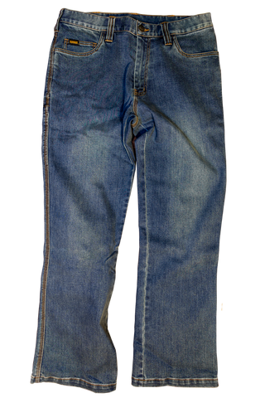
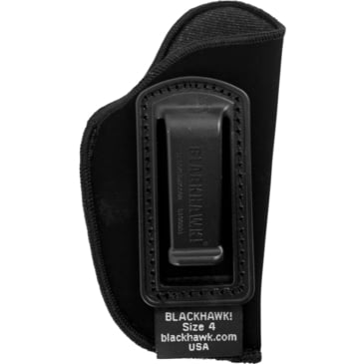
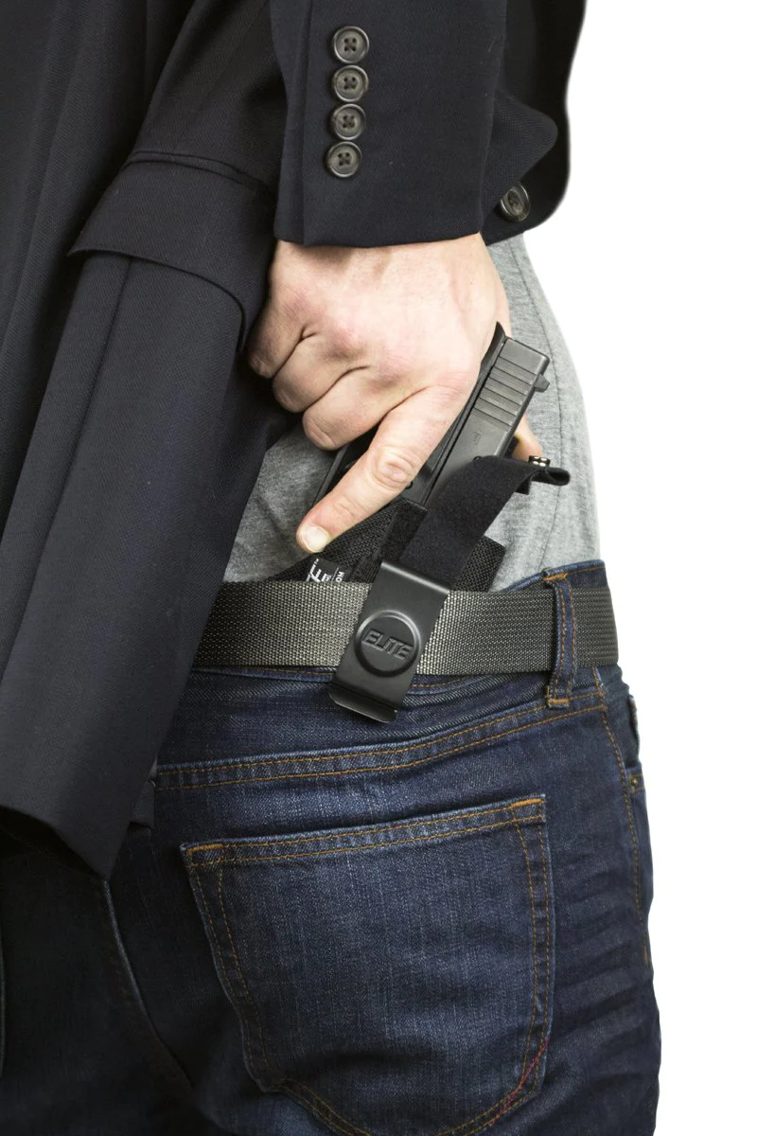
Concept
Sensing Mechanism:
NIR Reflectance Spectroscopy
Embedded Sensor System
Noninvasive Continuous Glucose Sensor
+
=
Sensor Holster

Slide 4
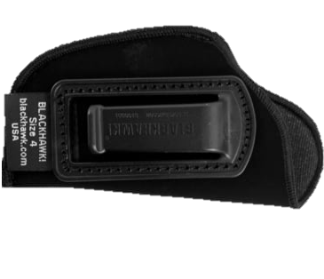
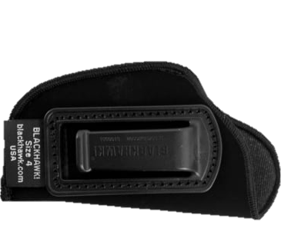
Concept System
LEDs
NIR Sensor
Clip bottom view
(surface touching skin)
PocketBeagle
Clip top view
(surface touching garment)
QI Charger
Power Source

Slide 5
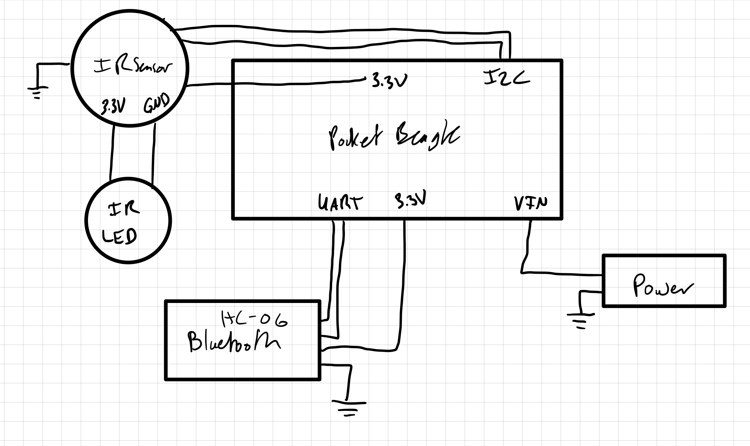
System Block Diagram

Slide 6
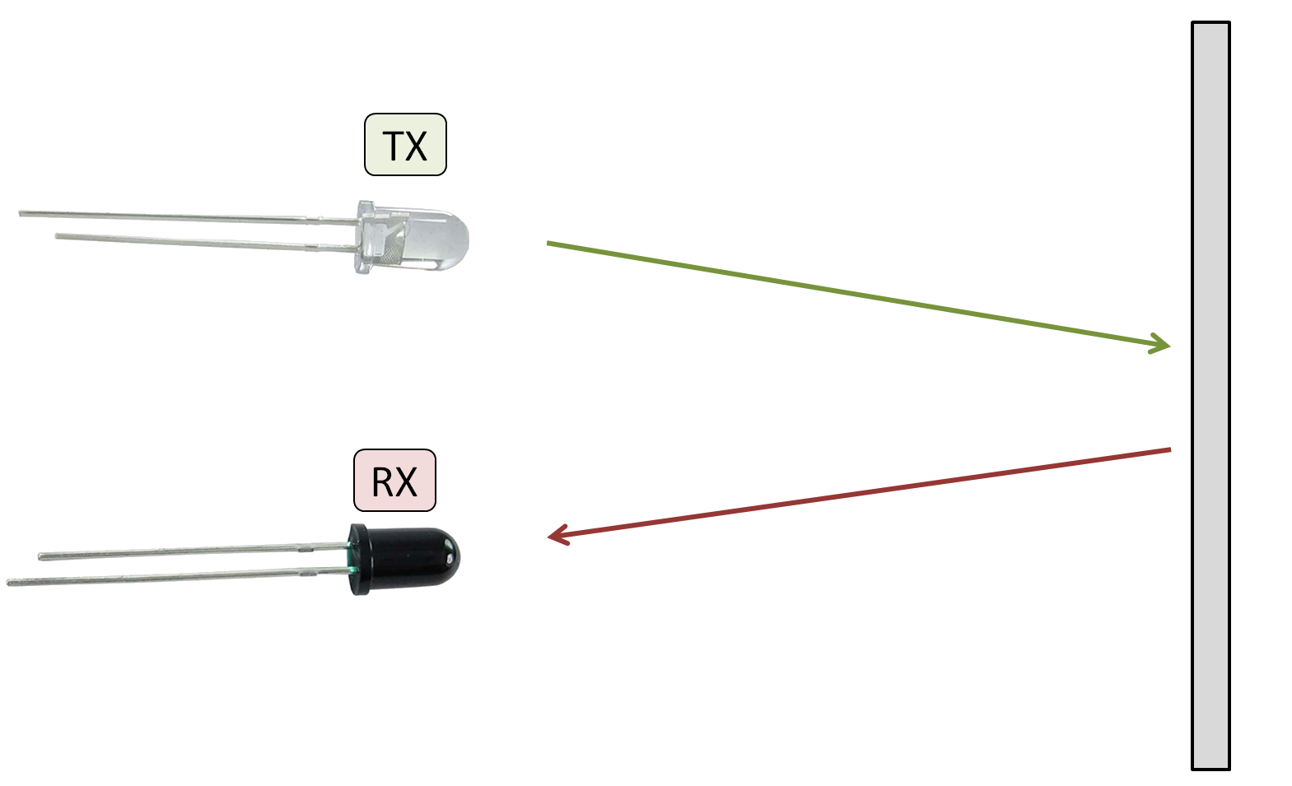
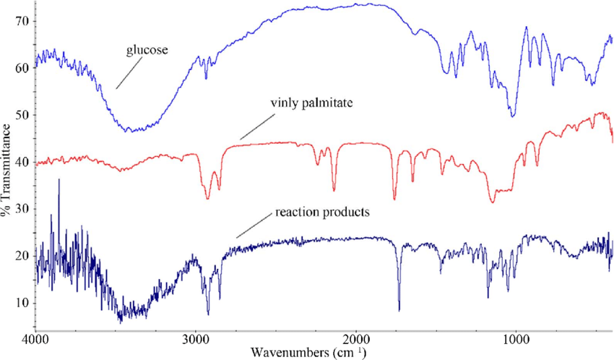
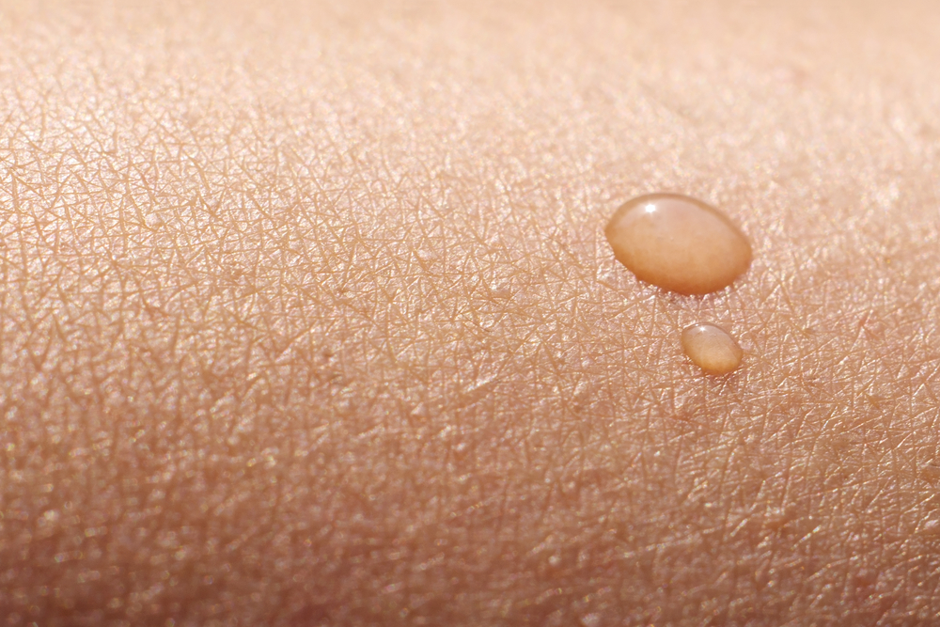

Flow Chart
2
1
Data Processing
Data Acquisition
3
4
Calibration/Training Regression
Classify BGL and Report Values
Glucose Dashboard
140mg/dL
Healthy
Notes:
Look up software aspects prior to arrival of materials (3 weeks)

Slide 7
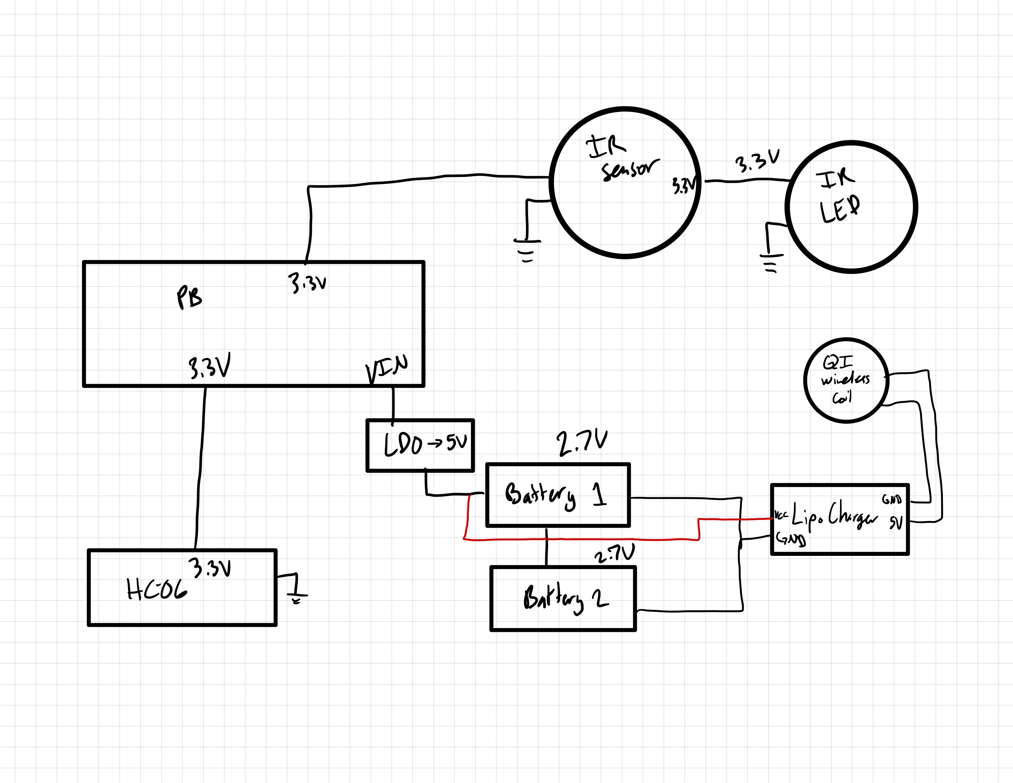
Power Block Diagram
I/O | Voltage | Current
QI Wireless | 5V | 500 mA
LiPo Charger | 5V | 1A
Batteries | 7.4V | 5.0 µA
Pocket Beagle | 5V | 140-230 mA
IR Sensor | 3.3V | 100 mA
IR LED | 3.3V | 50 mA
HC-06 | 5V | 30mA
Notes:
MVP

Slide 8
Roadmap
Basic Hardware (MVP Sensor)
Portability
Wireless Power Capabilities
Bluetooth Interface with PC
Android Bluetooth App
NIR Sensor circuit integrated with PB
Powered by basic USB
Button to start sensing
LEDs to indicate readings
Screen to display numerical data
Powered by USB battery
Powered by LiPo batteries
Include QI coils with charging circuit to recharge LiPo batteries
Initiate sensing and transmit data to PC via Bluetooth
Develop finished smartphone application with interface to initiate sensing and view data
Store data over time
View trends and send notifications highlighting progress

Slide 9
Components / Budget
Component | Need to Buy | Cost
QI Wireless Power Coils | 1 | $8.50
NIR LED 950nm (Mouser Part #755-SIR-34ST3F) | 1 | $0.87
NIR Sensor (SparkFun Spectral Sensor Breakout) | 1 | $27.95
LiPo Battery 3.7V | 2 | $12.50
Blackhawk Inside Waisteband Gun Holster | 1 | $14.99
HC-06 Bluetooth Module | 1 | $8.49
LiPo Battery Charger | 1 | $4.29
5V LDO (Mouser Part #511-LD29150PT50R) | 1 | $1.18
Total |  | $78.77
Notes:
Update links to websites

