Slide 1
ENGI 301 Etch-a-Sketch PCB Project
Ibrahim Al-Akash
Due 12/13/2022 @ 11:59pm

Slide 2
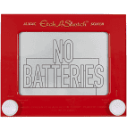
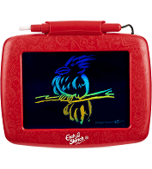
Background Information
Create a PCB for an “Etch-a-Sketch”
Hardware:
SPI Display Screen
Two Potentiometers
Two Buttons (Reset the Game, Change Color)
Three LEDs (Red, Green, and Blue for Color)
USB Port (Expansion)

Slide 3
System Block Diagram – “Etch-a-Sketch”
5V
3.3V
PocketBeagle
USB Host
VCC
SPI Display
USB
SPI
SPI
VCC
USB
SPI
GPIO
GPIO
GPIO
GND
3.3V
GND
GND
1k
1.8V
Potentiometer
3.3V
GPIO
1k
AIN
GPIO
AGND
GPIO
1.8V
Potentiometer
GPIO
AIN
AGND
GPIO

Slide 4
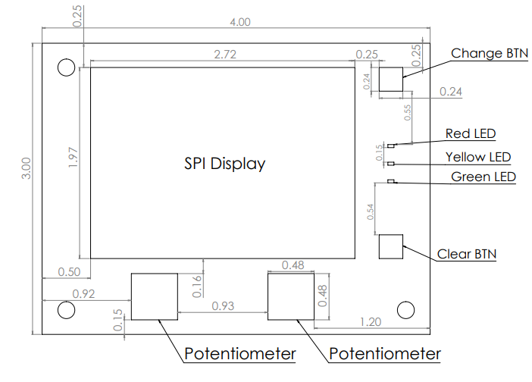
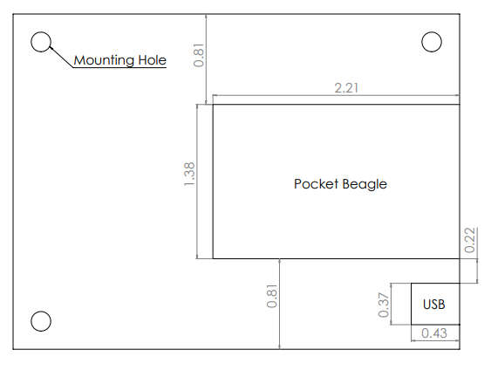
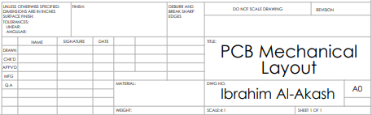
Original Mechanical Drawing
FRONT
BACK

Slide 5
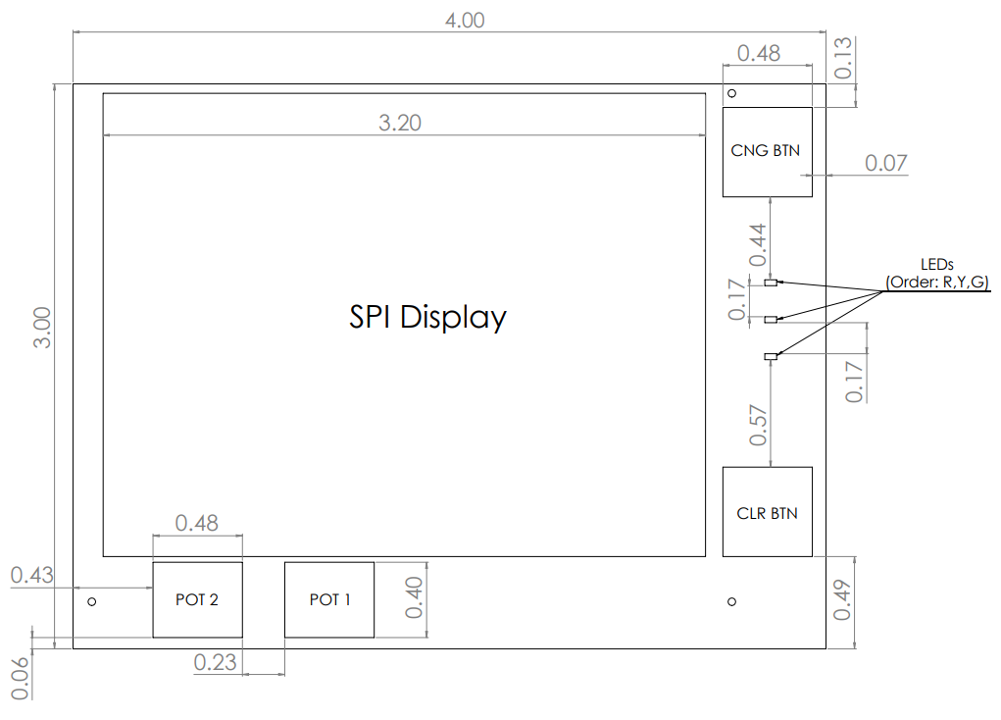
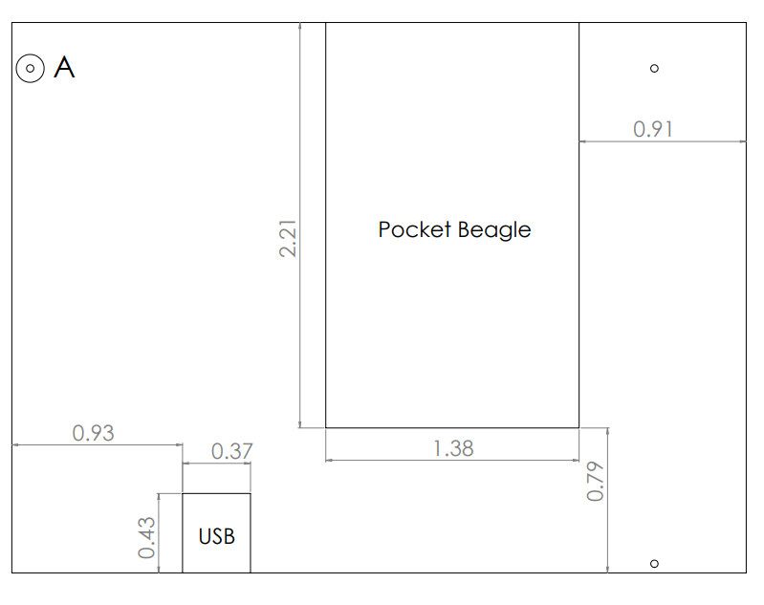
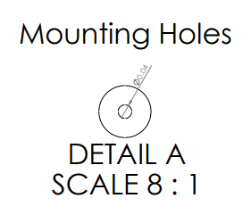
Final Rev 1 Mechanical Drawing
FRONT
BACK

Slide 6
Connections
SPI
3.3/5 Vin → 3.3V
GND → GND
CLK → CLK
MISO → MISO
MOSI → MOSI
D/C → GPIO89
RST → GPIO23
LEDs
Red → GPIO57
Yellow → GPIO58
Green → GPIO59
Buttons
CNG → GPIO60
CLR → GPIO64
Potentiometer 1
AIN0
Potentiometer 2
AIN1
USB
VBUS → VBUS → 5V
DM → D-
DP → D+
ID → GND
GND → GND
Shield → CGND

