Slide 1





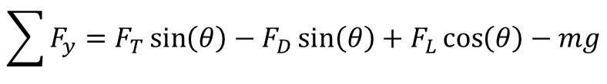

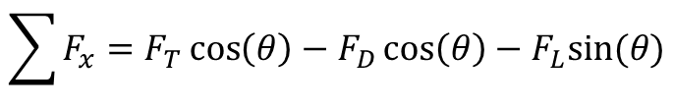


$$\vec{F_{L}}$$
$$\vec{F_{T}}$$
$$θ$$
$$θ$$
$$θ$$
$$θ$$
$$\vec{F_{D}}$$
$$\vec{F_{W}}$$
$$\sum{F_{x}=F_{T}\cos\left(θ\right)−F_{D}\cos\left(θ\right)−F_{L}sin⁡(θ)}$$
$$\sum{F_{y}=F_{T}\sin\left(θ\right)−F_{D}\sin\left(θ\right)+F_{L}\cos\left(θ\right)−mg}$$

Slide 2
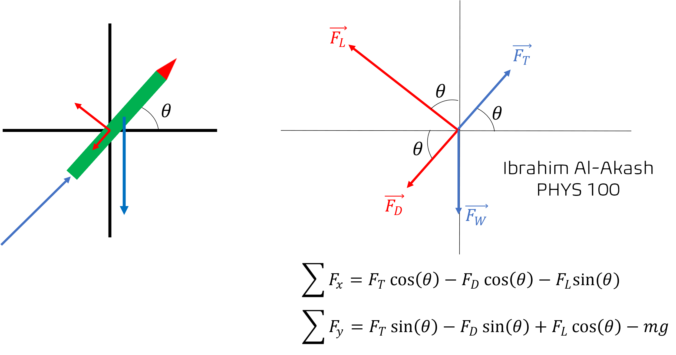

Slide 3
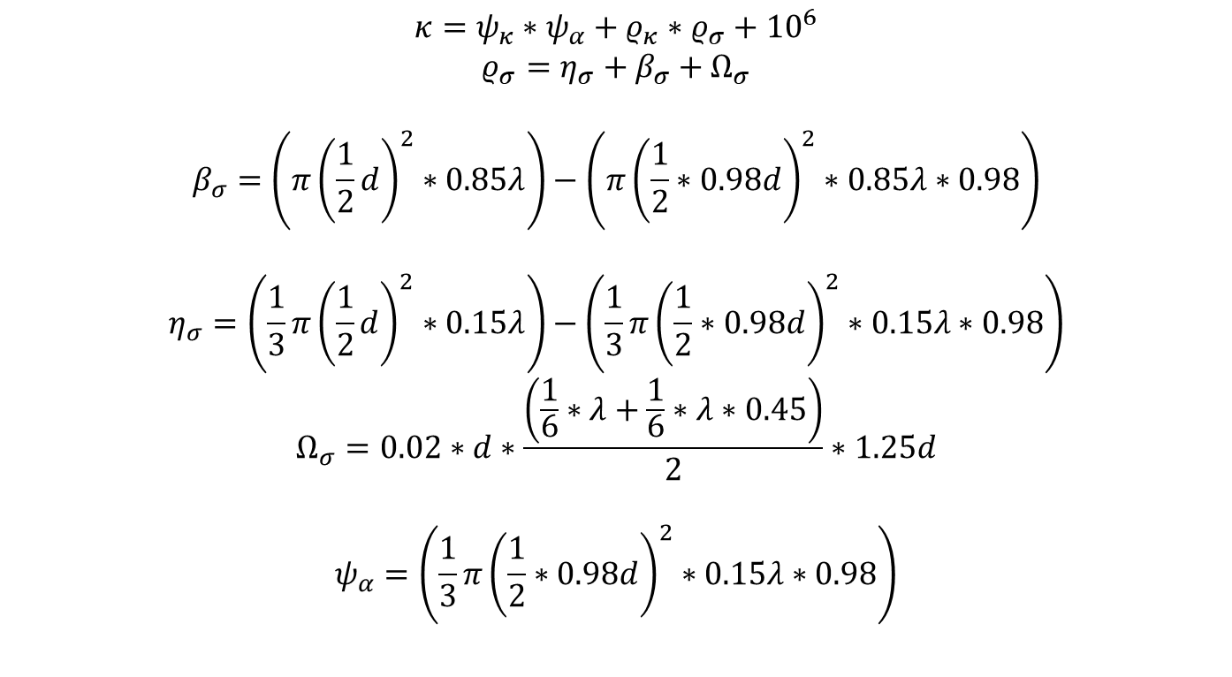
Cost = Propellant Cost ($/kg) * Propellant Amount + Rocket Material Cost ($/kg) * Rocket Size
Rocket Size = Nose Cone Size + Body Size
Nose Cone Size = (1/3 * pi * (½ * Diameter)^2 * 15% of Length) – (1/3 * pi * (½ * (Diameter*98%))^2 * 15% of Length * 98%)
Body Size = (pi * (1/2 * Diameter)^2 * 85% of Length) – (pi * (1/2 * (Diameter*98%))^2 * 85% of Length * 98%)
Propellant Amount = (pi * (1/2 * (Diameter*98%))^2 * 85% of Length * 98%)
$$κ=ψ_{κ}∗ψ_{α}+ρ_{κ}∗ρ_{σ}+{10}^{6}$$
$$ρ_{σ}=η_{σ}+β_{σ}+Ω_{σ}$$
$$β_{σ}=\left(π{\left(\frac{1}{2}d\right)}^{2}∗0.85λ\right)−\left(π{\left(\frac{1}{2}∗0.98d\right)}^{2}∗0.85λ∗0.98\right)$$
$$η_{σ}=\left(\frac{1}{3}π{\left(\frac{1}{2}d\right)}^{2}∗0.15λ\right)−\left(\frac{1}{3}π{\left(\frac{1}{2}∗0.98d\right)}^{2}∗0.15λ∗0.98\right)$$
$$Ω_{σ}=0.02∗d∗\frac{\left(\frac{1}{6}∗λ+\frac{1}{6}∗λ∗0.45\right)}{2}∗1.25d$$
$$ψ_{α}=\left(\frac{1}{3}π{\left(\frac{1}{2}∗0.98d\right)}^{2}∗0.15λ∗0.98\right)$$

Slide 4
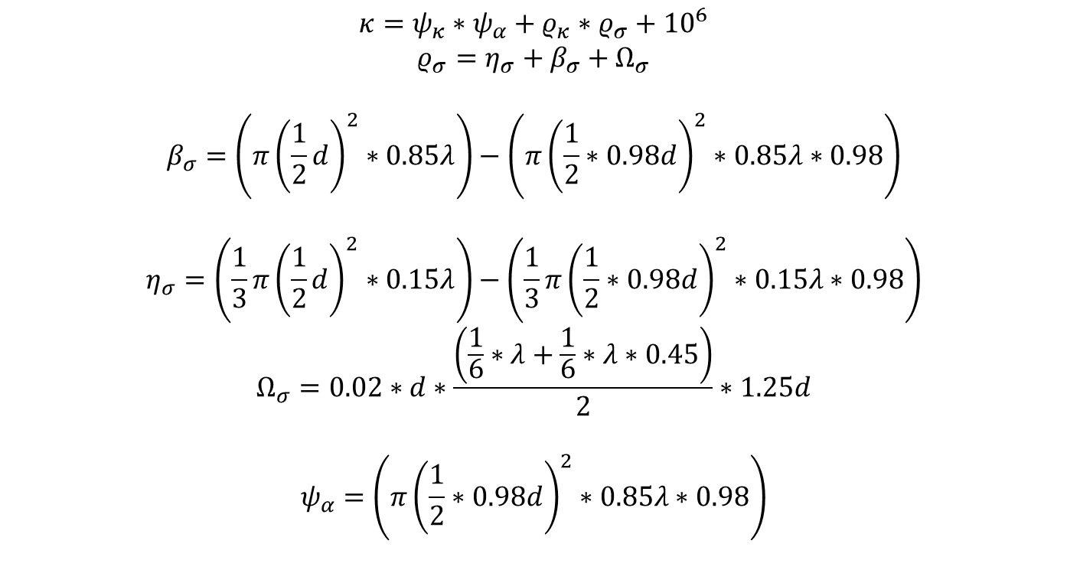
Cost = Propellant Cost ($/kg) * Propellant Amount + Rocket Material Cost ($/kg) * Rocket Size
Rocket Size = Nose Cone Size + Body Size
Nose Cone Size = (1/3 * pi * (½ * Diameter)^2 * 15% of Length) – (1/3 * pi * (½ * (Diameter*98%))^2 * 15% of Length * 98%)
Body Size = (pi * (1/2 * Diameter)^2 * 85% of Length) – (pi * (1/2 * (Diameter*98%))^2 * 85% of Length * 98%)
Propellant Amount = (pi * (1/2 * (Diameter*98%))^2 * 85% of Length * 98%)
$$κ=ψ_{κ}∗ψ_{α}+ρ_{κ}∗ρ_{σ}+{10}^{6}$$
$$ρ_{σ}=η_{σ}+β_{σ}+Ω_{σ}$$
$$β_{σ}=\left(π{\left(\frac{1}{2}d\right)}^{2}∗0.85λ\right)−\left(π{\left(\frac{1}{2}∗0.98d\right)}^{2}∗0.85λ∗0.98\right)$$
$$η_{σ}=\left(\frac{1}{3}π{\left(\frac{1}{2}d\right)}^{2}∗0.15λ\right)−\left(\frac{1}{3}π{\left(\frac{1}{2}∗0.98d\right)}^{2}∗0.15λ∗0.98\right)$$
$$Ω_{σ}=0.02∗d∗\frac{\left(\frac{1}{6}∗λ+\frac{1}{6}∗λ∗0.45\right)}{2}∗1.25d$$
$$ψ_{α}=\left(π{\left(\frac{1}{2}∗0.98d\right)}^{2}∗0.85λ∗0.98\right)$$

Slide 5
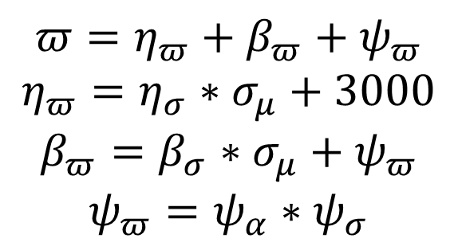
$$π=η_{π}+β_{π}+ψ_{π}$$
$$η_{π}=η_{σ}∗σ_{μ}+3000$$
$$β_{π}=β_{σ}∗σ_{μ}+ψ_{π}$$
$$ψ_{π}=ψ_{α}∗ψ_{σ}$$
$$π=Total Weight \left(kg\right), η_{π}=Nose Cone Weight \left(kg\right), η_{σ}=Nose Cone Size \left(m^{3}\right), σ_{μ}=Material Density \left(\frac{kg}{m^{3}}\right)$$
$$β_{π}=Body Weight \left(kg\right), β_{σ}=Body Size \left(m^{3}\right), ψ_{π}=Propellant Weight \left(kg\right), ψ_{α}=Propellant Amount (m^{3})$$

Slide 6
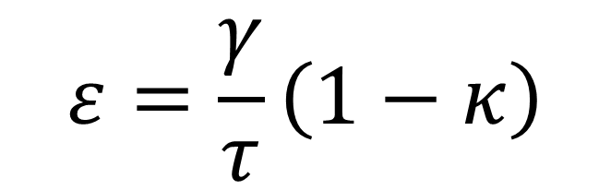
$$ε=\frac{γ}{τ}\left(1−κ\right)$$
$$ε=Efficiency Score, γ=Flight Range \left(m\right), τ=Flight Time \left(s\right), κ=Rocket Cost (\$)$$

Slide 7

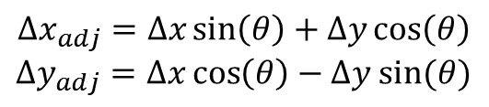

$$Δx_{adj}=Δx\sin\left(θ\right)+Δy\cos\left(θ\right)$$
$$Δy_{adj}=Δx\cos\left(θ\right)−Δy sin⁡(θ)$$
$$θ$$
$$θ$$

