Slide 1


Store Sales Data Analysis Project
A comprehensive analysis of store sales data using Power BI, developed as part of the Digital Egypt Pioneers Initiative under the Ministry of Communications and Information Technology.

Slide 2




Project Overview
Team
Tools Used
Focus
CLS-PBI Data Analysis-G3 led by Enas Mokhtar Sayed Omar
Excel and Power BI for comprehensive data analysis
Store Sales Dataset Analysis with visualization dashboards

Slide 3

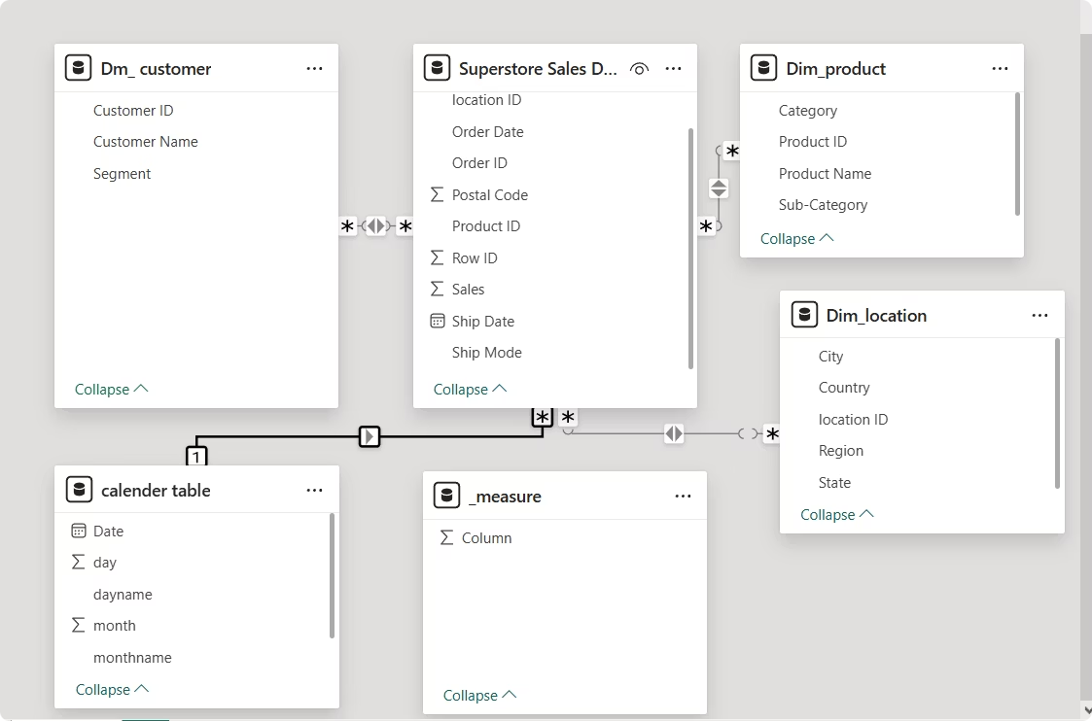
Data Model & Preprocessing
Data Import
Imported store sales CSV data into Power BI
Data Cleaning
Applied transformations: type changes, text formatting, and filtering empty values
Dimension Creation
Created customer, product, and location dimensions for better organization
Data Modeling
Built relationships between tables and created calendar table for date analysis

Slide 4

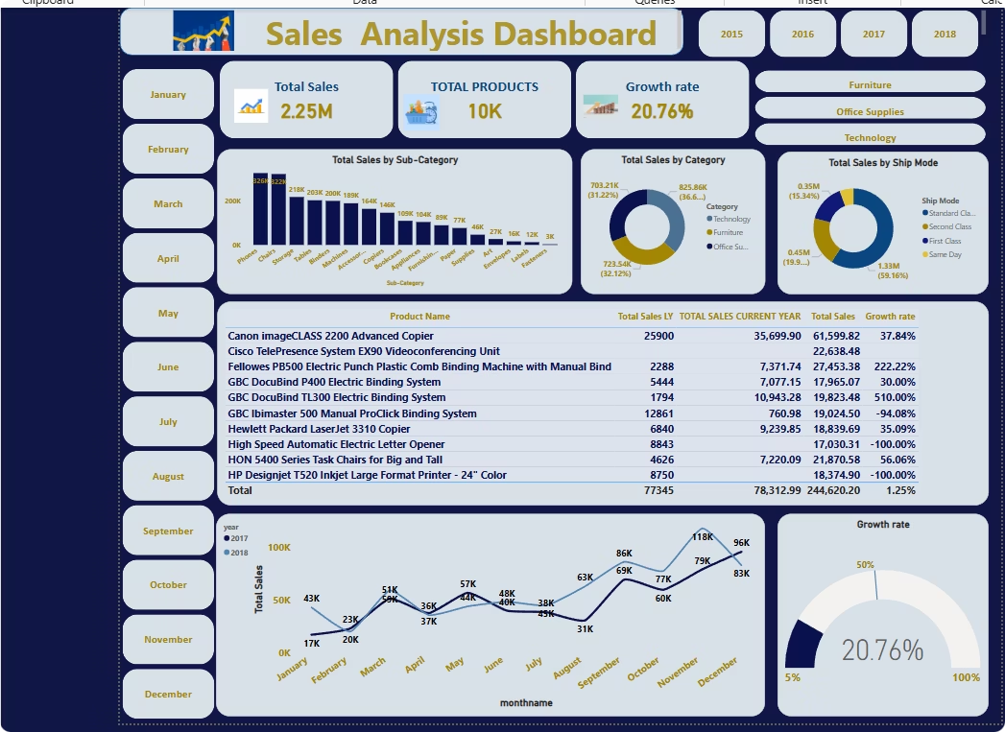
Sales Performance Analysis
$2.25M
20.76%
Total Sales
Growth Rate
Overall revenue generated
Year-over-year sales increase
38%
Technology Share
Largest category by sales

Slide 5






Product Category Performance
Office Supplies
Second highest at 33%
Technology
Storage items perform well
Highest sales category at 38%
Phones are the top-selling subcategory
Furniture
29% of total sales
Chairs lead this category

Slide 6






Customer Segmentation
Consumer
51.5% of total sales
Corporate
30.3% of total sales
Home Office
18.2% of total sales

Slide 7
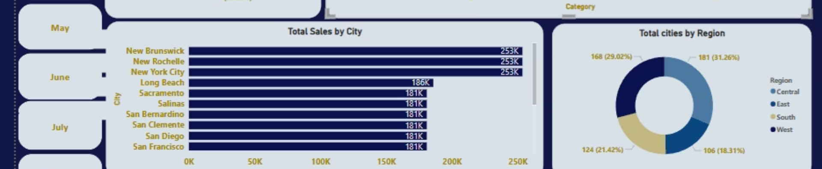
Regional Sales Distribution
West Region
East Region
32.6% of total sales
28.7% of total sales
Strong in Technology products
Highest number of cities but not leading in sales
Central Region
South Region
21.8% of total sales
16.9% of total sales
Balanced performance across categories
Potential growth opportunity area

Slide 8
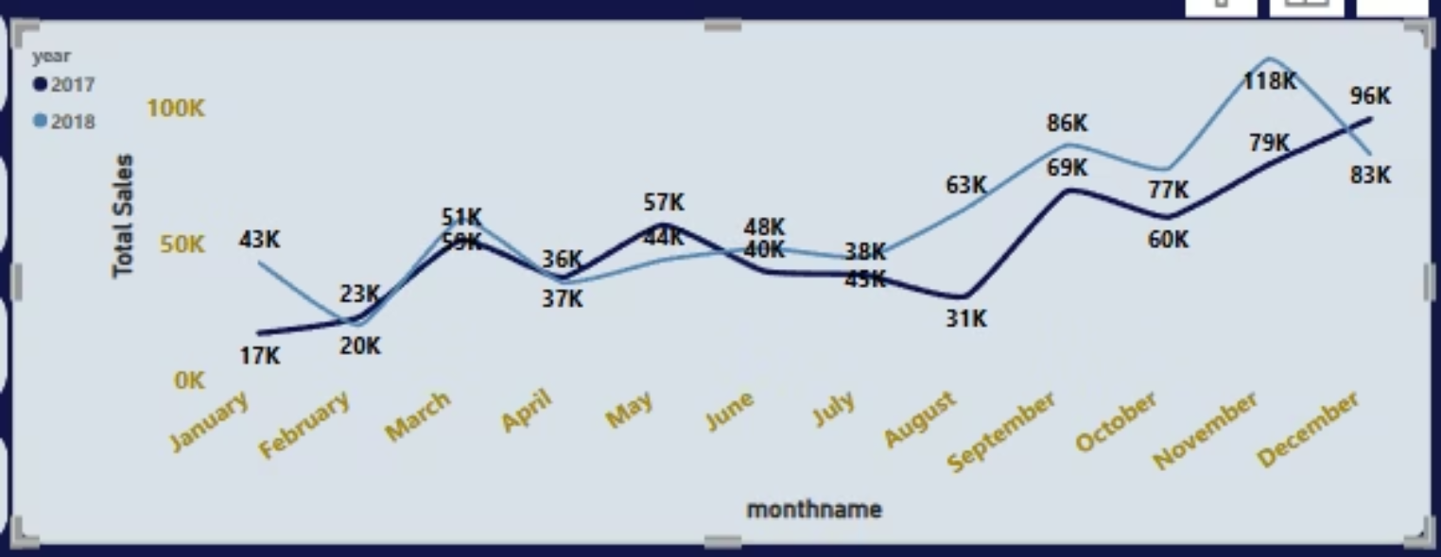
Monthly Sales Trends
Peak sales occur in November-December, likely due to holiday shopping. Each month in 2018 outperformed the same month in 2017.

Slide 9


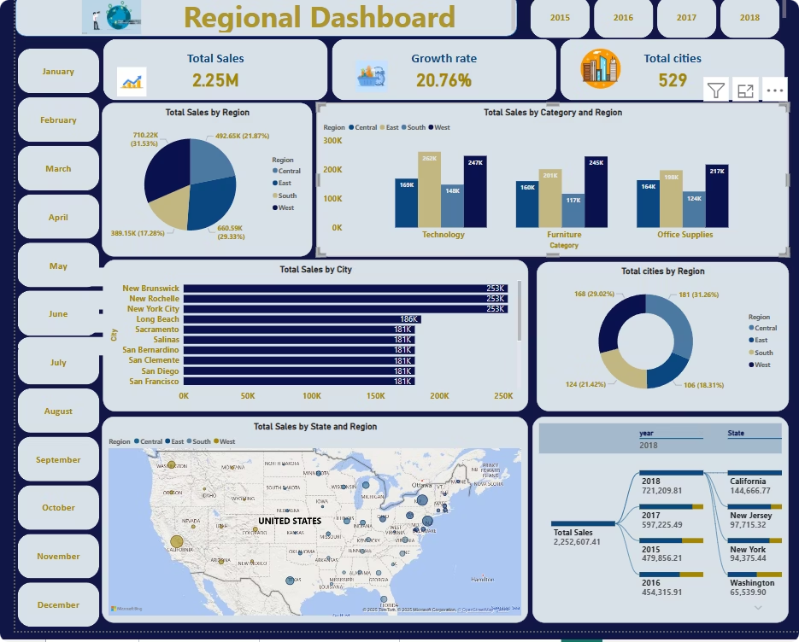



Top Performing Cities
New York
Highest total sales across all regions
Los Angeles
Strong technology product sales
Seattle
Consistent growth year-over-year
Philadelphia
Emerging market with rapid growth

Slide 10





Key Insights & Recommendations
Growth Opportunity
Seasonal Planning
Regional Focus
Focus on expanding Home Office segment with targeted marketing
Increase inventory and marketing for Q4 holiday shopping season
Improve performance in East region cities to match their high count
Product Strategy
Prioritize technology products, especially phones, for maximum revenue

