Slide 1

IMDb Dashboard
Data Analysis & Visualization

Slide 2
01
Data

Slide 3
2,850,421
Imdb dataset was very big dataset

Slide 4

Datasets
Dataset
Mercury
5-Files Each dataset is contained in a gzipped, The first line in each file contains headers that describe what is in each column.
40k+ movies scraped from FilmTV has columns filmtv_id,title,year,genre,
duration,country,directos,actors,avg_vote,num_vote

Slide 5
Merge Proplems(Consistency)
01
02
Handling Different Record IDs
Handling Different Record Names

Slide 6
02
Data Quality

Slide 7
Data quality issues
Uniqueness
Consistency
drop duplicated records by tconst
Country names
Replace the countries/genre with first country
Separate actors , directors
Completeness
Accuracy
Dealing with messing values
Limitations of Average Voting with Low Numbers of Votes

Slide 8
03
Feature Extraction

Slide 9
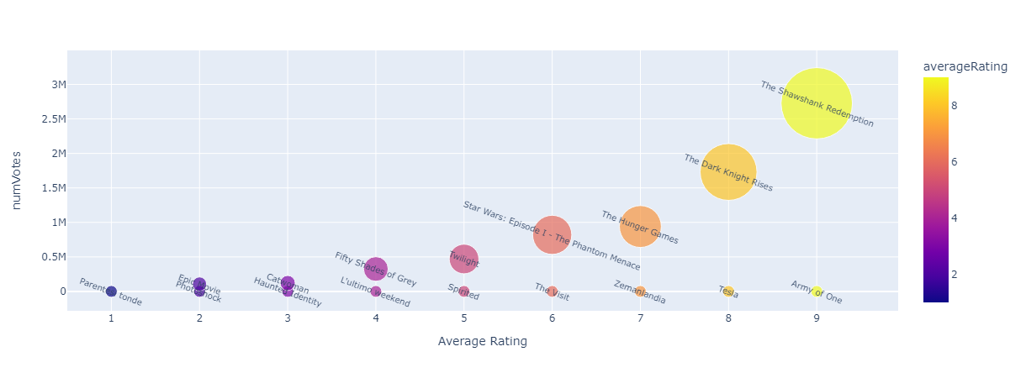
Why Weighted Rating?
In order to provide a more accurate representation of a production's quality, it is important to use weighted ratings instead of just the average rating:-
Set a weight threshold to determine the minimum votes needed for consideration.
Use a quantile of 0.70 to only include productions with a significant number of votes.
A quantile of 0.50 may include productions with very few votes and result in a biased rating.
The weighted rating formula considers the number of votes, average rating, and constant 'm’.
Weighting is determined by the number of votes.

Slide 10
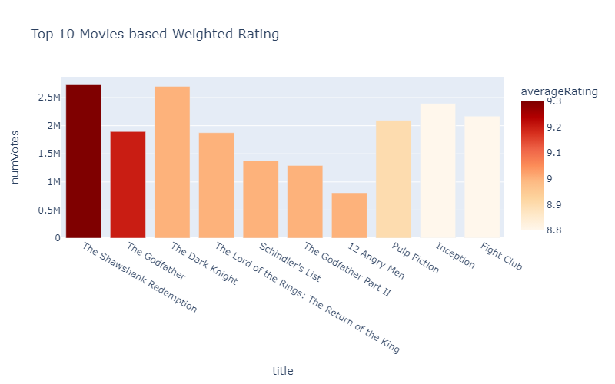
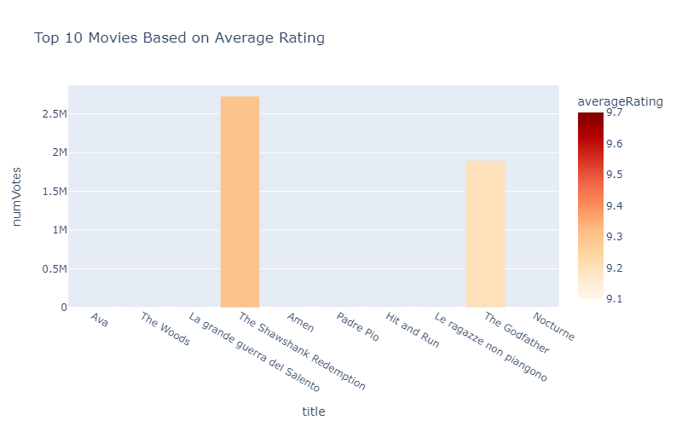
Why Weighted Rating?

Slide 11
Why Weighted Rating?
he equation for calculating the weighted rating and weighted votes for each row is:
weighted_rating = ((numVotes / (numVotes + m)) * averageRating) + ((m / (numVotes + m)) * C)
where:
numVotes is the number of votes for the production
averageRating is the average rating for the production
m is the weight threshold (i.e., the minimum number of votes required to be considered)
C is the mean rating across all productions in the dataset

