Slide 1

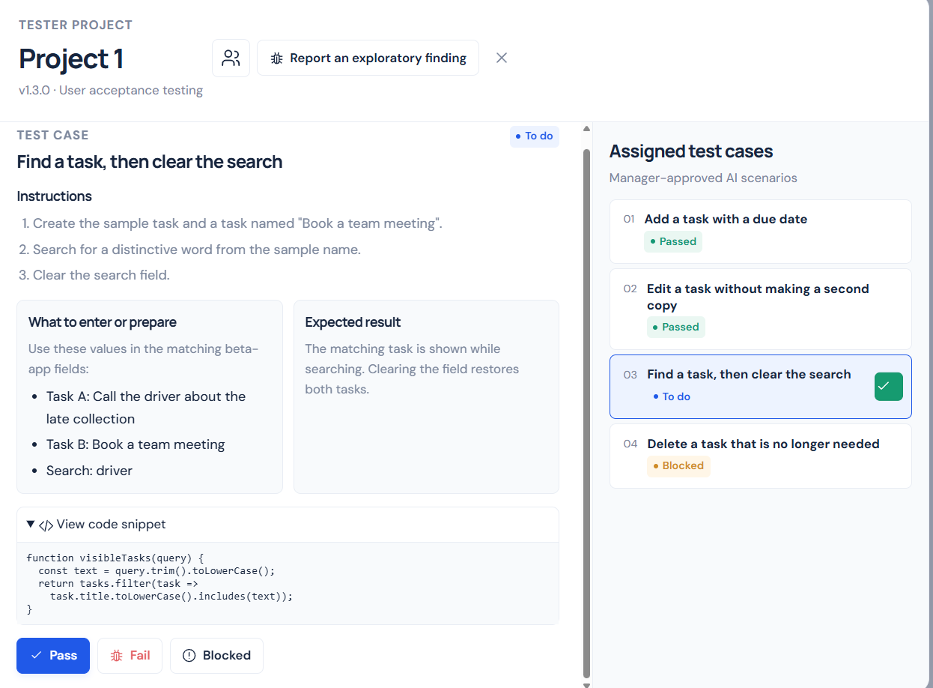
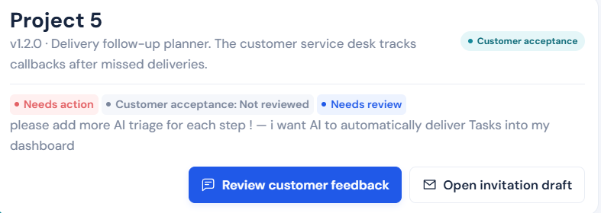
Built to address three recurring problems in UAT
PRE-SHIPMENT / THE UAT PROBLEM
Three problems in the UAT handoff
Pre-Shipment
The tester, UAT manager and developer need different things from the same feedback.
An all-in-one UAT platform designed for Pfizer
TESTER
UAT MANAGER
DEVELOPER
Managers, developers, testers and customers work together in one platform,
with AI assistance across test preparation, feedback review and defect resolution.
Limited issue traceability
Fragmented feedback
Incomplete issue reports
Testers lack a clear view of reported issues, decisions and outcomes.
Duplicate reports and inconsistent details delay issue prioritisation.
Missing reproduction steps and expected results delay investigation.
PROPOSED SOLUTION
PROPOSED SOLUTION
PROPOSED SOLUTION
Structured UAT workflow with status tracking.
AI-assisted issue consolidation and progress summaries.
Standardised reports with AI-assisted clarification.
OVERVIEW
MANAGER
TESTER
DEVELOPER
APPROVAL
CUSTOMER
01/16
Notes:
The opening problems come from the supplied stakeholder screenshot. The tester wants feedback to be heard even when it does not become a ticket. The UAT manager wants a short, trusted list. The developer wants an actionable ticket with reproducible context.
Pre-Shipment addresses these needs through persistent report IDs, project scope, status and ownership, evidence, testcase references, developer assignment, tester retesting and explicit manager decisions. These workflow controls make the outcome visible.
The following slides show the AI assistance used in these handoffs and a worked example before the interactive diagram.
Overview: Pre-Shipment is presented as an all-in-one UAT platform designed for Pfizer. Managers, developers, testers and customers share one workspace with AI assistance across test preparation, feedback review and defect resolution. The current application demonstrates AI assistance using simulations.
Presentation sequence: the app title, description and Pfizer logo start together in the middle of the slide. Click 1 moves them upward and reveals the problems heading and transition. Click 2 reveals the three role problems. Click 3 reveals their proposed solutions. The following click advances to the next slide.
Logo: official Pfizer color logo, reused from the prototype asset pfizer.png. Source https://cdn.pfizer.com/pfizercom/2022-10/Pfizer_Logo_Color_CMYK.png . Asset source page https://www.pfizer.com/newsroom/media-assets .

Slide 2
PRE-SHIPMENT / AI IN THE WORKFLOW
AI support at each UAT handoff
AI organizes the evidence around the case, the project and the submitted build.
ROLE
AI ASSISTANCE
HUMAN REVIEW
TESTER
Draft structured test scenarios, support GUI testing, and capture clear pass/fail outcomes.
Manager approves the scenarios.
Tester executes each scenario and records results with evidence.
UAT MANAGER
Prioritise issue urgency, present decision-ready insights for non-technical reviewers, and support scenario assignment without requiring source-code analysis.
Approve UAT scenarios, assign tasks to team members, and retain oversight of verified fixes and customer feedback.
DEVELOPER
For each verified defect, estimate effort, suggest likely code areas, and assess fix resilience before submission for retest.
Confirm the root cause and submit a build.
Tester retests the fix and the manager gives final approval.
Prototype AI suggestions are simulated. Test outcomes and approval decisions are recorded by the team.
OVERVIEW
MANAGER
TESTER
DEVELOPER
APPROVAL
CUSTOMER
02/16
Notes:
The AI assistance wording follows the supplied AI Assistance and Human Review Table. Prototype AI suggestions are simulated. The listed assistance includes scenario drafting and GUI testing support, urgency and progress insights, scenario assignment support, effort estimates, likely code areas and fix resilience assessment.
Potential duplicate matching compares titles and observed behaviour within a project. A suggestion links related reports and leaves their IDs, evidence, results and approvals independent. It does not automatically merge or close records.
Developer suggestions are investigation hypotheses. The build handoff organizes change notes, the original case and retest steps. The tester verifies the submitted build and the manager makes the approval decision. AI assistance does not replace those recorded human decisions.
Implementation references: dist/uat-manager.js scenario generation; dist/uat-workflow.js draftFailure and checkDuplicate; dist/workspaces.js analyzeFix and showFixResult.

Slide 3
PRE-SHIPMENT / WORKED EXAMPLE
One failure becomes an actionable finding
Example — the task planner saves a task with an empty title.
SOURCE EVIDENCE
AI-ASSISTED REPORT
CASE
UAT-02 · Require a task title
Empty task title accepted
TEST INPUT
Task name = "" → select Save
The report carries the approved steps, expected result, observed failure and evidence references.
EXPECTED
Prevent saving and show a required-field message
POSSIBLE DUPLICATE
OBSERVED
A task is created with no title
Compare similar reports in this project and preserve each submission for review.
EVIDENCE
Reproduction steps and a screen recording
Suggested checks are hypotheses for the developer to verify.
THE ISSUE CLOSES AFTER VERIFICATION
Developer fixes → tester retests the new build → manager approves
Illustrative case. The next slide shows the complete sequence and its exception paths.
OVERVIEW
MANAGER
TESTER
DEVELOPER
APPROVAL
CUSTOMER
03/16
Notes:
This is an illustrative record, not a claim about a measured production incident. The example uses the task planner acceptance scenario that requires a nonempty task title.
The tester records the input, expected behaviour, actual failure, reproduction steps and evidence. A report draft organizes these fields. Similarity suggestions help reviewers identify related observations without losing individual submissions.
Investigation suggestions are hypotheses rather than a confirmed root cause. The developer reproduces the issue and submits a new build. Passing the original test and obtaining manager approval is the closure path. The next slide shows the full workflow and return paths.

Slide 4
UAT WORKFLOW / USER FLOW
UAT execution and release control
Case ownership, versioned fixes and explicit approvals govern each handoff.
UAT PREPARATION
TEST EXECUTION
DEFECT RESOLUTION
CUSTOMER ACCEPTANCE
01 / MANAGER
02 / TESTER
03 / DEVELOPER
Approve the UAT plan
Run assigned cases
Submit a fix build
Manager forwards a new bug
UAT reopens · beta pauses
Requirements → reviewed cases
Assign developers and testers
Steps · data · expected result
Pass / Fail / Blocked
Issue + steps + evidence
New build → Awaiting retest
Failed retest → developer
05 / MANAGER APPROVAL
04 / TESTER RETEST
08 / CUSTOMER
Review verified fix
Verify the fix build
Open beta + feedback
Approve → Resolved
Request changes → developer
Repeat the original scenario
Pass → In review · Fail → Reopened
Project link + access key
Feedback returns to the manager
Revision requested
Passed cases
06 / RELEASE GATE
07 / MANAGER
All cases passed + every finding resolved
Send beta invitation
Click or press → to reveal the next handoff
OVERVIEW
MANAGER
TESTER
DEVELOPER
APPROVAL
CUSTOMER
04/16
Notes:
PowerPoint Slide Show controls: the plan is visible on entry. Seven clicks or Right Arrow presses reveal stages 2–8. The following click advances to Manager preparation. Left Arrow reverses a reveal.
1. Manager registers a finished development build, reviews requirements and mock generated scenarios, assigns developers and testers, and explicitly starts UAT. Employees accept their assignment keys.
2. The assigned tester executes the approved case against its steps, test data and expected result. Pass contributes to the release gate. Blocked stays unfinished. Failure creates a structured issue with a case reference and evidence. Exploratory findings can also enter the issue queue.
3. The assigned developer investigates the reproduction steps and evidence. They submit change notes and a new build version. The linked issue becomes Awaiting retest; submitting a fix does not resolve the issue.
4. The tester repeats the original scenario against that submitted version. Pass moves the linked issue to In review and records tester verification. Failure reopens the same issue. A blocked retest keeps the issue unresolved.
5. The project manager approves the specific verified build to resolve the finding. Requesting changes returns it to development and requires another retest. A stale review cannot approve a later build.
6. Standard customer acceptance requires every approved case to pass and every project finding to be resolved. This includes exploratory findings. A passed checklist alone cannot bypass an unresolved finding.
7. The manager explicitly sends the project to Customer Acceptance, reviews its invitation draft and simulates sending it. The project link and beta key identify the invited project.
8. The customer opens that project in the beta overlay, tries the task planner and submits session feedback to its manager. When the manager forwards a new bug for development, UAT reopens and customer acceptance pauses until the finding is fixed, retested and approved.
The optional acknowledged early-beta path is separate from standard customer acceptance. AI scenario generation and analysis, email delivery and beta setup are prototype simulations. Tester outcomes and manager decisions are recorded by the user.

Slide 5
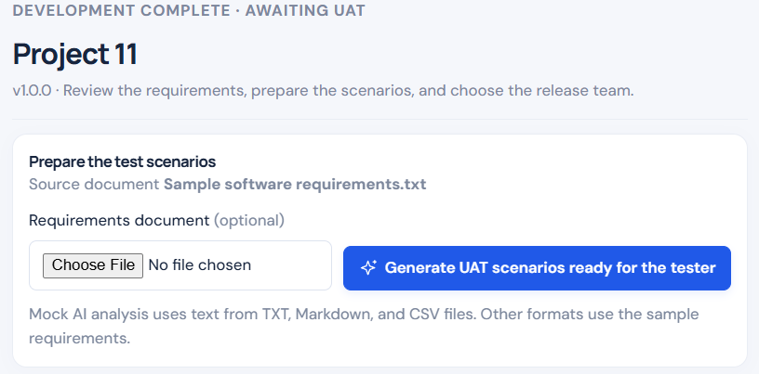
MANAGER / PREPARE
Start with reviewed, repeatable test scenarios.
Project and requirements → generated draft cases → manager review.
Start from requirements
The manager can upload TXT, Markdown or CSV requirements.
Generate draft scenarios
The current prototype demonstrates sample AI suggestions for UAT.
Human approval
Scenarios are reviewed before they reach testers.
OVERVIEW
MANAGER
TESTER
DEVELOPER
APPROVAL
CUSTOMER
05/16
Notes:
The manager opens a project and prepares test scenarios. The prototype takes requirements text and presents suggested cases. I would not call the current implementation a real repository scanner: the AI output is currently mocked, and the manager reviews it before publishing.

Slide 6
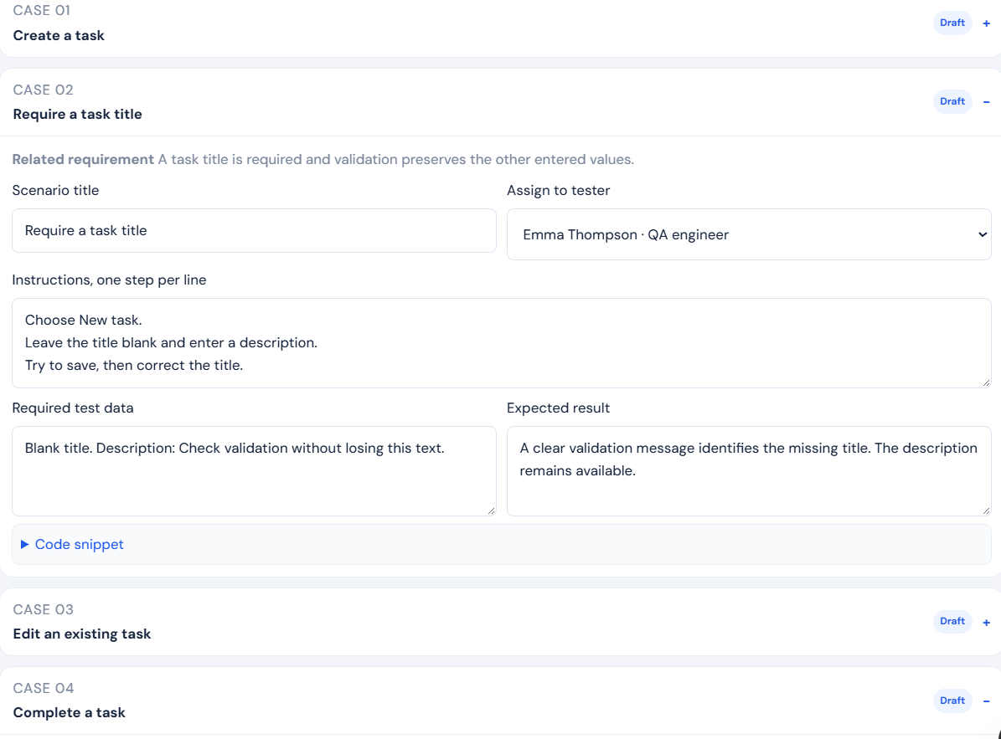
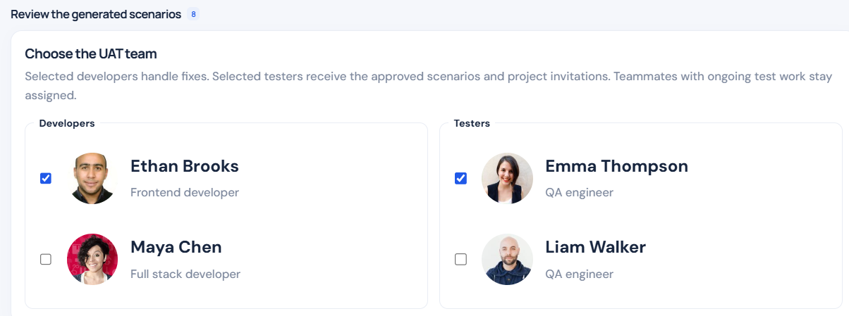
MANAGER / ASSIGN
Every case has an owner and a clear outcome.
REVIEW THE GENERATED SCENARIOS
01
Create a task
05
Find tasks with search and filters
02
Require a task title
06
Switch between List and Board views
03
Edit an existing task
07
Delete a task
04
Complete a task
08
Restore saved tasks after reopening
STEPS · EXPECTED RESULT · TEST DATA · CODE CONTEXT
OVERVIEW
MANAGER
TESTER
DEVELOPER
APPROVAL
CUSTOMER
06/16
Notes:
The manager can inspect and edit each generated draft, including instructions, test data, expected results and code context. The eight draft scenarios are shown as a readable register on the right. The manager assigns the release team and approves the cases before testing begins.

Slide 7
TESTER / EXECUTE
No vague “it is broken” reports.
A test case tells the tester exactly what to try and what should happen.
One assigned scenario
Step-by-step instructions and expected outcome are visible.
Code context
An attached snippet helps link a failure to relevant functionality.
Clear result
Pass, Fail or Blocked — against the same approved case.
OVERVIEW
MANAGER
TESTER
DEVELOPER
APPROVAL
CUSTOMER
07/16
Notes:
The tester does not have to invent the structure of the bug report. They follow approved steps, check the expected result and mark the scenario Pass, Fail or Blocked. A code snippet provides context, but does not prove the exact faulty line.

Slide 8
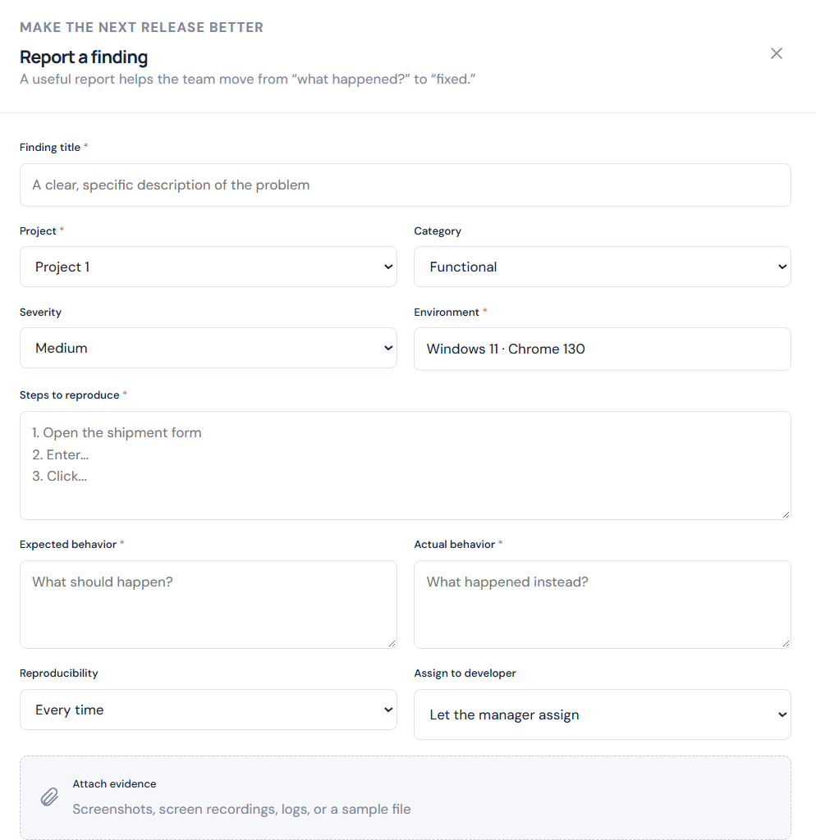
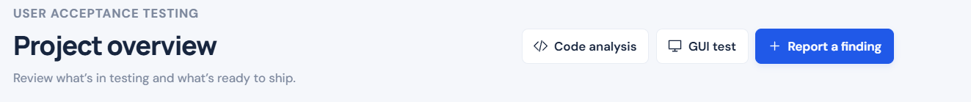
TESTER / EXPLORE
And there is room for unexpected bugs.
Exploratory reporting is still available when the scripted checklist misses something.
Code analysis · GUI test · Report a finding
Exploratory fallback
The tester can add steps, environment details, severity and evidence even when no approved case exists.
Why this matters
Structured scenarios reduce ambiguity; exploratory reporting catches edge cases and surprises.
OVERVIEW
MANAGER
TESTER
DEVELOPER
APPROVAL
CUSTOMER
08/16
Notes:
Structured testing is the default, but unplanned defects still happen. The tester can create an exploratory finding with severity, environment, reproduction steps and attachments. This is important because no generated test suite can guarantee that every defect is already covered.

Slide 9
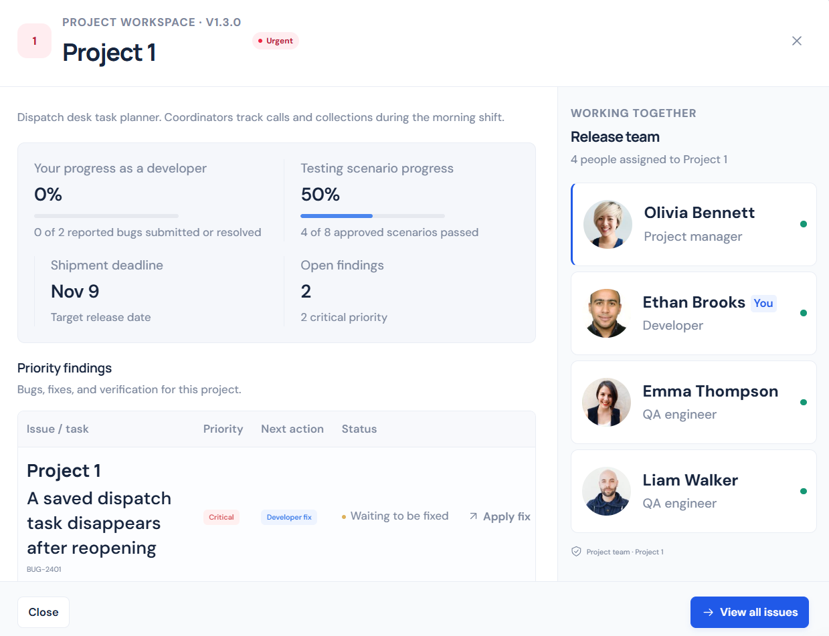
DEVELOPER / PRIORITISE
One inbox for progress and actionable fixes.
The developer sees the project status, assigned team and priority issues.
Project-wide visibility
See the proportion of approved cases that have passed.
Priority queue
Outstanding findings are visible with urgency and next actions.
Connected team
Know who tested the issue and who needs the fix.
OVERVIEW
MANAGER
TESTER
DEVELOPER
APPROVAL
CUSTOMER
09/16
Notes:
From the developer view, we see test progress and a prioritised list of findings. Instead of receiving a vague message out of context, a developer opens an issue linked to a project and recorded test evidence.

Slide 10
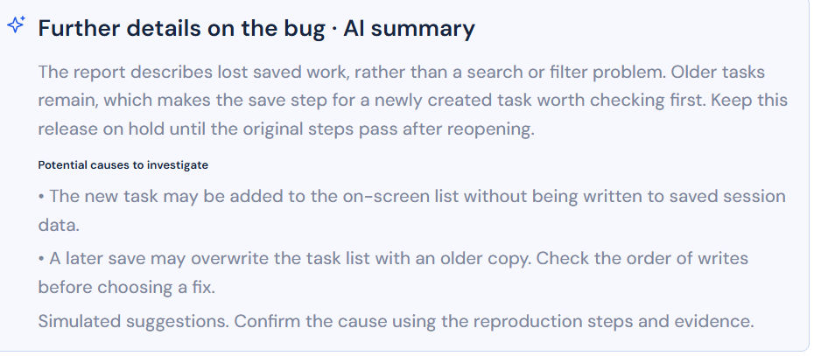
DEVELOPER / INVESTIGATE
AI triage turns a report into a starting point.
Summaries suggest what to check — the developer still verifies the cause.
Readable summary
Highlights the actual symptom and why it matters.
Possible causes
Proposes checks without claiming the root cause is proven.
Human judgement
Developers confirm against the reproduction steps and evidence.
Prototype note: the AI suggestions shown here are simulated.
OVERVIEW
MANAGER
TESTER
DEVELOPER
APPROVAL
CUSTOMER
10/16
Notes:
For this issue, the simulated AI summary highlights the symptom, suggests potential causes and identifies the next checks. It helps the developer investigate, but the AI analysis is not a verified root-cause diagnosis.

Slide 11
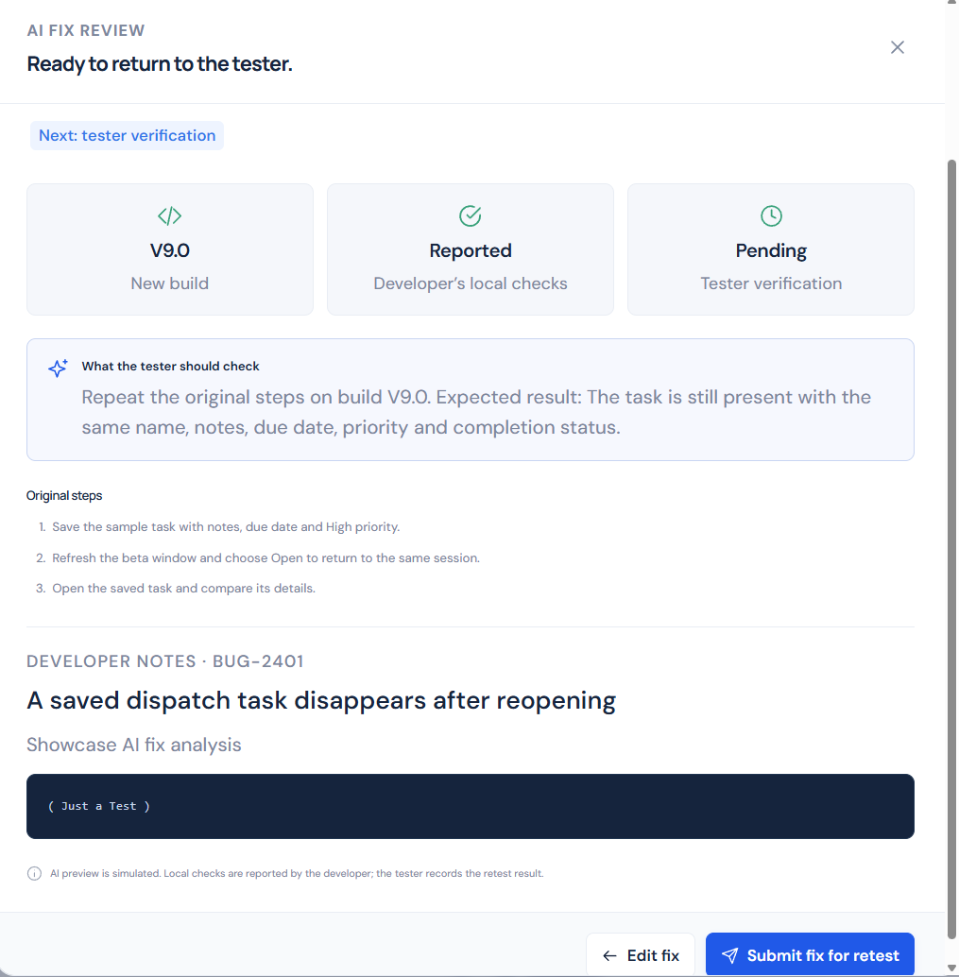
DEVELOPER / RESOLVE
A fix is not finished until it is retested.
01
Developer submits a build
Include notes and the changes made.
02
Tester repeats the original steps
The same scenario is used for verification.
03
Manager reviews the evidence
Only approved fixes move toward release.
OVERVIEW
MANAGER
TESTER
DEVELOPER
APPROVAL
CUSTOMER
11/16
Notes:
After working on the issue, the developer submits a proposed fix and build version. The tester repeats the original scenario and confirms the result. In this prototype, fix checking is reported or simulated, rather than running actual software tests automatically.

Slide 12
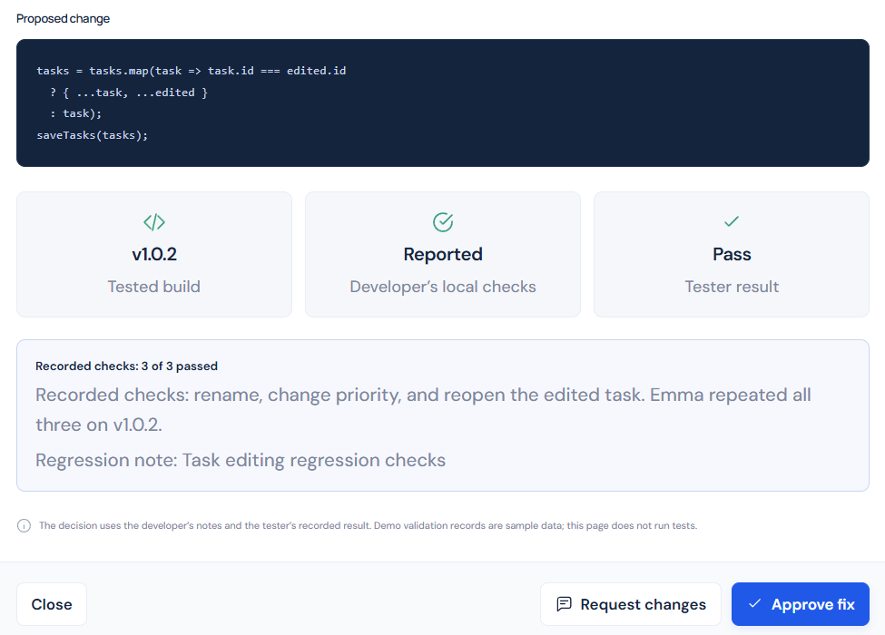
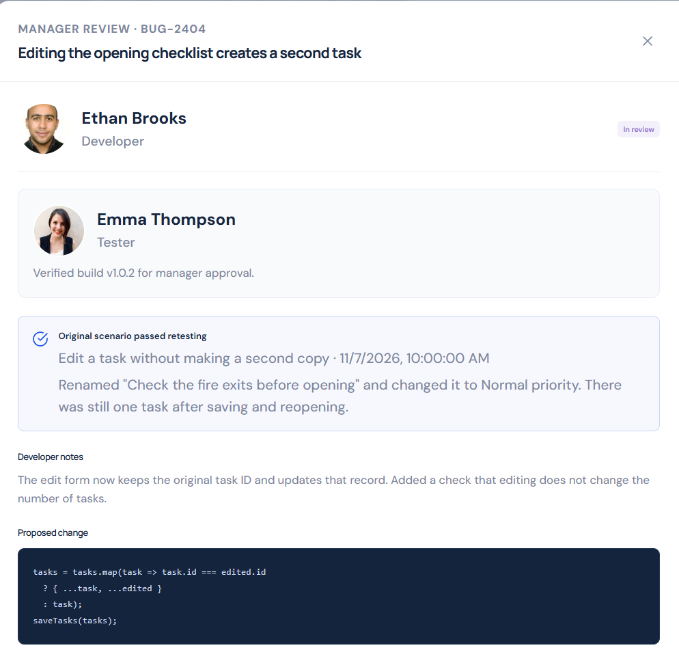
MANAGER / VERIFY
The manager keeps the final decision.
Evidence of the retest and proposed change stays visible.
Approve or request changes
Recorded checks
OVERVIEW
MANAGER
TESTER
DEVELOPER
APPROVAL
CUSTOMER
12/16
Notes:
When the tester verifies the fix, the manager can review the recorded checks, the developer’s notes and the proposed change. The manager can approve the fix or request another edit; approval is not delegated to an AI guess.

Slide 13
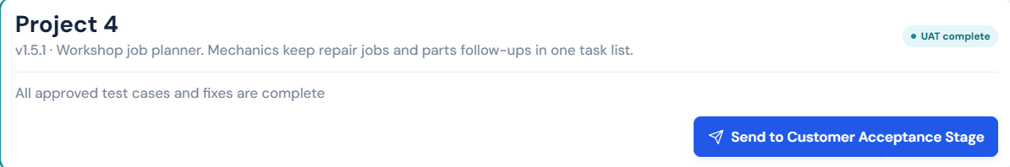
MANAGER / RELEASE GATE
UAT complete → customer acceptance.
01
All cases passed
02
Fixes approved
03
Controlled hand-off
The reviewed test checklist is complete.
The manager sees the verified results.
Customer access is the next explicit stage.
OVERVIEW
MANAGER
TESTER
DEVELOPER
APPROVAL
CUSTOMER
13/16
Notes:
Once all approved cases and fixes are complete, the manager can move the project to customer acceptance. This is an explicit stage gate, so the customer does not receive a build simply because a developer says it is done.

Slide 14
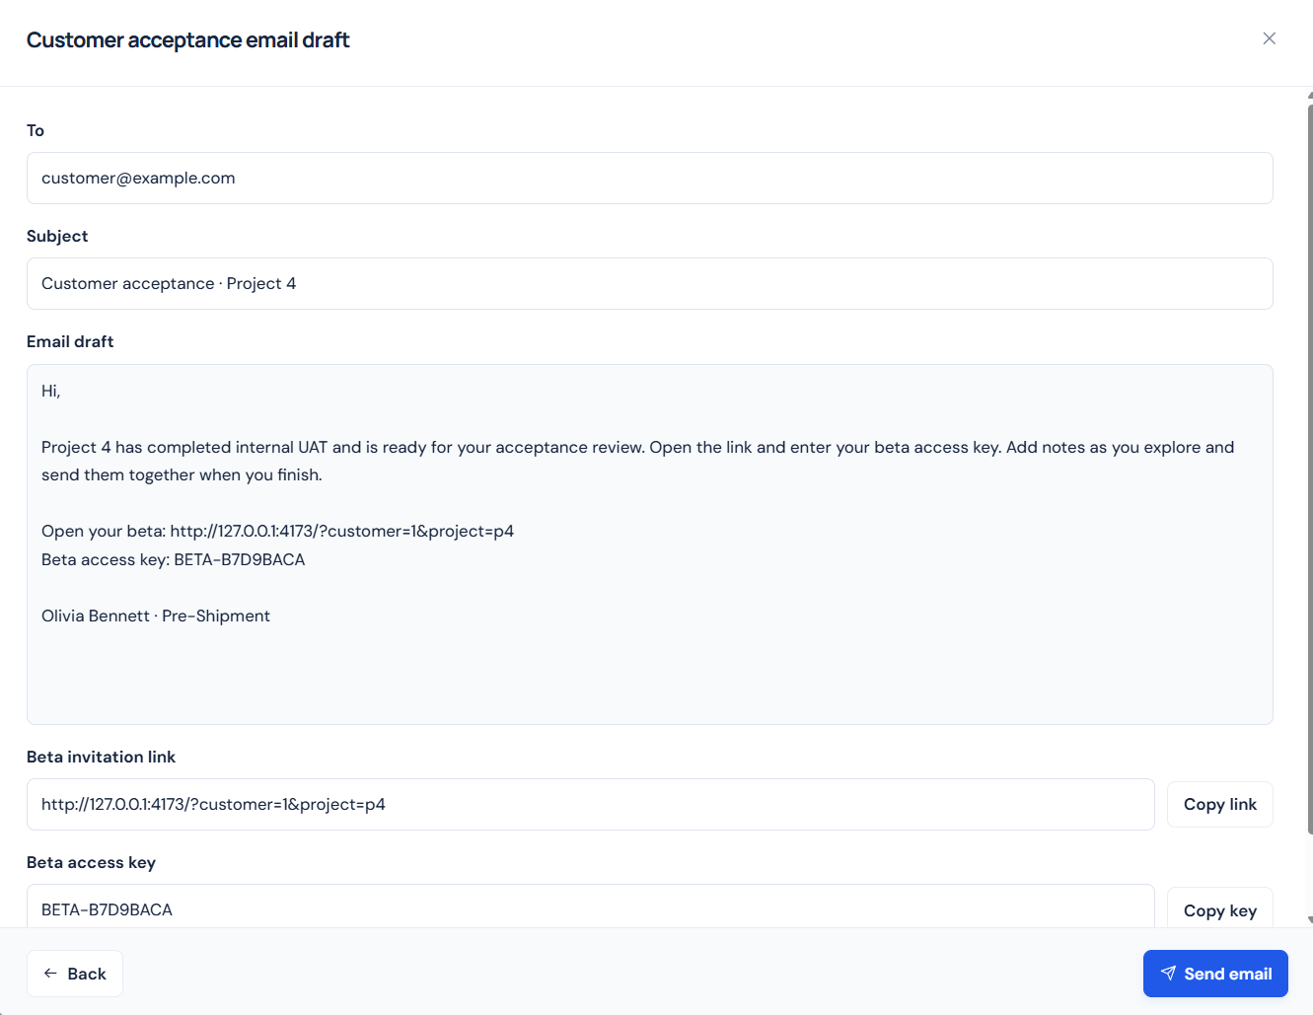
MANAGER / INVITE
The customer receives one clear invitation.
A draft email includes the beta link and access key.
Ready-to-review message
Project, instructions and purpose are pre-filled for the manager.
Access information
The demo generates a beta link and a sample access key.
Managed communication
The manager reviews the email before sending.
OVERVIEW
MANAGER
TESTER
DEVELOPER
APPROVAL
CUSTOMER
14/16
Notes:
When a project is ready, the manager opens a draft customer acceptance invitation with the project details, a beta link and an access key. The prototype shows the draft and sending workflow; actual external email integration should be presented as a future implementation.

Slide 15
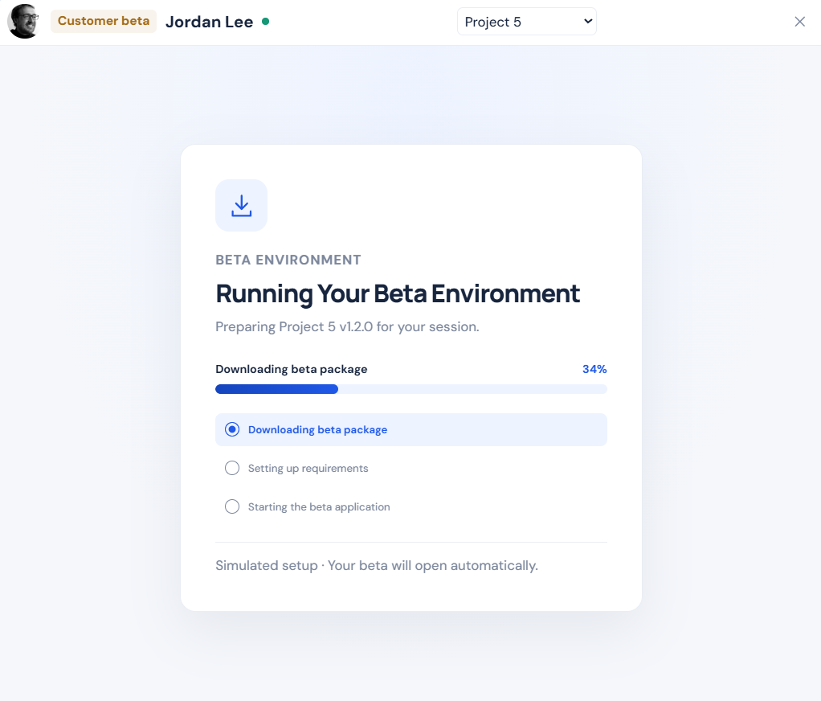
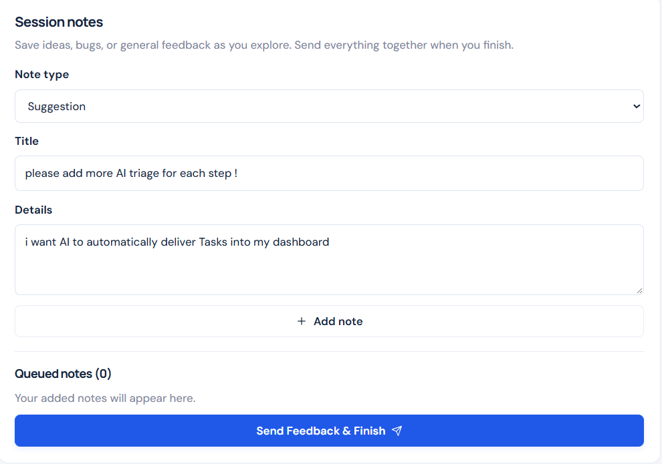
CUSTOMER / TRY THE BETA
Customers get a guided trial and simple feedback.
SIMULATED BETA LAUNCH
FEEDBACK CAPTURED IN THE SAME WORKSPACE
OVERVIEW
MANAGER
TESTER
DEVELOPER
APPROVAL
CUSTOMER
15/16
Notes:
The customer receives access to the beta experience and can record suggestions, issues and other notes in one place. The current setup screen is a simulation, not a downloaded isolated environment guaranteed to work on every operating system.

Slide 16
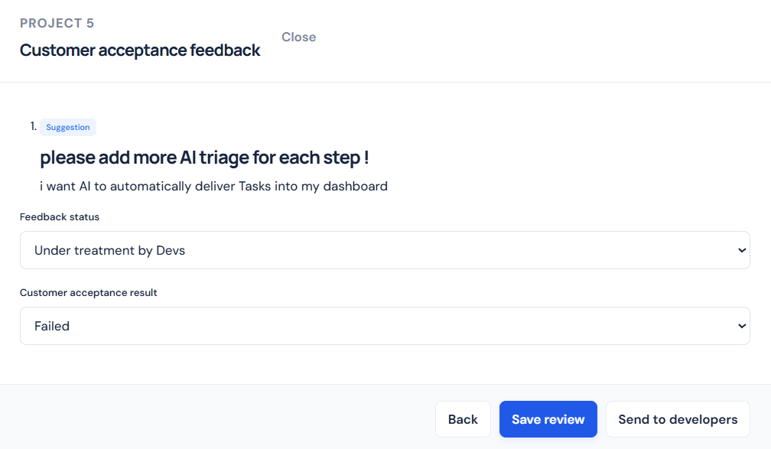
FEEDBACK LOOP / CLOSING
Feedback returns to the team — not a spreadsheet.
CUSTOMER → MANAGER → DEVELOPER
Suggestion, status, owner and next action stay connected.
Now I will demonstrate the full journey in the working prototype.
OVERVIEW
MANAGER
TESTER
DEVELOPER
APPROVAL
CUSTOMER
16/16
Notes:
The customer’s feedback reaches the manager, who can review the suggestion or finding, set acceptance status and send work back to the developers. The core value is a traceable process with four roles. This completes the overview; next I will show the working prototype from end to end.

