Slide 1


ITI FINAL PROJECT

Slide 2

SMART GARAGE SYSTEM

Slide 3
WHAT IS THE
PRODUCT?

Slide 4
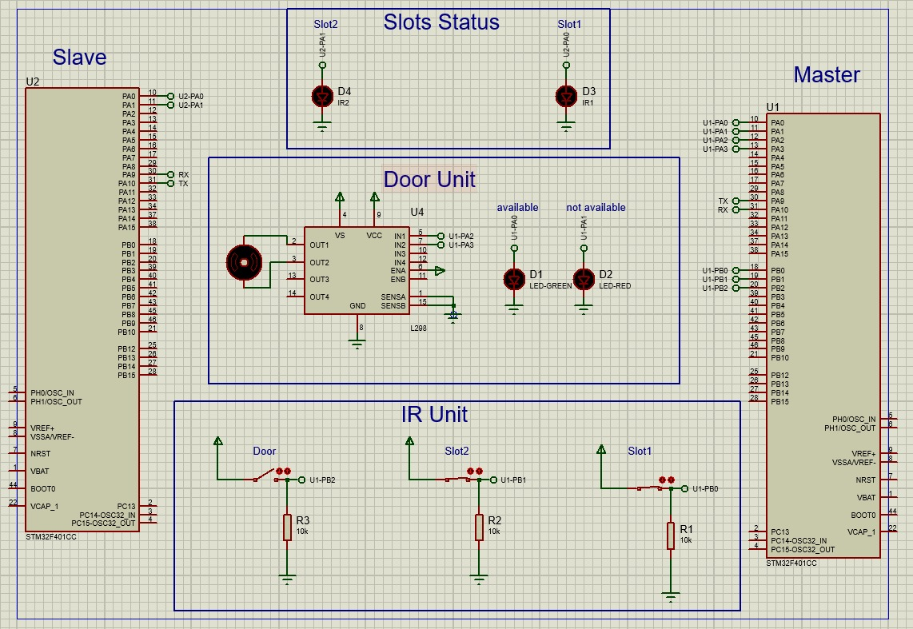
What is the product?
The product is a real-time garage tracking system that utilizes both wired and wireless communication means, including UART devices and WI-FI servers, to monitor and manage the status of garage doors.

Slide 5
WHAT IS ITS MAGIC?

Slide 6
What is its magic?
Its magic lies in the combination of wired and wireless technology, coupled with IR sensors and indication LEDs, to provide a complete and autonomous garage tracking and door operation system.

Slide 7
WHAT PROBLEM DOES THIS PRODUCT FIX?

Slide 8

What problem does this product fix?
Key Values
Our product's key value lies in solving the issue of wasted time and inconvenience associated with finding parking, providing users with real-time garage availability information.
We enable users to effortlessly check garage status from their seats, ensuring a more efficient and user-friendly parking experience.
Our product's core value is the elimination of parking hassles, saving time and improving convenience by streamlining the process of finding an available parking spot.

Slide 9
Today
Future
Where is the product today? Describe it in a concise sentence or two. Currently, the product offers real-time tracking and monitoring of garage availability using a combination of wired and wireless communication, IR sensors, and indication LEDs.
Where do we want the product to be? Share the long-term vision. In the long term, we envision this product to become a standard solution in parking management systems, offering seamless integration with various types of garages and providing a hassle-free parking experience for users worldwide.

Slide 10

Product vision
What does the future hold?
long-term vision and explain how the product will evolve over time.

Slide 11
What does the future hold?
The future holds a vision where this product evolves to incorporate advanced AI algorithms for predictive parking availability, integrates with smart city infrastructure, and expands to not only parking garages but also public parking spaces, contributing to efficient urban mobility.

Slide 12
Launch plan
Our launch plan aims to introduce this groundbreaking product to the market, revolutionizing the way people approach parking. The goal is to provide a hassle-free and time-saving parking experience for everyone. This launch is significant because it marks the beginning of a new era in parking convenience, and we're excited to bring this technology to the world.

Slide 13
THE END

