Slide 1
Paper Review on
Distributed Database Systems: The Case for NewSQL
Group no: 06
22273011 Salman Sadat Nur
22173003 S. M. Niaz Morshed
19101372 Ibrahim Lokman

Slide 2
Introduction
Combination of the features of both NoSQL and SQL
Mixing capabilities like “Fast Data Ingestion” and “SQL Queries”
Providing Online Analytics
New opportunities in real time decision making
Applications
Presenter: Salman Sadat Nur | ID: 22273011

Slide 3
Principle of Distributed Database System
Definitions
Types:Geo-Distributed and Single Location
Allowing the accommodation of increasing database sizes and bigger workloads
Supports both Horizontal and Vertical Scaling
Presenter: Salman Sadat Nur | ID: 22273011

Slide 4
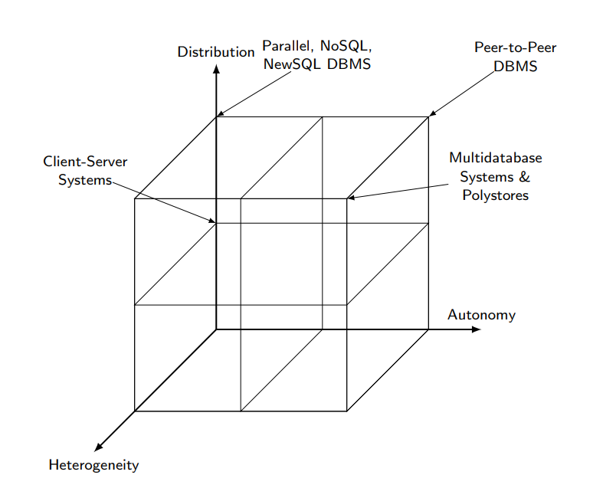
Principle of Distributed Database System
Presenter: Salman Sadat Nur | ID: 22273011

Slide 5
SQL Database Systems
SQL database systems are heart of any information system
Fundamental Principle behind relational databases is Data Independence
Data Independence enabled advanced capabilities
Two main variants:
Operational Database Systems
Analytical Database Systems
Presenter: S. M. Niaz Morshed | 22173003

Slide 6
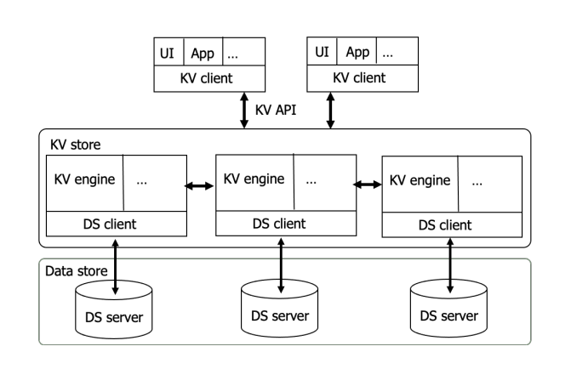
NoSQL Database Systems
NoSQL means “Not Only SQL”
It address the requirements of web and cloud applications
Four Main categories: Key-value, Wide column, Document and Graph
Fig: Key-Value Architecture
Presenter: S. M. Niaz Morshed | 22173003

Slide 7
NewSQL Database Systems
Combine the benefits of SQL with NoSQL.
The main new features are:
Scalable ACID transactions.
In-memory support.
Polystore.
HTAP support.
Two of the most advanced NewSQL systems:
Spanner
LeanXcale
Presenter: Ibrahim Lokman | 19101372

Slide 8
Spanner and LeanXcale database systems
Spanner:
Database system with:
Full SQL.
Scalable ACID transactions.
Implements TrueTime
Atomic Clock
GPS
Wide column datastore
Implements Multiversioning
LeanXcale:
Polystore Support.
Three main components:
Storage engine.
Query engine.
Transactional engine.
Presenter: Ibrahim Lokman | 19101372

Slide 9
Conclusion
New Features
Hard Problem
Research Directions
Presenter: Salman Sadat Nur | ID: 22273011

Slide 10
Thank You

