Slide 1

Sentiment Analysis On Airline Customer Feedback
Student: Ibrahim Maïga 101532327
Course: Mathematical Concepts for Deep Learning
Professor: Dr. Mahdieh Khalilinezhad
June 13, 2024

Slide 2

Table of Contents
1. Introduction
2. Dataset Description
3. Exploratory Data Analysis (EDA)
4. Data Preprocessing
5. Model Design and Architecture
6. Hyperparameter Tuning with Random Search
7. Model Training
8. Model Evaluation
9. Results and Discussion
10. Conclusion

Slide 3
1. Introduction
Project Overview
The aim of this project is to perform sentiment analysis on airline customer reviews to determine the likelihood of recommending a particular airline. By analyzing the textual feedback provided by passengers, I aim to understand their sentiments and derive actionable insights. Using deep learning techniques, I assess whether reviews are positive or negative, providing a basis for recommendations.
Objectives
1. Sentiment Analysis: Develop a neural network model using Keras to classify customer reviews as positive or negative.
2. Model Improvement: Enhance the initial model's performance through hyperparameter tuning to achieve higher accuracy and reliability.
3. Recommendation System: Develop a system to recommend airlines based on the sentiment of customer reviews.

Slide 4

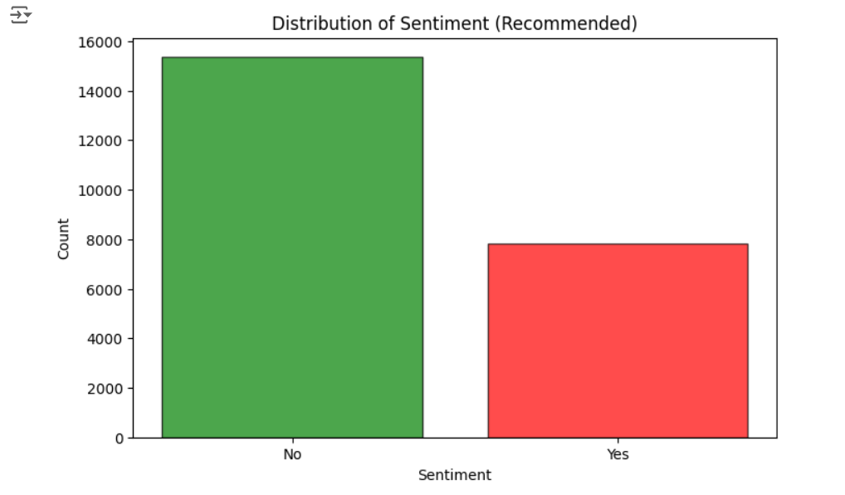
2. Dataset Description
Source of Data: The dataset used in this project was sourced from a public repository on GitHub, specifically from the following URL: https://github.com/Juhibhojani/Airline-Reviews-.
Key Features: The project will utilize a dataset containing customer reviews of various airlines. The primary focus will be on the Airline Name, Review, and Recommended columns.
Target Distribution:

Slide 5
Dataset Description (Cont.)
Initial Observations:
1. Imbalanced Data: The target variable is slightly imbalance between positive and negative reviews, which can affect the performance of the sentiment analysis model
2. Textual Variability: The reviews are text data, which can vary significantly in length and content.
3. Proper text preprocessing (cleaning, tokenization, and padding) is essential to standardize the input for the model.
4. Missing Values: Some columns, such as aircraft type or inflight entertainment ratings, contain missing values.
5. Feature Relevance: While the primary focus is on the Airline Name, Review, and Recommended columns, other features like Overall_Rating and Type Of Traveller could provide additional context and may be explored in further analysis.

Slide 6
3. Exploratory Data Analysis (EDA)
Dataset Size: The dataset contains 23,171 reviews across 497 distinct airlines.
Ratings Distribution: The overall ratings are skewed towards higher values, indicating general customer satisfaction.
Sentiment Distribution: There are more positive recommendations than negative ones.
Review Frequency: Certain airlines receive significantly more reviews, suggesting higher customer engagement.
Common Review Terms: Words like "service", "flight", "good", and "time" are frequently mentioned, highlighting key aspects of customer experiences.

Slide 7
4. Data Preprocessing
Data Cleaning: Removed irrelevant columns that were not needed for sentiment analysis.
Handling Missing Values: Decided to drop rows with missing values in the Review and Recommended columns as these are critical for the analysis.
Text Preprocessing: Converted the Review text to lowercase to standardize the text data. Removed non-alphabetic characters from the Review text to clean the data. Tokenized the Review text using Keras Tokenizer, converting the text into sequences of integers. Padded the tokenized sequences to ensure they are of the same length, making the data suitable for input into the neural network.
Mapping Sentiment Labels: Mapped the Recommended column to numerical values (yes = 1, no = 0) for binary classification.
Splitting the Data: Split the dataset into training and test sets using train_test_split from Scikit-learn. The split was done to ensure that the model could be trained and then evaluated on unseen data.
Normalization: Normalized the input data for consistent scaling.

Slide 8
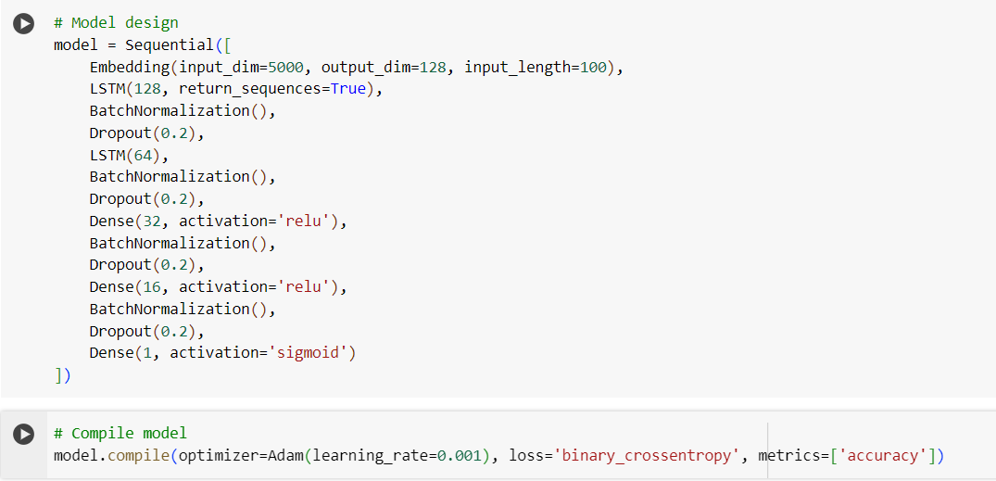
5. Model Design and Architecture

Slide 9
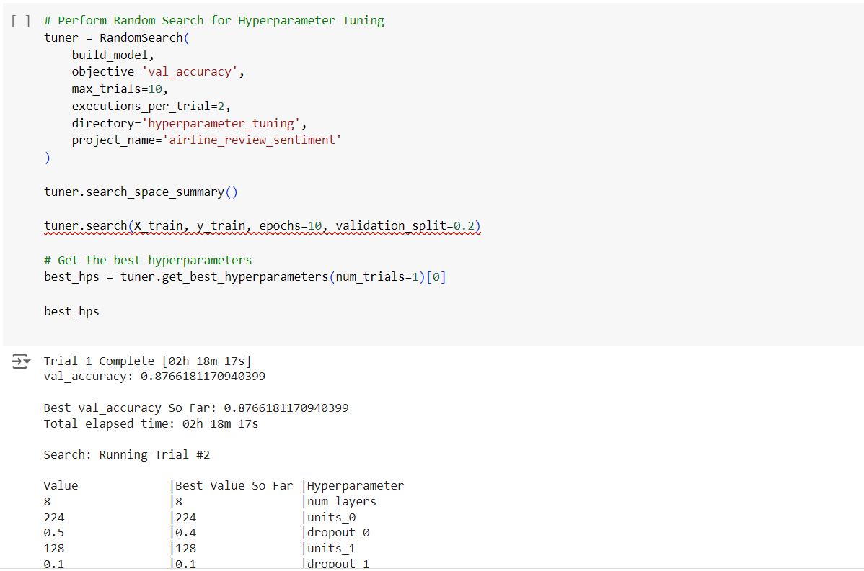
6. Hyperparameter Tuning with Random Search

Slide 10
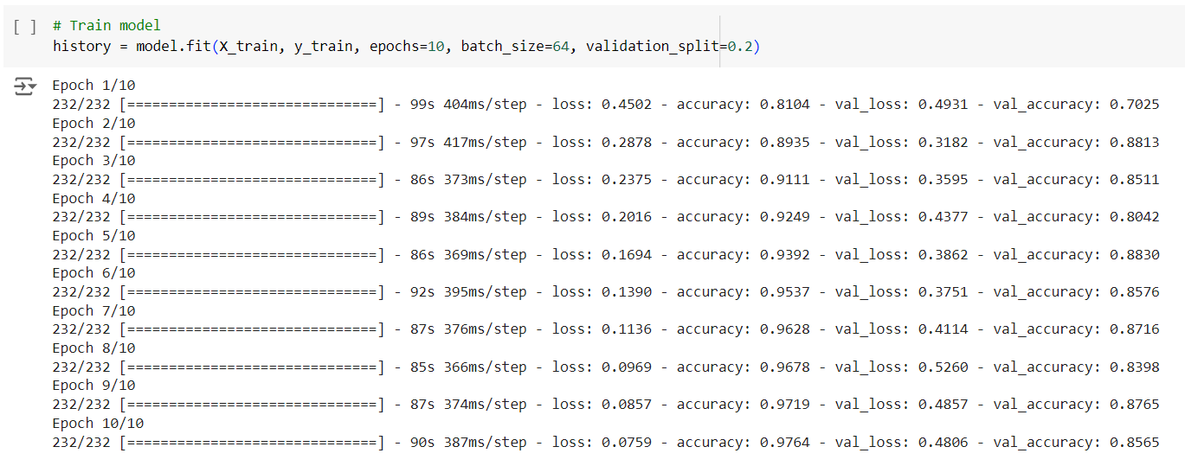
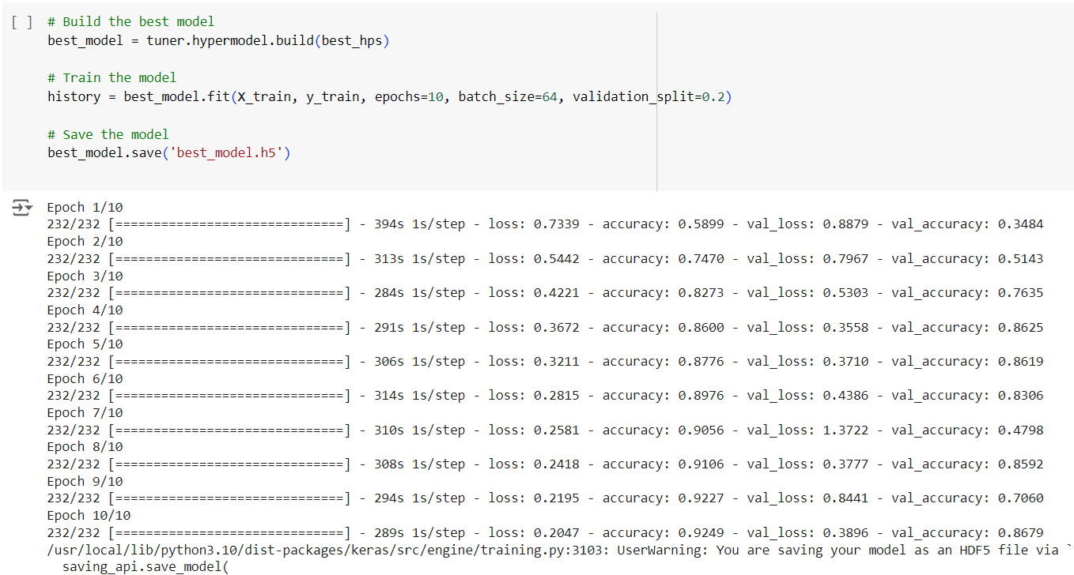
7. Model Training
Baseline model:
Tuned model:

Slide 11
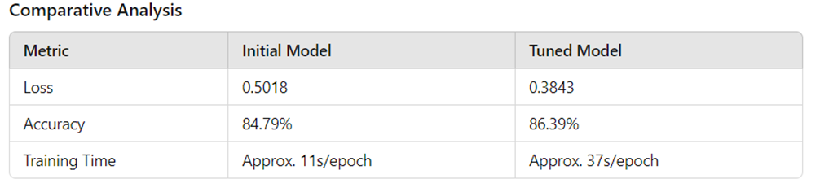
8. Model Evaluation
Evaluation Metrics: Loss and Accuracy

Slide 12
9. Results and Discussion
Key Findings: Hyperparameter tuning led to a improvement in both loss and accuracy. The tuned model demonstrated better generalization and performance on the test set compared to the initial model.
Comparison with Baseline Models
Baseline Model: The initial model served as the baseline with a straightforward architecture. The baseline model's performance provided a reference point for evaluating the effectiveness of hyperparameter tuning.
Performance Improvement: The accuracy improved from 84.79% (initial model) to 86.39% (tuned model). The loss reduced from 0.5018 to 0.3843, indicating better model predictions and lower error rates.
Strengths and Weaknesses of the Model
Strengths:
Robust Architecture: The use of LSTM layers allows the model to capture sequential dependencies in the text data effectively.
Regularization Techniques: Batch normalization and dropout layers help in preventing overfitting and stabilizing the training process.
Improved Performance: Hyperparameter tuning significantly enhanced the model's accuracy and reduced the loss, demonstrating the value of optimization.

Slide 13
Results and Discussion (Cont.)
Weaknesses:
Training Time: The tuned model's training time increased due to the added complexity and additional layers, making it computationally expensive.
Data Dependency: The model's performance is heavily reliant on the quality and quantity of the training data. Any biases in the data can affect the model's predictions.
Complexity: Increased model complexity can make it harder to interpret and understand the underlying decision-making process.
Potential Improvements
Transformer Models: Implement transformer-based models like BERT for potentially better performance in capturing contextual information.
Bidirectional LSTMs: Use bidirectional LSTM layers to capture dependencies from both directions in the text.
Diverse Data Sources: Incorporate reviews from multiple sources to provide a more comprehensive understanding of customer sentiment.
Deploying the Model: Implement real-time sentiment analysis by deploying the model as a service, allowing for immediate feedback on customer reviews.
Continuous Learning: Set up a pipeline for continuous model training and updating as new data comes in to keep the model up-to-date.

Slide 14
10. Conclusion
The improvement in model performance after hyperparameter tuning highlights the importance of this step in building robust machine learning models.
Regular evaluation and comparison of different models are crucial in understanding their strengths and weaknesses, guiding the development process.
Efficient use of computational resources, such as TPUs, can drastically reduce training times and enable the exploration of more complex models.
Airlines that consistently receive high recommendations often excel in areas such as customer service, in-flight experience, and punctuality. Other airlines can learn from their practices to improve their own services.
Customer reviews are a valuable source of feedback and can significantly influence the reputation and perceived quality of an airline. Maintaining a high standard of service to garner positive reviews is crucial.
Airlines can use this ranking to benchmark their services against competitors, identifying areas where they can improve or innovate.

