Slide 1
Digital Assets Management :
RAW to Archivals
Mentored by :
Dr Jacob L Dahl,
Professor of Assyriology
University of Oxford / Wolfson College

Slide 2
Problem Statement
Automation of processing RAW images of the tablet’s which was done manually.
Appending the system to the current framework.
Create an algorithm to efficiently crop the tablets from the background from an flatbed scan and images.
Create an algorithm to map these processed images into an archival based on a map.

Slide 3
Solution:
Algorithms are formulated using morphology, a field of image processing that uses math to enhance images.
A object oriented approach to extract and work on images.
A novel method to connect different runtimes to the framework.

Slide 4
Architecture
Presentation Layer
CDLI Framework
Logical Layer
Python + OpenCV
Task Queue
Redis

Slide 5
Processing
Done in two steps :
Extract object from background
Stitch multiple images as per map
Archival
Class
ImgClass_O
ImgClass_R
ImgClass_TE
ImgClass_BE
ImgClass_LE
ImgClass_RE

Slide 6
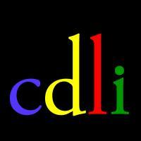


Thank You
Future Goals :
Extending the current implementation robustly
Creating an solution for on-device image processing
Aman Singh
@amansheaven

