Slide 1

DEPARTMENT OF COMPUTER SCIENCE AND ENGINEERING Internship Presentation On DENTAL X-RAY TOOTH DETECTION AND COUNTING USING MACHINE LEARNING
Presented by
Ibrahim naseef 4DM20CS019

Slide 2

CONTENTS
INTRODUCTION
PROBLEM STATEMENT
SOLUTION STRATEGY
RESULTS AND SNAPSHOT
CONCLUSION
FUTURE SCOPE OF THE PROJECT
REFERENCES

Slide 3
INTRODUCTION
This project aims to develop a machine learning (ML) model for the automated detection and counting of lower jaw teeth using YOLOv8, a state-of-the-art object detection algorithm. Dental diagnostics and treatments often require precise identification and quantification of teeth, a task that can be time-consuming and error-prone when done manually. By leveraging ML techniques, particularly YOLOv8, this project seeks to streamline this process, offering dentists and dental technicians a reliable tool for lower jaw tooth detection and counting.

Slide 4
PROBLEM STATEMENT
Manual Inefficiency: Manual tooth detection and counting in dental X-ray images is labor-intensive and prone to errors, hindering the efficiency of dental diagnostics and treatments.
Time Consumption: Traditional methods for tooth detection and counting consume significant time, delaying patient care and increasing workload for dental professionals.
Accuracy Concerns: Human error in manual tooth counting may lead to inaccuracies in diagnosis and treatment planning, impacting patient outcomes and satisfaction.
Automation Need: There is a growing demand for automated solutions to streamline dental image analysis, providing accurate and efficient tooth detection and counting for improved clinical decision-making.

Slide 5
SOLUTION STRATEGY
Dataset Collection: Gather a diverse dataset of dental X-ray images with lower jaw teeth annotations from Kaggle or Roboflow.
Data Preprocessing: Implement preprocessing steps such as resizing, grayscale conversion, and normalization to ensure compatibility with the YOLOv8 model and enhance detection performance.
Model Training and Optimization: Train the YOLOv8 model using annotated dental X-ray images, and fine-tuning the model to achieve optimal performance in lower jaw tooth detection.
Post-processing and Counting: Develop post-processing algorithms to accurately count the detected lower jaw teeth, ensuring precise quantification for clinical analysis and treatment planning.

Slide 6
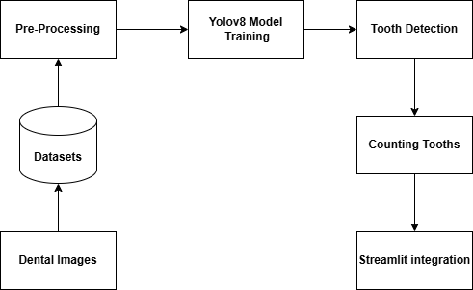
METHODOLOGY

Slide 7
Datasets: The project starts with collecting dental images from various sources to create datasets for training and evaluation.
Pre-Processing: The dental images undergo various pre-processing steps to prepare them for the model training phase. This may include resizing, cropping, color conversion, and enhancement techniques.
YOLOv8 Model Training: The pre-processed images are used to train a YOLOv8 object detection model for tooth detection.
Tooth Detection: The trained YOLOv8 model is applied to detect teeth in the dental images.
Counting Teeth: After detecting the teeth, a separate step is performed to count the number of teeth present in the lower jaw region.
Streamlit Integration: The tooth detection and counting functionalities are integrated into a Streamlit application, likely for creating a user-friendly interface or deploying the system.

Slide 8
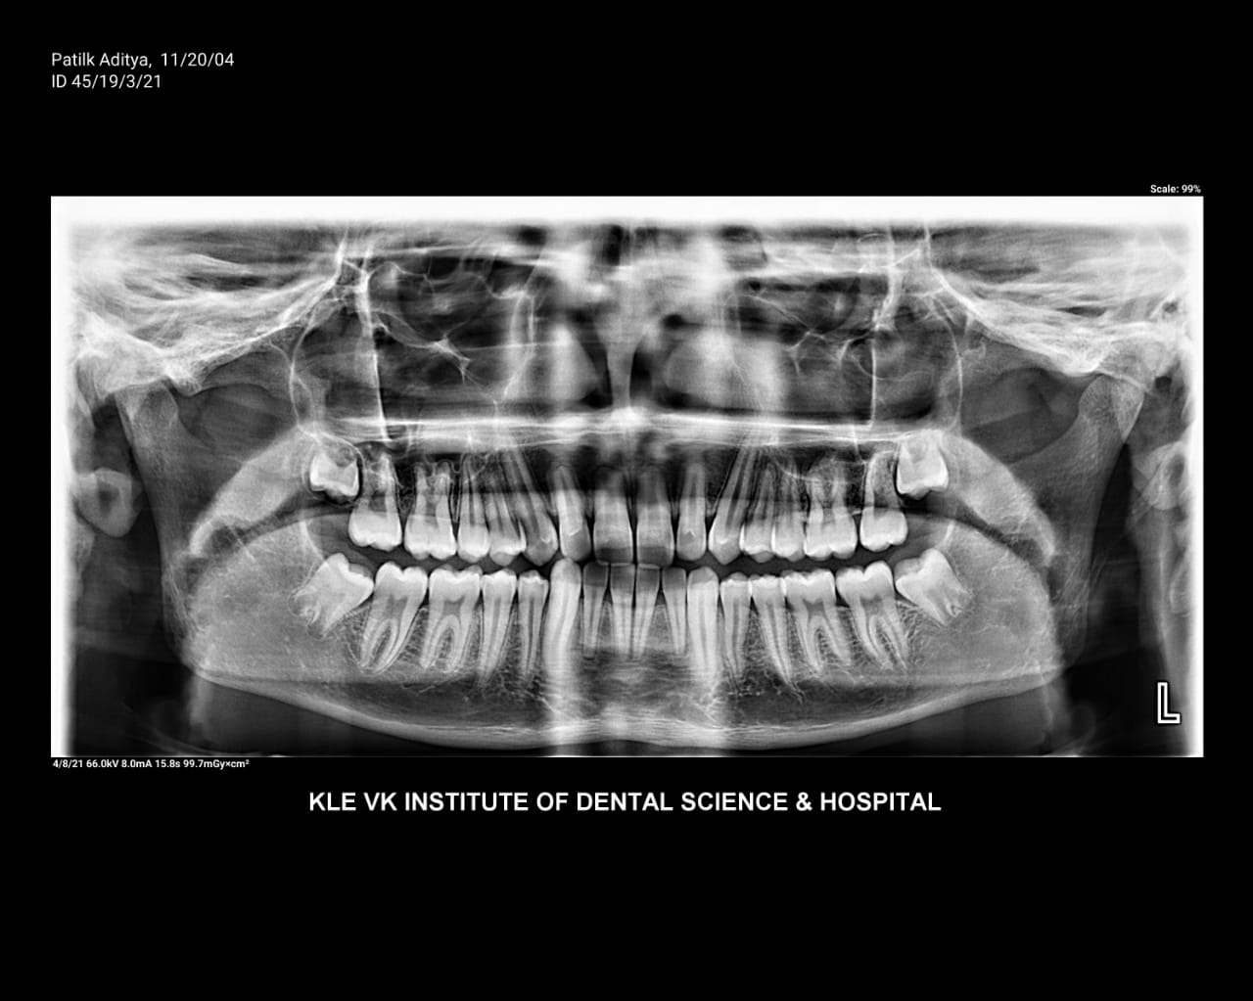
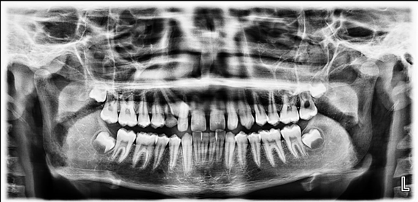
RESULTS AND SNAPSHOTS
Fig: Raw Xray Image
Fig: Pre-processed Image

Slide 9
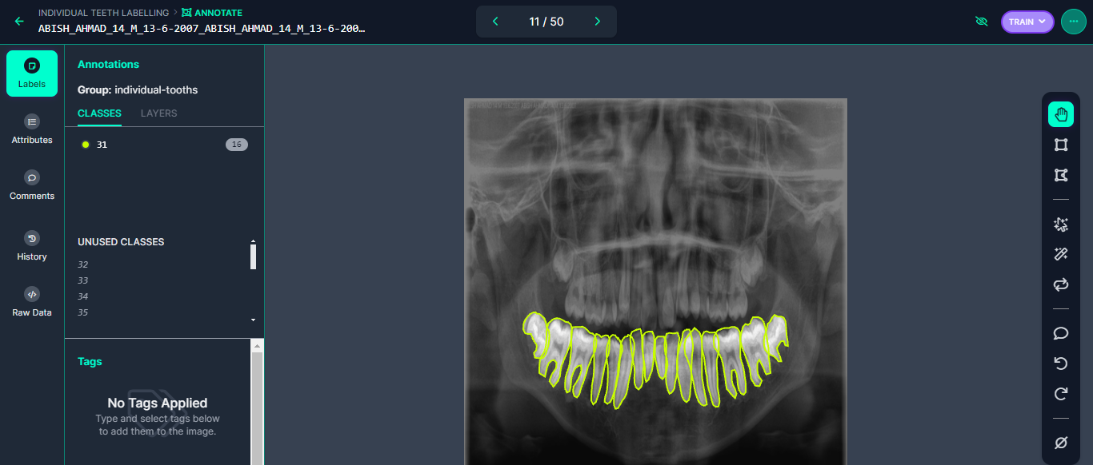
Fig: Annotated lower jaw Image

Slide 10
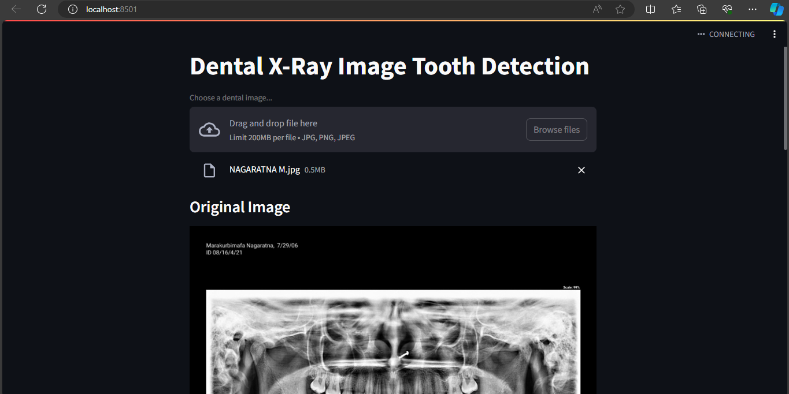
Fig: Streamlit Integration

Slide 11
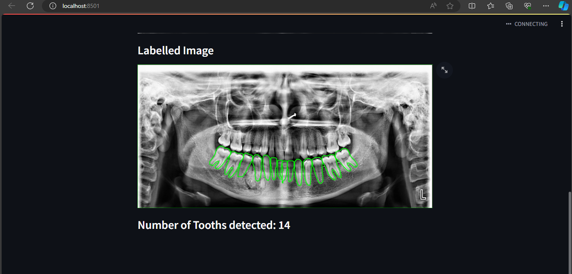
Fig: Tooth detection and Counting

Slide 12
CONCLUSION
Improved Diagnostic Accuracy: Our project has successfully demonstrated that pre-processing and annotating dental images significantly enhance diagnostic accuracy, providing dental professionals with more reliable tools for patient evaluation.
Efficiency and Time-Saving: The automation of image processing and annotation greatly reduces the time required for manual analysis, allowing dentists to focus more on patient care and treatment.
Enhanced Patient Care: By increasing the accuracy and efficiency of dental image analysis, our project directly contributes to better patient care, early disease detection, and improved treatment planning.
Research Opportunities: Our work opens up new avenues for dental research by providing standardized, annotated datasets for future studies and innovations in the field.

Slide 13
FUTURE SCOPE OF THE PROJECT
AI-Enhanced Diagnosis: Implement artificial intelligence to provide real-time, automated diagnosis and treatment recommendations, reducing human error and improving patient outcomes.
Integration with Electronic Health Records (EHR): Expand the project to seamlessly integrate with EHR systems, ensuring comprehensive and efficient patient management.
Educational Tools: Develop educational modules using pre-processed images to train dental professionals and students, ensuring a well-informed workforce for the future.

Slide 14
REFERENCES
https://www.w3schools.com/
https://www.codeacademy.com/
https://www.researchgate.net/
Dental Imaging Solutions. (n.d.). "Improving Dental Workflow Efficiency Through Automated Tooth Detection."
Zhang, L., & Wang, S. (2020). "Automatic Lower Jaw Tooth Detection Using Convolutional Neural Networks." Journal of Dental Research, 45(2), 123-136.

Slide 15
THANK YOU

