Slide 1
2024
PROJECT : COST OF LIVING
By: Ibrahim Musa

Slide 2
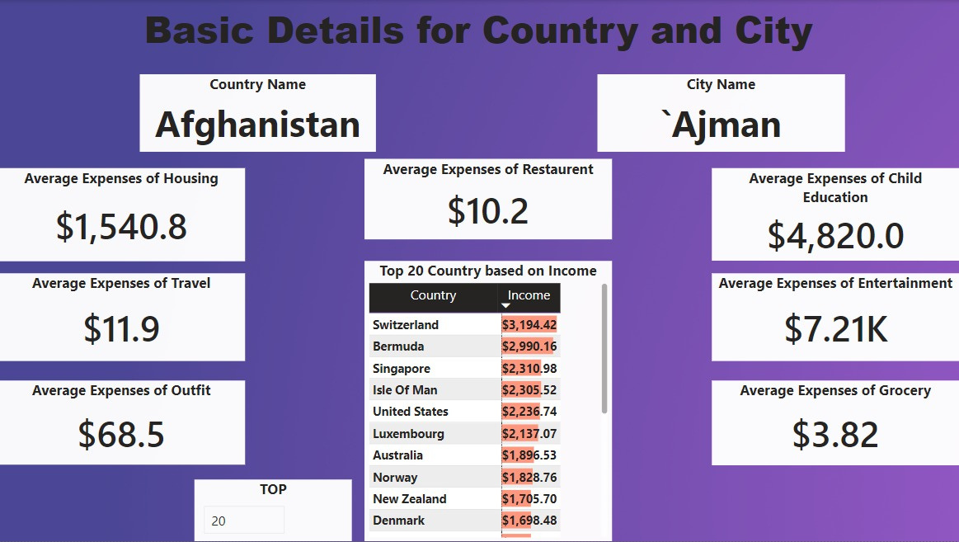

Slide 3

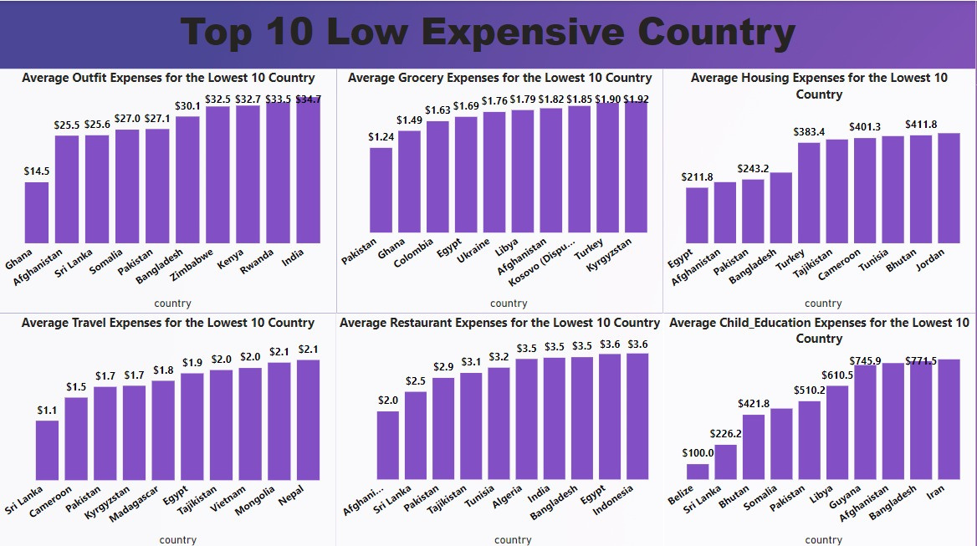



Slide 4
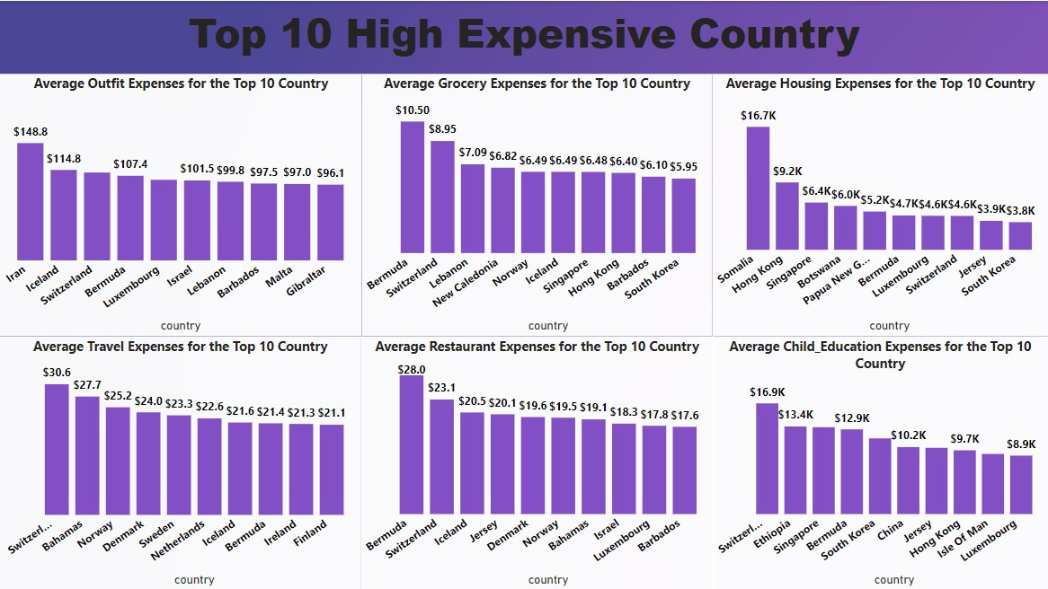


Slide 5
Thank You

