Slide 1
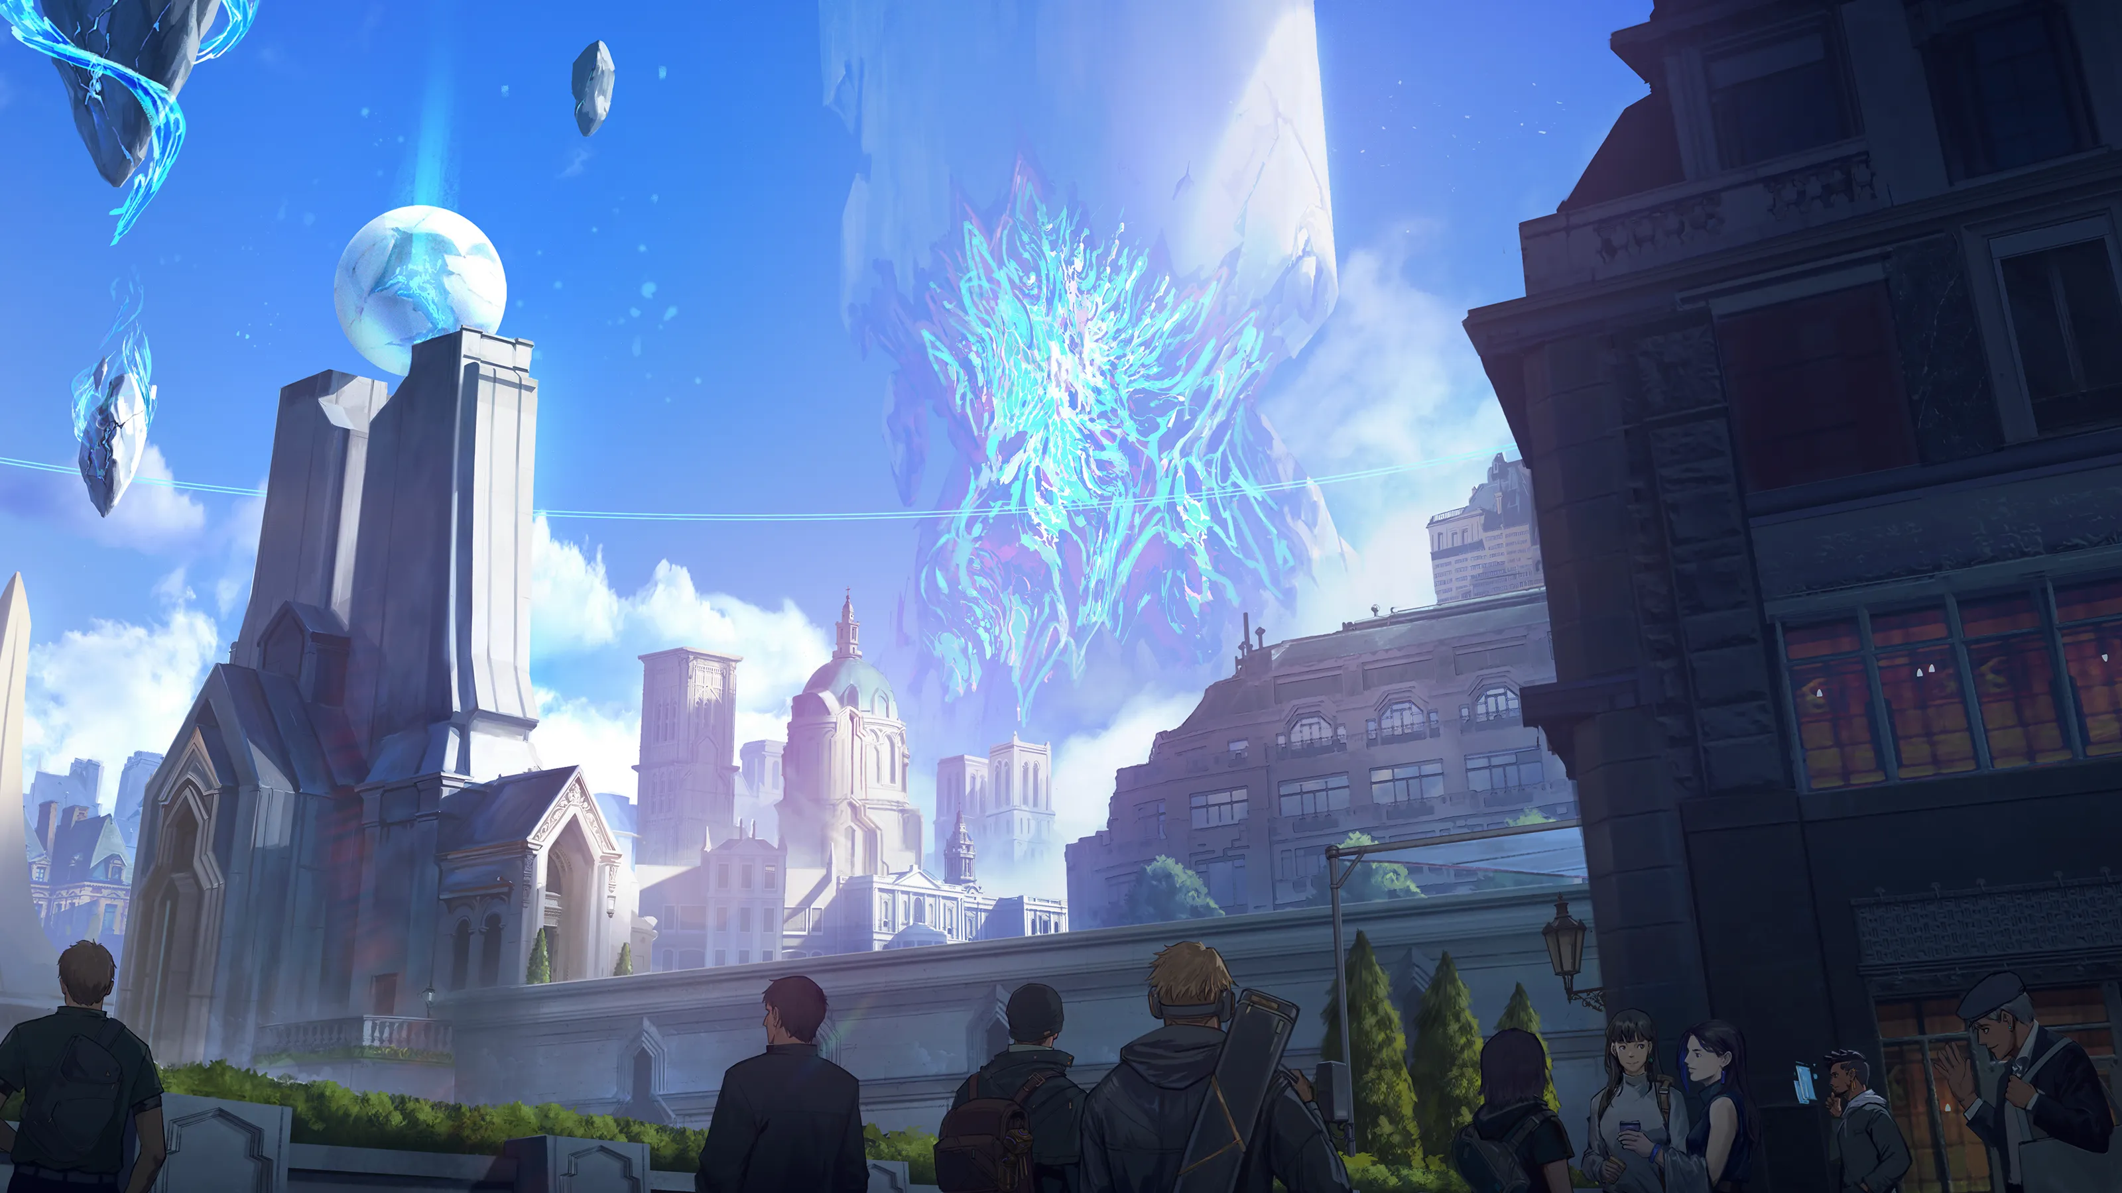
AL-RUF
GAMING WEB PLATFORM
A multi-page front-end experience for a fictional gaming universe.
PROJECT PRESENTATION
Concept | Purpose | Modules | Technology
Presented by: Ibrahim Saasa

Slide 2
AL-RUF / PROJECT PRESENTATION
02
PROJECT CONCEPT
A gaming world, presented as a platform
AL-RUF is designed as the digital home of Zenithal: a fictional gaming brand that brings products, community, lore, services, and collections into one navigable experience.
01
02
03
Discover
Explore
Engage
A strong landing page introduces the universe through video, visual storytelling, and clear calls to action.
Visitors move through seven focused pages instead of one crowded screen.
Filters, FAQ interaction, forms, modals, and community features make the site feel alive.
The result is a presentable prototype that feels like the front end of a larger gaming ecosystem.
AL-RUF Gaming Web Platform
FRONT-END PROJECT | 2025

Slide 3
AL-RUF / PROJECT PRESENTATION
03
PURPOSE AND OBJECTIVES
Why this project exists
PURPOSE
01 Create a professional gaming-themed interface
02 Organize content into meaningful user journeys
03 Use JavaScript for practical front-end interaction
04 Make the experience responsive across devices
05 Build a foundation for future database features
06 Demonstrate applied HTML, CSS, JavaScript, and JSON
From static page to usable platform
The project demonstrates how a fictional gaming idea can be transformed into a structured, responsive, and interactive web experience suitable for real users and future backend integration.
AL-RUF Gaming Web Platform
FRONT-END PROJECT | 2025

Slide 4
AL-RUF / PROJECT PRESENTATION
04
USER EXPERIENCE
One journey, seven connected destinations
01
02
03
04
HOME
PRODUCTS
NEXUS
VAULT
Brand story and visual entry point
Browse and filter offerings
Community, events, and stats
Digital collections and rarity
05
06
07
ABOUT
SERVICES
CONTACT
Lore, mission, and identity
Offerings and FAQ support
Validated message form
Shared navigation and footer patterns keep every page connected while page-specific styles give each destination a distinct role.
AL-RUF Gaming Web Platform
FRONT-END PROJECT | 2025

Slide 5
AL-RUF / PROJECT PRESENTATION
05
MODULE OVERVIEW
The core modules
HOME
PRODUCTS
NEXUS
VAULT
Visual introduction
Product showcase
Community hub
Digital collections
Hero video, brand story, featured metagame cards, and calls to action.
Mock JSON data, category filters, cards, and product detail modals.
Global community, battles, events, ranked seasons, and platform statistics.
Collection cards with rarity filters and reasons to collect.
ABOUT
SERVICES
CONTACT
Lore and mission
Support center
Communication
The Zenithal story, ancient order, convergence, and brand values.
Service offerings and an expandable FAQ accordion.
Contact details, social links, form validation, and success modal.
AL-RUF Gaming Web Platform
FRONT-END PROJECT | 2025

Slide 6
AL-RUF / PROJECT PRESENTATION
06
FEATURE SPOTLIGHT
Discovery is built into the interface
PRODUCTS MODULE
VAULT MODULE
Browse, filter, inspect
Collect, classify, return
The Products page renders mock product records from data/products.json. Users can separate hardware, games, and merchandise, then open a modal to inspect descriptions and specifications.
The Vault page presents the collectible side of the universe. Rarity-based filtering and collection cards give users a reason to explore and revisit the page.
This pairing demonstrates the difference between transactional discovery and world-building discovery.
AL-RUF Gaming Web Platform
FRONT-END PROJECT | 2025

Slide 7

AL-RUF / PROJECT PRESENTATION
07
ENGAGEMENT MODULES
The platform is more than a catalogue
NEXUS A community-facing hub with global community, epic battles, seasonal events, ranked seasons, and headline statistics.
ABOUT A narrative layer that turns the fictional brand into a world with lore, mission, and values.
SERVICES A practical support layer covering premium support, tournament hosting, enterprise solutions, learning, security, and VIP membership.
CONTACT A direct communication path with validation and a success state, making the prototype feel operational.
COMMUNITY / STORY / SUPPORT
AL-RUF Gaming Web Platform
FRONT-END PROJECT | 2025

Slide 8
AL-RUF / PROJECT PRESENTATION
08
TECHNICAL IMPLEMENTATION
A front end designed for extension
STRUCTURE
VISUAL SYSTEM
BEHAVIOR
HTML5
CSS3
JavaScript + JSON
Seven separate HTML pages share a consistent navigation system, footer, semantic sections, and accessible form controls.
Common, animation, responsive, and page-specific styles keep the code organized while supporting motion, blur transitions, hover states, and mobile layouts.
Dynamic product rendering, filters, FAQ accordion behavior, form validation, modal dialogs, and mock data create an interactive prototype.
Current architecture: static front end -> future backend integration with PHP/MySQL
AL-RUF Gaming Web Platform
FRONT-END PROJECT | 2025

Slide 9
AL-RUF / PROJECT PRESENTATION
09
CURRENT SCOPE
What is complete, and what comes next
DELIVERED
LIMITATIONS
A complete presentable prototype
Front end only
Multi-page navigation Responsive layouts Animated gaming visual language Product data and filtering FAQ interaction Contact validation and success modal
No user authentication No live database No online payment No admin dashboard Mock product data External assets require network access
AL-RUF Gaming Web Platform
FRONT-END PROJECT | 2025

Slide 10
AL-RUF / PROJECT PRESENTATION
10
FUTURE SCOPE
A strong base for the next phase
01
02
03
Backend
Accounts
Commerce
PHP / Node.js services with MySQL or another database.
Registration, login, profiles, saved collections, and preferences.
Cart, checkout, order tracking, and inventory management.
04
05
Community
Administration
Live events, leaderboards, comments, and moderation tools.
Dashboard for products, services, FAQs, and site analytics.
The prototype already establishes the information architecture; the next phase can add persistence, identity, and real transactions without redesigning the entire experience.
AL-RUF Gaming Web Platform
FRONT-END PROJECT | 2025

Slide 11
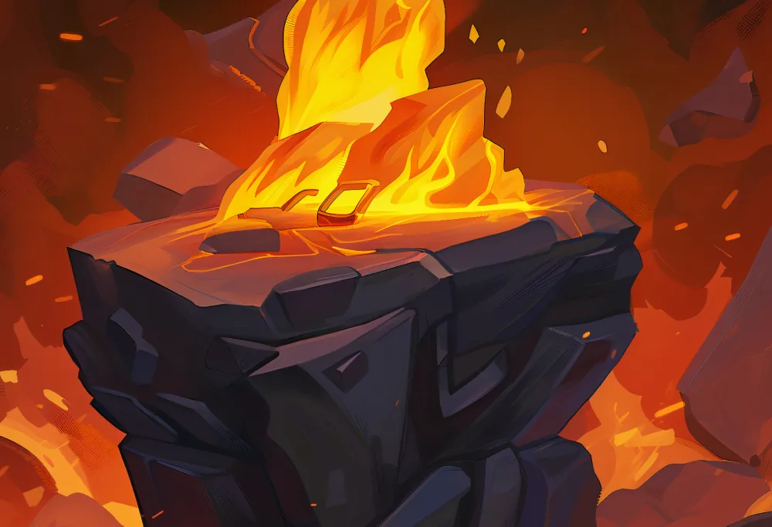
THANK YOU
AL-RUF Gaming Web Platform
A front-end concept for a connected gaming universe.
Questions and discussion
Ibrahim Saasa

