Slide 1

Contract Monthly Claim System
Done By : Ibrahim Tagari (ST10062630)

Slide 2
Contents :
Overview of the Contract Monthly Claim System (Slide 3)
Lecturer View : (Slide 4)
Programme Coordinator and Academic Manager view : (Slide 5)
HR view : (Slide 6)
Screenshots of the Contract Monthly Claim System Interface (Slides 7 -11)
Summary and Conclusion (Slides 12)
Features
Functionality
Benifits
Features
Functionality
Benifits
Features
Functionality
Benifits

Slide 3
Overview of the system :
Features:
Automates workflows and data entry.
Reduces human errors in claims and approvals.
Centralized platform for managing lecturer claims.
Benefits:
Saves time for all stakeholders.
Improves accuracy and reliability of data processing.
Streamlines the approval process.

Slide 4
Lecturer View :
Features:
Automated claim submission system for inputting hours worked and hourly rates.
Real-time calculations of claims based on hours reported.
Integration with validation checks for data accuracy.
Functionality:
Tools: ASP.NET Core MVC, JQuery (frontend), and Entity Framework (backend).
User inputs hours worked, and the system auto-calculates claim totals.
Simple and intuitive interface for lecturer use.
Benefits:
Eliminates manual errors in claim submissions.
Provides lecturers with quick access to payment processing.
Increases transparency and trust.

Slide 5
Programme Coordinator and Academic Manager View :
Features:
  Automates the verification and approval of submitted claims.
  Reviews and processes claims against predefined criteria (e.g., hours worked, rates).
  Integrated workflows for streamlined approvals.
Functionality:
  Entity Framework manages back-end data operations.
  Approval system integrated with frontend validation tools.
  Supports workload management through third-party libraries.
Benefits:
  Saves time by automating repetitive approval tasks.
  Ensures compliance with institutional policies.
  Improves oversight and governance.

Slide 6
HR View :
Features:
  Automates claim processing and lecturer data management tasks.
  Provides functionality for generating reports and summaries.
  Supports updates to lecturer payment information.
Functionality:
  Tools: ASP.NET Core Razor Pages or Web Forms.
  Generates detailed payment breakdowns (PDF/Excel).
  Seamless integration with HR databases for record-keeping.
Benefits:
  Streamlines HR workflows, reducing manual intervention.
  Offers real-time updates for payroll accuracy.
  Ensures timely payment processing, enhancing lecturer satisfaction.

Slide 7
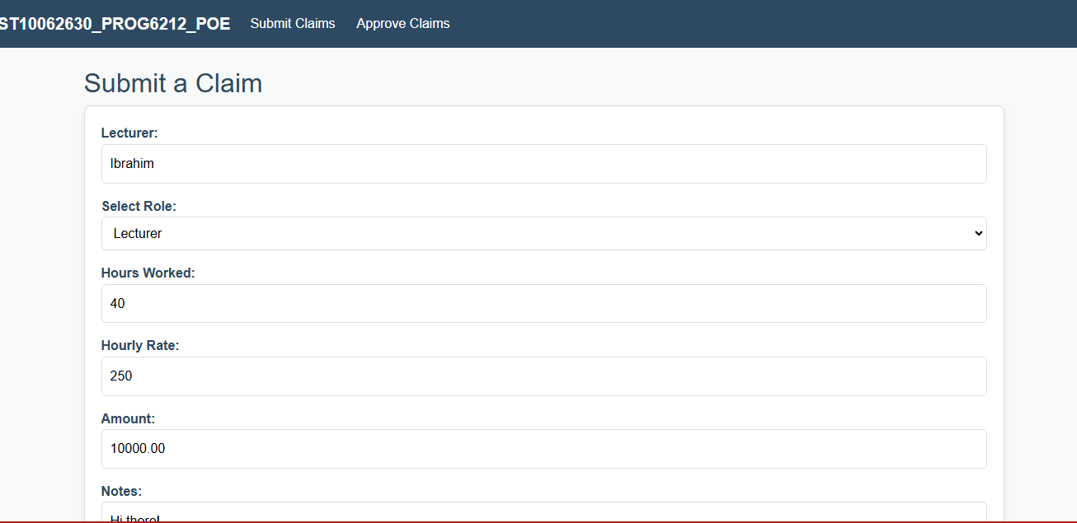
Screenshots of Interface :

Slide 8
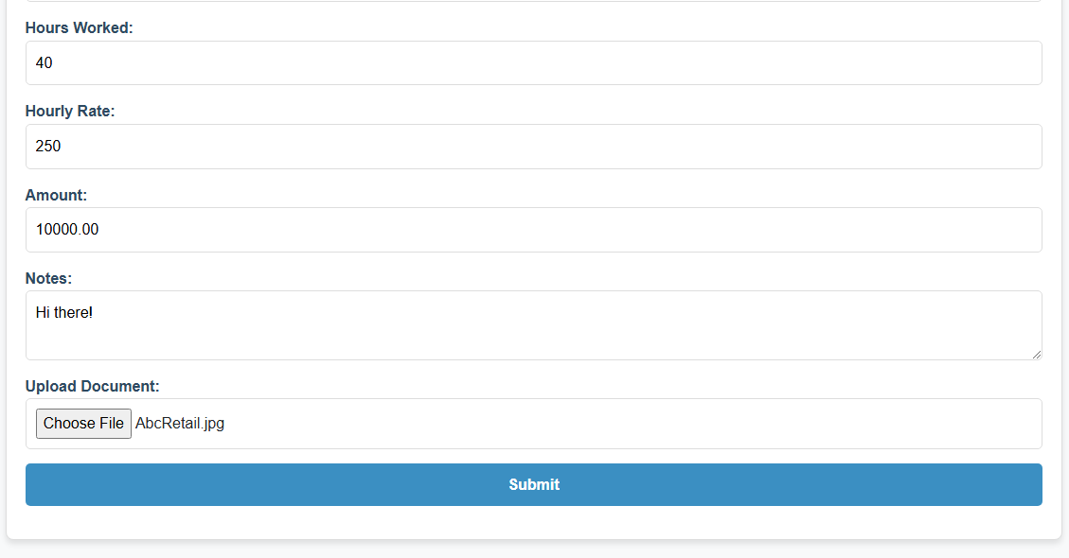
Screenshots of Interface :

Slide 9
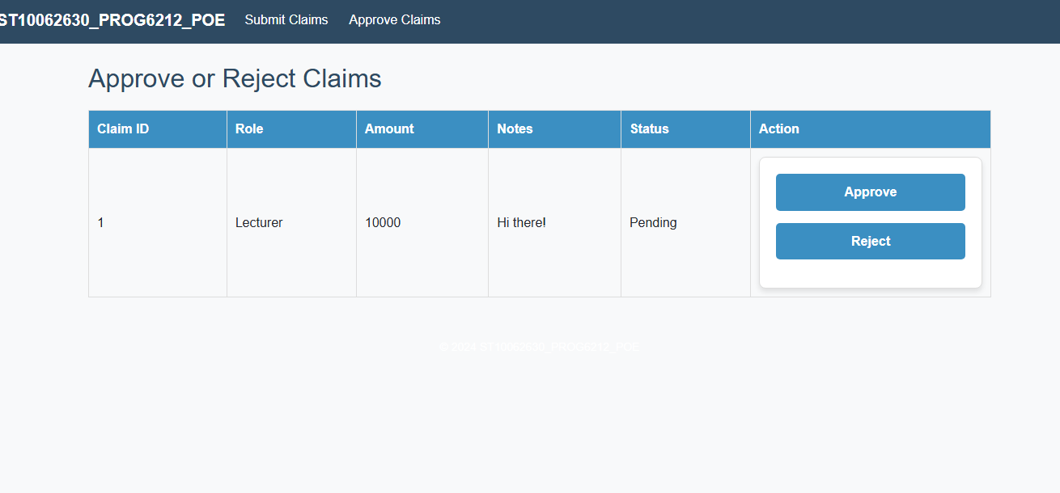
Screenshots of Interface :

Slide 10
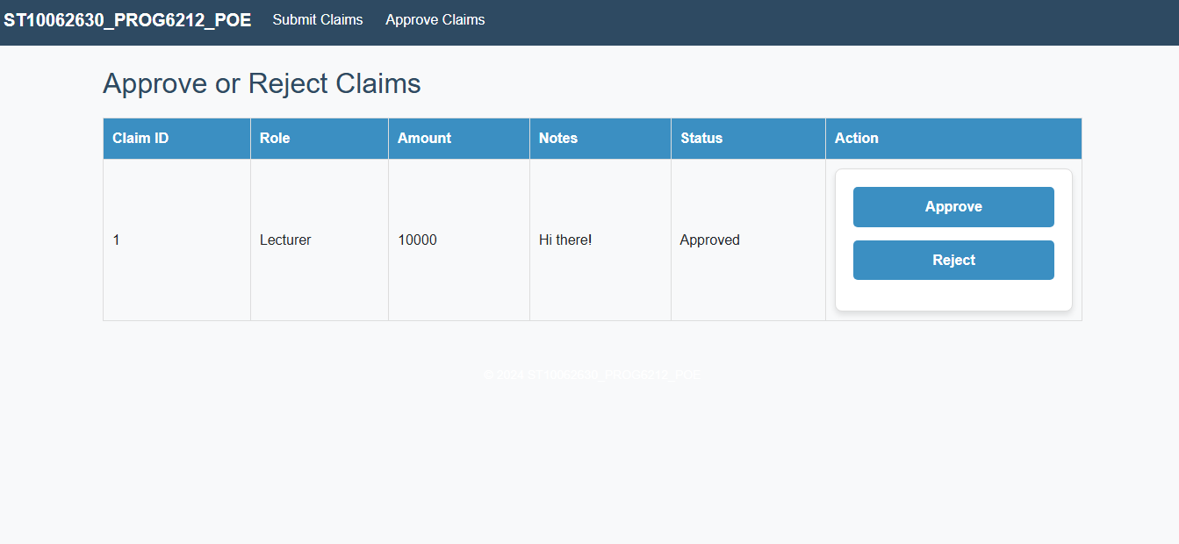
Screenshots of Interface :

Slide 11
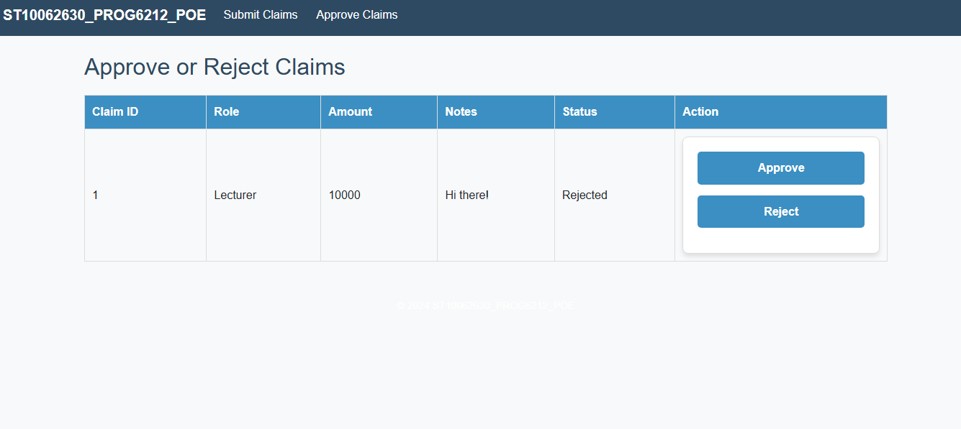
Screenshots of Interface :

Slide 12
Summary and Conclusion :
Key Highlights:
Lecturer View: Simplifies submission and ensures accurate claims.
Academic Manager View: Streamlines approvals and enforces compliance.
HR View: Centralizes claim processing and improves efficiency.
Conclusion:
The system delivers a seamless, efficient solution for managing lecturer claims and approvals.

