Slide 1
Notes to AG Erfle internship

Slide 2


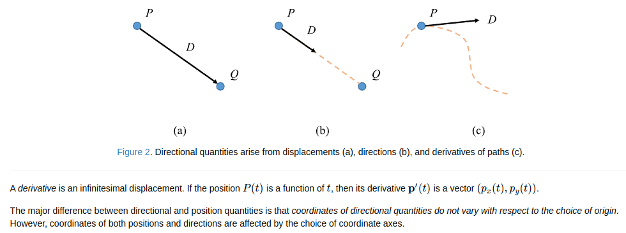
Coordinate systems
Requires a coordinate frame with orthogonal axes and origin point.
2D positions are defined by 2-element vectors
Vectors give us directional quantities e.g. displacement, direction and derivative:
Displacement
Direction:
(With the angle measured counter clockwise from X)
Or

Slide 3
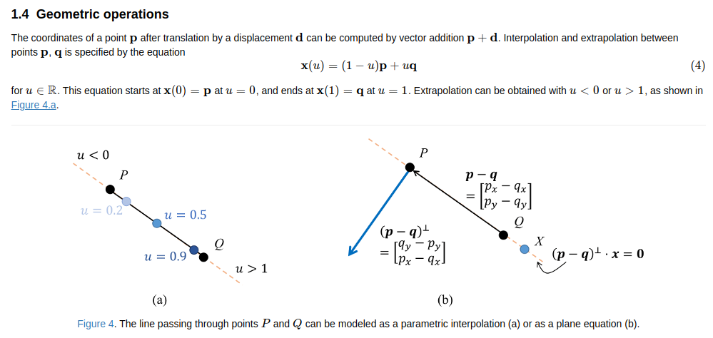
Geometric operations

Slide 4
Logging

Slide 5
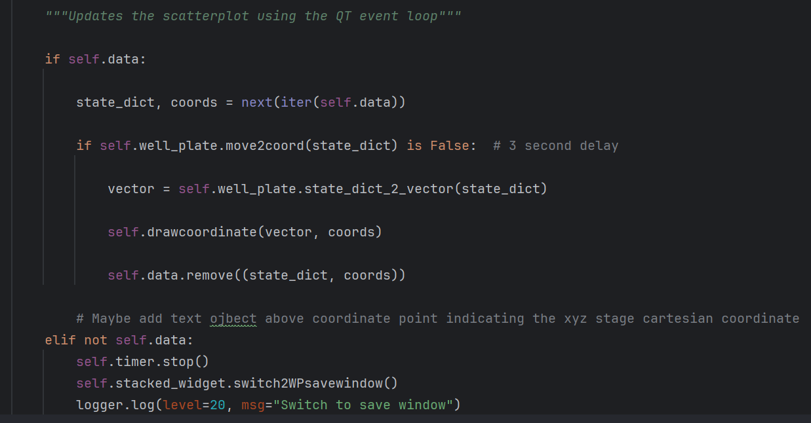
XYZ stage simulator
The XYZ stage is only updated once the simulator has been updated. The simulator is only updated using the QT event loop

Slide 6
Image based autofocus​
Spatial domain
Frequency domain

Slide 7
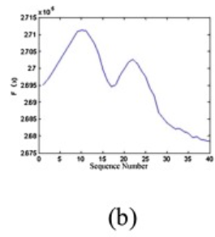


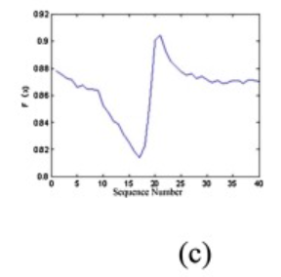
Image based autofocus
Focus evaluation functions:
Variance
Brenner
https://doi.org/10.1016/j.ijleo.2020.164232

