Slide 1


Slide 2

About ?
The presentation is about rain data analysis in Australia. Moreover, try to take some insights from the data and which model is the best choice of this data.

Slide 3
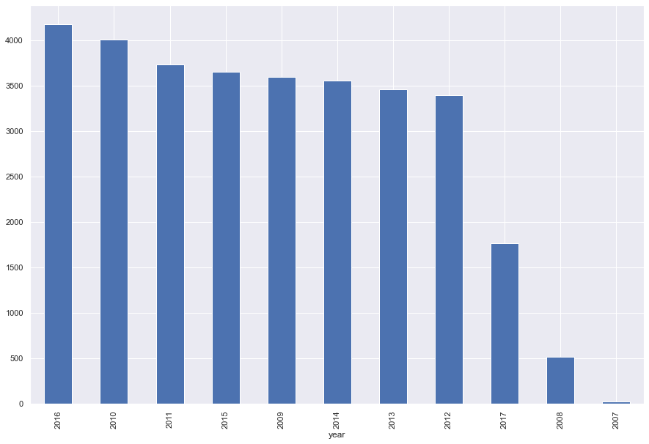
Rainiest year ?
2016 is the rainiest year but, it depend on the data because not every year has the same sample of data

Slide 4
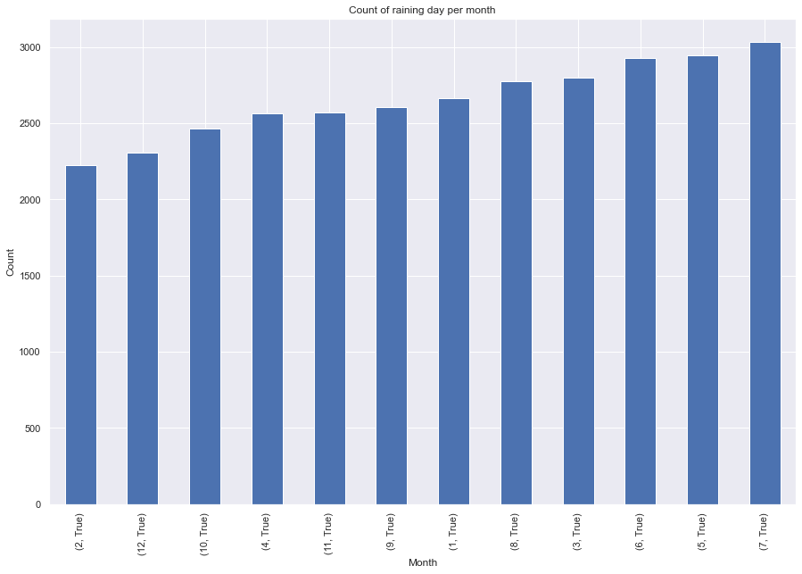
Rainiest month ?
The seventh month is the rainiest month and from the plot we notice that it rains all the year in Australia.

Slide 5
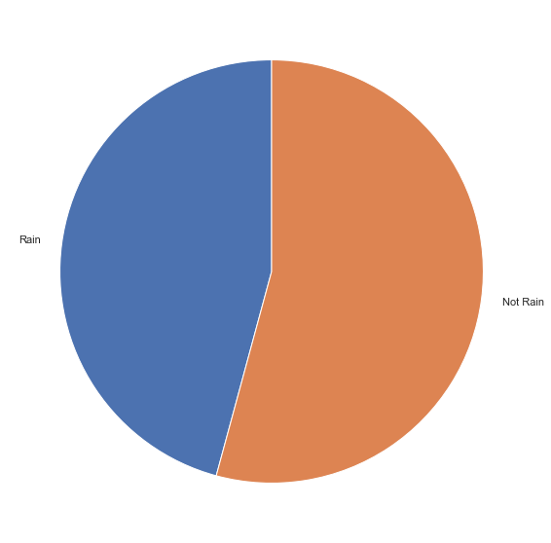
If it rains today Will rain tomorrow ?
There is a high probability to rain next day.

Slide 6
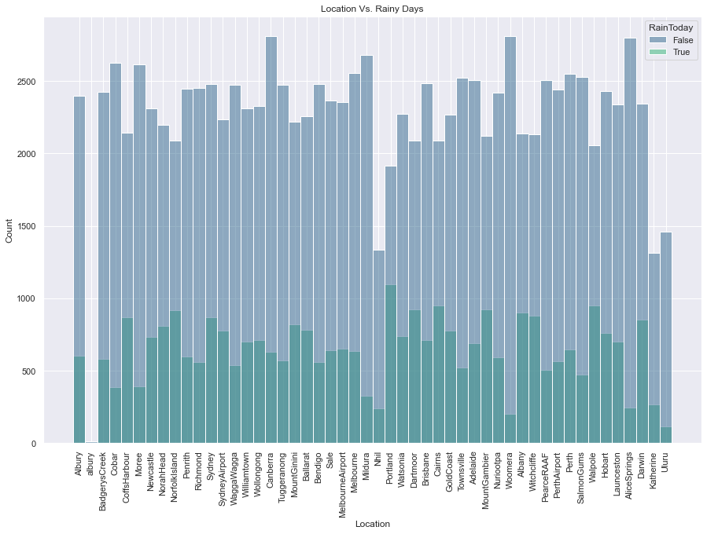
The most / least rainy city ?
Portland is the rainiest city and Uluru is the least rainy city

Slide 7
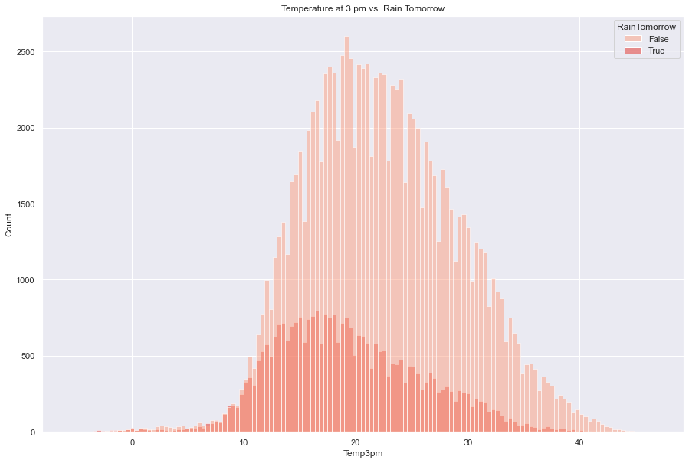
Is there any correlation between temperature at 3pm and it will rain tomorrow ?
when the temp is lower the prob of rain is high and the opposite.

Slide 8
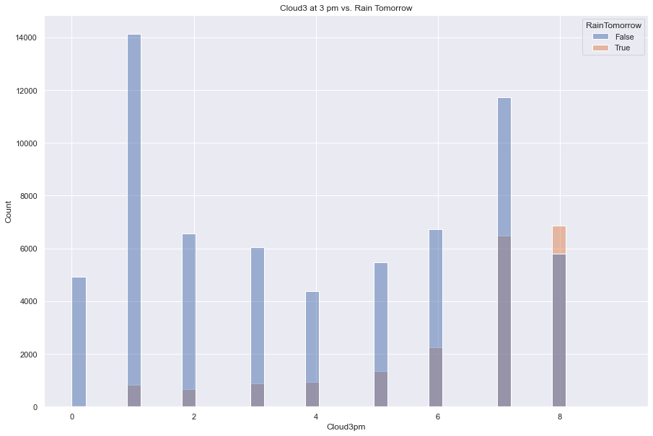
From cloud at 3 pm could predict if it will rain tomorrow ?
more of cloud in 3 pm indicates for raining but it's difficult to decide

Slide 9
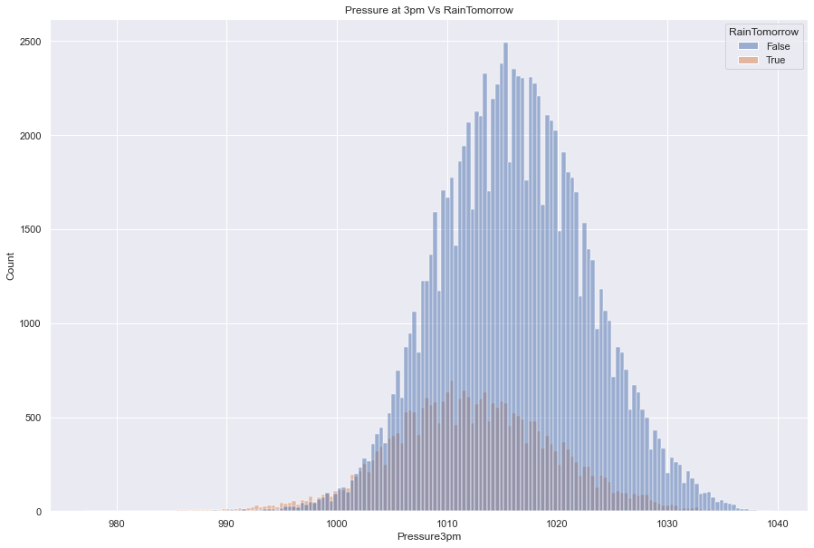
Pressure at 3 pm could predict if it will rain tomorrow ?
when the Pressure is lower the prob of rain is high and the opposite.

Slide 10
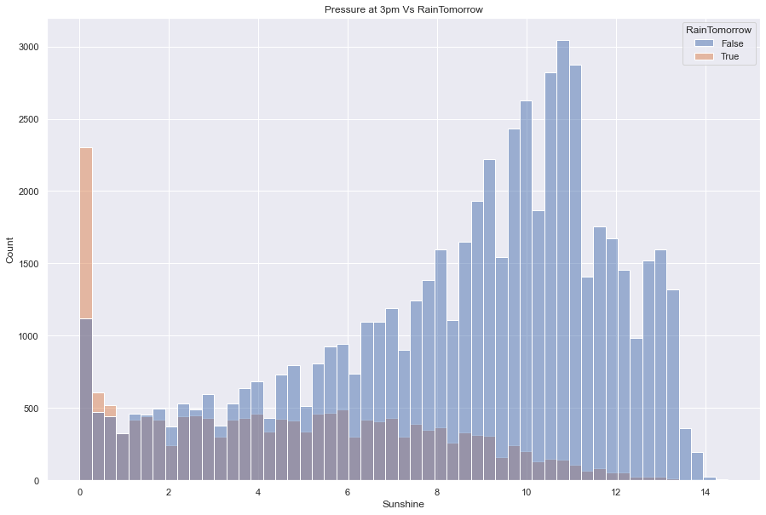
Is sunshine time effect on rain tomorrow ?
low sunshine time means high prob with raining tomorrow.

Slide 11

Prediction model
Regard to analysis the data we notice that not all features in the data linearly correlated so, we exclude Logistic Regression. Also, there are Overlap in the data so, exclude K Neighbor Classifier. Additionally, algorithms with tree base is a good choice for this data.
(next page example of linearly correlation and overlapping)

Slide 12
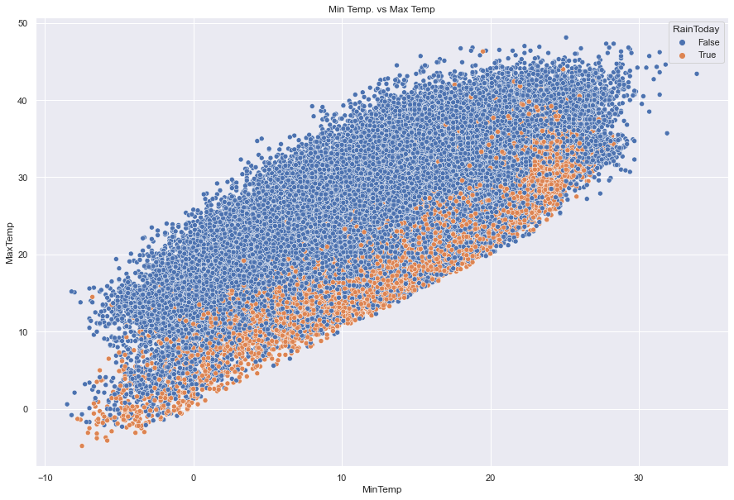
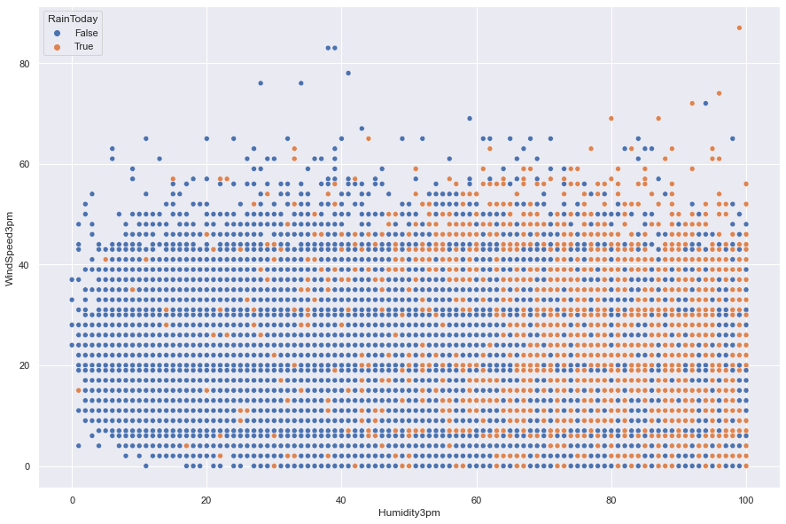
Here we can see the overlapping
Here we can see the linear correlation

Slide 13

Finally
Random Forest Classifier
(Get 99% in training
data and 95% in testing).

Slide 14

Any Question ?

Slide 15


