Slide 1
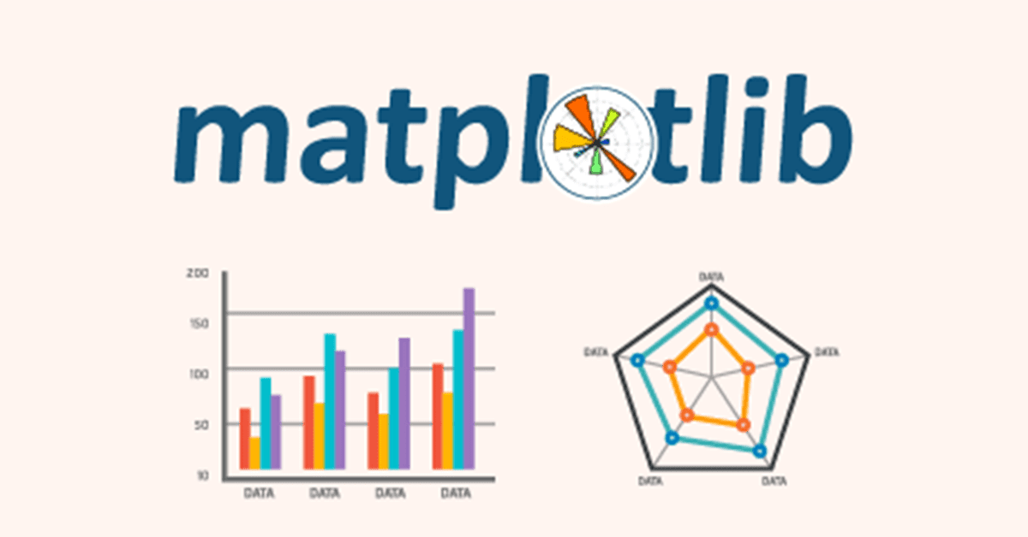
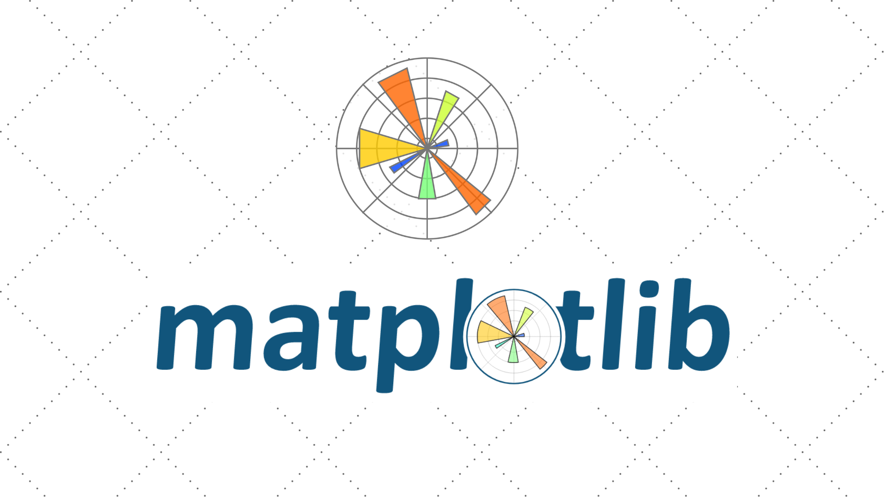

Slide 2
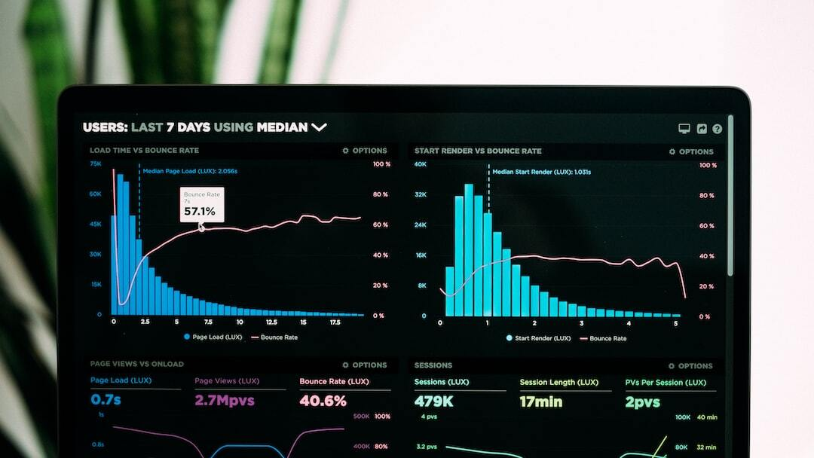
Introduction to Data Visualization
Definition and Importance: Data visualization is the graphical representation of information and data. It uses visual elements like charts, graphs, and maps to provide an accessible way to see and understand trends, outliers, and patterns in data.
Key Objectives: 1. Simplify complex data 2. Reveal insights 3. Aid decision making 4. Communicate information clearly
Historical Context: From ancient maps to modern infographics, the history of data visualization is rich and varied, illustrating the evolution of data representation.

Slide 3
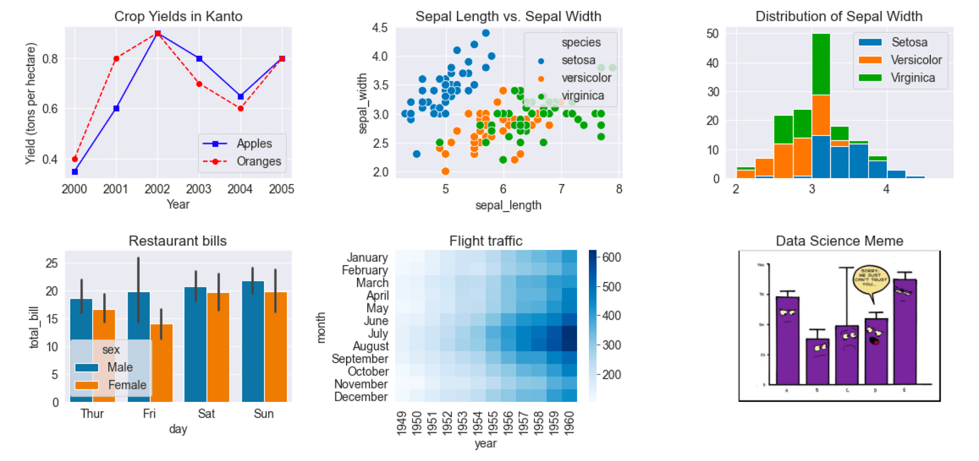
Overview of Matplotlib
What is Matplotlib?: Matplotlib is a comprehensive library for creating static, animated, and interactive visualizations in Python.
Key Features: 1. Versatility: Supports a wide variety of plots 2. Integration: Works well with other libraries like NumPy and Pandas 3. Customization: Highly customizable to meet specific needs
Comparison with Other Libraries: Compared to other libraries like Seaborn or Plotly, Matplotlib offers a more low-level control over plots, making it a preferred choice for detailed and customized visualizations.

Slide 4

Installing Matplotlib
Installation Process: Matplotlib can be easily installed using pip or conda. Use the command `pip install matplotlib` or `conda install matplotlib`.
Basic Setup: After installation, import Matplotlib in your Python script using `import matplotlib.pyplot as plt`.
Importing Matplotlib: Commonly used aliases include `plt` for `pyplot`, which provides a MATLAB-like interface for plotting.

Slide 5
Basic Plotting
Creating a Simple Plot: 1. Import matplotlib.pyplot as plt 2. Create data: `x = [1, 2, 3, 4]`, `y = [10, 20, 25, 30]` 3. Plot data: `plt.plot(x, y)` 4. Show plot: `plt.show()`
Customizing Plots: 1. Adding titles: `plt.title('Title')` 2. Labeling axes: `plt.xlabel('X-axis')`, `plt.ylabel('Y-axis')` 3. Customizing line styles and colors: `plt.plot(x, y, 'r--')`
Plotting Multiple Lines: 1. Create multiple datasets 2. Plot them using multiple `plt.plot()` calls 3. Add legends: `plt.legend(['Line 1', 'Line 2'])`

Slide 6
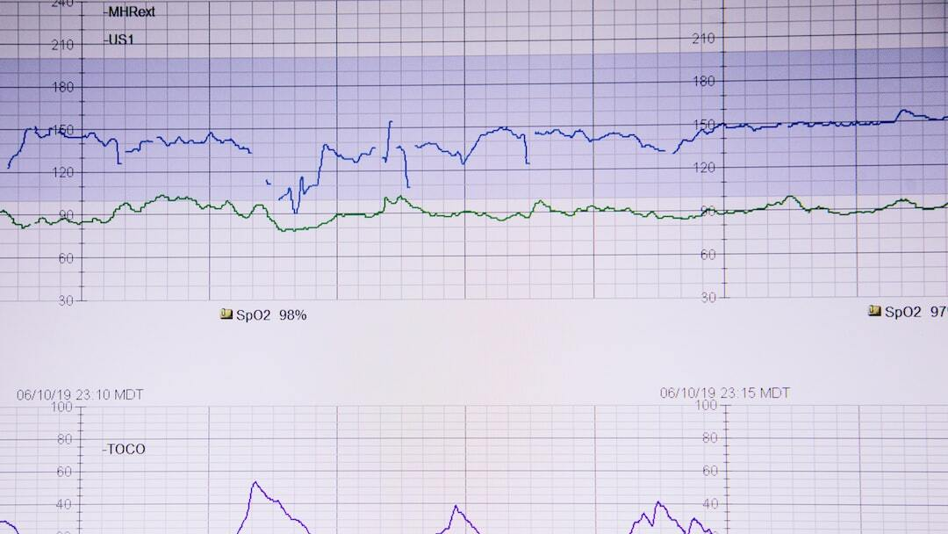
Line Charts
Use Cases: 1. Trend analysis over time 2. Comparison of multiple datasets 3. Displaying continuous data
Creating Line Charts: 1. Import matplotlib.pyplot as plt 2. Create data: `x = [1, 2, 3, 4]`, `y = [10, 20, 25, 30]` 3. Plot data: `plt.plot(x, y)` 4. Show plot: `plt.show()`
Customizing Line Charts: 1. Line styles and colors: `plt.plot(x, y, 'r--')` 2. Adding markers: `plt.plot(x, y, marker='o')` 3. Filling area under the curve: `plt.fill_between(x, y)`

Slide 7
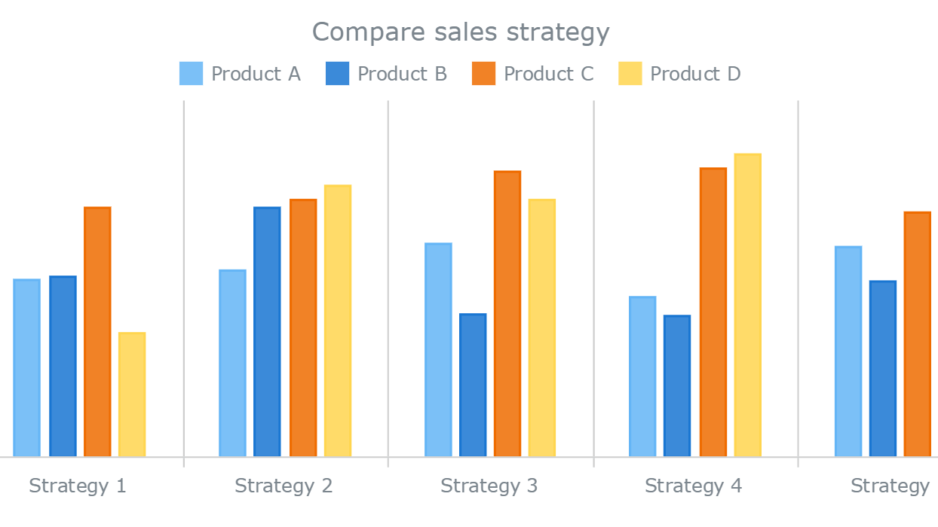
Bar Charts
Use Cases: 1. Comparing categorical data 2. Visualizing frequencies 3. Representing proportions
Creating Bar Charts: 1. Import matplotlib.pyplot as plt 2. Create data: `categories = ['A', 'B', 'C']`, `values = [10, 20, 15]` 3. Plot data: `plt.bar(categories, values)` 4. Show plot: `plt.show()`
Customizing Bar Charts: 1. Bar colors: `plt.bar(categories, values, color='blue')` 2. Adding titles and labels: `plt.title('Bar Chart')`, `plt.xlabel('Category')`, `plt.ylabel('Values')` 3. Horizontal bars: `plt.barh(categories, values)`

Slide 8
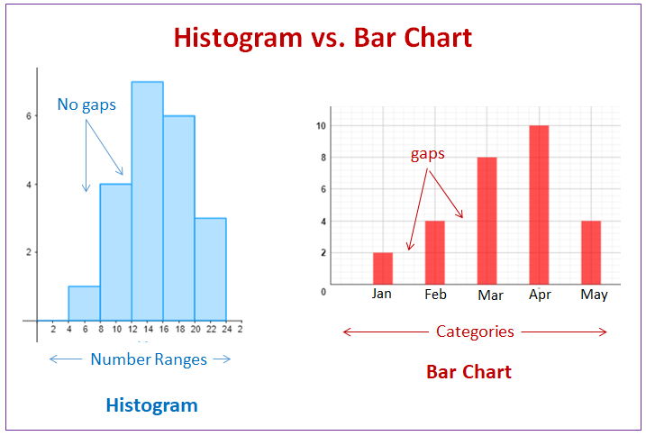
Histograms
Use Cases: 1. Visualizing the distribution of a dataset 2. Showing frequency of data points 3. Identifying patterns and outliers
Creating Histograms: 1. Import matplotlib.pyplot as plt 2. Create data: `data = [1, 2, 2, 3, 3, 3, 4, 4, 4, 4]` 3. Plot histogram: `plt.hist(data, bins=4)` 4. Show plot: `plt.show()`
Customizing Histograms: 1. Number of bins: `plt.hist(data, bins=10)` 2. Color and edge color: `plt.hist(data, bins=4, color='blue', edgecolor='black')` 3. Adding titles and labels: `plt.title('Histogram')`, `plt.xlabel('Data')`, `plt.ylabel('Frequency')`

Slide 9
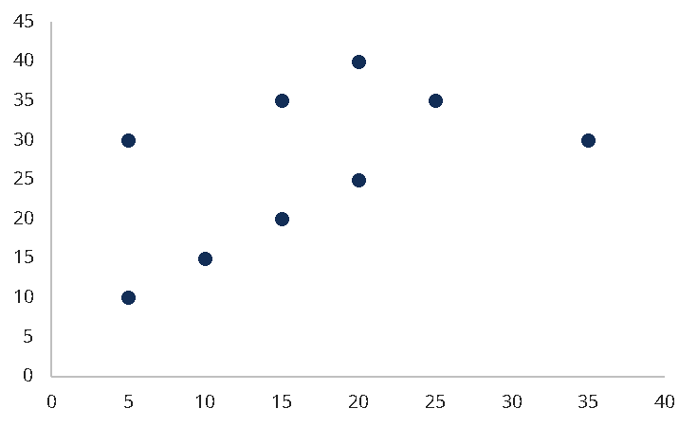
Scatter Plots
Use Cases: 1. Identifying correlations between variables 2. Detecting outliers 3. Visualizing clusters and distributions
Creating Scatter Plots: 1. Import matplotlib.pyplot as plt 2. Create data: `x = [1, 2, 3, 4]`, `y = [10, 20, 25, 30]` 3. Plot data: `plt.scatter(x, y)` 4. Show plot: `plt.show()`
Customizing Scatter Plots: 1. Marker size and color: `plt.scatter(x, y, s=100, c='red')` 2. Adding titles and labels: `plt.title('Scatter Plot')`, `plt.xlabel('X-axis')`, `plt.ylabel('Y-axis')` 3. Adding grid: `plt.grid(True)`

Slide 10
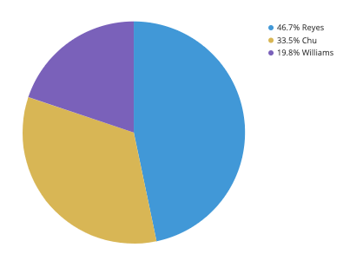
Pie Charts
Use Cases: 1. Showing proportions of a whole 2. Comparing relative sizes of categories 3. Visualizing categorical data
Creating Pie Charts: 1. Import matplotlib.pyplot as plt 2. Create data: `sizes = [15, 30, 45, 10]` 3. Plot data: `plt.pie(sizes)` 4. Show plot: `plt.show()`
Customizing Pie Charts: 1. Adding labels: `plt.pie(sizes, labels=['A', 'B', 'C', 'D'])` 2. Exploding slices: `plt.pie(sizes, explode=(0, 0.1, 0, 0))` 3. Adding a legend: `plt.legend(['A', 'B', 'C', 'D'])`

Slide 11
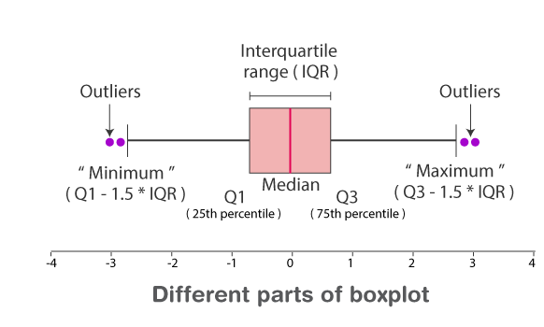
Box Plots
Use Cases: 1. Summarizing the distribution of a dataset 2. Highlighting median, quartiles, and outliers 3. Comparing distributions between groups
Creating Box Plots: 1. Import matplotlib.pyplot as plt 2. Create data: `data = [np.random.normal(size=100), np.random.normal(size=100)]` 3. Plot data: `plt.boxplot(data)` 4. Show plot: `plt.show()`
Customizing Box Plots: 1. Adding labels: `plt.boxplot(data, labels=['Group 1', 'Group 2'])` 2. Customizing whiskers: `plt.boxplot(data, whis=[5, 95])` 3. Adding grid: `plt.grid(True)`

Slide 12

Advanced Plotting Techniques
Subplots: 1. Creating multiple plots in one figure 2. Using `plt.subplot()` to specify layout 3. Example: `plt.subplot(2, 1, 1)` and `plt.subplot(2, 1, 2)`
Logarithmic Scale: 1. Applying log scale to axes 2. Using `plt.xscale('log')` and `plt.yscale('log')` 3. Example: `plt.plot(x, y)` with log scale
Annotations: 1. Adding text and arrows to plots 2. Using `plt.annotate()` for custom annotations 3. Example: `plt.annotate('Point', xy=(x, y), xytext=(x+1, y+1), arrowprops=dict(facecolor='black', shrink=0.05))`

Slide 13
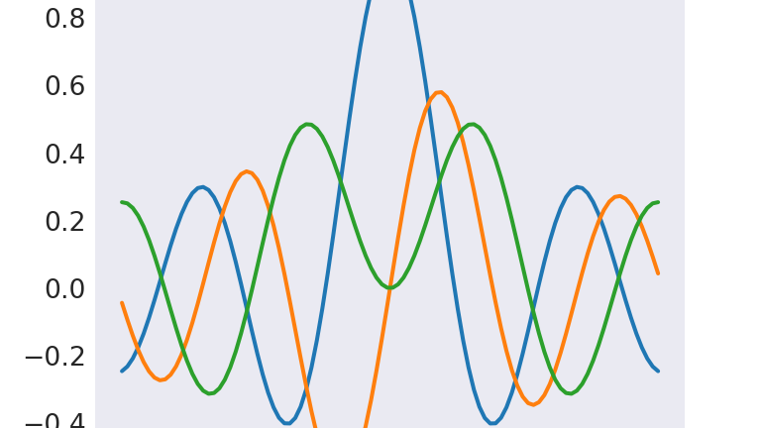
Styling Plots
Customizing Colors and Markers: 1. Changing line colors: `plt.plot(x, y, color='red')` 2. Customizing markers: `plt.plot(x, y, marker='o')` 3. Using hex color codes: `plt.plot(x, y, color='#FF5733')`
Using Styles and Themes: 1. Applying built-in styles: `plt.style.use('ggplot')` 2. Viewing available styles: `print(plt.style.available)` 3. Creating custom styles: Define style dictionary and use `plt.style.use()`
Adding Grid and Legends: 1. Adding grid: `plt.grid(True)` 2. Customizing grid lines: `plt.grid(color='gray', linestyle='--', linewidth=0.5)` 3. Adding legends: `plt.legend(['Line 1', 'Line 2'])`

Slide 14
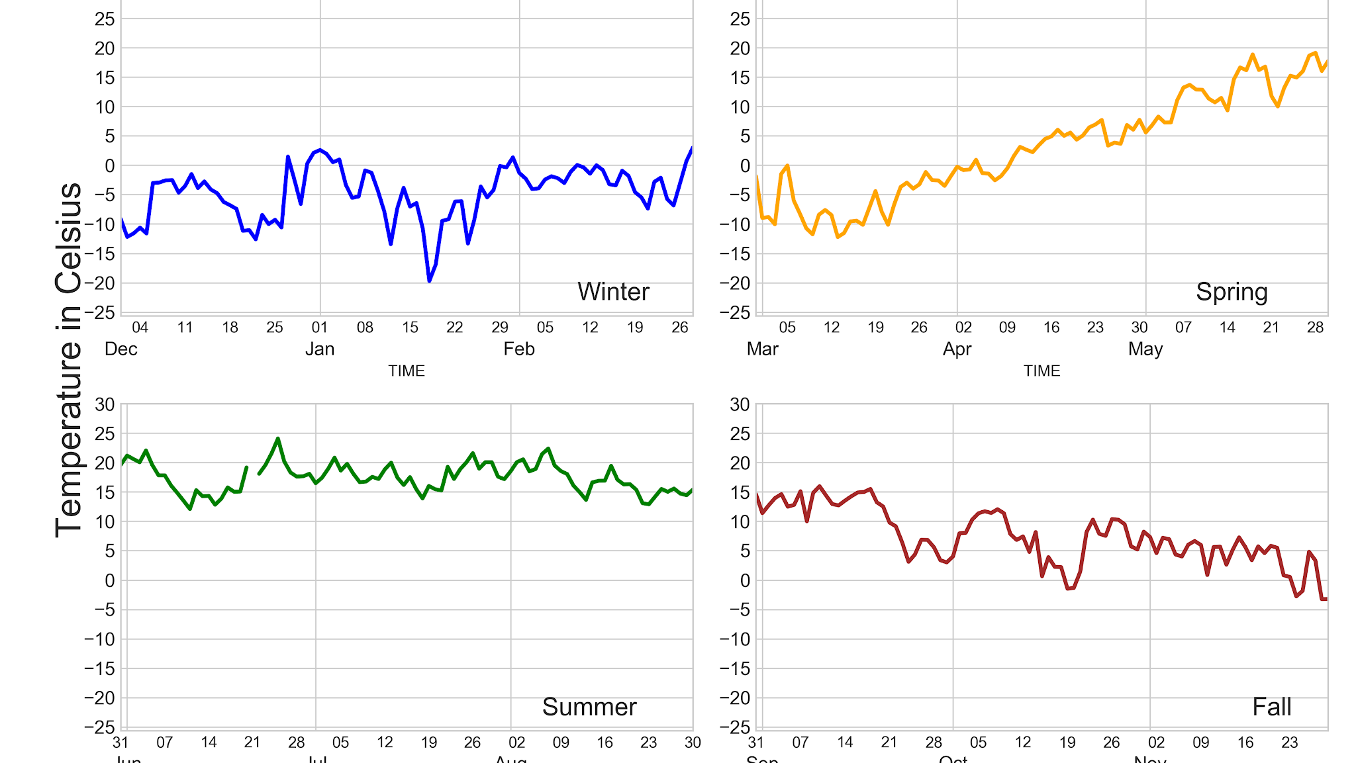
Plotting with Pandas
Integrating with Pandas DataFrames: 1. Using Matplotlib with Pandas for easy plotting 2. Creating plots directly from DataFrames 3. Example: `df.plot()` to generate plots from DataFrame `df`
Plotting Data Directly from DataFrames: 1. Line plot: `df.plot.line()` 2. Bar plot: `df.plot.bar()` 3. Histogram: `df.plot.hist()`
Example Code Snippets: 1. `import pandas as pd` 2. `import matplotlib.pyplot as plt` 3. `df = pd.DataFrame({'x': range(1, 10), 'y': range(10, 1, -1)})` 4. `df.plot(x='x', y='y')` 5. `plt.show()`

Slide 15

3D Plotting
Introduction to 3D Plotting: 1. Matplotlib supports 3D plotting through `mpl_toolkits.mplot3d` 2. Useful for visualizing complex datasets 3. Example: 3D scatter plots, surface plots
Creating 3D Plots: 1. Import necessary modules: `from mpl_toolkits.mplot3d import Axes3D` 2. Create a figure and add 3D axes: `fig = plt.figure()`, `ax = fig.add_subplot(111, projection='3d')` 3. Plot data: `ax.scatter(x, y, z)`
Customizing 3D Plots: 1. Setting labels: `ax.set_xlabel('X Label')`, `ax.set_ylabel('Y Label')`, `ax.set_zlabel('Z Label')` 2. Changing view angle: `ax.view_init(elev=20, azim=30)` 3. Adding color maps: `ax.plot_surface(X, Y, Z, cmap='viridis')`

Slide 16
Interactive Plots
Introduction to Interactive Plots: 1. Enhancing user experience with interactive elements 2. Tools like mpld3, Plotly, and Bokeh for interactivity 3. Embedding interactive plots in web applications
Creating Interactive Plots: 1. Using mpld3: `import mpld3` 2. Converting Matplotlib plots to interactive: `mpld3.show()` 3. Example: `mpld3.save_html(fig, 'interactive_plot.html')`
Using mpld3 and Other Tools: 1. mpld3 for integrating with Matplotlib 2. Plotly for advanced interactive visualizations 3. Bokeh for web-based interactive plots

Slide 17

Saving and Exporting Plots
Different File Formats: 1. Supported formats: PNG, PDF, SVG, EPS 2. Choosing the right format based on use case 3. Example: PNG for images, PDF for documents
Saving Plots: 1. Using `plt.savefig('filename.png')` 2. Customizing output: `plt.savefig('filename.png', dpi=300, bbox_inches='tight')` 3. Example code snippet for saving a plot
Exporting High-Resolution Images: 1. Ensuring high resolution for publications 2. Setting DPI (dots per inch): `plt.savefig('filename.png', dpi=300)` 3. Example: `plt.savefig('high_res_plot.png', dpi=300)`

Slide 18
Common Pitfalls and Troubleshooting
Common Issues: 1. Overlapping plots 2. Incorrect labels and titles 3. Poor plot readability
Debugging Tips: 1. Check data ranges and scales 2. Verify correct usage of functions 3. Use `plt.show()` to preview plots during development
Best Practices: 1. Keep plots simple and clear 2. Use appropriate plot types for data 3. Consistently label and title plots

Slide 19
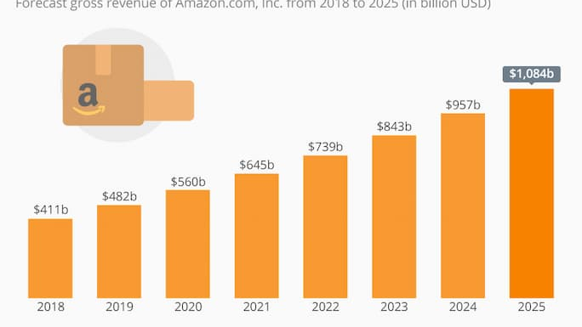
Real-World Examples
Example 1: Data Analysis: 1. Visualizing sales data over time 2. Identifying trends and outliers 3. Tools: Line charts, bar charts
Example 2: Financial Data Visualization: 1. Comparing stock performance 2. Visualizing financial metrics 3. Tools: Candlestick charts, histograms
Example 3: Scientific Research: 1. Analyzing experimental data 2. Visualizing distributions and correlations 3. Tools: Scatter plots, box plots

