Slide 1
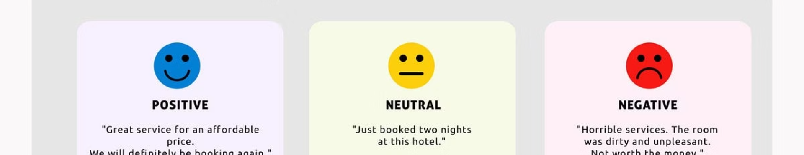
Twitter Sentiment Analysis
This presentation provides a comprehensive overview of our project focused on leveraging transformer models for sentiment analysis on Twitter data. Sentiment analysis is crucial for social media monitoring, offering valuable insights into public opinion. We will delve into each phase of the project, from data preparation to model deployment, showcasing our methodology and outcomes. We will also be acknowledging the individual contributions of each team member who made this project a success. Let's dive in!

Slide 2
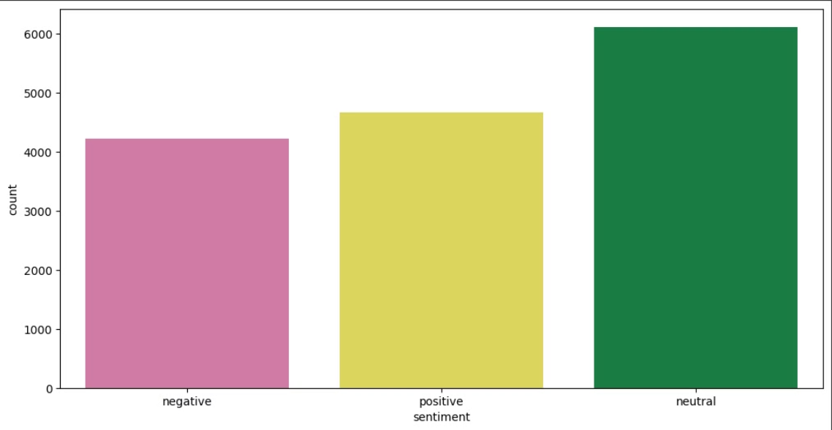
Project Objective & Data Preparation
The primary objective is to accurately perform sentiment analysis on Twitter data using a BERT-based transformer model. For this, we utilized a dataset comprising 15,000 tweets, with columns including TEXT, SELECTED_TEXT, and SENTIMENT. The process began with rigorous data preparation steps to ensure the quality and suitability of the data for model training.
Data cleaning involved several transformations: lowercasing all text, removing punctuation, and eliminating stop words. Exploratory data analysis was conducted to understand sentiment distribution and identify common words. Finally, the data was split into training and testing sets using an 80/20 split with stratification to maintain representative proportions of each sentiment class.

Slide 3
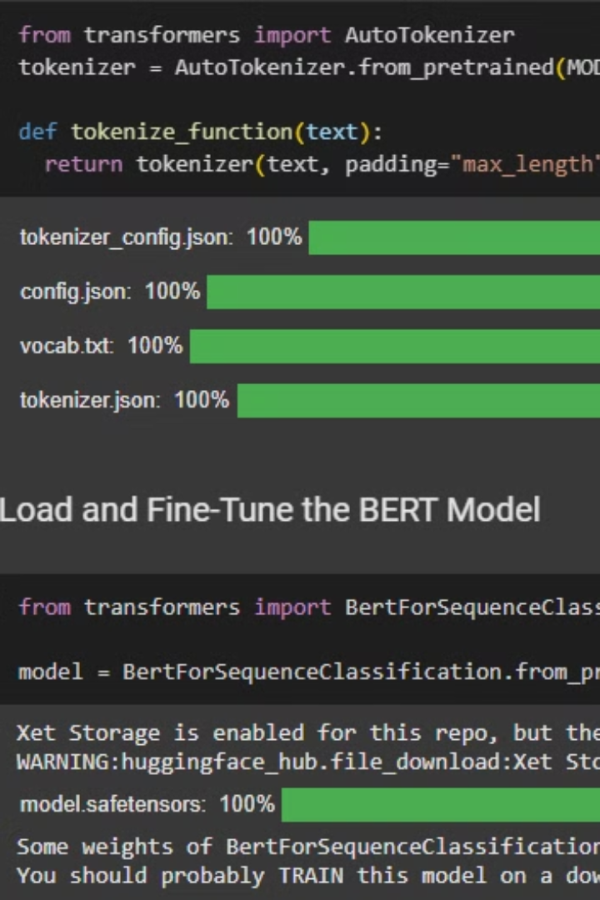
Model Selection and Setup
We began by installing essential libraries such as Hugging Face Transformers and PyTorch. Several models were considered before selecting 'bert-base-uncased' for its pre-trained capabilities and suitability for our task. This choice was motivated by the model's ability to understand context in text effectively.
The next step was initializing the tokenizer and configuring the model for three-class classification: positive, negative, and neutral. This involved adjusting the model's architecture to align with the specific requirements of our sentiment analysis task. Attention to detail was given to ensure seamless integration and optimal performance.

Slide 4
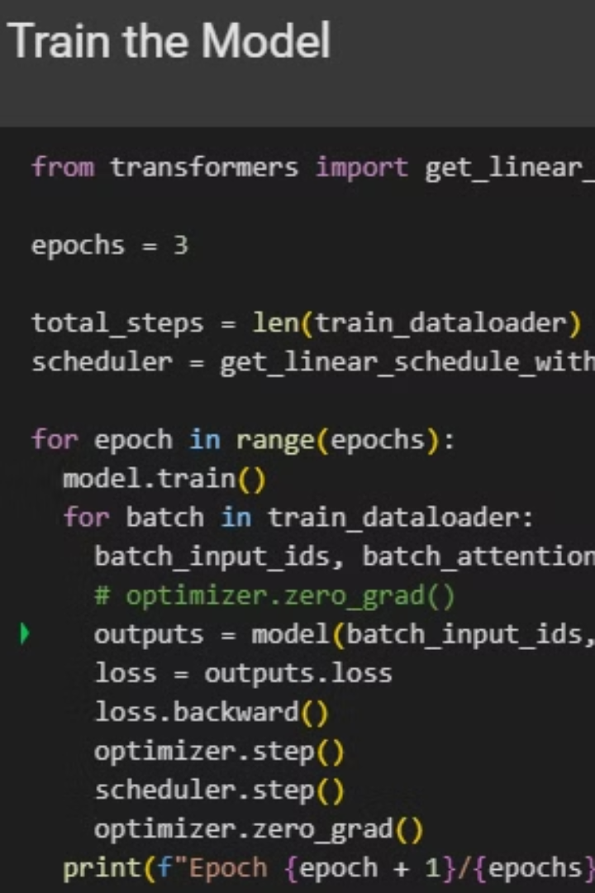
Model Training
The model training phase was crucial for achieving high accuracy in sentiment prediction. It involved a carefully designed training loop that included preparing the data for training, batch processing to efficiently manage memory, and learning rate scheduling to optimize convergence. We trained the model over three epochs to allow it to learn the nuances of the sentiment in the Twitter data.

Slide 5

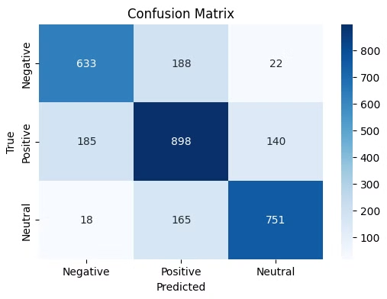
Model Evaluation Metrics
To assess the model's performance, we employed a combination of simple and comprehensive evaluation metrics. Accuracy provided a basic measure of correctness, while the weighted F1 score offered a more nuanced view by considering precision and recall across all sentiment classes. To gain deeper insights, we visualized the results using a confusion matrix, which displayed the model's classification errors.
The emphasis on effective performance assessment allowed us to fine-tune the model and ensure its reliability. These metrics provided valuable feedback, enabling us to make informed decisions and enhance the model's predictive capabilities. We consider model evaluation to be a major success of the project and we were very satisfied with our assessment.

Slide 6
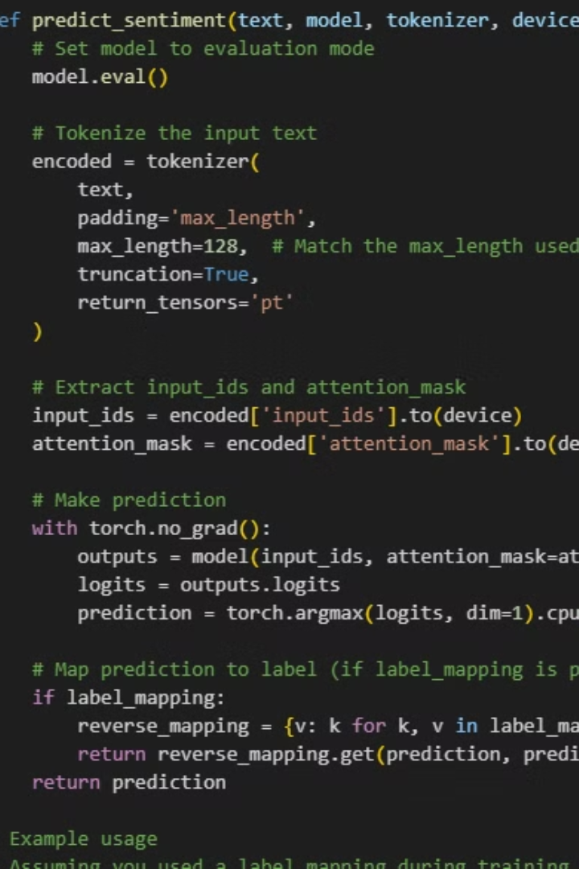
Inference and Model Persistence
The inference function played a key role in making real-time sentiment predictions. This function tokenizes the input text and maps the model's predictions to meaningful sentiment labels. It allows us to take new, unseen tweets and quickly determine their sentiment.
For future use, we implemented a model persistence approach. This involved saving both the model and tokenizer in a way that enables easy reloading and reuse. This ensures that our work can be reproduced and built upon without retraining from scratch. Saving models is essential to the field.

Slide 7

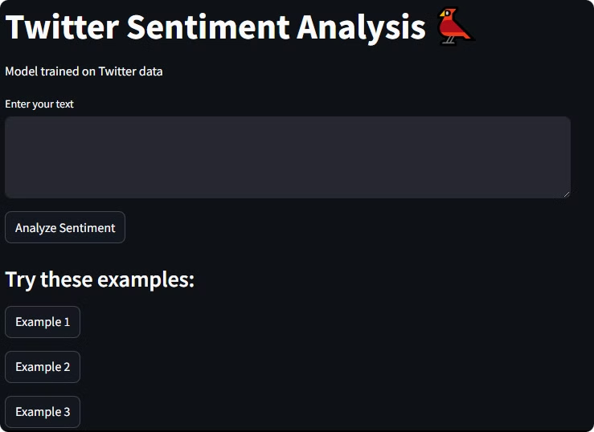
Model Deployment via Streamlit & Gradio
Our model was deployed using Streamlit and Gradio to create interactive interfaces for real-time sentiment prediction. These platforms allow users to input text and instantly see the model's sentiment analysis results. This hands-on approach ensures that stakeholders can easily interact with the model and understand its capabilities. These intuitive apps make the model more accessible to a wider audience.

Slide 8

Summary and Acknowledgement
In summary, this project successfully implemented a transformer-based sentiment analysis system for Twitter data. The key achievements included high-accuracy sentiment prediction, the creation of interactive deployment applications, and the development of a robust model training and evaluation pipeline. This project has significant potential applications in social media sentiment monitoring and analysis.
Finally, we would like to acknowledge the contributions of the team members:
Ibrahim Abdelsattar(Team Leader)
Amr Belal
Nour Mostafa
Moaz Ramadan
Noran Alaa.
Each member played a crucial role in the success of this project. Their dedication, expertise, and collaborative efforts were essential to achieving our goals. Well done team!

Slide 9
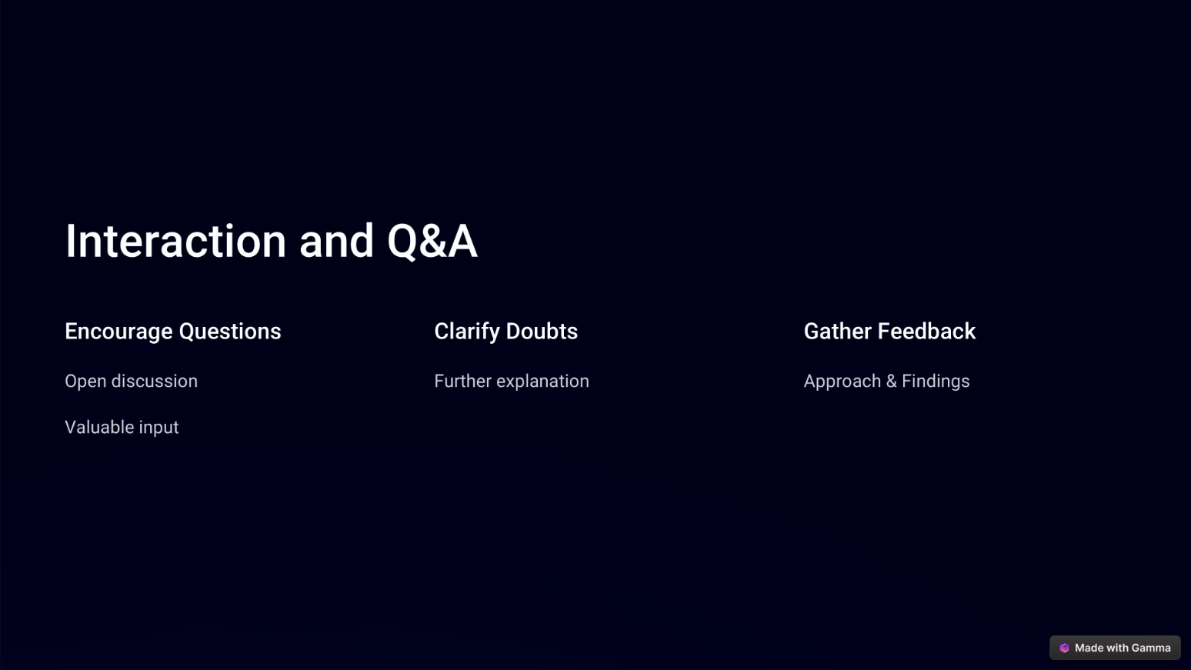

Slide 10


