Slide 1
Diodes
Fundamental Semiconductor Device for Current Control

Slide 2
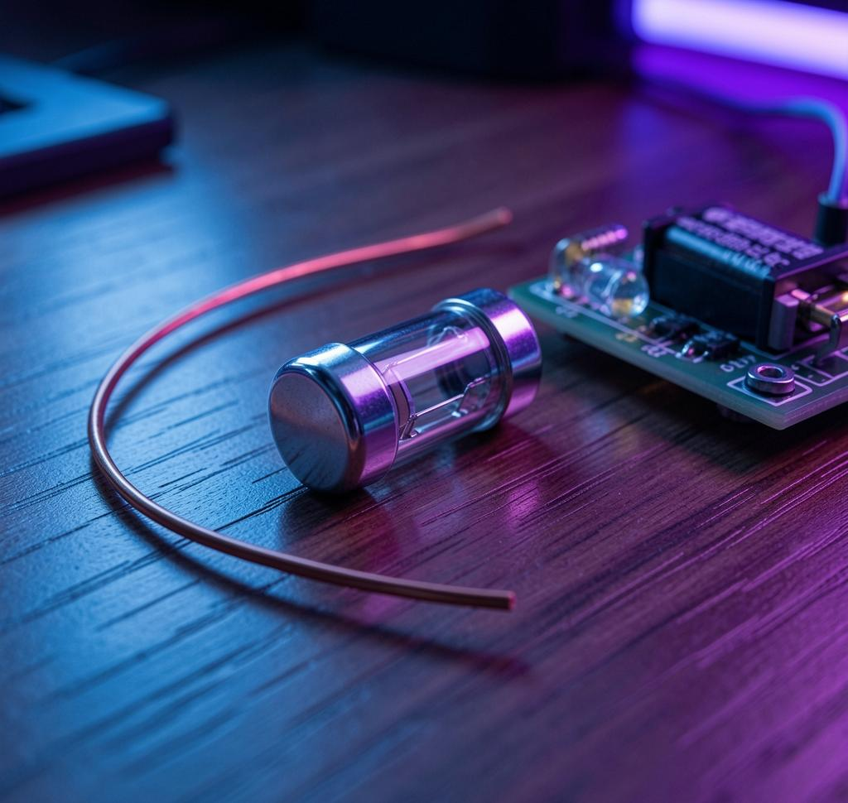
Introduction
Diodes are two‑terminal semiconductor devices allowing current primarily in one direction. They enable *rectification*, *signal control*, and protection in circuits.
Speaker notes: Briefly state diode role in electronics, highlight practical relevance in power supplies and signal processing, and preview topics: structure, V‑I behavior, types, and applications.

Slide 3
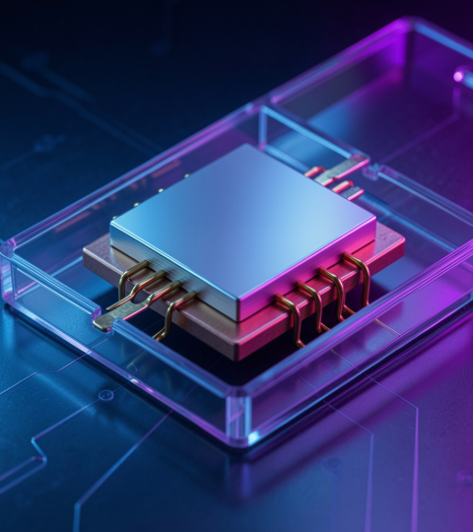
02
Diode Fundamentals

Slide 4
Definition & Importance
Definition: A diode is a PN junction device permitting asymmetric current flow.
Importance: Enables rectification, voltage regulation, switching, and protection in electronic systems.
Speaker notes: Emphasize the PN junction concept, practical functions (rectifiers, clamping, LEDs), and why diodes are foundational in circuit design.

Slide 5
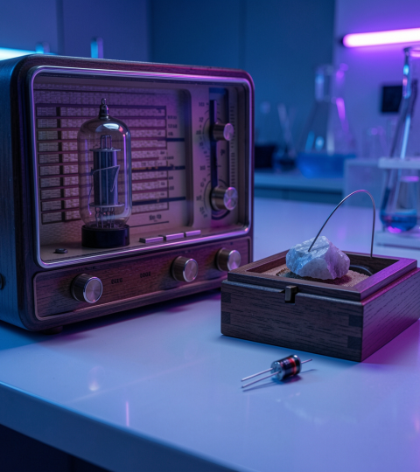
History & Development
Early: Vacuum tube and cat's‑whisker detectors preceded modern diodes.
Semiconductor era: Development of silicon and germanium PN diodes led to compact, reliable devices and mass adoption in electronics.
Speaker notes: Outline timeline from early detectors to semiconductor diodes, mention key advancements (material shift to silicon) and impact on miniaturization and efficiency.

Slide 6
PN Junction Structure
P-type and N-type semiconductors form a PN junction with a depletion region where mobile carriers recombine. Built-in potential prevents charge flow at equilibrium.
Include PN junction diagram and diode symbol.
Speaker notes: Explain doping, carrier diffusion, and formation of the depletion region; point to diagram to show charge distribution and electric field.

Slide 7
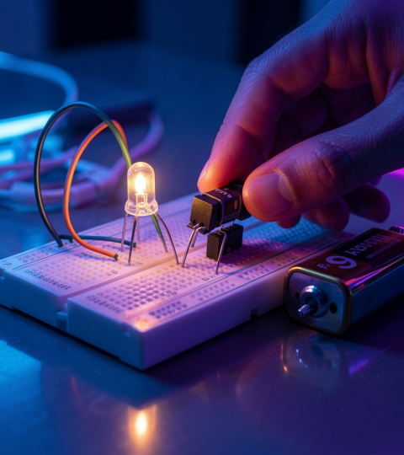
02
Diode Behavior & Uses

Slide 8
V-I Characteristics
Diode shows exponential forward I–V; small forward voltage drop (≈0.7V Si). In reverse, current is negligible until breakdown (Zener/avalanche).
Include V–I characteristic graph.
Speaker notes: Describe forward conduction region, knee voltage, reverse saturation, and breakdown mechanisms; reference graph for operating regions.

Slide 9
Diode Types & Circuits
Rectifier, Zener, LED, Schottky, photodiode — each varies in junction, Vf, speed, and breakdown behavior. Common circuits: half‑wave, full‑wave, bridge rectifiers.
Include diode symbols for each type.
Speaker notes: Compare properties and typical uses; show schematic snippets of rectifier circuits and note performance trade-offs.

Slide 10
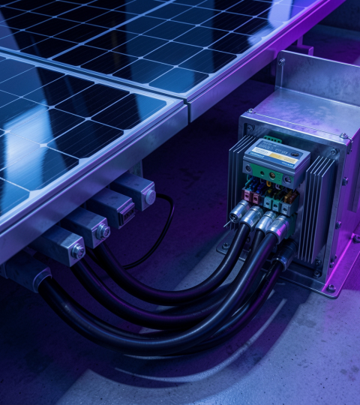
Applications & Modern Importance
Diodes enable rectification, voltage regulation, signal clipping, protection, and light emission across power supplies, communications, and renewable systems.
Highlight role in efficient power conversion and protection.
Speaker notes: Emphasize practical impact in modern electronics: SMPS, RF front-ends, solar inverters, and consumer devices; mention trends like wide‑bandgap materials.

Slide 11
Conclusions
Diodes are fundamental PN‑junction devices controlling current direction, enabling rectification, regulation, switching, and optoelectronic functions. Their varied types meet diverse circuit needs; understanding V–I behavior and junction structure is essential for reliable design.
Speaker notes: Summarize key takeaways, stress practical considerations (Vf, breakdown, speed), and suggest further study: diode modeling and circuit simulation.

Slide 12
Thanks!
Do you have any questions?
youremail@freepik.com
+34 654 321 432
yourwebsite.com
Please keep this slide for attribution

