Slide 1
Title : Animal Health Prediction Using Artificial Intelligence
Presented by
Ibrahim Bagwan 1RV24AI404
Mohith V 1RV23AI057
Mohit M 1RV23AI056
Pratamesh 1RV23AI134

Slide 2
Introduction
Animal health is critical for both economy and ecosystem. Traditional methods of checking animal health can be slow and inaccurate. Our solution: an AI-based web tool that detects dangerous health conditions using symptoms.
Project Overview
This project uses AI to predict whether an animal’s health condition is dangerous, based on symptoms. A web interface allows users to input symptoms and get quick predictions. Goal: Help animal caretakers take fast, informed actions without needing expert intervention.

Slide 3
Methodology
Preprocessing: OneHotEncoding of symptoms.
Model: Random Forest Classifier trained on labeled data.
Deployment: Streamlit-based web app where users input symptoms for prediction.

Slide 4
Objectives of the Project
The main goals of our project are:
Create an AI model to predict animal health danger level.
Design an easy-to-use Streamlit interface.
Ensure predictions are fast and accurate.
Promote biosafety through early disease detection.
Help caretakers respond promptly and prevent fatalities.

Slide 5
Our Planned Approach
Phase-wise Plan:
Data Collection: Use CSV dataset with symptoms and labels.
Model Training: Use Random Forest for binary classification.
Interface Design: Streamlit-based frontend.
Testing: Evaluate accuracy using test data.
Deployment: Make the web app publicly accessible.

Slide 6
Real-World Impact
Reduces dependency on vets for basic diagnosis.
Supports biosafety via early warnings.
Prevents severe health outcomes.
Useful tool for animal shelters, farms, and pet owners.

Slide 7
Expected Outcomes
Once the project is complete, we expect:
A fully functional AI-powered health checker for animals.
Users input symptoms and instantly see risk status.
Can be expanded to more conditions, add treatment suggestions and support more species.

Slide 8
Conclusion and Next Steps
In Phase 1, we explored the idea and planned our project in detail. In the upcoming phase, we will:
Train the AI model
Build and test Streamlit interface
Launch for public testing and feedback
Application of AI in real-world animal health and biosafety!

Slide 9
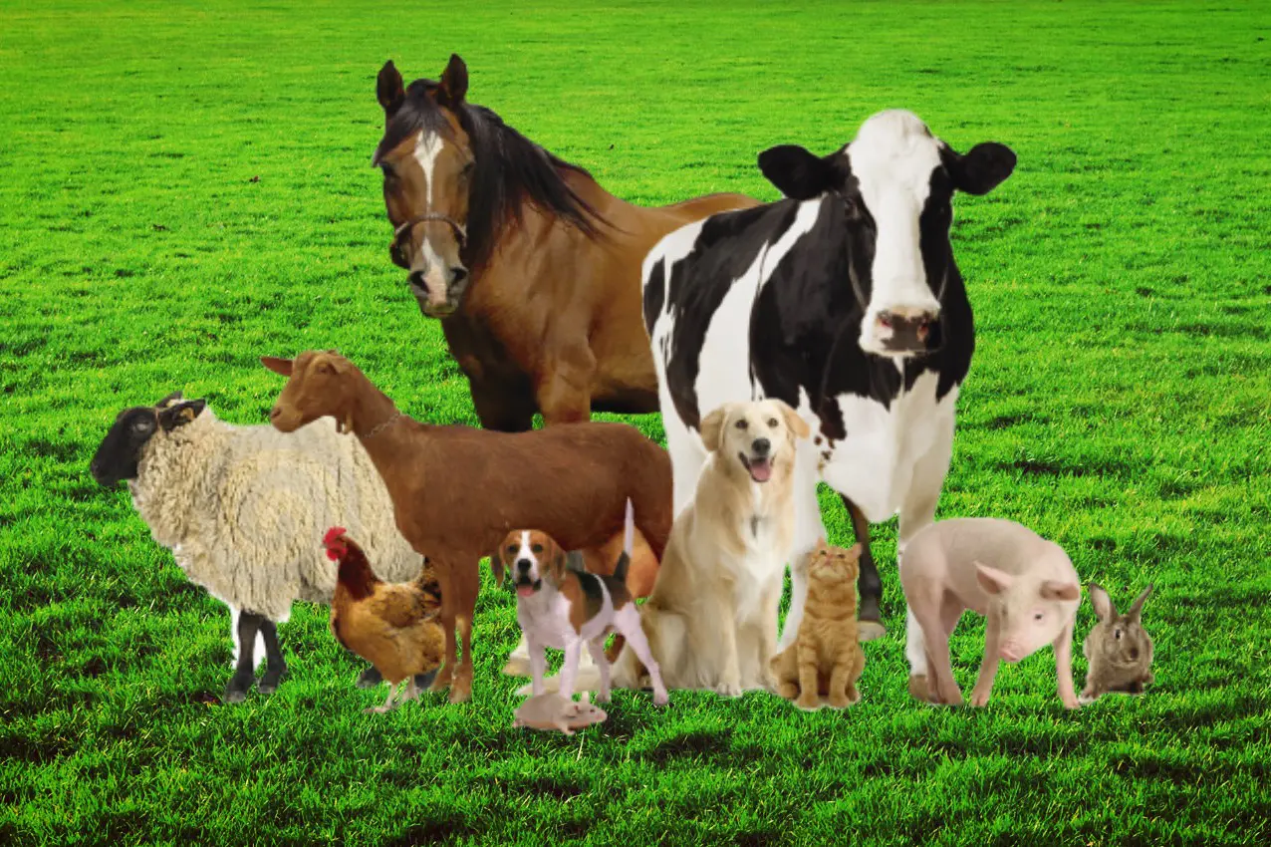
THANK YOU

