Slide 1
RATE TICKER
Team Members
Ibrahim Balsania
Sagar Dhumal

Slide 2
INTRODUCTION
An app which streams live rates location wise.
Chat facility provided to share suggestions and assumptions.
Users can opt for chatting if they want to do so.

Slide 3
TECHNOLOGIES
NodeJS
Websocket
Redis
PubSub

Slide 4
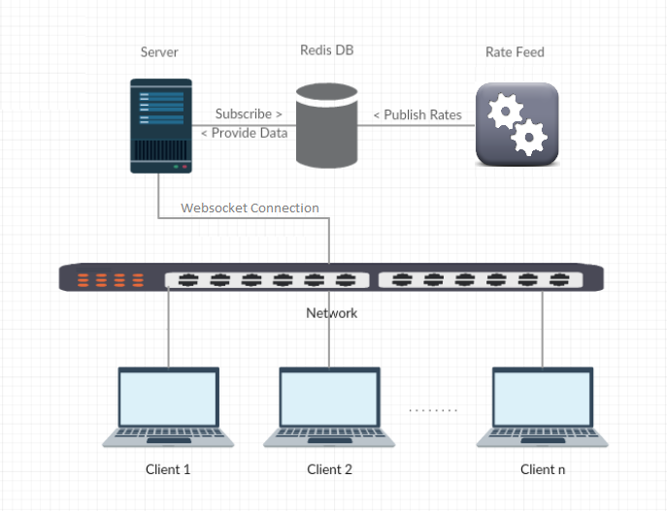
RATE FEED ARCHITECTURE

Slide 5
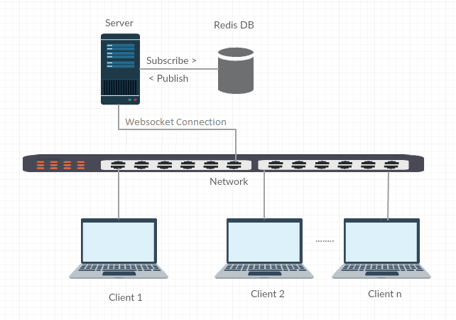
CHAT ARCHITECTURE

Slide 6
TESTING & EXCEPTION HANDLING
General exception handling
Redis server failure
Streaming to active connections

Slide 7
REPLICABILITY
Product
mercury
Where
Rate Streaming
Why
to Improve Performance
To avoid browser cache overflow

Slide 8
REPLICABILITY
Product
mercury
Where
chat facility in deal negotiation
Why
To avoid polling
To Improve Performance

Slide 9
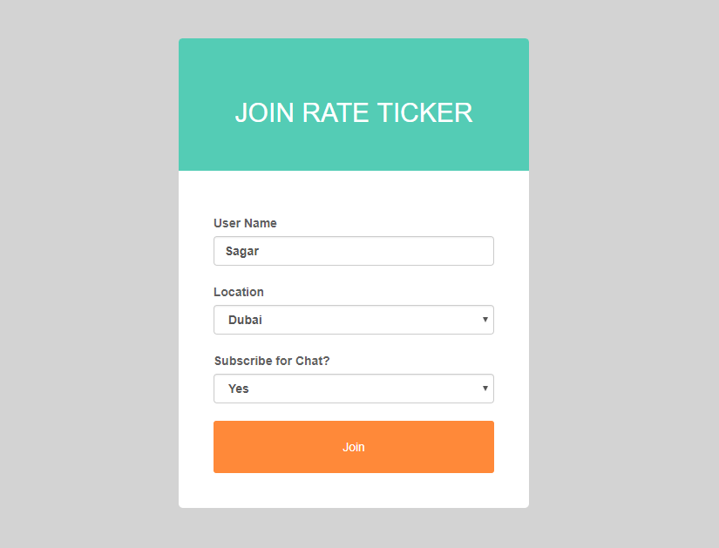
LOGIN SCREEN

Slide 10
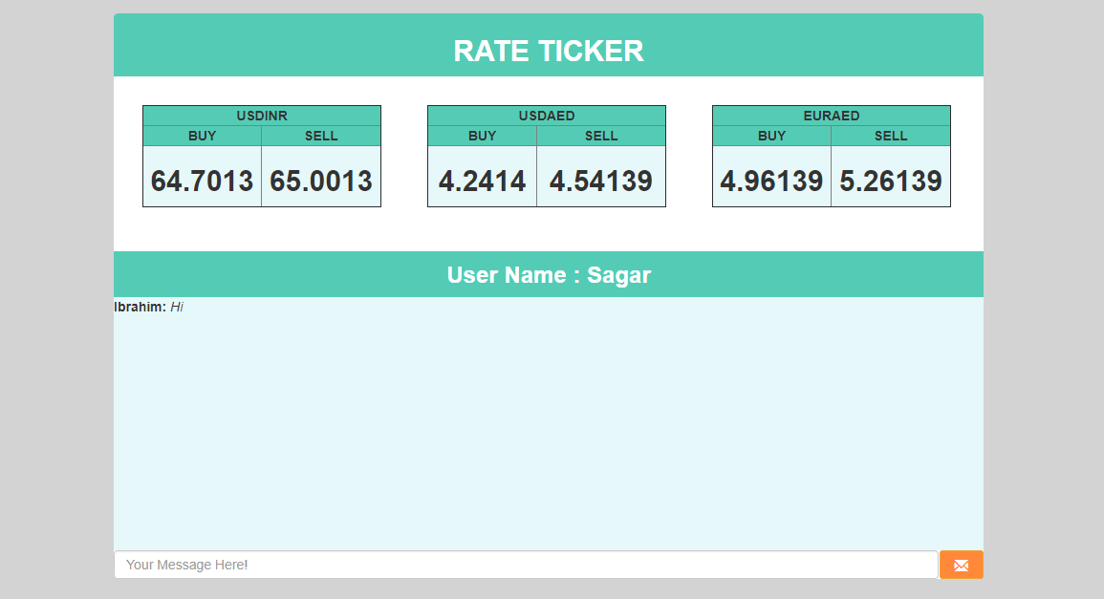
HOME SCREEN

Slide 11
DEMO

Slide 12
THANK YOU

