Slide 1
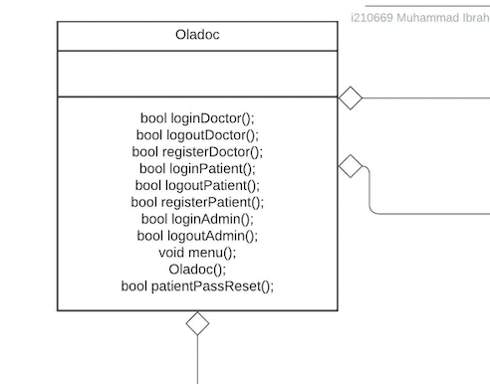
The main class oladoc links to the sub user classes like doctor patient and admin. And provides the main menu as well as the login/register functions for all users. This class has an aggregation relationship with Admin, patient, and doctors.

Slide 2
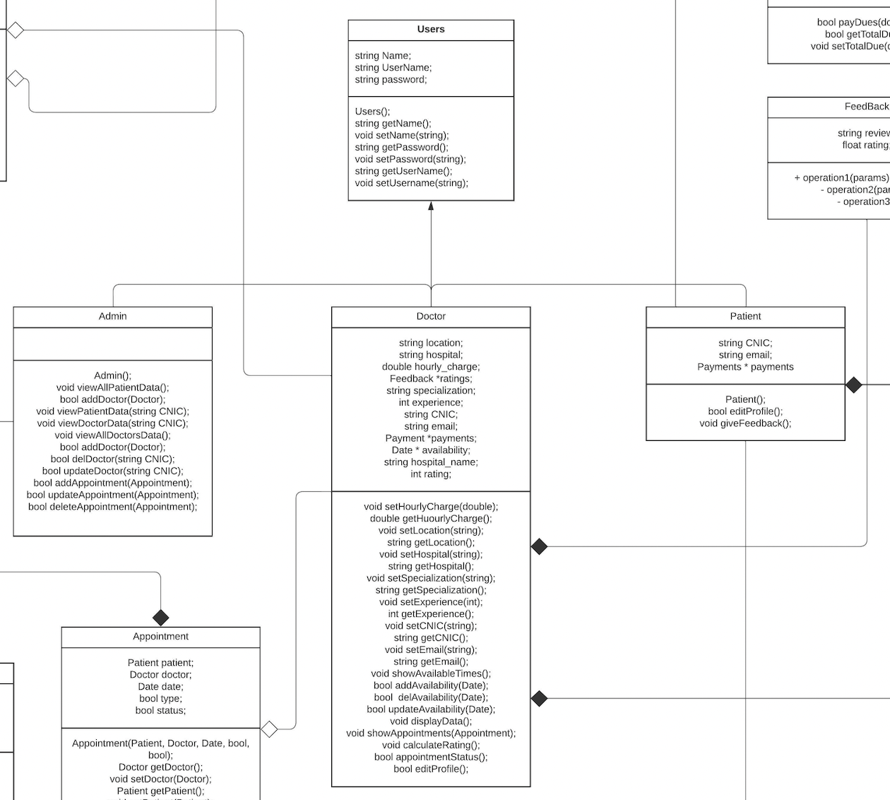
The doctor, patient and admin classes inherit from the base user class and polymorph into their own functionality.

Slide 3
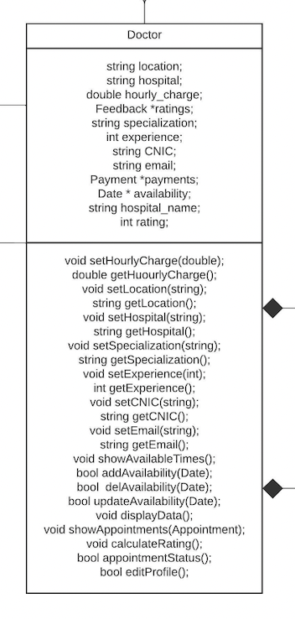
The doctor class composes of other classes such as Payments, and feedbacks. Aside from this, this class provides functions for the doctor to modify their or the patien’s details.

Slide 4
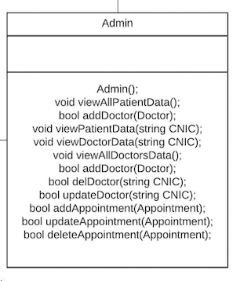
The admin class has full authority and can access data from both the doctor and patient classes.

Slide 5
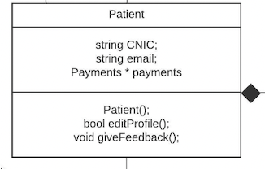
The patient class composes of the Payments class with functions to edit their info or provide feedback to a certain doctor.

Slide 6
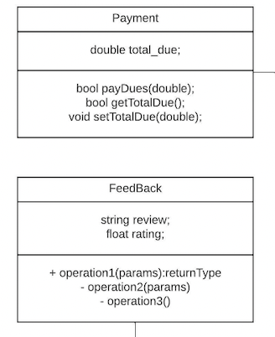
The Payment and feedback classes represent left over payments by the patients and the rating a certain user has given a doctor respectively

Slide 7
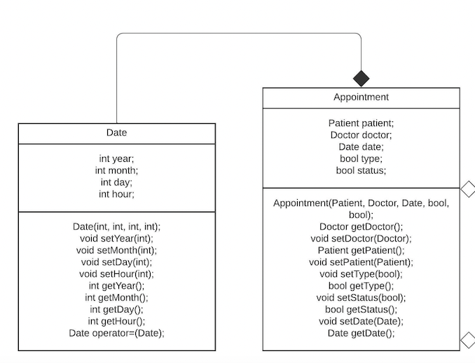
The date class is a helper class to track date and time of appointments easily
The appointment class composes of the date class and also aggregates a relationship with the doctor and patient classes.

