Slide 1
بسم الله الرحمن الرحيم
Microprocessor
Prepared by : DR. Ala Eldin Abdallah Awouda.
Lecture No 1

Slide 2
Reference Book:
The 8088 and 8086 Microprocessors, Walter A. Triebel and Avtar Singh, Fourth Edition.
Microprocessors and Interfacing Programming and Hardware, Douglas V. Hall, Second Edition
10/24/20
Lecture No 1

Slide 3
Contents:
Introduction.
What is Computer ?.
What is Microprocessor ?.
What is CPU ?.
Operation Types in a Microprocessor.
Microprocessor interfacing.
The Intel 8086 Microprocessor.
10/24/20
Lecture No 1

Slide 4
Why??
A Microprocessor is great at solving problems, but if it can’t communicate with the outside world, it is of little worth.
A Microcomputer performs a task by reading and executing the set of instructions written in its memory. This set of instructions, written in a sequence, is called a program.
Each instruction in the program is a command, in binary, to the microprocessor to perform an operation.
Assembly language is low level language.
10/24/20
Lecture No 1

Slide 5
1-1 Introduction
The Microprocessor is something like the heart of a computer.
The microprocessor world become more complicated.
The item processor was solely used for the central processing unit (CPU) of the von-Neuman-model.
The microprocessor can be programmed to perform functions on given data by writing specific instructions into its memory.
The microprocessor reads one instruction at a time, matches it with its instruction set, and performs the data manipulation specified. The result is either stored back into memory or displayed on an output device.
10/24/20
Lecture No 1

Slide 6
1-2 What is Computer ???
Data Processing
Computer
Data Storage
10/24/20
Lecture No 1

Slide 7
Major Components of a Computer
MEMORY
I/O
SYSTEM BUS
Computer
CPU
10/24/20
Lecture No 1

Slide 8
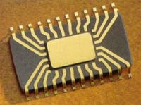
1-3 What is Microprocessor ?
CPU
10/24/20
Lecture No 1

Slide 9
1-4 What is CPU ?
Control Unit & Instruction Decoder
Arithmetic/Logic Unit
Registers
10/24/20
Lecture No 1

Slide 10
To synchronize and control the
overall operation of the μP system
Control Unit & Instruction Decoder
Arithmetic/Logic Unit
To decode instruction and
pass the necessary control signals to CU
Registers
10/24/20
Lecture No 1

Slide 11
    To perform the arithmetic and
    logical operations within the CPU
Control Unit & Instruction Decoder
Arithmetic/Logic Unit
Registers
To perform shift and rotate
operations that may either be
arithmetic or logical in nature
10/24/20
Lecture No 1

Slide 12
Control and Status Registers
User-Variable Registers
Control Unit & Instruction Decoder
A set of internal storage
locations within the CPU
Arithmetic/Logic Unit
Registers
10/24/20
Lecture No 1

Slide 13
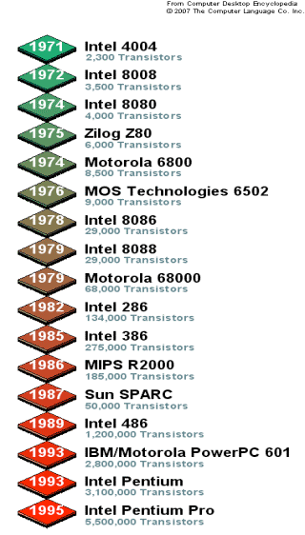
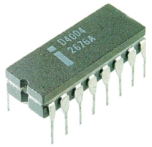
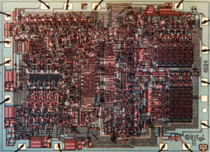
Past Microprocessors ...
1971: Intel 4004 - The first microprocessor on the market
10/24/20
Lecture No 1

Slide 14
1-5 Operation Types in a Microprocessor
All of the operations of the microprocessor can be classified into one of three:
    Microprocessor Initiated Operations.
    Internal Operations.
    Peripheral Initiated Operations.
10/24/20
Lecture No 1

Slide 15
Microprocessor Initiated Operations
These are operations that the microprocessor itself starts.
These are usually one of four operations:
  Memory Read.
  Memory Write.
  I/O Write(Send data to an output device).
  I/O Read (Get data from an input device).
It is important to note that the microprocessor treats memory and I/O devices the same way.
10/24/20
Lecture No 1

Slide 16
Microprocessor Internal Operations
The microprocessor can perform a number of internal operations such as:
  Storing Data.
  Logic Operations.
  Testing for Condition.
  Arithmetic Operations.
10/24/20
Lecture No 1

Slide 17
1-6 Microprocessor interfacing
A microprocessor communicates with other devices using some of its pins.
Processor’s software reads and writes a port just like a register. Processor has one or more N-bit ports.
Processor has address, data and control ports that form a single bus.
Communication protocol is built into the processor.
A single instruction carries out the read or write protocol on the bus.
10/24/20
Lecture No 1

Slide 18
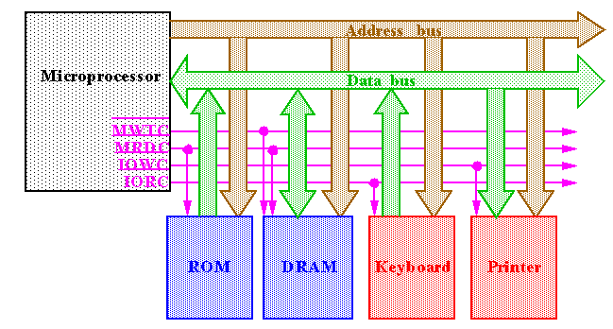
10/24/20
Lecture No 1

Slide 19
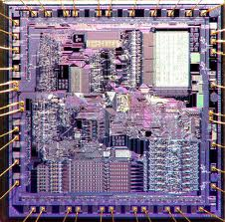
1-7 The Intel 8086 Microprocessor
10/24/20
Lecture No 1

Slide 20
1-8 Components of Intel 8086 Architecture
The components of Intel 8086 microprocessor are:
Buses.
Memory.
Registers.
I/O Units.
Control Unit (CU).
Arithmetic Logic Unit (ALU).
10/24/20
Lecture No 1

Slide 21
1-9 Von Neumann Architecture
Early computer programs were hard wired. To reprogram a computer mean to change the hardware switches manually, that took a long time with potential errors. The computer memory was only used for storing data.
Dr John von Neumann suggested in 1946 that data and programs should be stored together in memory, it is now called Von Neumann architecture.
The von Neumann processor has been the foundation of computing from the start. In it the programs are fetched from memory for executions by a central unit that is what we call the CPU. Basically programs and data are represented on memory in the same way. The program is just data coded for special meaning.
10/24/20
Lecture No 1

Slide 22
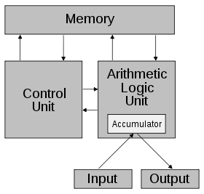
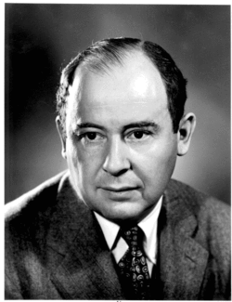
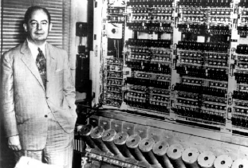
Cont …
A computer design model that uses a processing unit and a single separate storage structure to hold both instructions and data.
• Named after mathematician and early computer scientist John von Neumann.
10/24/20
Lecture No 1

Slide 23
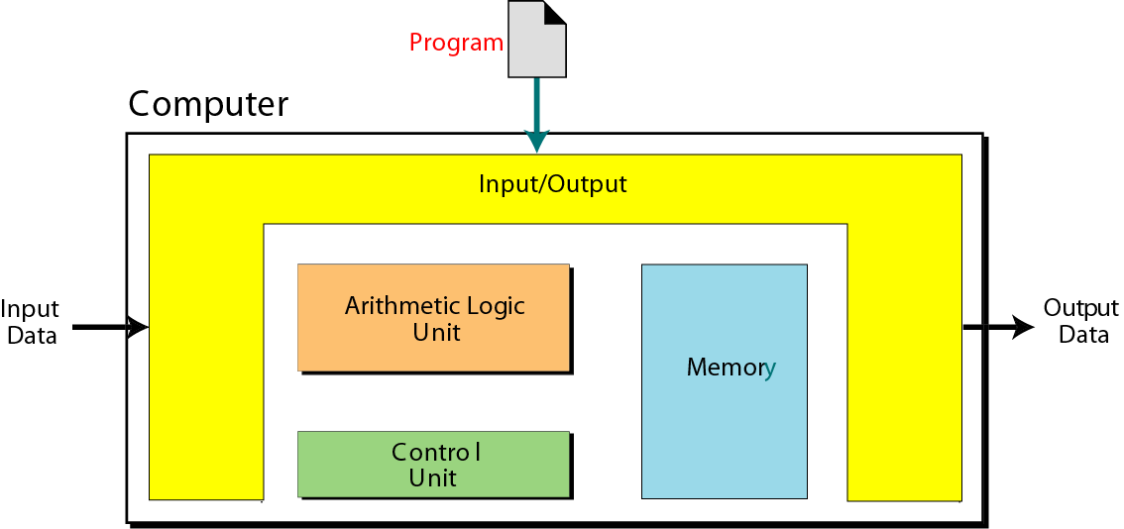
1-10 Components of Von Neumann Architecture
The components of Von-Neumann microprocessor are:
Arithmetic Logic Unit (ALU).
Control Unit (CU).
I/O Units.
Memory.
Buses.
10/24/20
Lecture No 1

Slide 24
Cont …
Arithmetic Logic Unit (ALU) :
The ALU is where calculation and logical operations take place.
Control Unit :
The control unit controls the operations of the memory, ALU, and the input/output subsystem.
Input/Output:
The input subsystem accepts input data and the program from outside the computer; the output subsystem sends the result of processing to the outside.
Memory :
Memory is the storage area. It is where programs and data are stored during processing.
10/24/20
Lecture No 1

Slide 25
STORED PROGRAM CONCEPT
The von Neumann model states that the program must be stored in memory. This is totally different from the architecture of early computers in which only the data were stored in memory.
Both the data and programs should have the same format because they are stored in memory. They are, in fact, stored as binary patterns (a sequence of 0s and 1s ) in memory.
SEQUENTIAL EXECUTION OF INSTRUCTIONS:
A program in the von Neumann model is made of a finite number of instructions. In this model, the control unit fetches one instruction from memory, interprets it, and then executes it.
10/24/20
Lecture No 1

Slide 26
1-11 Von Neumann microprocessor
A Von Neumann microprocessor is a processor that follows this pattern:
Fetch: An instruction and the necessary data are obtained from memory.
Decode: The instruction and data are separated, and the components and pathways required to execute the instruction are activated.
Execute: The instruction is performed, the data is manipulated, and the results are stored.
10/24/20
Lecture No 1

Slide 27
Cont …
The Execute is typically implemented by separating the task to:
Control : The control unit reads the instruction, and activates the appropriate parts of the datapath.
Datapath: The datapath is the pathway that the data takes through the microprocessor. As the data travels to different parts of the datapath, the command signals from the control unit cause the data to be manipulated in specific ways, according to the instruction. The datapath consists of the circuitry for transforming data and for storing temporary data. It contains ALUs capable of transforming data through operations such as addition, subtraction, logical AND, OR, inverting, and shifting.
10/24/20
Lecture No 1

Slide 28
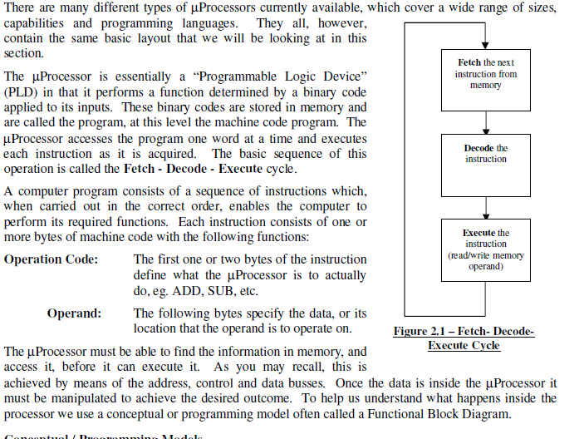
Microprocessor Architecture

Slide 29
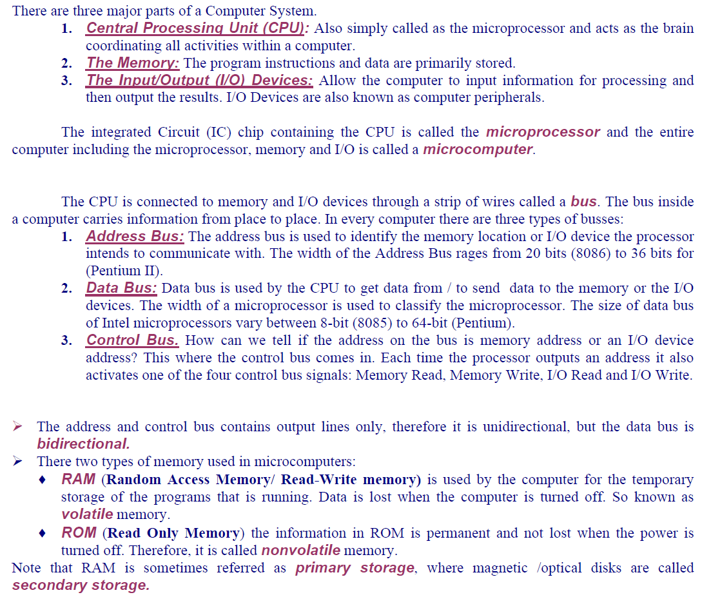
MICROCOMPUTERS AND MICROPROCESSORS.

Slide 30
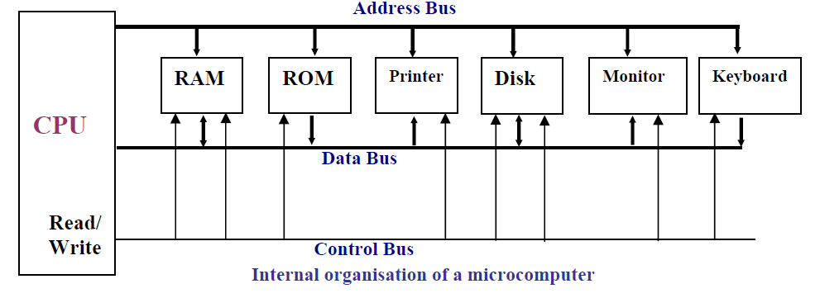
MICROCOMPUTERS AND MICROPROCESSORS

Slide 31
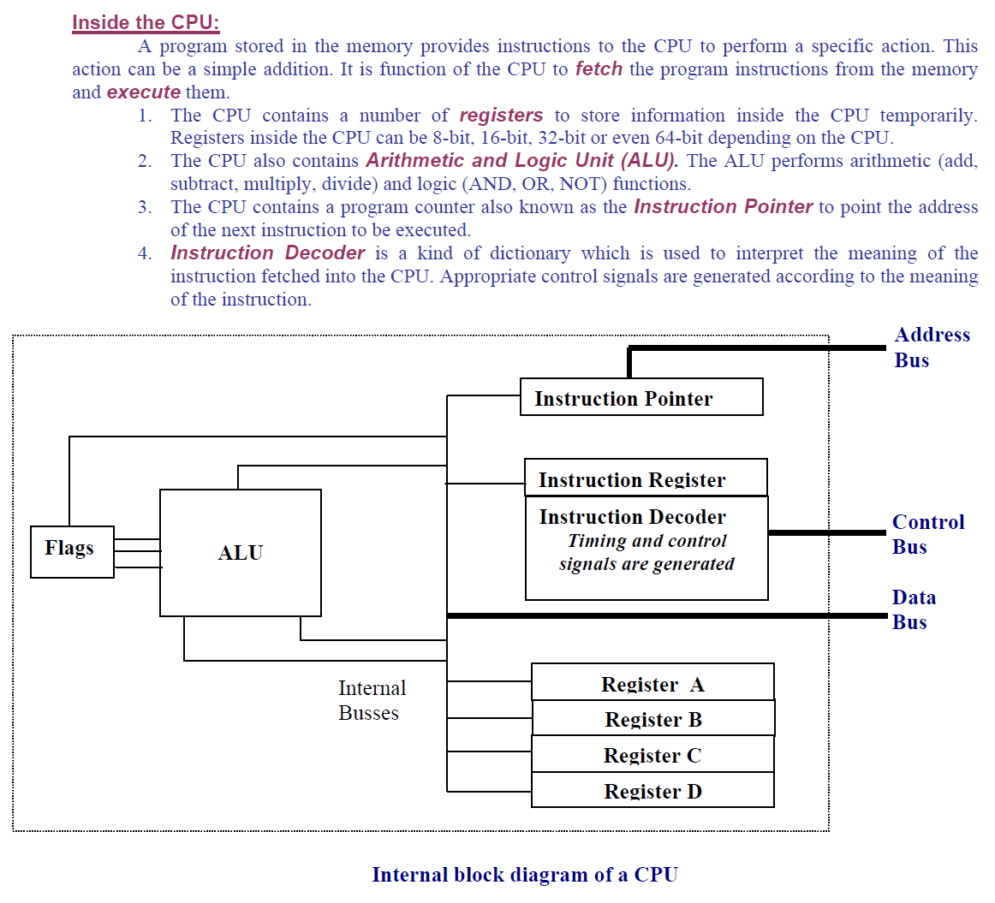

Slide 32
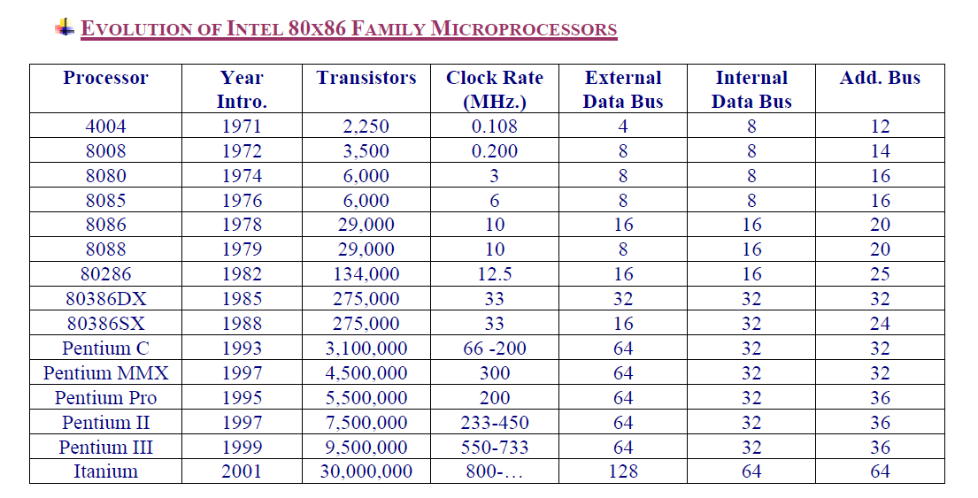

Slide 33
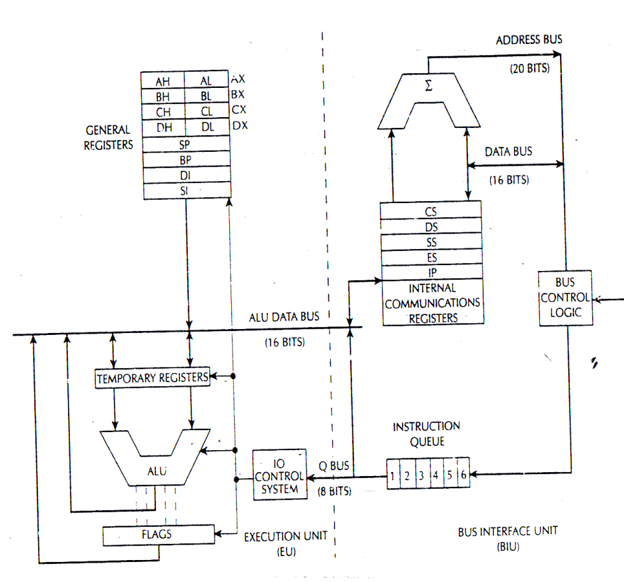
Intel 8086 CPU

Slide 34
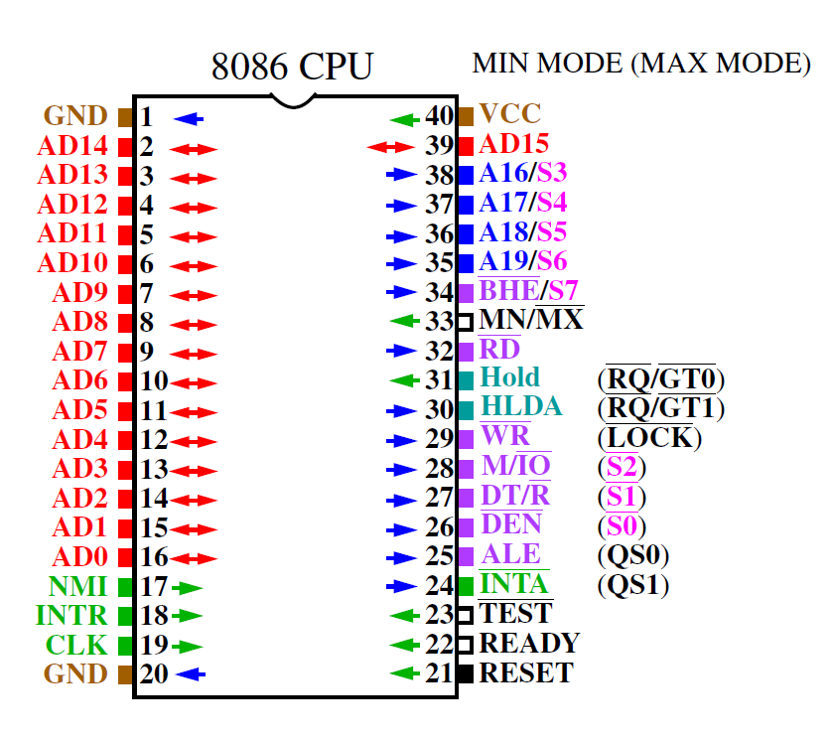

Slide 35
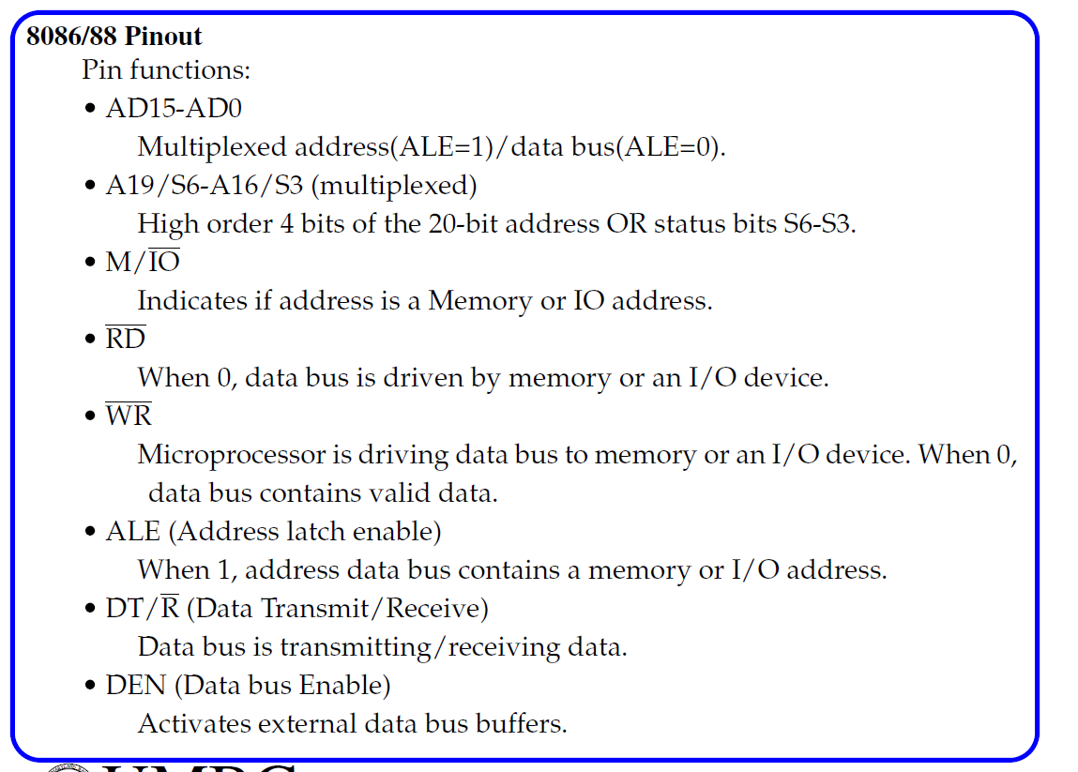

Slide 36
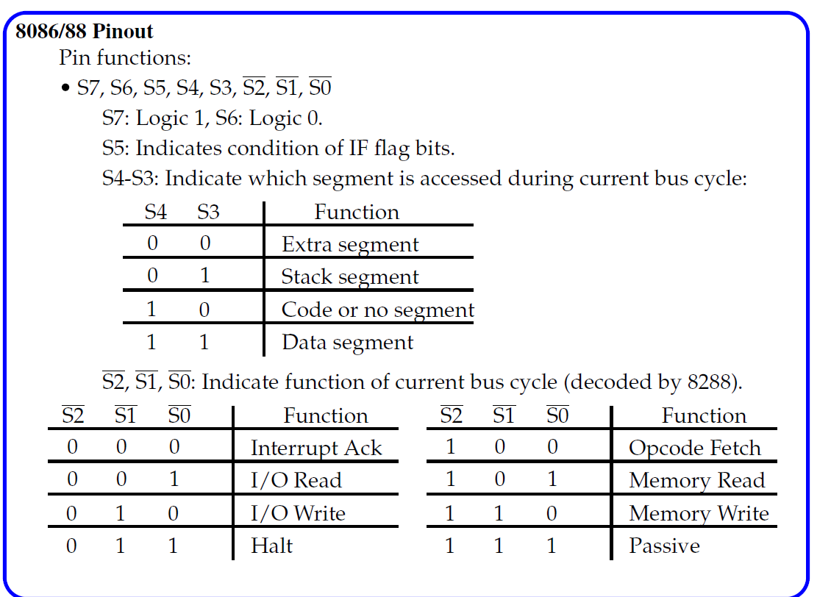

Slide 37
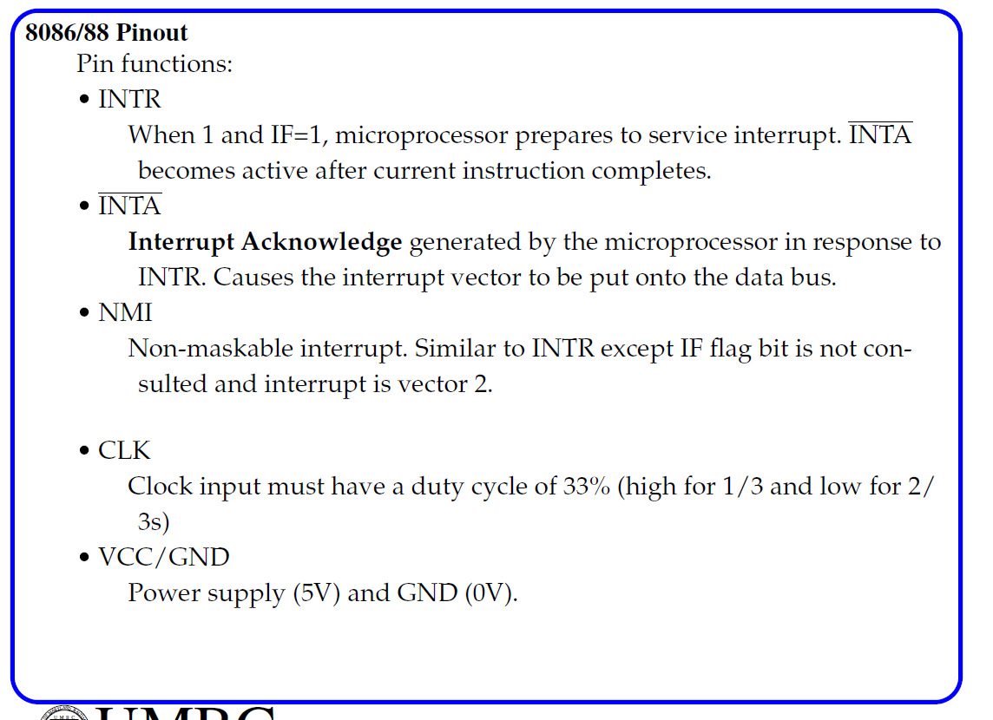

Slide 38
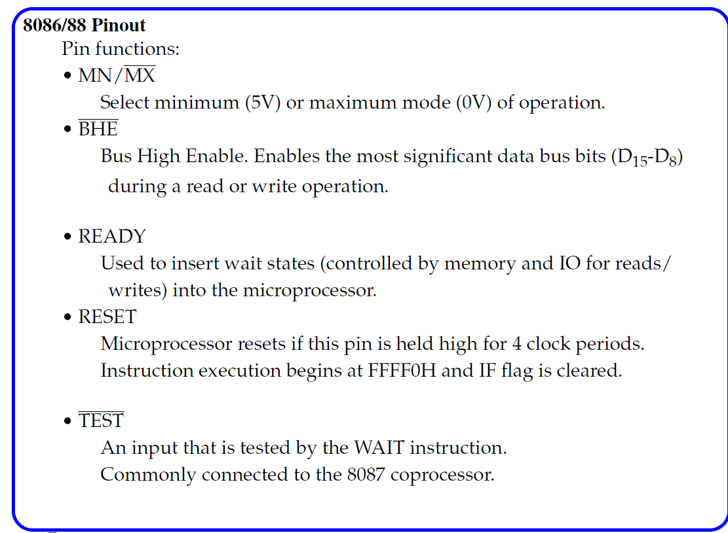

Slide 39
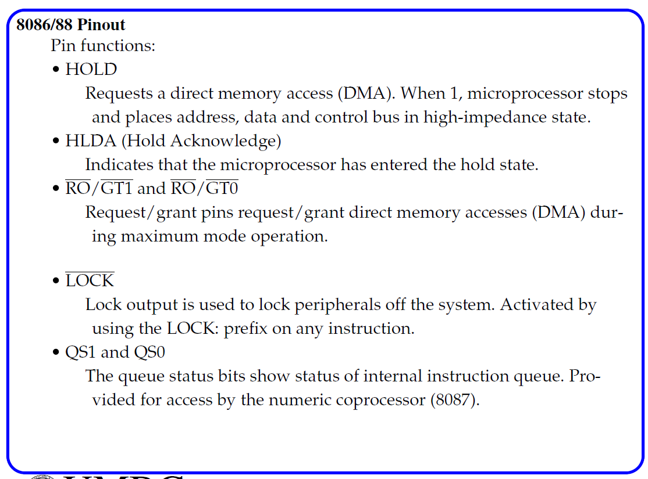

Slide 40
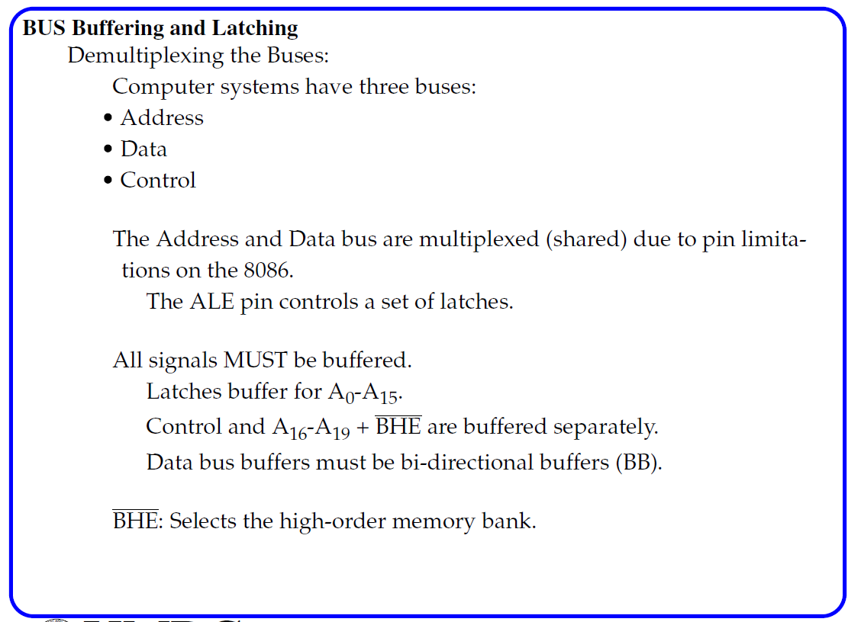

Slide 41
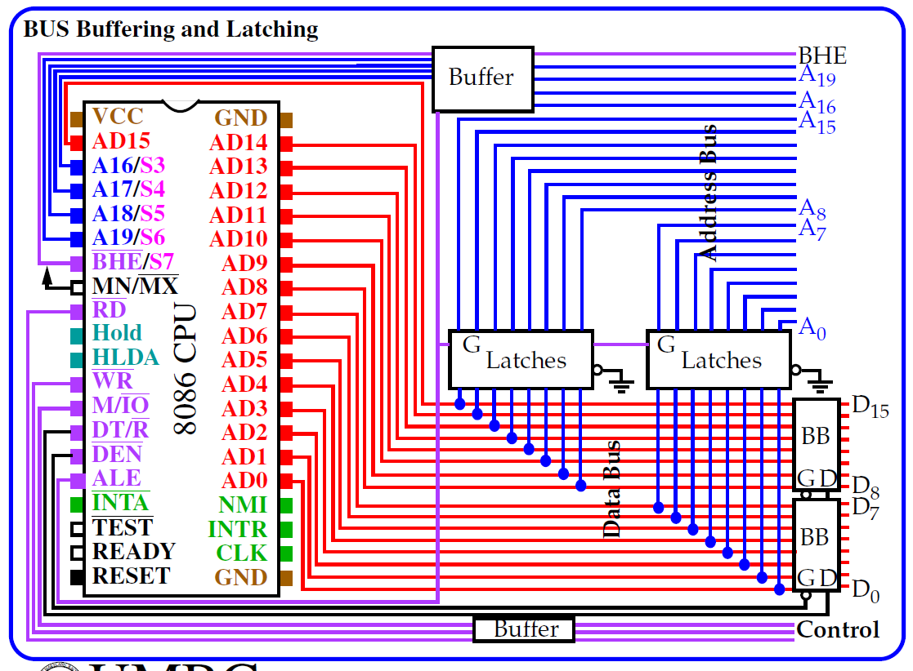

Slide 42
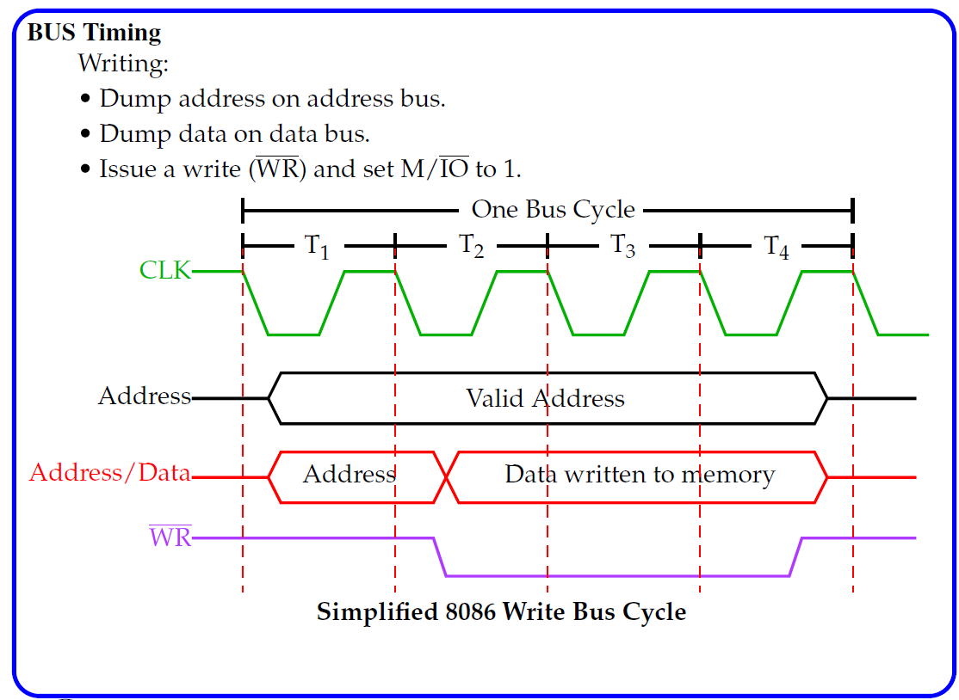

Slide 43
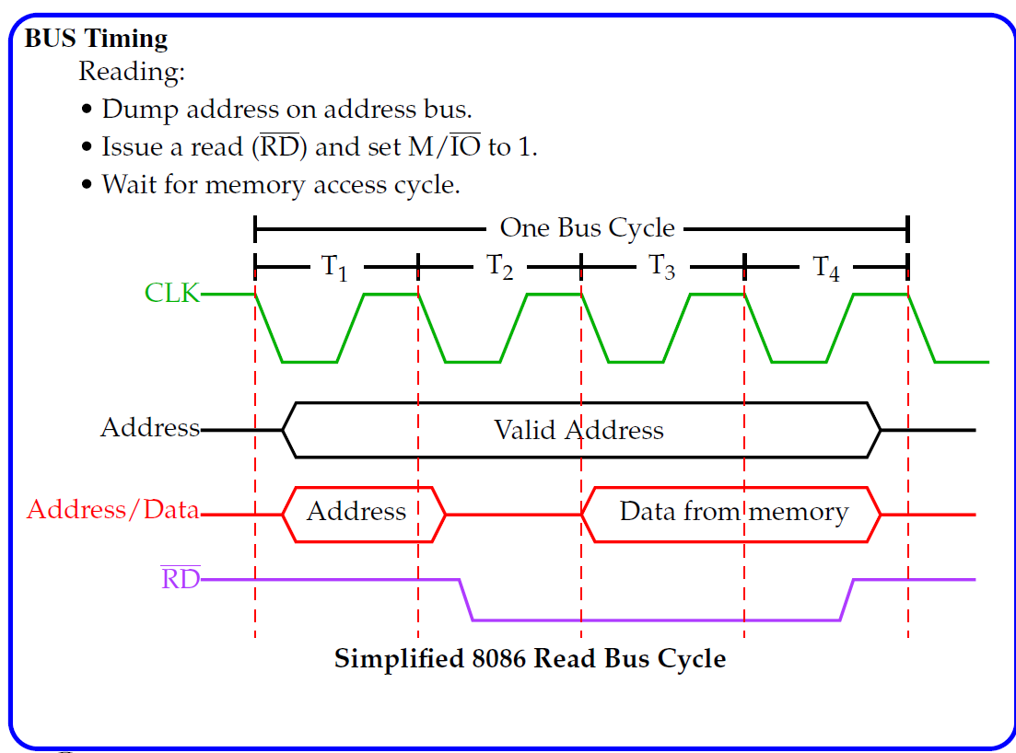

Slide 44
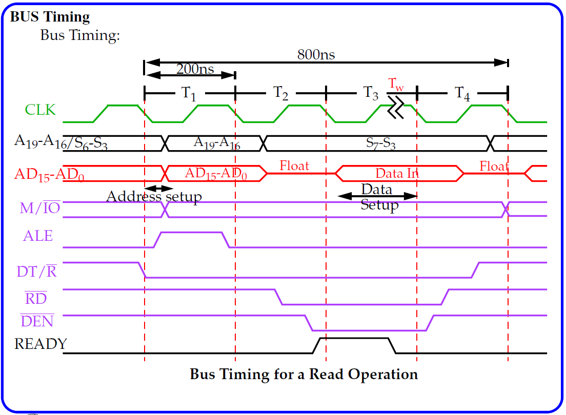

Slide 45
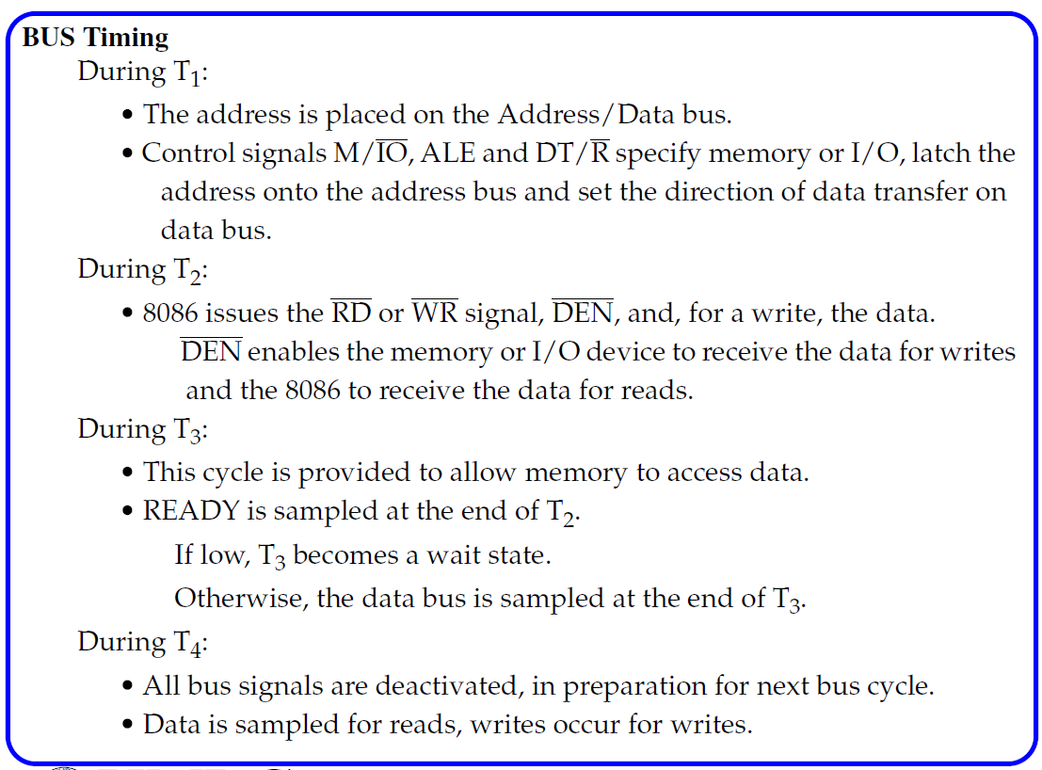

Slide 46
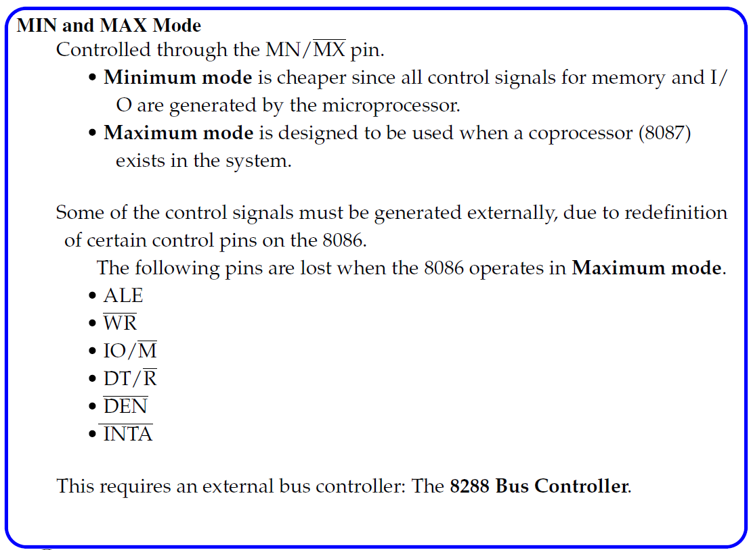

Slide 47
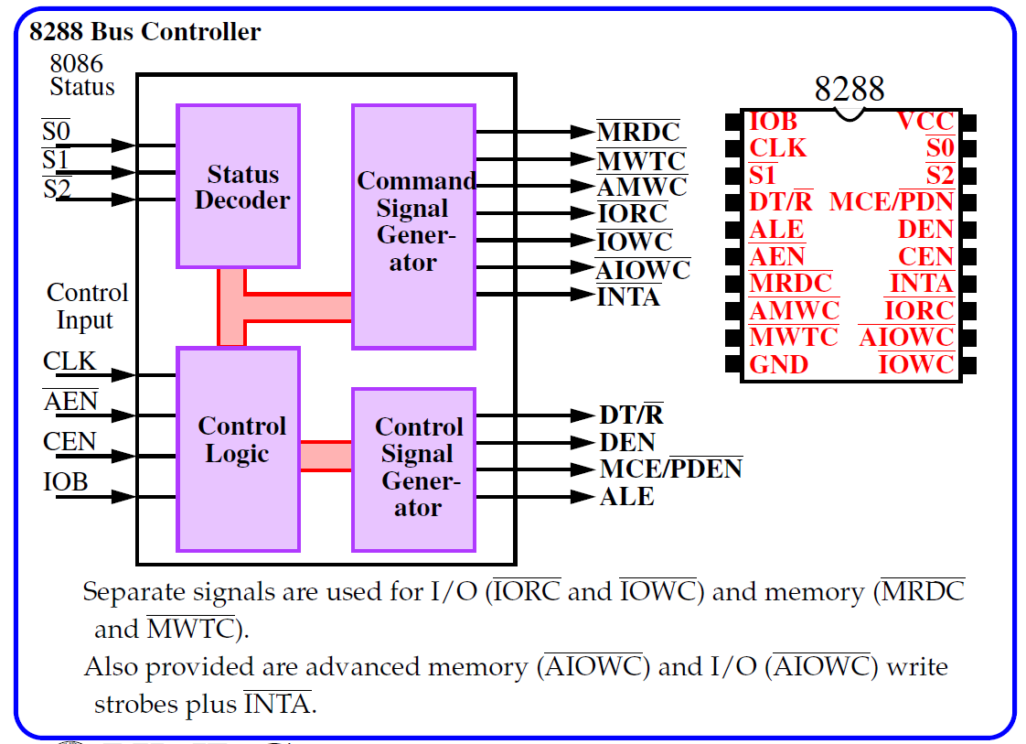

Slide 48
