Slide 1

Healthcare Provider Fraud Detection
”A machine learning approach for Medicare provider fraud detection”
Team Members: Karim Walid, Khaled Habib, Ibrahim Darwish, Aly Waleed
Course: Machine Learning
An end‑to‑end ML pipeline to detect fraudulent Medicare providers.

Slide 2

Problem & Impact
Medicare fraud costs the U.S. over $60 billion annually
Goal: identify suspicious providers.
Minimize false positives to avoid unnecessary investigations.
Manual audits are slow and expensive — ML can prioritize suspicious providers.
Machine learning helps investigators focus on the providers most likely to commit fraud, improving efficiency

Slide 3
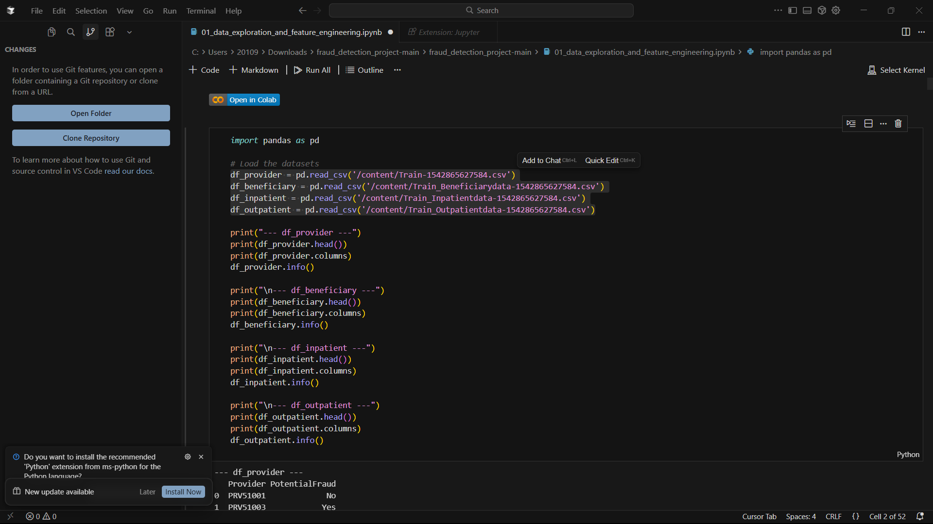
Dataset Overview
Train Beneficiary data
Inpatient claims
Outpatient claims
Provider-level fraud labels
Unit of analysis: Provider.

Slide 4
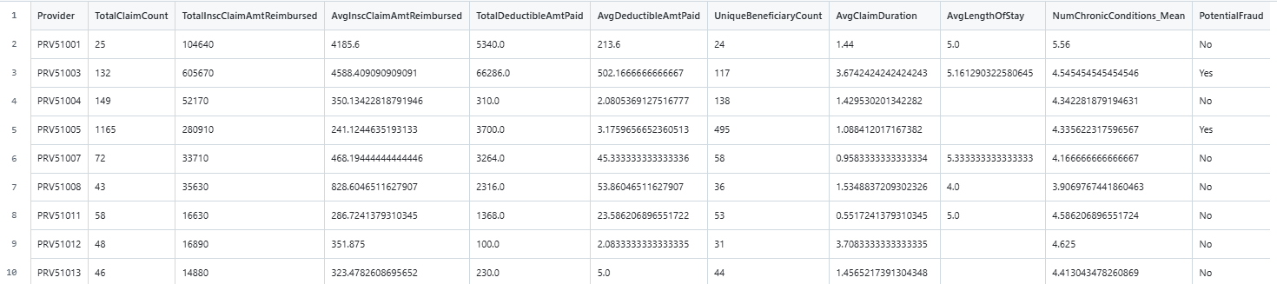
Feature Engineering
TotalClaimCount: total number of claims submitted
TotalInscClaimAmtReimbursed : total Medicare reimbursement
AvgInscClaimAmtReimbursed : average reimbursement per claim
UniqueBeneficiaryCount: number of distinct patients
AvgLengthOfStay: average inpatient stay duration
NumChronicConditions_Mean: patient complexity indicator

Slide 5
Class Imbalance Strategy
Fraudulent providers (Yes) : 25 -> ~10.8%
Non-fraudulent providers (No) : 207 -> ~89.2%
Why it matters?
Fraud is rare -> only ~ 1 in 10 providers, model must be trained to avoid bias
Accuracy is misleading -> We prioritize Precision, Recall, PR-AUC
Imbalance handling
We used:
Class_weight = ‘balanced’ Which increases the penalty for misclassifying fraudulent providers, helping the model focus more on the minority class which was applied in
Logistic Regression
Random Forest

Slide 6
Modeling Approach
Models evaluated:
LogisticRegression(class_weight='balanced', random_state=42, max_iter=1000)
RandomForestClassifier(class_weight='balanced', random_state=42, n_estimators=100),
Gradient boosting(random_state=42)
Model Selection:
Performed 5-fold Stratified cross-validation (F1 score) to compare models.
Final model: Gradient Boosting (based on highest CV F1 score).

Slide 7
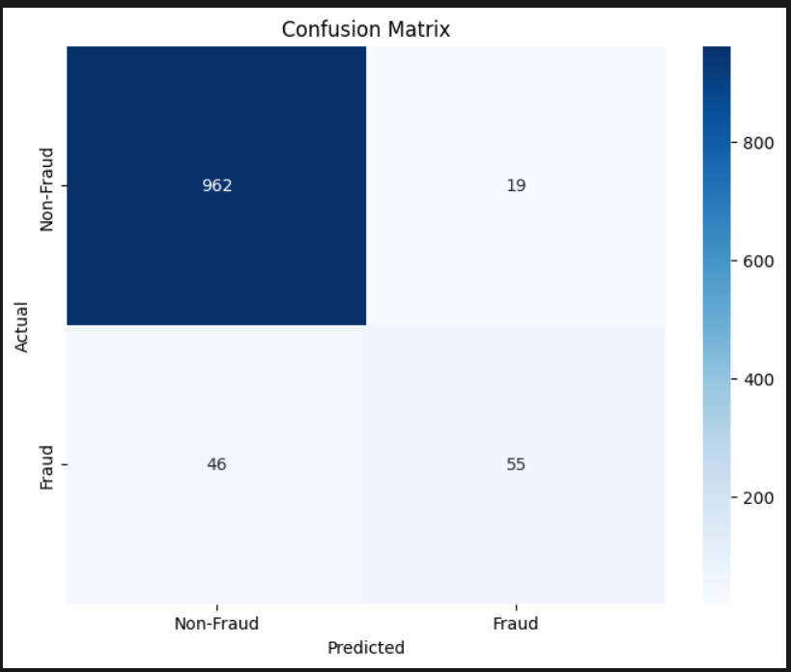
Performance Results
Metrics | Value
Precision | 0.74
Recall | 0.54
F1-Score | 0.63
ROC-AUC | 0.95
PR-AUC | 0.67
The model achieves strong detection performance with 74% precision, 54% recall, and high ROC-AUC (0.95), enabling investigators to focus on high-risk providers.

Slide 8
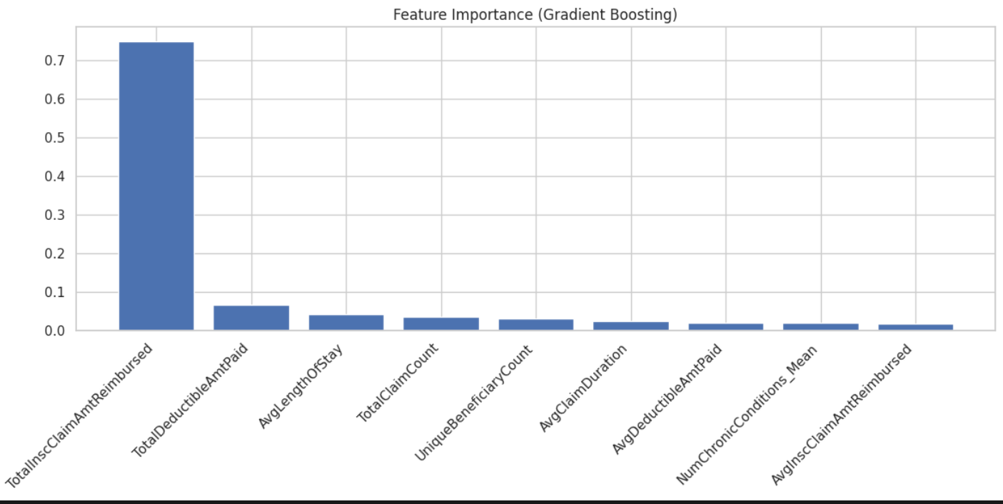
Feature Importance
Top features used by the Gradient Boosting model:
TotalInscClaimAmtReimbursed -> strongest indicator; unusually high total reimbursement raises suspicion
TotalDeductibleAmtPaid -> High deductibles suggest unusual billing patterns.
AvgLengthOfStay -> Longer stays may reflect unnecessary or inflated admissions.
Reimbursement amounts and claim volume were the strongest predictors of potential fraud.

Slide 9
Error Analysis & Limitations
False Positives:
High claim volume but legitimate practice patterns.
High reimbursements due to specialized or expensive treatments.
Unusual patient mix (many chronic conditions) causing atypical billing but valid payment
False Negatives:
Providers with very few claims (not enough data).
Fraud patterns that look similar to normal behavior
Subtle or hidden fraud indicators not captured by available features
Limitations:
Small dataset (only 232 providers) limits learning.
Class imbalance (~11% fraud) still affects recall despite class weighting.
Missing fraud-relevant features (e.g., referral networks, provider reputation).
Gradient Boosting is less interpretable compared to linear models.

Slide 10
Conclusion & Demo
Key Takeaways:
Built an end-to-end ML pipeline: data processing → feature engineering → modeling → evaluation.
Gradient Boosting selected as final model based on cross-validation and test performance.
Strong precision (0.74) and high ROC-AUC (0.95) show reliable fraud ranking.
Feature analysis revealed reimbursement amounts & claim volume as the strongest fraud indicators.
Impact:
Helps investigators prioritize high-risk providers.
Reduces unnecessary audits by minimizing false positives.
Demo:
Load the trained model (best_model.pkl).
Predict fraud risk for unseen providers and display top suspicious cases.

Slide 11


