Slide 1
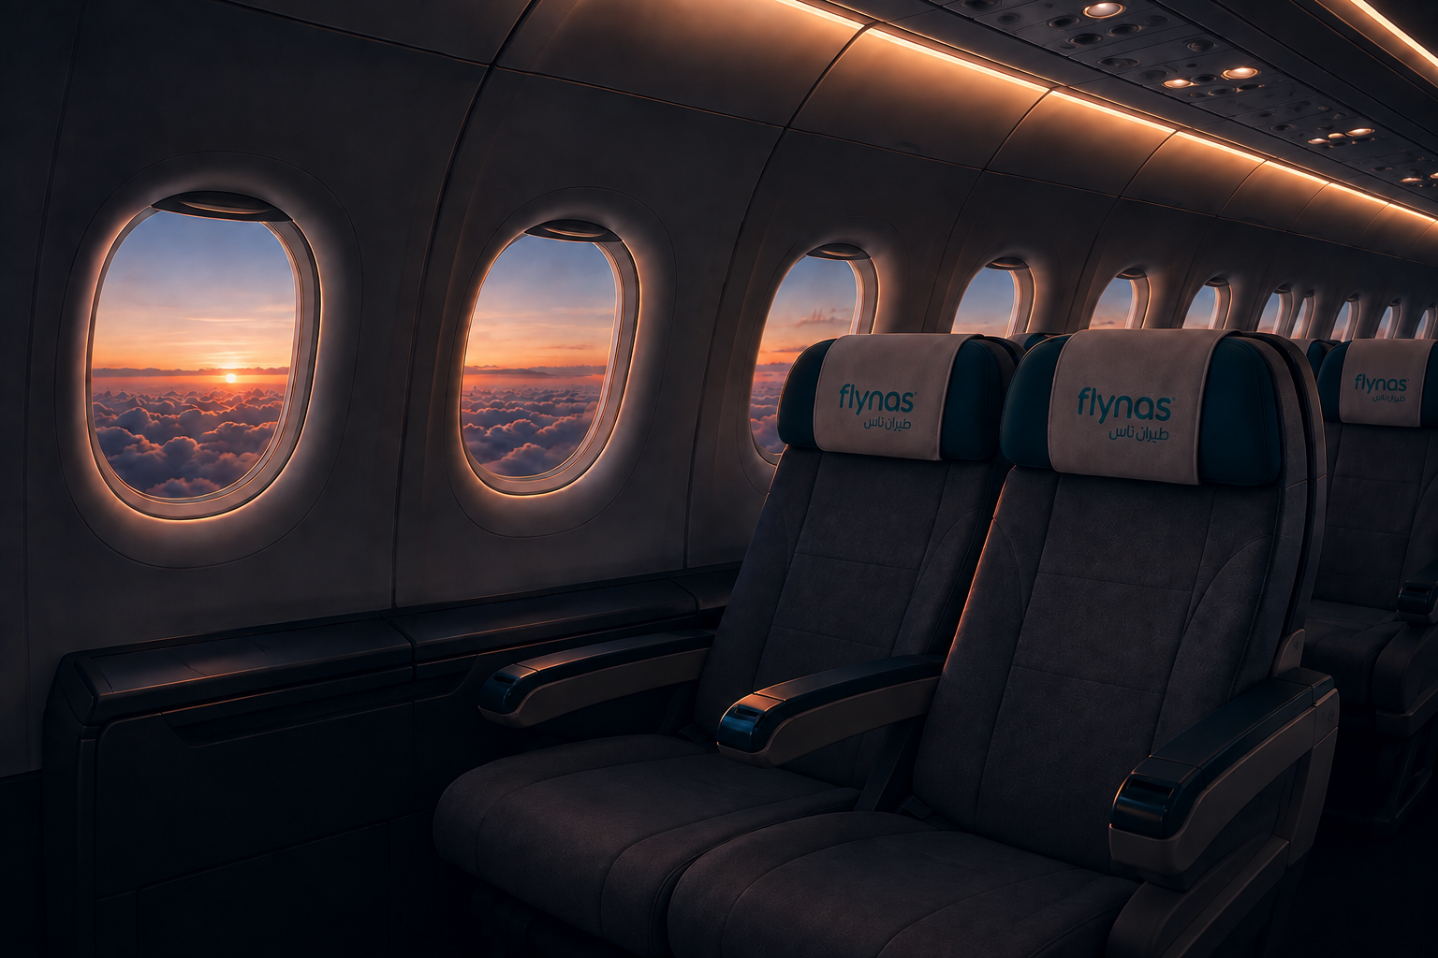

AI PRODUCT PROTOTYPE · MVP
FlyNAS AI
Travel Assistant
An AI-powered assistant that helps FlyNAS passengers get flight, fare, and baggage answers in Arabic and English.
Arabic + English
SQL + RAG
GPT-5.5
FLYNAS AI TRAVEL ASSISTANT
01

Slide 2




THE IDEA
One assistant, every travel question
FlyNAS AI Travel Assistant is a conversational layer that sits on top of FlyNAS travel data — built to answer real passenger questions in plain language.
For FlyNAS passengers
Arabic & English
Travel & airline Q&A
AI + structured data
Designed around real questions travelers ask before and during a trip.
Understands and replies naturally in both languages.
Flights, fares, baggage, booking, cancellation and policies.
Combines a language model with real data lookup and knowledge retrieval.
FLYNAS AI TRAVEL ASSISTANT
02

Slide 3







CAPABILITIES
What can it do?
Flight Search
Baggage
Fare Pricing
Fare Comparison
Booking Changes
Cancellation
FAQ / RAG
Arabic + English
FLYNAS AI TRAVEL ASSISTANT
03

Slide 4





ARCHITECTURE
How it works
→
→
→
→
→
→
User
React Frontend
FastAPI
Question Router
SQL / RAG
OpenAI GPT-5.5
Response
Asks a question in Arabic or English
Chat interface
Backend service
Decides how to handle it
Structured data + knowledge base
Generates the answer
Delivered back to the user
A single question flows through one clean pipeline — from chat input to a grounded answer.
FLYNAS AI TRAVEL ASSISTANT
04

Slide 5
TECHNOLOGY STACK
What it is built with
FRONTEND
BACKEND
AI
DATABASE
React
Python
OpenAI GPT-5.5
SQLite
Vite
FastAPI
Embeddings
SQL
JavaScript
Uvicorn
RAG
CSS
Cosine Similarity
FLYNAS AI TRAVEL ASSISTANT
05

Slide 6


HYBRID APPROACH
SQL + RAG, working together
Structured questions
→
Flights · Fares · Baggage · Booking
via SQL
FAQ questions
→
Knowledge Base
via RAG
Both paths
→
OpenAI
→
Final Answer
“Not every question is handled the same way.”
FLYNAS AI TRAVEL ASSISTANT
06

Slide 7
LIVE DEMO
Try it live
Sample questions to ask the assistant during the demo:
وش الرحلات المتاحة من الرياض إلى دبي؟
1
وش الرحلات الي تودي على دبي؟
2
What baggage is included in Value?
3
وش الفرق بين Light وValue وPlus؟
4
هل أقدر ألغي Value وكم الرسوم؟
5
من فاز بكأس العالم سنة 2026؟
7
FLYNAS AI TRAVEL ASSISTANT
07

Slide 8


RELIABILITY
Smart & safe responses
Unknown information
Unsupported fare
Ambiguous question
Out-of-scope question
→ Does not invent an answer
→ Premium is not available
→ Asks for clarification
→ Stays focused on FlyNAS
EXAMPLE
هل يوجد Wi-Fi على الطائرة؟
→ Information is insufficient.
FLYNAS AI TRAVEL ASSISTANT
08

Slide 9





ROADMAP
NOT CURRENT FEATURES
Future development
Real FlyNAS data
Real-time availability
Authentication
Move from sample data to production data sources
Live flight and fare lookups
Secure, personalized passenger sessions
Larger knowledge base
Production deployment
Analytics & monitoring
Broader FAQ and policy coverage
Hardened, scalable infrastructure
Usage insight and quality tracking
FLYNAS AI TRAVEL ASSISTANT
09

