Slide 1
CIE-552 · Computer Vision · Spring 2026
American Sign Language Recognition System
Comparative Deep Learning Study · Real-Time Web Deployment
Ibrahim Hanafy · Abdullah Ahmed · Mai Ibrahim
Supervised by Dr. Mohamed Tolba | TAs: Retaj Yousri · Mennah Mohamed
99.96%
98.9%
5+
Live
Best Accuracy
Real-World MLP
Models Compared
Web Deployed

Slide 2
Agenda
30-minute presentation roadmap
01
02
Problem & Motivation
Dataset Overview
03
04
5 Core Models
Training Curves
05
06
Results & Confusion Matrices
Bonus: Landmarks + Web App
07
08
Challenges We Faced
Live Demo & Conclusion

Slide 3
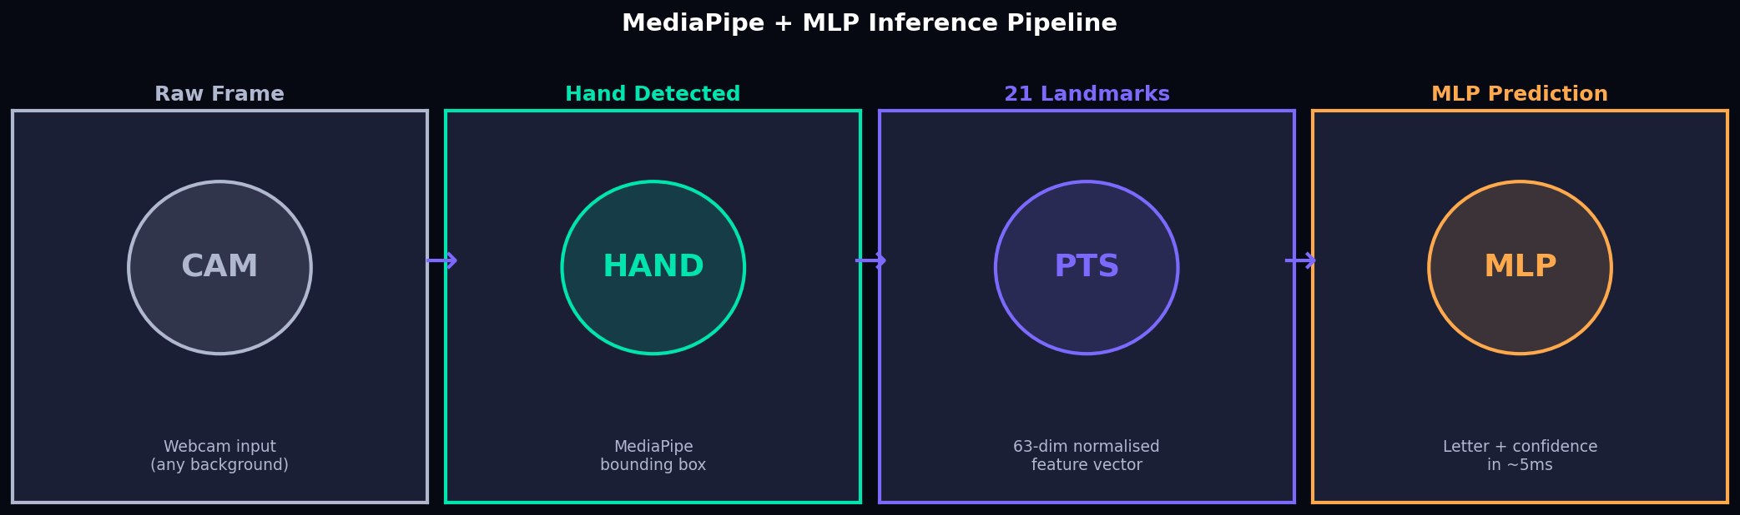
Problem Statement
Why automated ASL recognition matters
70 million+ deaf and hard-of-hearing people worldwide rely on sign language as their primary communication.
Automated recognition → real-time translation, assistive devices, educational tools.
Domain Gap
Real-Time
Robustness
Deployment
Dataset ≠ webcam. Perfect benchmark score ≠ working product.
Must run live video smoothly. No buffering or lag tolerated.
Varied lighting, backgrounds, skin tones, hand sizes.
Local model ≠ accessible. Must work from any browser.

Slide 4
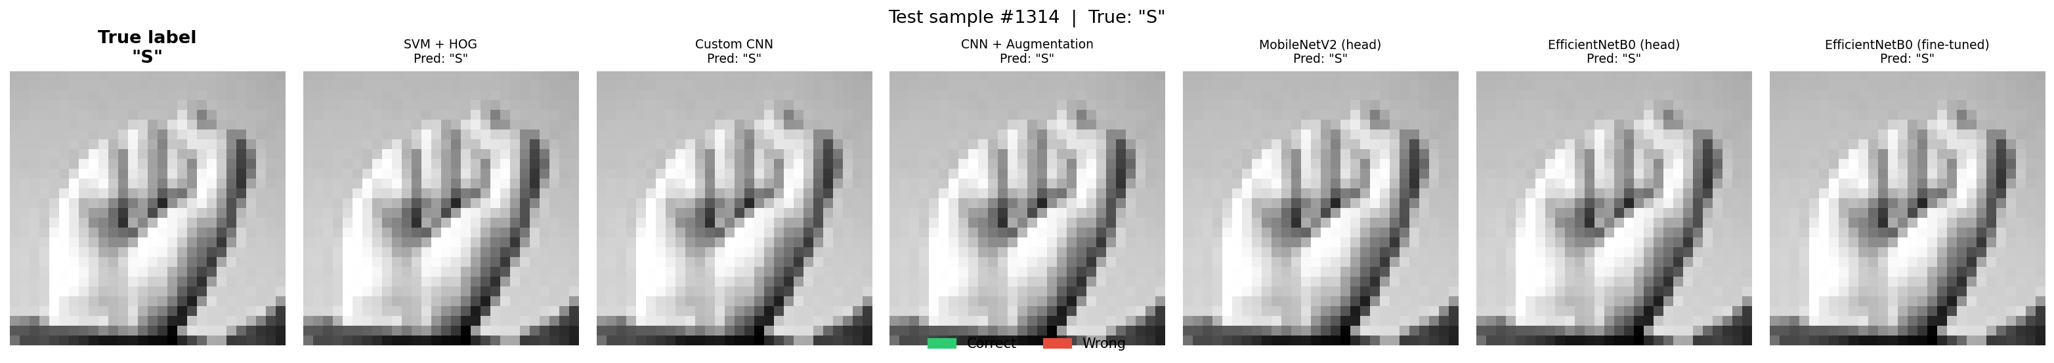
Dataset — Sign Language MNIST
27,455
7,172
24
28×28
Training Images
Test Images
Classes (A–Y, no J/Z)
Grayscale Pixels
Key Properties
Misclassification example
▸ Drop-in MNIST replacement — same format and split
True label: S — CNN predicted incorrectly Illustrates domain gap: even 99%+ models fail on edge cases
▸ J and Z excluded (require motion, not static)
▸ Tightly cropped, background-free, uniform lighting
▸ Labels 0–25, indices 9 and 25 absent
▸ Pixels normalised from [0,255] to float32 [0,1]
▸ The catch: looks nothing like a real webcam frame

Slide 5
Methodology — 5 Pipelines + 4 Bonus Modules
Custom CNN
Bonus Contributions
01
Baseline — 6-layer conv net, Adam, 30 epochs
A
Robust Augmented CNN → TFLite export
02
CNN + Augment
Same arch + RandomBrightness/Zoom/Rotation
SVM + HOG
B
MediaPipe Landmarks + MLP (98.9%)
03
Classical: 576-dim HOG features + RBF-SVM
04
MobileNetV2
C
TFLite Quantisation + Optimisation
Frozen ImageNet backbone + dense head
05
EfficientNetB0
Head-only AND full fine-tune (best result)
D
FastAPI + Docker + HF Spaces Deploy

Slide 6
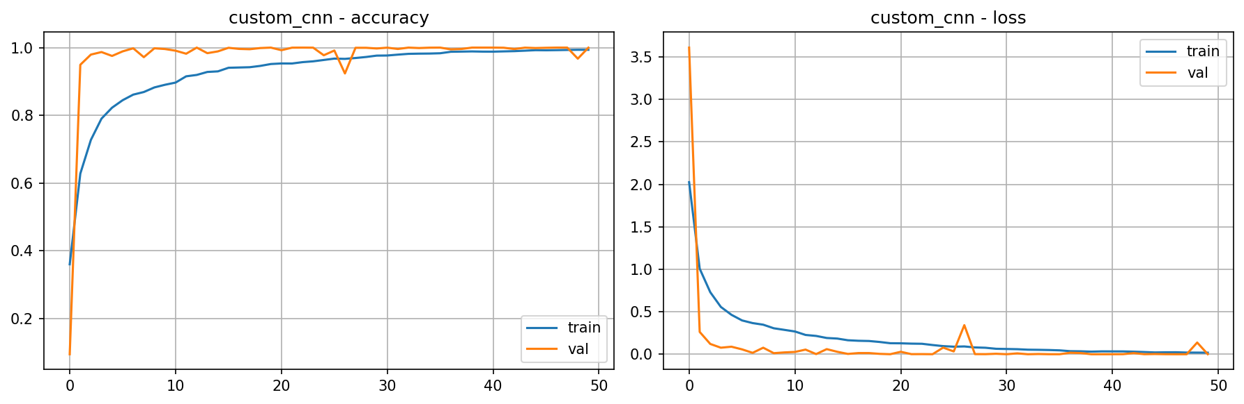
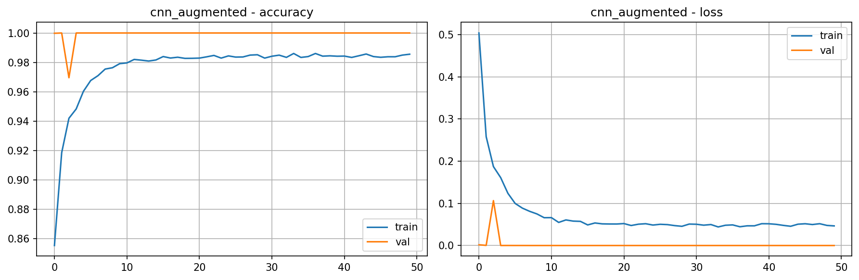
Training Curves — CNN Models
Baseline vs Augmented
Custom CNN (Baseline)
CNN + Data Augmentation
Augmentation reduces overfitting — validation loss stays closer to training loss, generalisation improves.

Slide 7
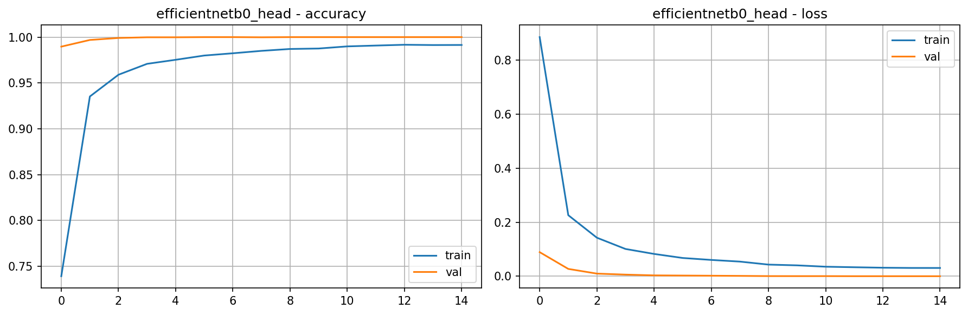
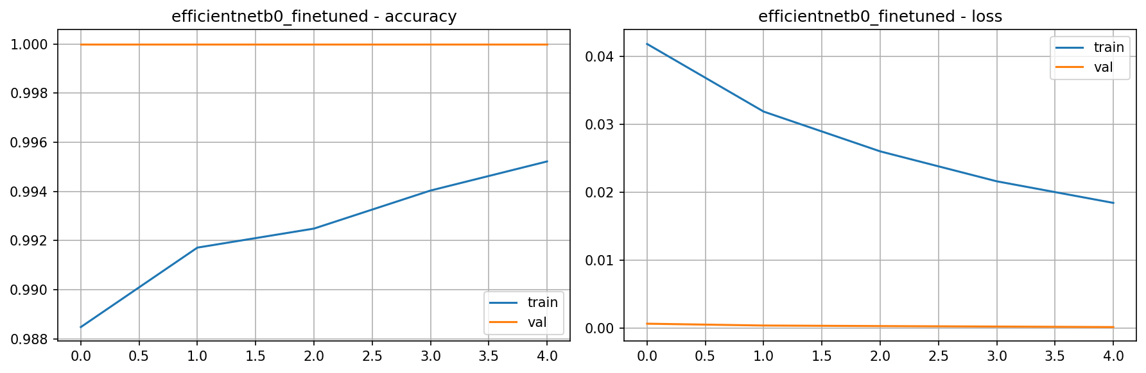
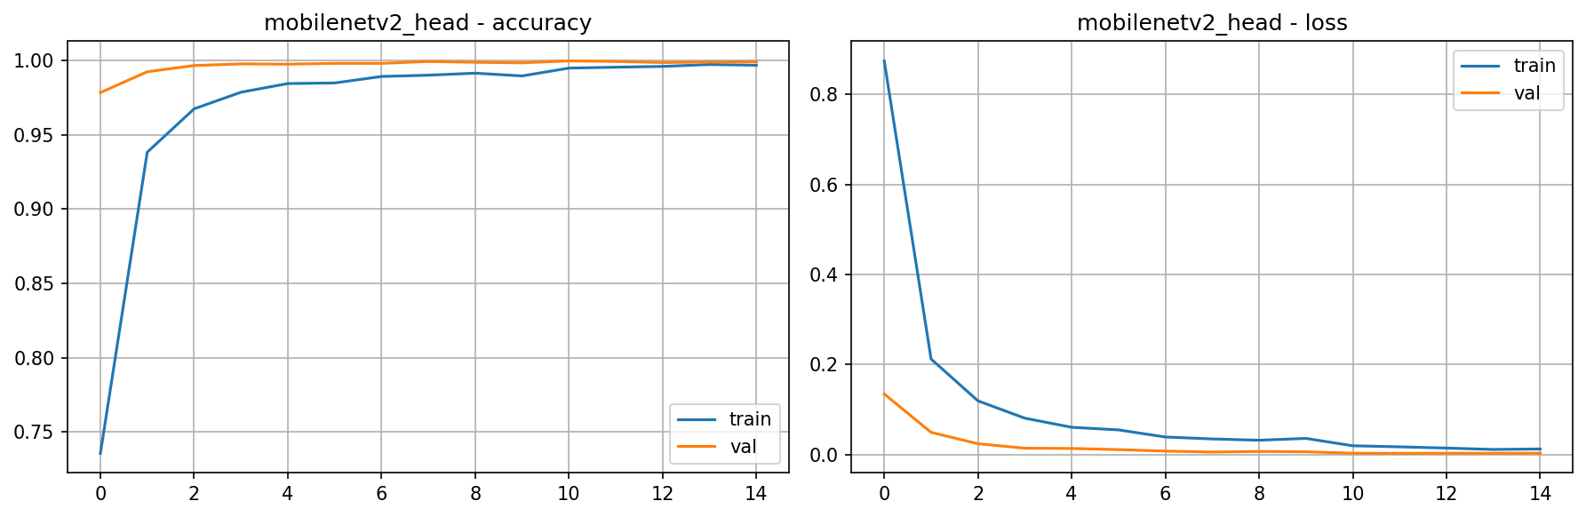
Training Curves — Transfer Learning
EfficientNetB0 head-only vs fine-tuned
EfficientNetB0 — Head Only
EfficientNetB0 — Fine-Tuned ★ Best Model
MobileNetV2 — Head Only
Fine-tuning insight: full unfreeze with low lr (1e-4) pushes EfficientNetB0 from 99.50% → 99.96%. Head-only training converges faster but plateaus earlier.

Slide 8
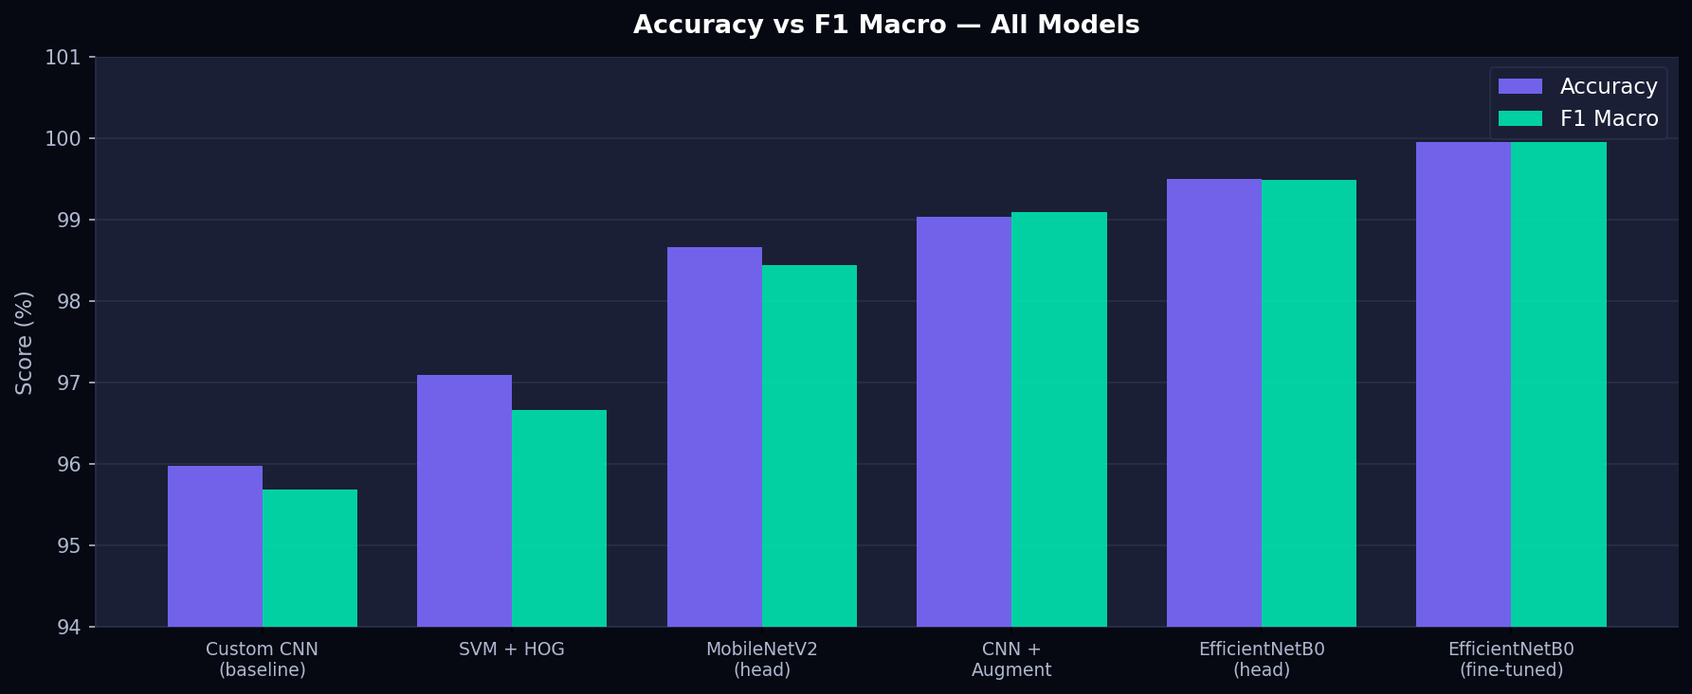
Results — Model Comparison
Sign Language MNIST test set (7,172 samples)
Model
Acc
F1
EfficientNetB0 FT ★
99.96
99.96
EfficientNetB0 Head
99.50
99.49
CNN + Augment
99.04
99.10
MobileNetV2 Head
98.66
98.44
SVM + HOG
97.09
96.67
Custom CNN
95.98
95.69
Key insight: fine-tuning beats head-only (+0.46%). SVM+HOG (97%) beats baseline CNN (95.98%) — strong classical baseline worth noting.

Slide 9
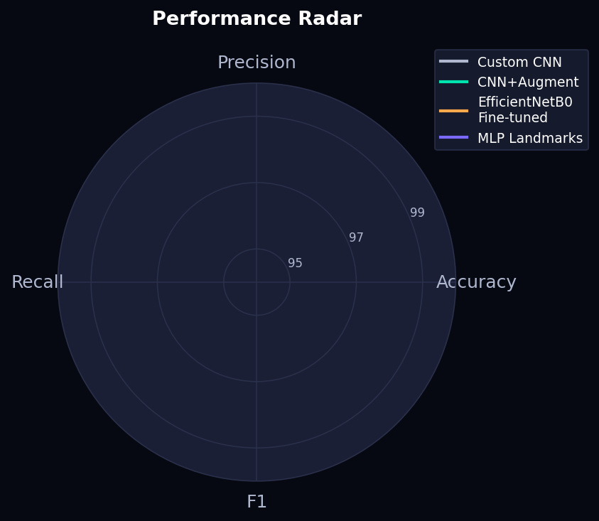
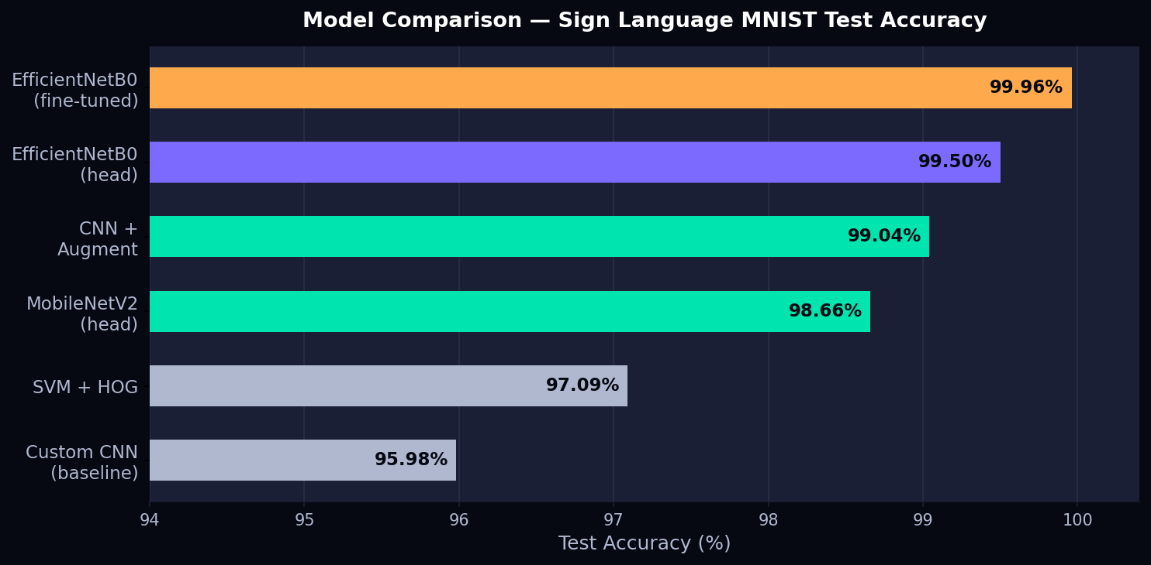
Results — Performance Radar
Multi-metric view across all models

Slide 10
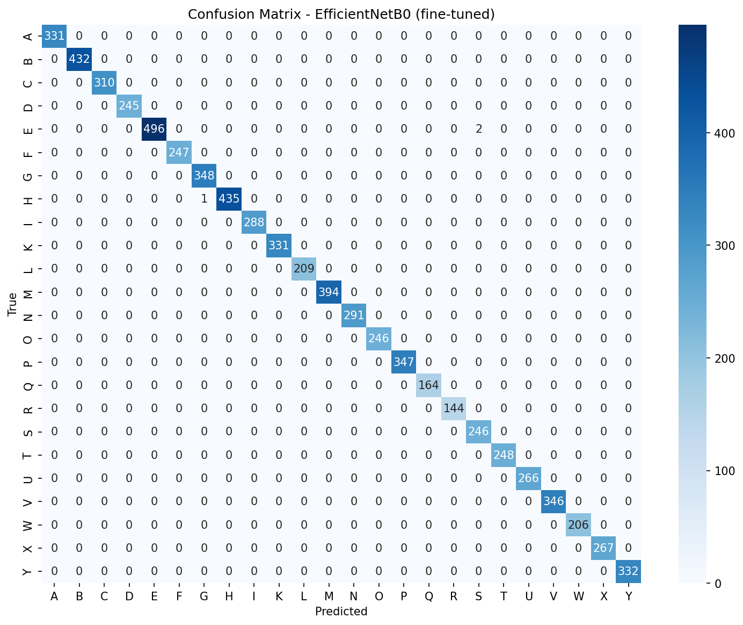
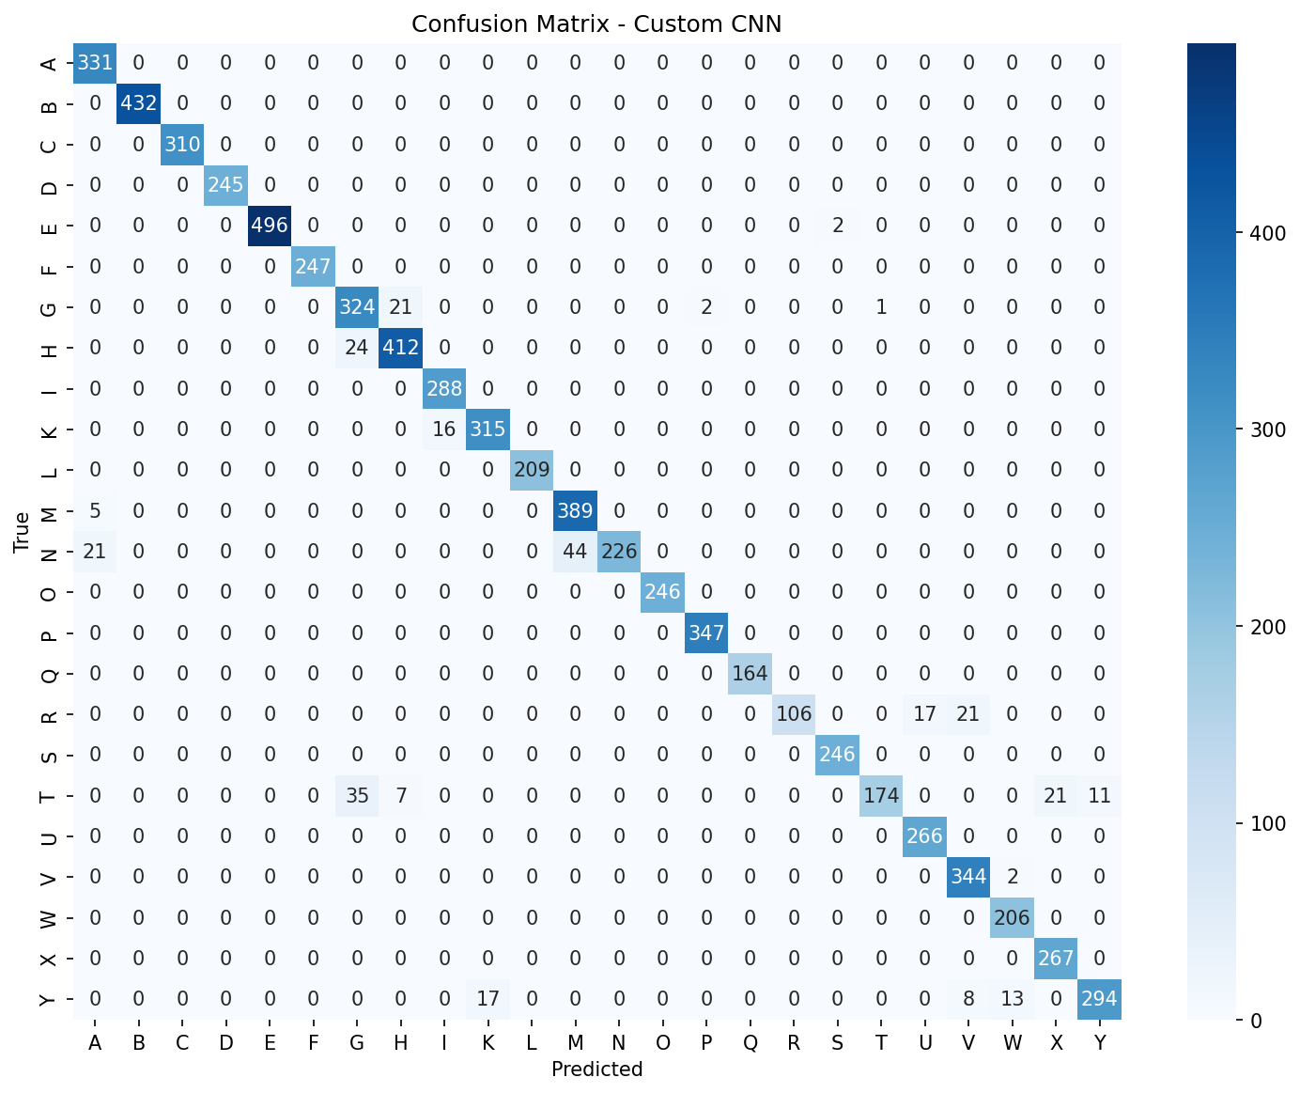
Confusion Matrices — Best vs Worst
Near-perfect vs inter-class confusion
EfficientNetB0 Fine-Tuned (99.96%)
Custom CNN Baseline (95.98%)
Custom CNN: M/N and U/V most confused. Fine-tuned EfficientNetB0: near-zero off-diagonal.

Slide 11
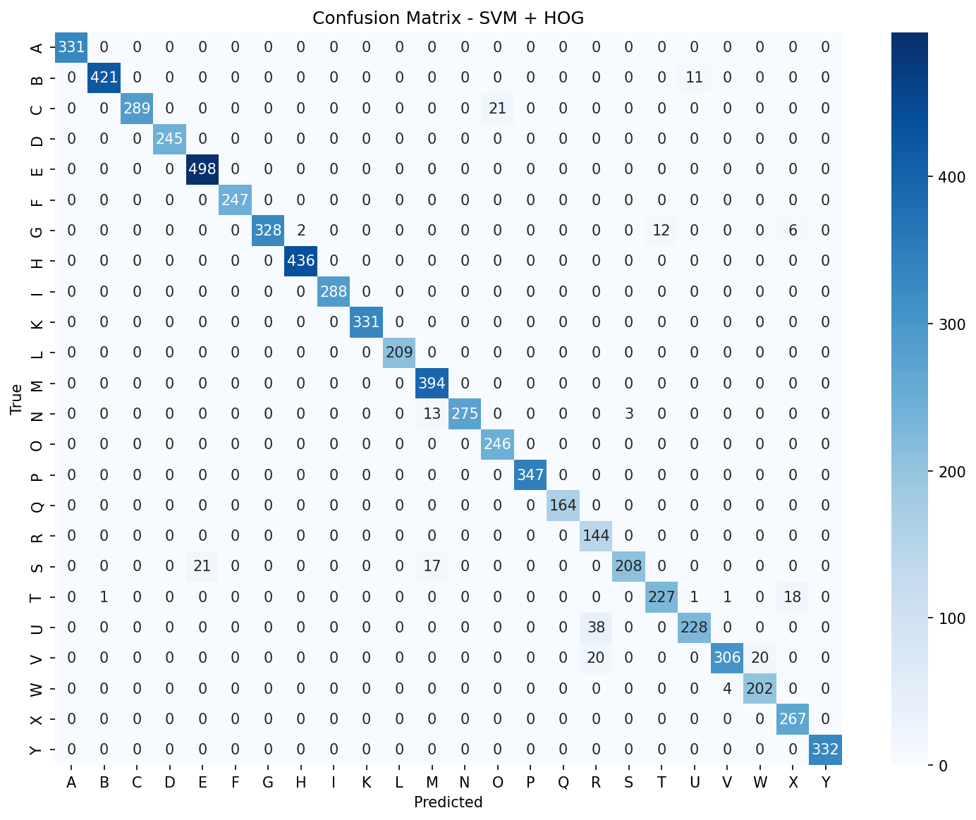



All Confusion Matrices
Side-by-side comparison of all 6 models
Custom CNN 95.98%
SVM + HOG 97.09%
MobileNetV2 Head 98.66%
CNN + Augment 99.04%
EfficientNetB0 Head 99.50%
EfficientNetB0 FT ★ 99.96%

Slide 12
Bonus B — MediaPipe Landmarks + MLP
Appearance-invariant real-time recognition
98.9%
Real Webcam Accuracy
~5 ms
Per-frame CPU inference
Why landmarks beat pixels
▸ Pixels vary: lighting · background · skin tone · scale
21
▸ Landmarks capture only hand SHAPE — none of above matters
▸ Normalise: wrist → origin, scale by wrist→MCP distance
Hand Keypoints (3D)
▸ 63-dim vector → StandardScaler → MLPClassifier (256,128)
63-dim
optionB.pkl = {mlp, scaler, classes} — loaded with joblib
Feature Vector

Slide 13
Bonus A & C — Robust CNN + Optimisation
Bonus A — Augmented CNN → TFLite
Bonus C — Model Optimisation
▸ Heavier augmentation than core model:
▸ Post-training quantisation strategies:
· RandomBrightness(0.15, value_range=(0,1)) ← critical
· Float32 → Int8 full quantisation
· RandomContrast · RandomZoom · RandomRotation
· Dynamic-range quantisation (lighter option)
· tf.clip_by_value(img, 0.0, 1.0) post-augment
▸ Float32 model → ~4MB
▸ Exported to TFLite (.tflite) — 2ms/frame on CPU
▸ Int8 quantised → ~1MB (4× smaller)
▸ Int8 quantisation → 4× size reduction
▸ Accuracy loss < 0.1% after quantisation
▸ Runs on Raspberry Pi, Android, edge devices
▸ Enables browser/mobile/Pi deployment
▸ Analysed speed vs. accuracy trade-off
4×
<0.1%
Size Reduction
Accuracy Loss

Slide 14
Bonus D — FastAPI Web Application + Docker Deployment
Upload Tab — CNN
Live Webcam Tab — MediaPipe + MLP
1
User uploads image
1
Browser streams JPEG frames over WebSocket
2
Server: MediaPipe → 21 landmarks
2
Server: PIL → grayscale → 28×28
3
MLP classifies 63-dim feature vector
3
TFLite CNN inference
4
Server returns: letter, bbox, 21 coords
4
Top-5 predictions + bars returned
5
Browser draws skeleton overlay on canvas
Docker → python:3.11-slim | libgl1 · libgles2 · libegl1 | EXPOSE 7860
🌐 ibrahimhanafy2222-vision-project.hf.space
Hugging Face Spaces — free Docker hosting, 16GB RAM, CPU inference

Slide 15
Challenges We Faced
Real engineering problems — documented with solutions
.keras + Lambda Serialisation
RandomBrightness value_range Bug
Lambda layers can't be JSON-serialised → TypeError on save. Fix: replaced with explicit subclassed Keras Layer objects.
Default range (0,255) adds ±38 to [0,1] images → all-black samples. Fix: value_range=(0,1) + tf.clip_by_value after augment.
HF Spaces: LFS → Xet Migration
Missing Docker System Libraries
git push rejected for .tflite/.task — LFS also blocked at hook. Fix: hf upload CLI — uses Xet storage transparently.
libgl1-mesa-glx removed in Debian trixie. libGLESv2.so.2 missing. Fix: libgl1 + libgles2 + libegl1 in Dockerfile.
Starlette TemplateResponse API Break
scikit-learn Version Mismatch
request must be keyword arg not in context dict in new Starlette. Caused TypeError: unhashable type 'dict' inside Jinja2.
pkl saved with 1.6.1 (Colab), Docker installed 1.8.0. Fix: pin scikit-learn==1.6.1 in requirements.txt.

Slide 16
Live Demo
https://ibrahimhanafy2222-vision-project.hf.space
Upload Tab
Live Webcam Tab
Pick any ASL letter photo → see top-5 predictions with confidence bars
→
Show a hand sign to camera → real-time skeleton overlay + letter + confidence
If the live site is unavailable, we will show a recorded screen capture.

Slide 17
Conclusion
EfficientNetB0 fine-tuned → 99.96% on Sign MNIST — best benchmark result
Benchmark accuracy ≠ real-world — domain gap is real and significant
Landmark MLP (98.9%) outperforms all pixel models on live webcam video
TFLite + quantisation → 4× smaller model, <2ms/frame, edge-deployable
Complete Docker + HF Spaces deployment — live and publicly accessible
6 non-trivial engineering challenges documented with root-cause analysis
Future work: dynamic signs (J,Z) · word-level ASL · real-world training data · mobile app

Slide 18
Thank You
Questions & Discussion
Ibrahim Hanafy · Abdullah Ahmed · Mai Ibrahim
CIE-552 Computer Vision · Zewail City · Spring 2026
ibrahimhanafy2222-vision-project.hf.space
99.96%
98.9%
Live
Best Accuracy
Real-World
Deployed

