Slide 1
Grammatical Error Correction on C4_200M
Bag-of-Words -> LSTM -> Attention -> Transformer
Abdullah Ahmed (202200206) | Ibrahim Hanafy (202200518)
CIE 555 - Neural Networks and Deep Learning
Instructor: Dr. Ibrahim Swelam | TAs: Aya Abdelaziz, Mahmoud Farahat

Slide 2
The Problem: Grammatical Error Correction
Rewrite an ungrammatical sentence into its corrected form.
Errors: tense, agreement, articles, plurals, punctuation, spelling.
The output is a whole new sentence - a sequence-to-sequence task.
Input: "She go to school yesterday and learning many thing." Output: "She went to school yesterday and learned many things."

Slide 3
The Data: C4_200M Subset
Clean web text automatically corrupted into (corrupted, clean) pairs.
Train: 850,000 Validation: 50,000 Test: 100,000 (Total 1,000,000)
16k Byte-Level BPE tokenizer; max length 64 tokens.
Same splits and tokenizer for every model - no data leakage.

Slide 4
Four Models of Increasing Power
# | Model | What it adds
1 | Bag-of-Words (TF-IDF) | Baseline - only detects errors
2 | LSTM encoder-decoder | First corrector; fixed-size bottleneck
3 | LSTM + Bahdanau attention | Decoder re-queries the full source
4 | Transformer | Self-attention; no recurrence
Model 1 detects. Models 2-4 correct.

Slide 5
Model 1 - Bag-of-Words Baseline
TF-IDF (unigrams+bigrams, 50k vocab) + Logistic Regression / Linear SVM. Each pair -> corrupted = 0, clean = 1.
Result: ~62% accuracy - barely above 50% chance. Why so weak? Structural, not bad tuning:
Detector, not corrector - outputs one label, never corrected text.
Bag-of-words discards order - but grammar IS order ("she goes" vs "go she").
Error signal swamped - a 1-word error is invisible next to content-word weights.
No generalisation - only memorises lexical statistics.
Proves GEC needs sequence modelling and text generation - which the next three models provide.

Slide 6
Model 2 - LSTM Encoder-Decoder
BiLSTM encoder compresses the input into ONE 512-dim state.
LSTM decoder generates the correction token by token.
Teacher forcing 1.0 -> 0.5; 19.55M parameters; 3 epochs.
Test GLEU 0.213 (greedy) - the weakest corrector.
The bottleneck: after the first step the decoder never sees the source again - everything is squeezed into 512 numbers.

Slide 7
Model 3 - LSTM + Bahdanau Attention
Keep ALL encoder states; the decoder attends to them every step.
score(s,h) = v.tanh(W.s + W.h) -> alpha = softmax -> context = sum(alpha_i . h_i).
Removes the bottleneck; alignment weights are interpretable.
Padding masked with -inf before softmax. 29.06M parameters.
The decisive jump: GLEU 0.213 -> 0.599 (+0.386). Attention matters most.

Slide 8
Model 4 - Transformer
No recurrence - self-attention only.
d_model 256, 8 heads, 3+3 layers, FFN 512.
Sinusoidal positional encoding; causal mask in the decoder.
Label smoothing 0.1; warmup learning rate; weight tying.
Smallest and strongest: only 8.05M parameters (3.6x fewer than Model 3). Best validation GLEU 0.613.

Slide 9
Comparative Results - Test Set
Model | Decoding | Params | EM | GLEU
LSTM (no attention) | greedy | 19.55M | ~0.008 | 0.213
LSTM (no attention) | beam-4 | 19.55M | - | 0.256
LSTM + Bahdanau | greedy | 29.06M | 0.024 | 0.599
LSTM + Bahdanau | beam-4 | 29.06M | 0.026 | 0.618
Transformer | greedy | 8.05M | 0.022 | 0.618
Transformer | beam-4 | 8.05M | 0.020 | 0.618
Beam search helps the LSTM, not the well-calibrated Transformer. Transformer ties Model 3 on GLEU with 3.6x fewer parameters.

Slide 10
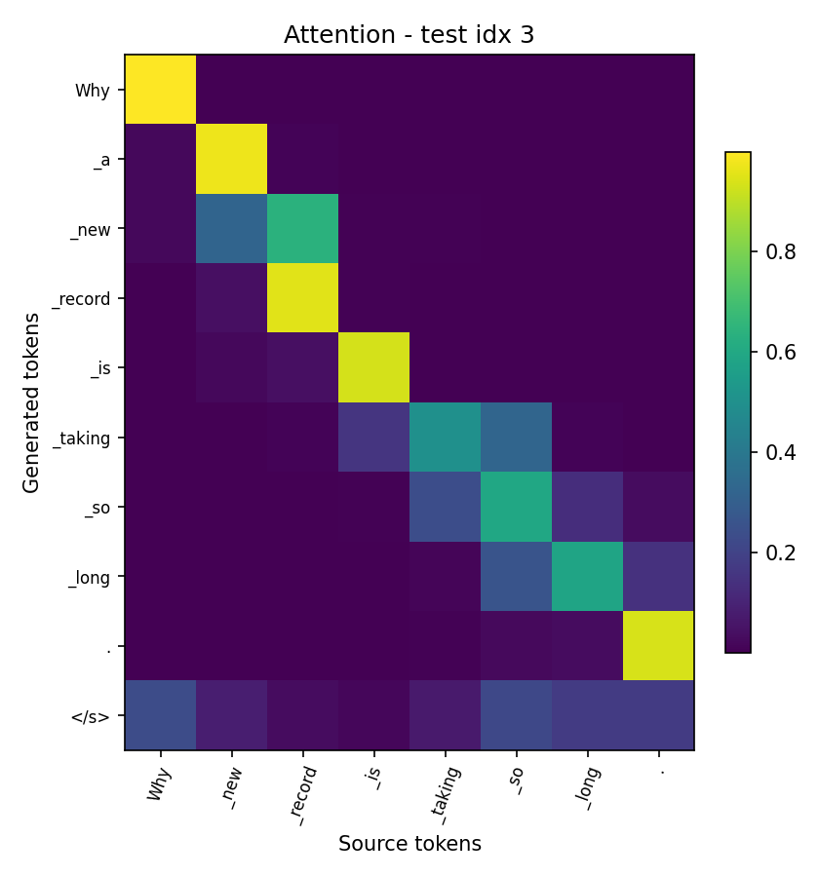
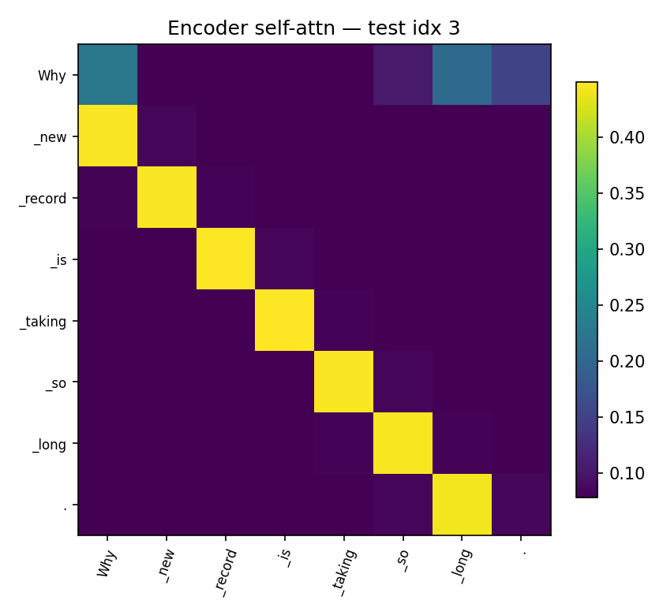
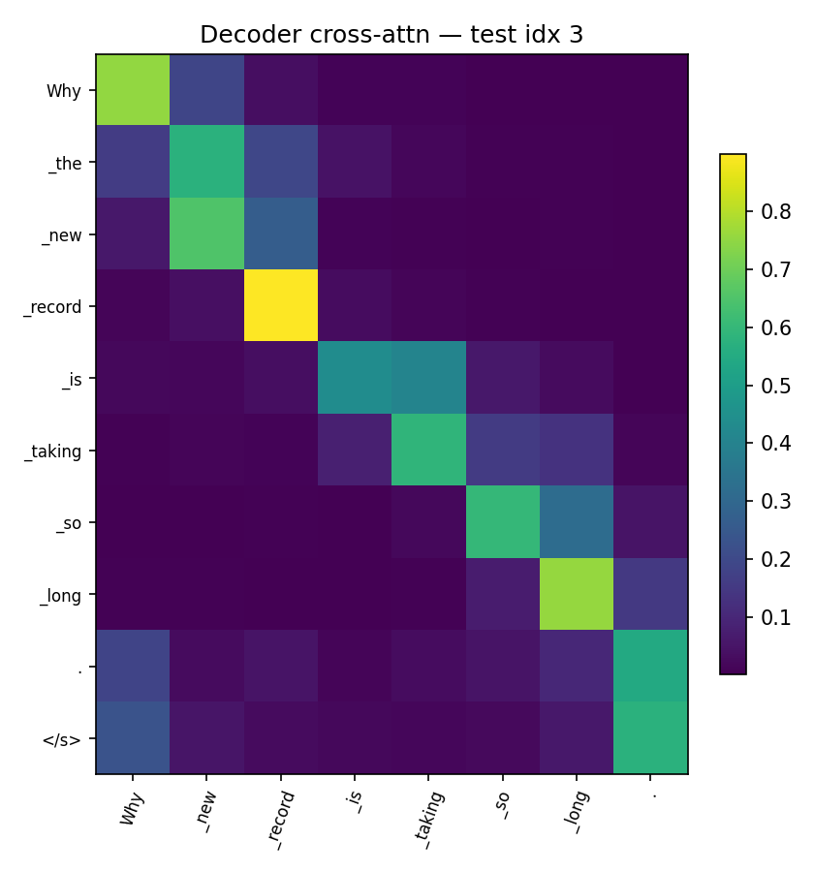
Attention Is Interpretable
Bahdanau decoder alignment | Transformer encoder self-attention | Transformer decoder cross-attention. Bahdanau and Transformer cross-attention learn visually similar source-to-output alignments.

Slide 11
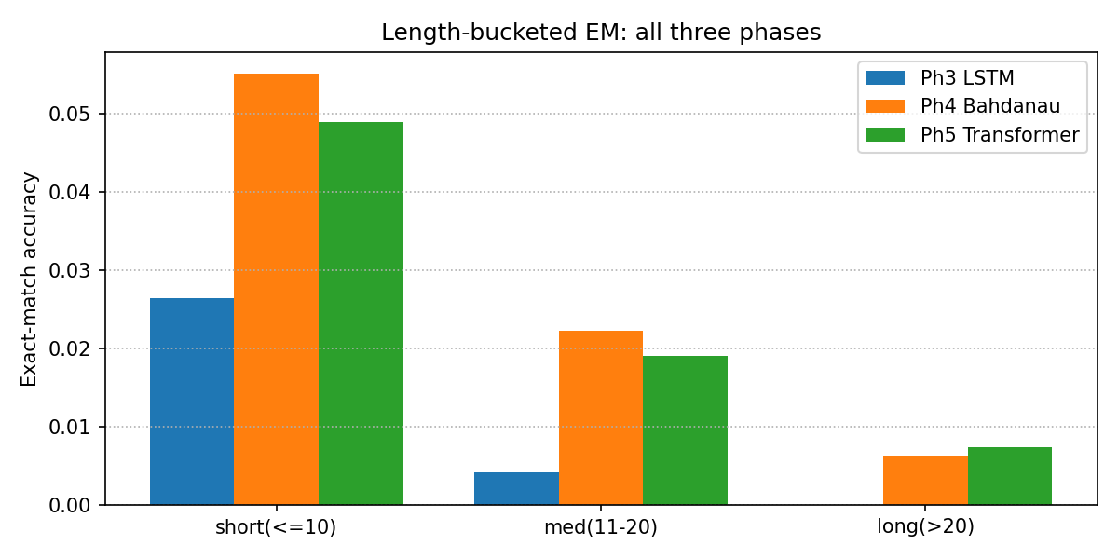
Behaviour by Sentence Length
Bottleneck LSTM (blue) collapses to ~0 on medium/long sentences.
Bahdanau and Transformer stay non-zero - attention prevents the collapse.
Crossover: Transformer (green) overtakes Bahdanau (orange) on the LONG bucket - its O(1) path helps most there.

Slide 12
Worked Example - The Three Correctors
Short sentence (insert a missing article):
SRC : Why new record is taking so long.
REF : Why the new record is taking so long.
P3 : Why new record is taking so long. LSTM - no edit (copies)
P4 : Why a new record is taking so long. Bahd. - inserts article 'a'
P5 : Why new record is taking so long? Trans. - '.' -> '?'
Long, noisy sentence:
P3 : '...cpue to buy and/indukine stead...' hallucinated nonsense
P4 : copies source, corrupts the URL
P5 : copies source, fixes 'got' -> 'get' the one real fix
LSTM collapses on long input; P4 and P5 differ by only 1-2 tokens.

Slide 13
Why Bahdanau LSTM ~ Transformer
Test GLEU is tied at 0.618. The Transformer matches, not beats:
Decisive feature is shared - both have full source access via attention (the +0.386 jump). LSTM-vs-self-attention is second-order.
Both hit the data ceiling - same budget, same noisy C4_200M references -> both converge to GLEU ~0.62.
Sentences are mostly short - the O(1) path only helps long-range dependencies (see the crossover).
On hard inputs both just copy - outputs differ by 1-2 tokens.
The real win is efficiency: same quality with 8.05M params vs 29.06M (3.6x fewer) + faster parallel training - it would pull ahead with more data or cleaner references.

Slide 14
Grammar-Rule Analysis of Outputs
Learned well (local syntax):
Subject-verb agreement: "What are this job" -> "What is this job"
Articles: "Why new record" -> "Why the new record"
Verb tense, punctuation, spacing.
Still hard:
Long-range / semantic edits; rare-word spelling (hallucination).
Dominant failure = under-correction: copying the source unchanged.

Slide 15
The Final Challenge - Dataset Quality
Why does EVERY model score only ~2% exact match?
Reference quality is the ceiling - not model capacity:
References are paraphrases: "informed"->"suggest", "startups"->"start-ups" - not grammar errors.
References can be noisy: target "no brain worky" - not a word.
Many valid corrections exist; exact match credits exactly one.
Report GLEU / F0.5, not exact match. Cleaner data would help more than a bigger model.

Slide 16
Conclusion
BoW detects grammaticality at ~62% - cannot correct.
LSTM corrects but is limited by the bottleneck (GLEU 0.213).
Bahdanau attention is the decisive jump (GLEU 0.599).
Transformer ties on GLEU (0.618) with 3.6x fewer params; best validation GLEU 0.613.
Key insight: the binding constraint is dataset quality, not architecture - synthetic C4_200M references are often paraphrases or noise.

Slide 17
Thank You
Questions?

