Slide 1
Medical Text Simplification
A Comparative Study of Five Biomedical Simplification Systems
CIE 553 — Natural Language Processing
Ibrahim Hanafy · Khaled Mahmoud · Salahdin Ahmed · Spring 2026 · Zewail City

Slide 2
The Problem
Medical knowledge is locked behind technical language
Patients increasingly read their own clinical reports, abstracts, and discharge summaries — but the text is written for doctors, not for them.
• Average medical abstract: FKGL ≈ 18 (university graduate level)
• Target patient reader: FKGL ≤ 8 (US grade school)
• Misreading → poor adherence, anxiety, worse outcomes
• Manual rewriting by clinicians is slow and expensive
• Demand growing: patient portals, MyChart, open-notes laws
Concrete Goal
Take a sentence written for doctors and rewrite it so a patient with grade-8 reading skill understands it — without losing medical meaning.
Why Now?
Modern transformers can paraphrase fluently — but do they handle medical jargon? We test this.
Medical Text Simplification · CIE 553 NLP · Ibrahim Hanafy
2 / 27

Slide 3
Why is this Hard?
Medical text breaks normal simplification assumptions
Dense terminology
'Myocardial infarction', 'thrombocytopenia' — patients don't know these words.
Latin & abbreviations
'In vivo', 'p.o.', 'q.d.', '(n = 147)' — meaningful to clinicians, noise to patients.
Long syntactic chains
30+ word sentences with nested clauses, citations, statistics.
Precision matters
Wrong simplification = wrong medical advice. Cannot drop quantities, doses, conditions.
Limited parallel data
Few sentence-aligned (technical, plain) pairs exist — mostly document-aligned.
Medical Text Simplification · CIE 553 NLP · Ibrahim Hanafy
3 / 27

Slide 4
Research Question
Can lightweight dictionary-driven and transformer-based methods reduce reading difficulty of medical abstracts without losing information?
We compare 4 systems · 3 metrics · 2 public datasets
• Does biomedical pretraining (SciFive) help over generic T5?
• Does combining symbolic + neural beat either alone?
• Can we get good results without huge LLMs and GPUs?
Medical Text Simplification · CIE 553 NLP · Ibrahim Hanafy
4 / 27

Slide 5
Our Approach
Five lanes, one evaluation harness
Same data → same metrics → fair comparison across paradigms.
Rule-Based
Symbolic Dictionary + regex
T5-Small
Neural seq2seq Fine-tuned 60M
SciFive
Biomedical T5 Domain pretrained
Hybrid
Symbolic → Neural Rules feed T5
Unified Evaluation Harness
Same test split · SARI + BLEU + FKGL · Same reference set
Key design choice: every system sees the same inputs and is scored the same way. No system gets a custom metric.
Medical Text Simplification · CIE 553 NLP · Ibrahim Hanafy
5 / 27

Slide 6
Datasets
PLABA + Cochrane PLS — two public biomedical sources
Dataset | Domain | Pairs
PLABA | PubMed → plain | ~7,500
Cochrane | Reviews → PLS | ~4,500
Preprocessing Pipeline
• SpaCy sentencize
• Positional pair alignment
• Token-count filter (5–80 src, 3–60 tgt)
• Length-ratio filter (0.5 – 3.0)
• FKGL-difference filter (Δ ≥ 1.0)
• 80 / 10 / 10 train / val / test split
Source pairs: technical sentence ↔ plain-language version.
Medical Text Simplification · CIE 553 NLP · Ibrahim Hanafy
6 / 27

Slide 7
System 1 — Rule-Based
Pure symbolic. No machine learning.
Baseline. Tests how far simple dictionary + regex can go before adding any neural model.
[1] Remove Latin parentheticals → '(in vivo)' stripped
[2] Substitute 507 jargon terms → 'myocardial infarction' → 'heart attack'
[3] Split long sentences → semicolon / FANBOYS conjunction
Strengths
• Deterministic, explainable
• No GPU, no training
• Fast at inference
Weaknesses
• No paraphrasing
• Cannot rewrite grammar
• Limited to dictionary
Medical Text Simplification · CIE 553 NLP · Ibrahim Hanafy
7 / 27

Slide 8
Rule-Based — Inside the Pipeline
Step 1: Latin parenthetical removal
'The drug was tested in vivo (in vivo trials in mice).'
→ 'The drug was tested in vivo.' # parenthetical with Latin marker removed
Step 2: Dictionary substitution (507 entries, longest-first)
patterns sorted: 'acute myocardial infarction' before 'myocardial infarction'
→ 'acute myocardial infarction' → 'sudden heart attack' (no partial overlap)
Step 3: Sentence splitting on long sentences (> 30 tokens)
Try semicolon first: 'A; B' → 'A.' 'B'
Else FANBOYS: 'A, but B' → 'A.' 'But B'
Both halves must be ≥ 5 tokens (min_fragment) — avoids fragments.
Medical Text Simplification · CIE 553 NLP · Ibrahim Hanafy
8 / 27

Slide 9
System 2 — T5-Small (Fine-tuned)
General-purpose seq2seq, fine-tuned on PLABA + Cochrane
T5 = Text-to-Text Transfer Transformer. Frames EVERY NLP task as text-in → text-out.
Input: 'simplify: <source sentence>'
Model: T5-small (60M parameters, encoder-decoder)
Output: simplified sentence
• Why T5-Small? Cheap to train, fits on free Colab GPU
• Fine-tuning: 3 epochs, AdamW, lr 3e-4
• Decoding: beam search, num_beams = 4, max_new_tokens = 128
• Input prefix 'simplify: ' tells the model which task to perform
Medical Text Simplification · CIE 553 NLP · Ibrahim Hanafy
9 / 27

Slide 10
T5-Small — What Fine-Tuning Teaches the Model
Before fine-tuning, T5 knows English. After fine-tuning, it knows medical → plain mapping.
Before fine-tuning
After fine-tuning
Input:
simplify: myocardial
infarction is acute.
Output:
myocardial infarction
is acute.
Input:
simplify: myocardial
infarction is acute.
Output:
a heart attack is
sudden and serious.
What the model learned
Three things simultaneously: vocabulary substitution (jargon → plain), syntactic restructuring (passive → active, shorter clauses), and content compression (keep the medically important parts).
Medical Text Simplification · CIE 553 NLP · Ibrahim Hanafy
10 / 27

Slide 11
System 3 — SciFive
T5 pretrained on biomedical corpora
• Identical architecture to T5-Small (60M params)
• Pretrained on PubMed abstracts + PMC full articles
• Already 'speaks' medical English before fine-tuning
• Fine-tuned on PLABA + Cochrane with the same recipe as T5-Small
• Controlled experiment: only difference = pretraining corpus
Hypothesis
Domain pretraining gives SciFive a head start on medical terminology — it should beat vanilla T5-Small on biomedical simplification.
Medical Text Simplification · CIE 553 NLP · Ibrahim Hanafy
11 / 27

Slide 12
System 4 — Hybrid
Symbolic substitution then neural generation
source → [jargon dictionary] → [T5-small fine-tuned] → output
Idea: pre-simplify medical terms so T5 can focus on syntax and fluency.
• Stage 1: dictionary jargon substitution (same 507 terms)
• Stage 2: T5-Small fine-tuned model generates final output
• Hypothesis: T5 frees up capacity it would have used on jargon
• Tests whether explicit knowledge helps a neural model
Medical Text Simplification · CIE 553 NLP · Ibrahim Hanafy
12 / 27

Slide 13
Evaluation Metrics
Three complementary signals
Metric | Direction | Measures
SARI | ↑ higher | Edit quality vs reference (add / keep / delete)
BLEU | ↑ higher | n-gram overlap with reference
FKGL Δ | ↓ more negative | Drop in reading grade (input − output)
Implementation
• SARI via EASSE (corpus_sari)
• BLEU via sacrebleu (effective_order=True, smooths short sentences)
• FKGL via textstat (Flesch–Kincaid Grade Level — US grade)
src/metrics.py
Medical Text Simplification · CIE 553 NLP · Ibrahim Hanafy
13 / 27

Slide 14
Metric Deep-Dive 1 — SARI
System output Against References and against the Input
SARI is the standard simplification metric. Unlike BLEU, it rewards EDITS, not just overlap.
SARI = average of three F-scores:
add_F1 — words system adds that match reference
keep_F1 — words system keeps that match reference
delete_P — words system deletes that reference also dropped
Why it matters here
A system that just copies the input gets high BLEU but low SARI. SARI punishes 'do nothing'.
Limitation
Single-reference SARI is noisy. Our datasets have only one reference per source.
Medical Text Simplification · CIE 553 NLP · Ibrahim Hanafy
14 / 27

Slide 15
Metric Deep-Dive 2 — BLEU
n-gram overlap with reference
Originally for machine translation. Measures how many short word sequences match the reference.
BLEU = geometric mean of n-gram precisions (n = 1..4) × brevity penalty
1-gram match: words
2-gram match: adjacent word pairs
3-gram, 4-gram: longer phrases
Why it matters here
BLEU rewards fluency and lexical fidelity. A good simplification should still share content words with the reference.
Caveat
BLEU rewards copying — so SARI must accompany it to detect 'no-op' systems.
Medical Text Simplification · CIE 553 NLP · Ibrahim Hanafy
15 / 27

Slide 16
Metric Deep-Dive 3 — FKGL
Flesch–Kincaid Grade Level
A reference-free readability score. Estimates US school grade needed to read the text.
FKGL = 0.39 × (words / sentences)
+ 11.8 × (syllables / words)
− 15.59
FKGL Δ = FKGL(input) − FKGL(output) # bigger drop = simpler output
Why it matters here
SARI and BLEU need a reference. FKGL doesn't — it directly measures the OUTPUT'S reading difficulty.
Caveat
Surface metric — doesn't check meaning. A garbled short sentence scores well. Must pair with SARI / BLEU.
Medical Text Simplification · CIE 553 NLP · Ibrahim Hanafy
16 / 27

Slide 17
Why These Three Metrics Together?
Each one alone is gameable. Together they triangulate quality.
Every metric has a failure mode. Together they catch cheaters.
Metric Used Alone | Easy Way to Cheat It
SARI only | Add random edits → high SARI, garbled output
BLEU only | Copy input verbatim → high BLEU, no simplification
FKGL only | Output 'A.' → very low grade, zero meaning
Together
SARI demands edits, BLEU demands fidelity, FKGL demands actual readability gain. A system must satisfy all three — no single hack wins.
Medical Text Simplification · CIE 553 NLP · Ibrahim Hanafy
17 / 27

Slide 18
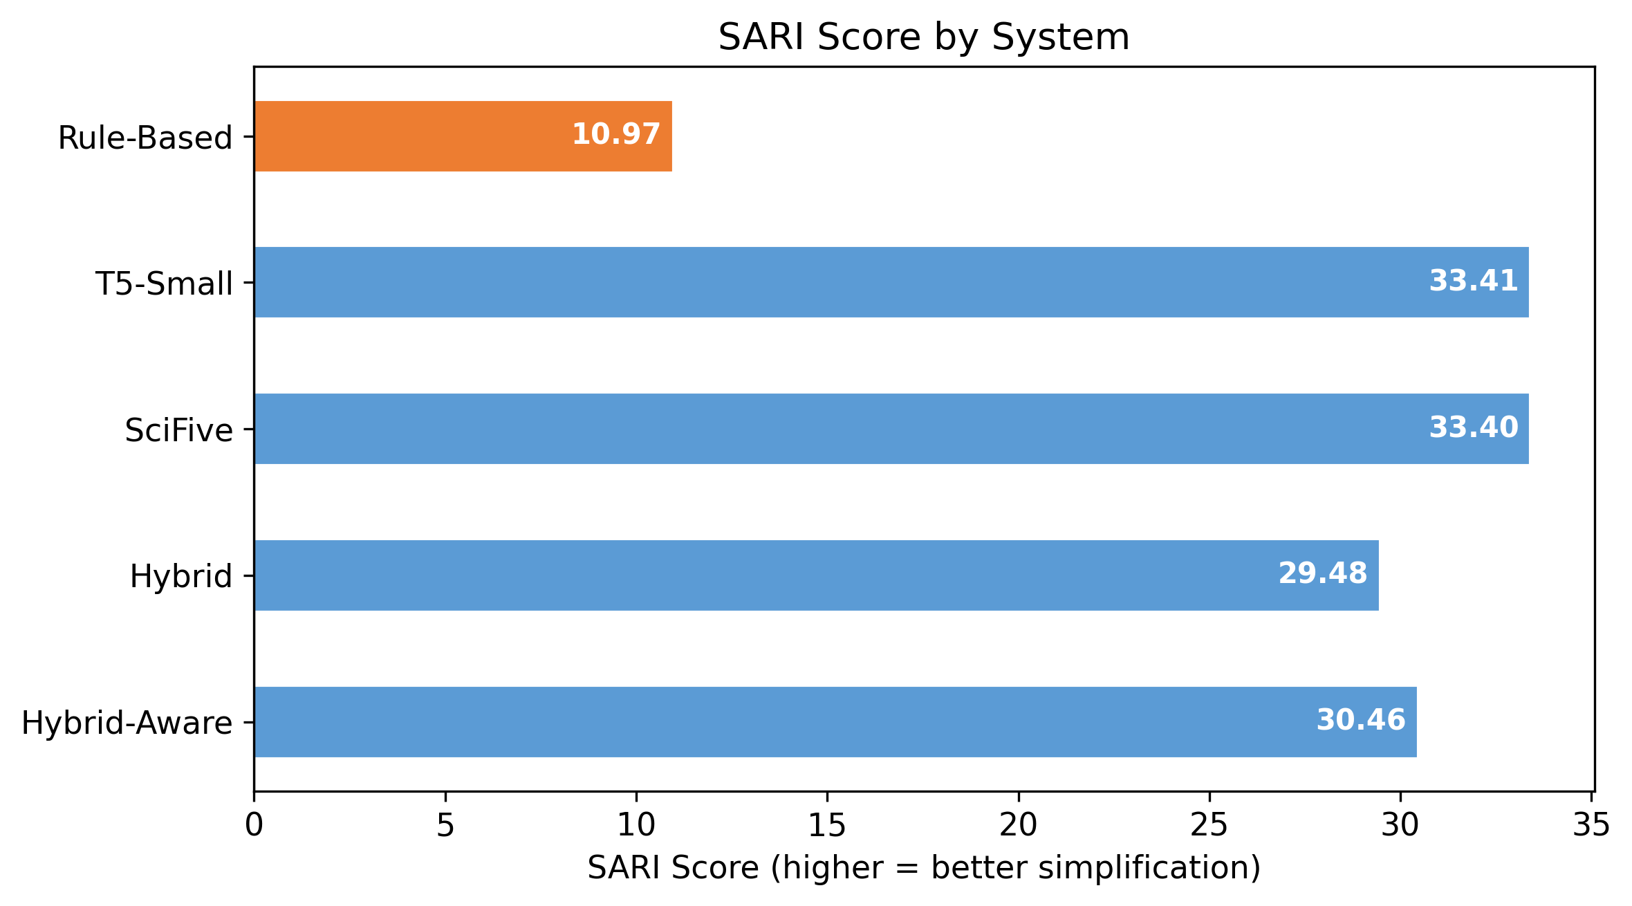
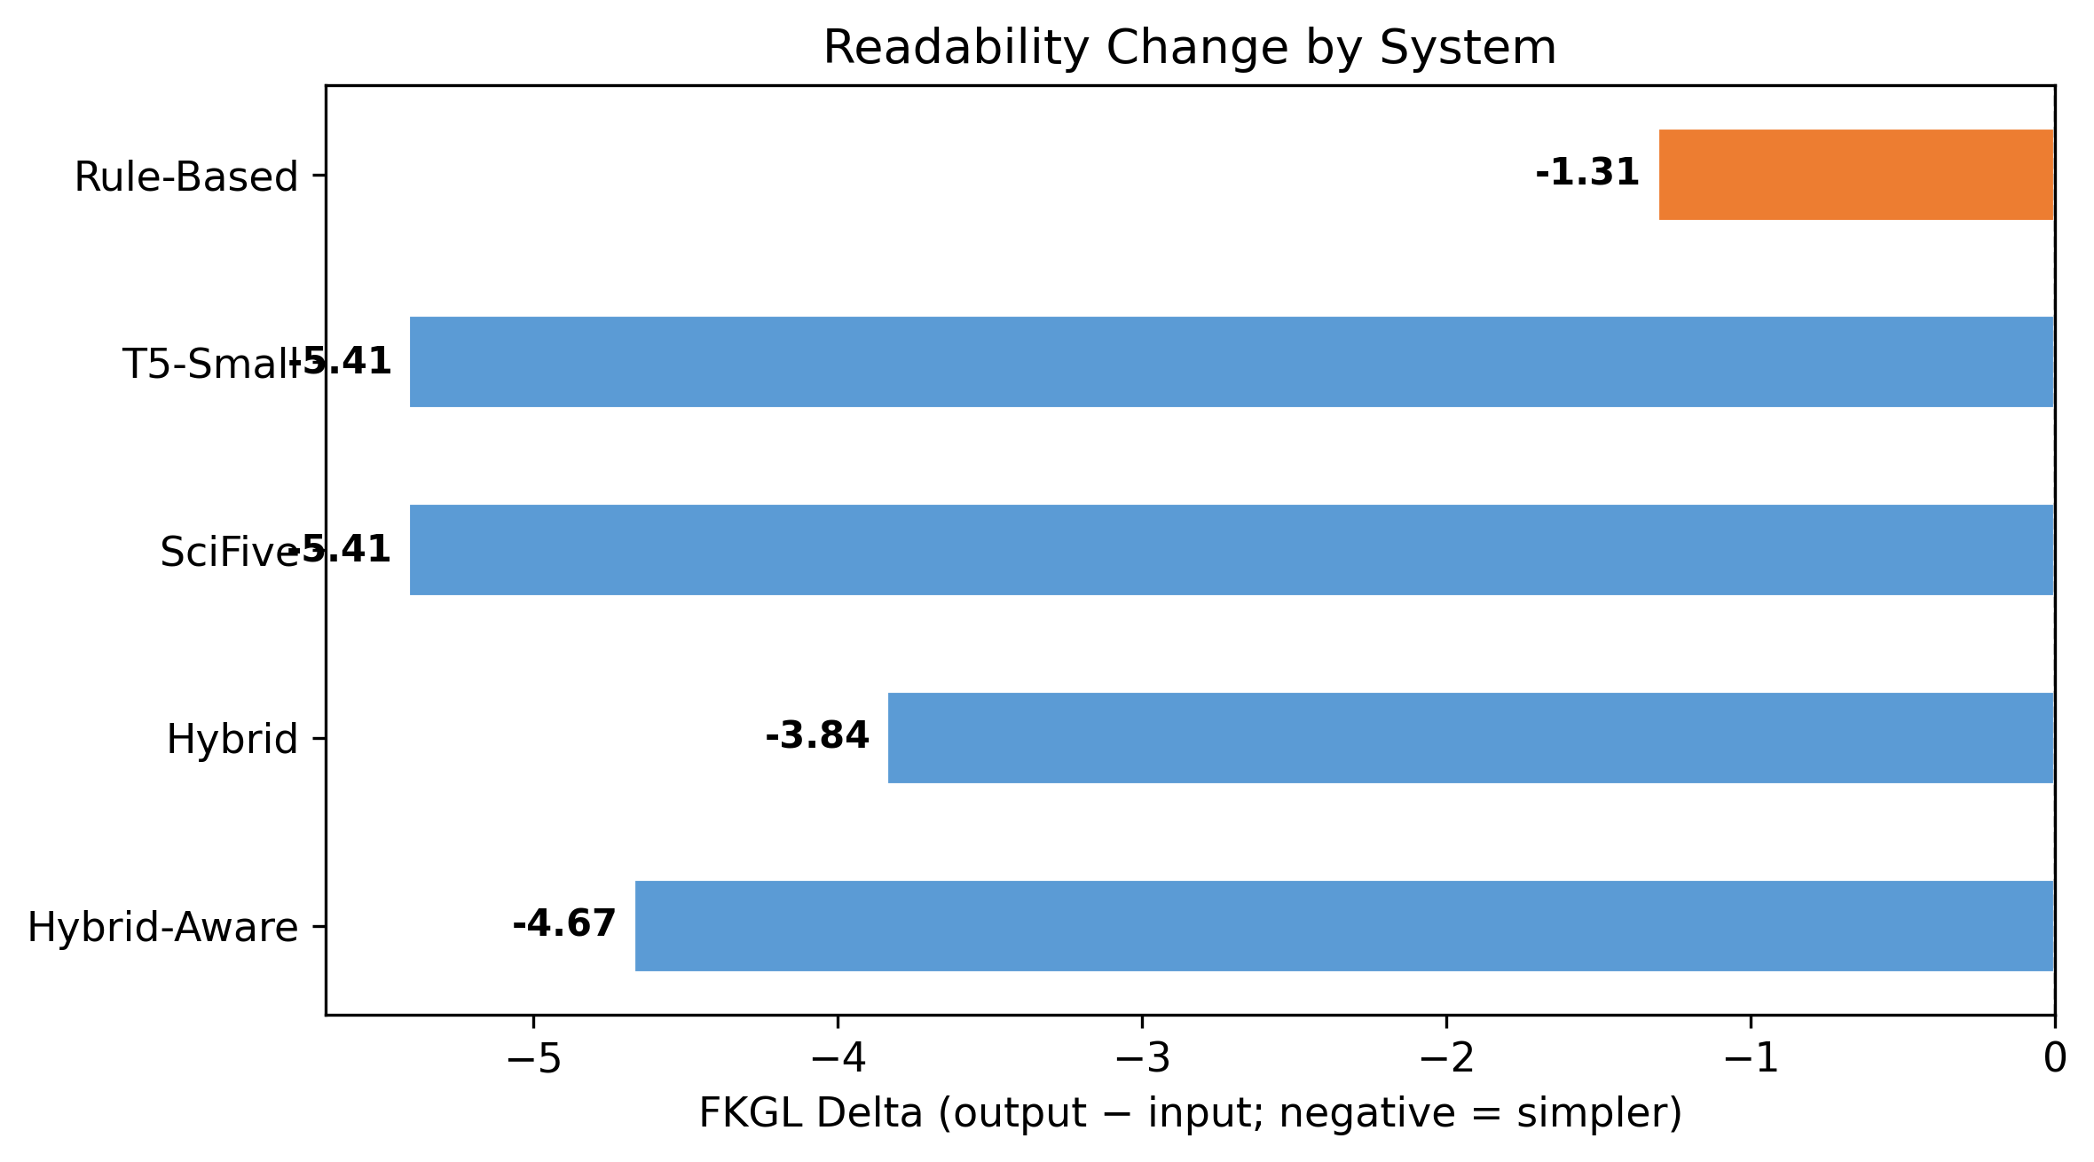
Results
All five systems on the same test split
System | SARI ↑ | BLEU ↑ | FKGL Δ ↓
Rule-Based | 10.97 | 5.96 | −1.31
T5-Small | 33.41 | 7.92 | −5.41
SciFive | 33.40 | 7.92 | −5.41
Hybrid (naive) | 29.48 | 6.37 | −3.84
Hybrid-Aware | 30.46 | 6.83 | −4.67
T5-Small wins on all 3 metrics
Medical Text Simplification · CIE 553 NLP · Ibrahim Hanafy
18 / 27

Slide 19
Key Findings
1
Fine-tuned T5 wins
Best on all 3 metrics. Task-specific fine-tuning dominates.
2
SciFive ≈ T5-Small
Domain pretraining did NOT help at this scale.
3
Naive hybrid underperforms T5
Pre-substitution at inference removes context T5 was trained on.
4
Aware hybrid recovers ~25% of gap
29.48 → 30.46 SARI. Still below T5 (33.41) — residual cost of preprocessing.
5
Rule-based loses on SARI / BLEU
Lowers FKGL but cannot rewrite.
Medical Text Simplification · CIE 553 NLP · Ibrahim Hanafy
19 / 27

Slide 20
Why Hybrid < T5?
Rule substitution destroys context
Source: 'myocardial infarction caused by occlusion'
After rule: 'heart attack caused by blockage'
After T5: 'a heart attack happened.' ← T5 over-shortens
Insight
T5 already learned 'myocardial infarction' → 'heart attack' during fine-tuning. Pre-substitution gives T5 a shorter input, so it over-compresses output. Symbolic preprocessing HURT the strong neural model.
Medical Text Simplification · CIE 553 NLP · Ibrahim Hanafy
20 / 27

Slide 21
Distribution-Aware Hybrid
Testing the shift hypothesis
Naive hybrid: T5 trained on ORIGINAL src → inference fed SUBSTITUTED src (mismatch)
Aware hybrid: T5 trained on SUBSTITUTED → inference fed SUBSTITUTED (matched)
System | SARI | Δ vs T5
T5-Small | 33.41 | —
Hybrid (naive) | 29.48 | −3.93
Hybrid-Aware | 30.46 | −2.95
Verdict
Distribution alignment recovers +0.98 SARI (~25% of the gap). Remaining 2.95 SARI is residual cost of lexical substitution itself — not just shift.
Medical Text Simplification · CIE 553 NLP · Ibrahim Hanafy
21 / 27

Slide 22
Qualitative Sample
Hybrid output vs reference
SOURCE
The psychosocial interventions considered in the studies were: cognitive-behavioural coping skills training, twelve-step programme, brief intervention, motivational interviewing, and brief motivational interviewing.
HYBRID
The studies included: cognitive-behavioural coping skills training, twelve-step programme, brief intervention, motivational interviewing, and brief motivational interviewing.
REFERENCE
The twelve-step programme is based on theories from Alcoholics Anonymous and aims to motivate the person to develop a desire to stop using drugs or alcohol.
Caveat: References are document-level, not sentence-aligned. This caps BLEU ceiling regardless of system quality.
Medical Text Simplification · CIE 553 NLP · Ibrahim Hanafy
22 / 27

Slide 23
Repository Structure
src/ shared Python modules
rule_based.py RuleBasedSimplifier class
hybrid.py HybridPipeline class
metrics.py SARI / BLEU / FKGL wrappers
data_utils.py preprocessing filters
notebooks/ 5 sequential experiment notebooks
results/
metrics.csv canonical results table
figures/ SARI + FKGL bar charts
predictions/samples/ 10 records / system for demo
paper/ IEEE conference paper (LaTeX + PDF)
Medical Text Simplification · CIE 553 NLP · Ibrahim Hanafy
23 / 27

Slide 24
Reproducibility
Demo runs in minutes, no GPU
• Open notebooks/05_evaluation.ipynb → Run All
• No GPU required — all predictions pre-committed
• Figures regenerate from results/metrics.csv
• Local Jupyter + Google Colab both supported
• All dependencies pinned in requirements.txt
git clone https://github.com/IbrahimHanafy2222/NLP-Project-Submission
cd NLP-Project-Submission
pip install -r requirements.txt
jupyter notebook notebooks/05_evaluation.ipynb
Medical Text Simplification · CIE 553 NLP · Ibrahim Hanafy
24 / 27

Slide 25
Limitations & Future Work
Limitations
Future Work
• Reference misalignment in Cochrane caps BLEU
• 60M-parameter model — larger models likely improve fluency
• No human evaluation (automatic metrics only)
• English only
• Try LLaMA-3 / Flan-T5-large
• Human readability study with patients
• Smarter hybrid: rule pass AFTER T5, not before
• Multi-reference evaluation
Medical Text Simplification · CIE 553 NLP · Ibrahim Hanafy
25 / 27

Slide 26
Conclusion
Fine-tuned T5-Small (60M) beats biomedical pretraining (SciFive), naive hybrid, AND distribution-aware hybrid at biomedical text simplification.
Takeaways
• Task-specific fine-tuning > generic domain pretraining at small scale
• Symbolic preprocessing can hurt strong neural models — even with matched train/inference distribution
• Lexical substitution imposes a residual cost beyond distributional shift
• Three complementary metrics (SARI + BLEU + FKGL) prevent gaming
• Reproducible, GPU-free demo pipeline shipped
Medical Text Simplification · CIE 553 NLP · Ibrahim Hanafy
26 / 27

Slide 27
Q & A
Code: github.com/IbrahimHanafy2222/NLP-Project-Submission
Paper: paper/NLP_Project.pdf · Demo: notebooks/05_evaluation.ipynb
Thank you.

