Slide 1
UNIVERSITY OF SCIENCE AND TECHNOLOGY · ZEWAIL CITY
MLE Estimation & Estimator Distribution in Linear Regression
CIE 457 — Statistical Inference and Data Analysis · Spring 2026
Ibrahim Hanafy 202200518 Mai Ibrahim 202200504 Mohamed Alaa 202100905
Instructor: Dr. Mahmoud Abdelaziz

Slide 2
Outline
§1
The Linear Model & MLE–OLS Equivalence
§2
Distribution of β̂ — Analytical Derivation
§3
Part 1: Monte Carlo Validation (Homoscedastic)
§4
Part 2: Heteroscedasticity — OLS vs. WLS
§5
Part 3: Confidence & Prediction Intervals
§6
EDA — Advertising Dataset
§7
Part 4: Real-Data Heteroscedasticity Detection
§8
Cramér–Rao Bound & UMVUE (Bonus)
CIE 457 · MLE in Linear Regression · Zewail City · Spring 2026

Slide 3
§ 1 — The Linear Model
Gaussian noise · OLS as MLE · The estimator as a random variable

Slide 4

The Linear Regression Model
Symbol
Dimension
Role
y (vector)
n × 1
Observed response
X (matrix)
n × p
Design matrix — treated as fixed
β (vector)
p × 1
True unknown coefficient vector
ε (vector)
n × 1
Additive noise — sole source of randomness
σ² (scalar)
—
Common noise variance (homoscedastic)
Key assumption: every observation shares the same noise variance σ². Relaxing this assumption leads to the heteroscedastic model analysed in Part 2.
CIE 457 · MLE in Linear Regression · Zewail City · Spring 2026

Slide 5


Why OLS Equals MLE
Under Gaussian noise, the log-likelihood of β given data y is:
Observation
Maximising ℓ(β) over β is equivalent to minimising ‖y − Xβ‖² — the ordinary least-squares criterion.
Setting ∇_β ℓ = 0 yields the Normal Equations:
Conclusion
OLS is not merely a geometric trick — it is the Maximum Likelihood Estimator under i.i.d. Gaussian errors. For non-Gaussian noise, MLE and OLS diverge.
CIE 457 · MLE in Linear Regression · Zewail City · Spring 2026

Slide 6


Distribution of β̂_OLS
Substitute y = Xβ + ε into the closed-form solution:
Unbiasedness
Covariance
E[β̂] = β + (X'X)⁻¹X' · E[ε] Since E[ε] = 0, we get E[β̂] = β → OLS is an unbiased estimator
Cov(β̂) = (X'X)⁻¹X' · σ²I · X(X'X)⁻¹ = σ²(X'X)⁻¹ Controls spread of estimates across datasets
Central Theorem
Since β̂ is a linear function of Gaussian ε, and linear maps preserve Gaussianity:
CIE 457 · MLE in Linear Regression · Zewail City · Spring 2026

Slide 7
§ 2 — Part 1: Monte Carlo Validation
Homoscedastic Gaussian noise · M = 5 000 replications

Slide 8
Monte Carlo Design
Part 1 — Homoscedastic noise
Simulation Parameters
Procedure (per replication)
• Observations: n = 100
• 1. Draw ε⁽ᵐ⁾ ~ N(0, σ²I)
• Predictors: p = 3
• 2. Compute y⁽ᵐ⁾ = Xβ + ε⁽ᵐ⁾
• True coefficients: β = [1, 2, 3]ᵀ
• 3. Estimate β̂⁽ᵐ⁾ = (X'X)⁻¹X'y⁽ᵐ⁾
• Noise variance: σ² = 1.0
• 4. Collect β̂⁽ᵐ⁾ for m = 1, …, 5 000
• Replications: M = 5 000
• Design matrix X: fixed across all trials
Expected Result
Empirical distribution of each β̂ⱼ should match: N( βⱼ , σ² [(X'X)⁻¹]ⱼⱼ )
CIE 457 · MLE in Linear Regression · Zewail City · Spring 2026

Slide 9
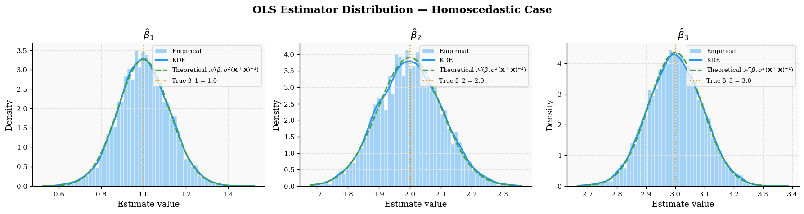
Empirical vs. Theoretical Distribution
Part 1
Result
Empirical histograms (blue) align precisely with theoretical Gaussians (orange dashed). Vertical dotted line = true βⱼ. Confirms: β̂_OLS ~ N(β, σ²(X'X)⁻¹).
Figure 1. Histograms of β̂₁, β̂₂, β̂₃ over M = 5 000 replications vs. theoretical Gaussian (orange). True β marked by dotted vertical line.
CIE 457 · MLE in Linear Regression · Zewail City · Spring 2026

Slide 10
§ 3 — Part 2: Heteroscedasticity
OLS inefficiency · Weighted Least Squares · Variance comparison

Slide 11

Heteroscedastic Noise Model
Part 2
Relaxed Assumption
Each observation has its own noise variance: ε ~ N(0, Σ), Σ = diag(σ₁², …, σₙ²)
OLS under Heteroscedastic Noise
WLS — Correct MLE
• β̂_OLS = (X'X)⁻¹X'y (formula unchanged)
• β̂_WLS = (X'Σ⁻¹X)⁻¹X'Σ⁻¹y
• Still unbiased: E[β̂] = β
• Weight wᵢ = 1/σᵢ² (down-weights noisy obs.)
• Cov(β̂_OLS) = (X'X)⁻¹X'ΣX(X'X)⁻¹ (sandwich)
• Cov(β̂_WLS) = (X'Σ⁻¹X)⁻¹
• INEFFICIENT — variance larger than necessary
• EFFICIENT — achieves Cramér–Rao bound
Gauss–Markov Corollary
OLS is BLUE (Best Linear Unbiased Estimator) only under homoscedasticity. Under heteroscedasticity, WLS is the BLUE — OLS is still unbiased but no longer best.
CIE 457 · MLE in Linear Regression · Zewail City · Spring 2026

Slide 12
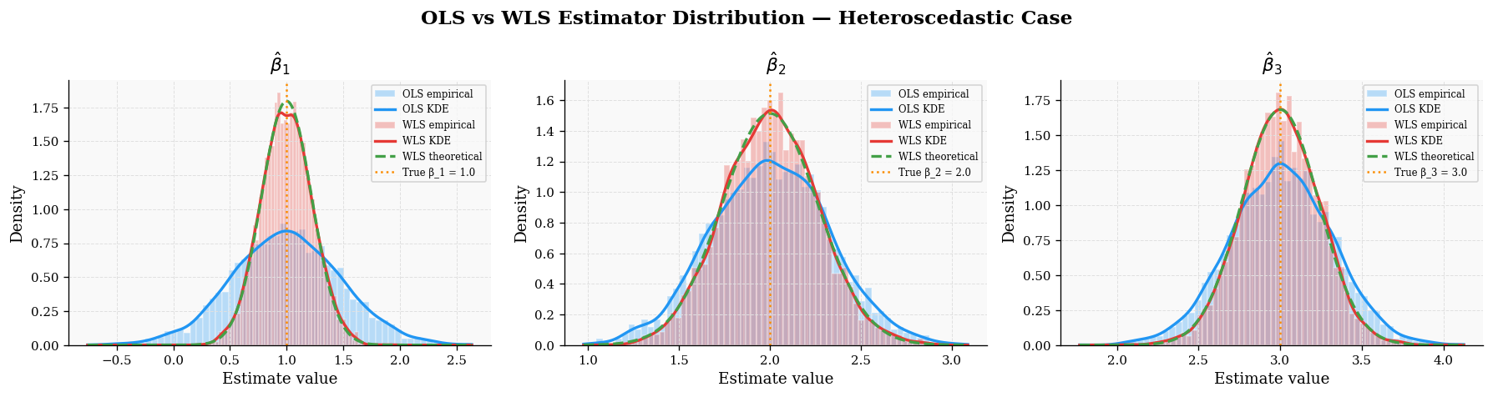
OLS vs. WLS — Sampling Distributions
Part 2
Observation
Both OLS (blue) and WLS (red) centred at true β — both unbiased. WLS distribution is narrower — lower variance — more efficient. The width gap is the cost of ignoring heteroscedasticity.
Figure 2. Empirical distributions of β̂_OLS (blue) and β̂_WLS (red) over M = 5 000 trials under heteroscedastic noise. Both centred at true β; WLS is narrower.
CIE 457 · MLE in Linear Regression · Zewail City · Spring 2026

Slide 13
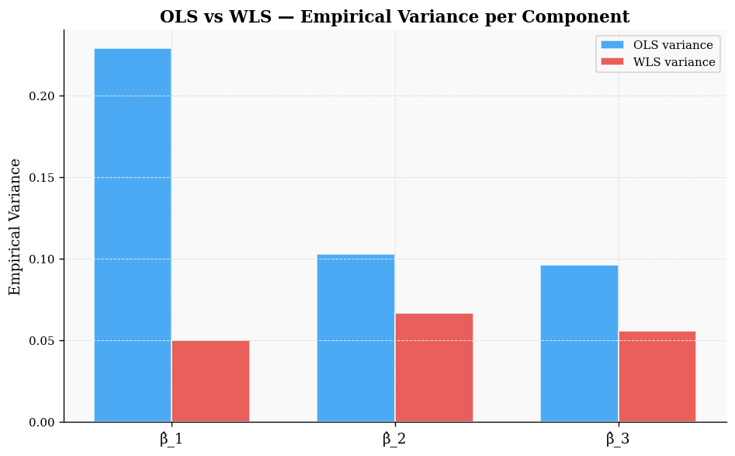
Variance Comparison: OLS vs. WLS
Part 2
Interpretation
For every coefficient component, the OLS bar (blue) is taller than WLS (red). The gap = efficiency gained by using the correct probabilistic model. Ignoring heteroscedasticity costs statistical precision — wider intervals, weaker tests.
Figure 3. Empirical variance of β̂ components for OLS (blue) and WLS (red). WLS achieves strictly lower variance across all three components.
CIE 457 · MLE in Linear Regression · Zewail City · Spring 2026

Slide 14
§ 4 — Part 3: Confidence & Prediction Intervals
Interval construction · Coverage verification · CI vs. PI distinction

Slide 15


Confidence & Prediction Intervals
Part 3
95% Confidence Interval for β̂ⱼ
95% Prediction Interval at x*
Uncertainty source: randomness in β̂ At 95%: z₀.₀₂₅ = 1.96
Uncertainty sources: (1) randomness in β̂, (2) future noise ε* — irreducible
Key Asymptotic Distinction
As n → ∞: CI collapses to a point (β̂ → β exactly) PI width → 2 z_{α/2} σ (future noise never disappears) Use CI for uncertainty in the mean response. Use PI for uncertainty about a single future observation.
CIE 457 · MLE in Linear Regression · Zewail City · Spring 2026

Slide 16
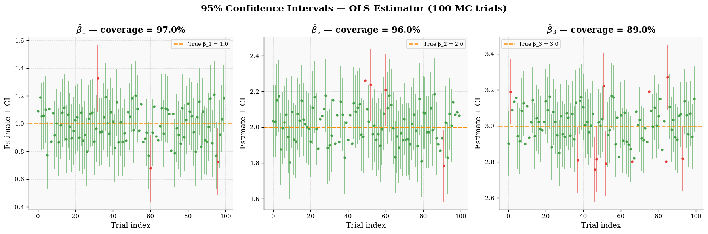
Empirical CI Coverage
Part 3
Frequentist Interpretation
If we repeat the experiment 100 times and build a 95% CI each time, approximately 95 intervals contain the true parameter. Green = contains true β₁. Red = misses. Empirical coverage ≈ 95%.
Figure 4. 95% confidence intervals for β̂₁ across 100 MC trials. Green = contains true β₁. Red = misses. Empirical coverage ≈ 95%.
CIE 457 · MLE in Linear Regression · Zewail City · Spring 2026

Slide 17
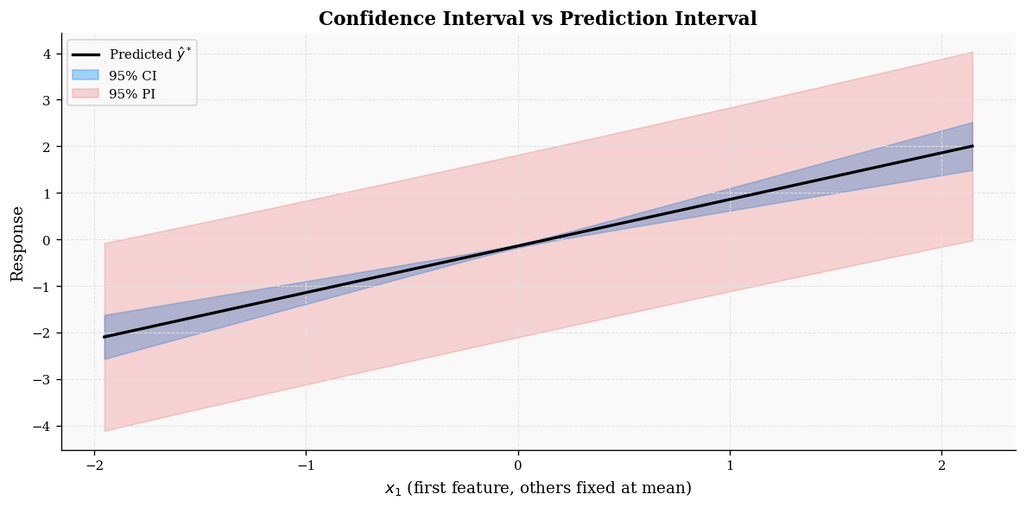
CI vs. PI Width Comparison
Part 3
Key Result
PI (red) is uniformly wider than CI (blue). Gap = σ² contribution from future noise ε*. As n → ∞: CI collapses, PI → ±1.96σ.
Figure 5. 95% confidence band (blue, narrow) vs. 95% prediction band (red, wider). PI is uniformly wider due to irreducible future-observation uncertainty.
CIE 457 · MLE in Linear Regression · Zewail City · Spring 2026

Slide 18
§ 5 — Exploratory Data Analysis
Advertising dataset · 200 observations · TV, Radio, Newspaper → Sales

Slide 19
Advertising Dataset Overview
Variable
Range
Description
Key Prior Findings
TV
0.7 – 296.4
TV advertising budget ($000s)
• TV: strongest predictor (r ≈ 0.78)
radio
0.0 – 49.6
Radio advertising budget ($000s)
• Radio: second (r ≈ 0.58)
• Newspaper: weak (r ≈ 0.23) — non-significant in multiple regression
newspaper
0.4 – 114.0
Newspaper budget ($000s)
• TV–Sales scatter suggests heteroscedasticity
sales
1.6 – 27.0
Units sold (thousands)
Source
James et al., An Introduction to Statistical Learning (ISLR) n = 200 · No missing values · Continuous variables
CIE 457 · MLE in Linear Regression · Zewail City · Spring 2026

Slide 20
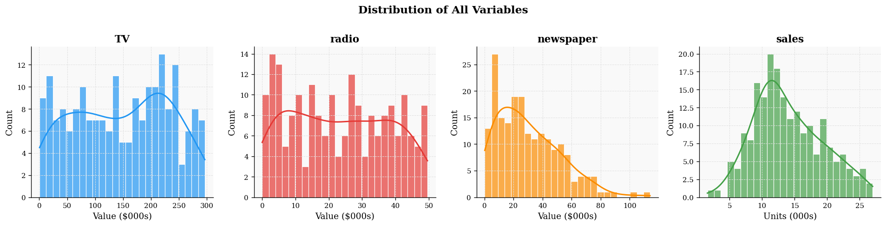
Variable Distributions
Figure 6. Marginal distributions of all four variables with KDE overlay. TV is right-skewed; Sales is approximately symmetric; Newspaper has a heavy right tail.
CIE 457 · MLE in Linear Regression · Zewail City · Spring 2026

Slide 21
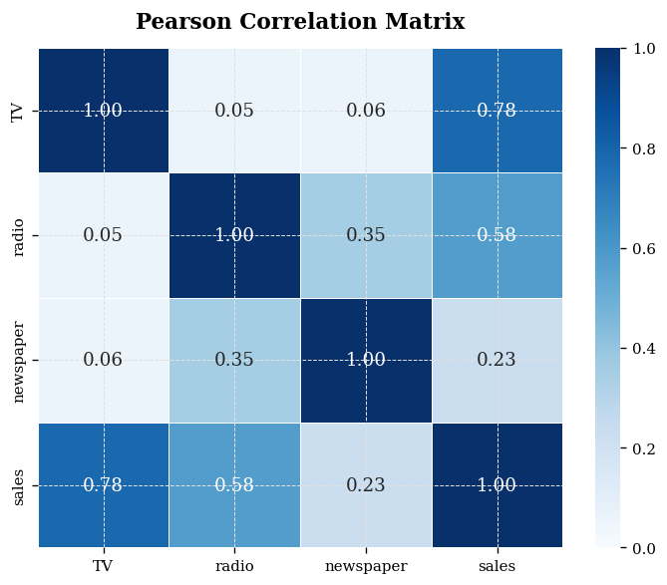
Correlation Structure
Correlations with Sales
r(TV, sales) ≈ 0.78 r(radio, sales) ≈ 0.58 r(newspaper, sales) ≈ 0.23 TV dominates. Radio adds incremental value. Newspaper's marginal correlation partly spurious (correlated with TV/Radio).
Figure 7. Pearson correlation heatmap. TV shows the strongest pairwise association with Sales.
CIE 457 · MLE in Linear Regression · Zewail City · Spring 2026

Slide 22
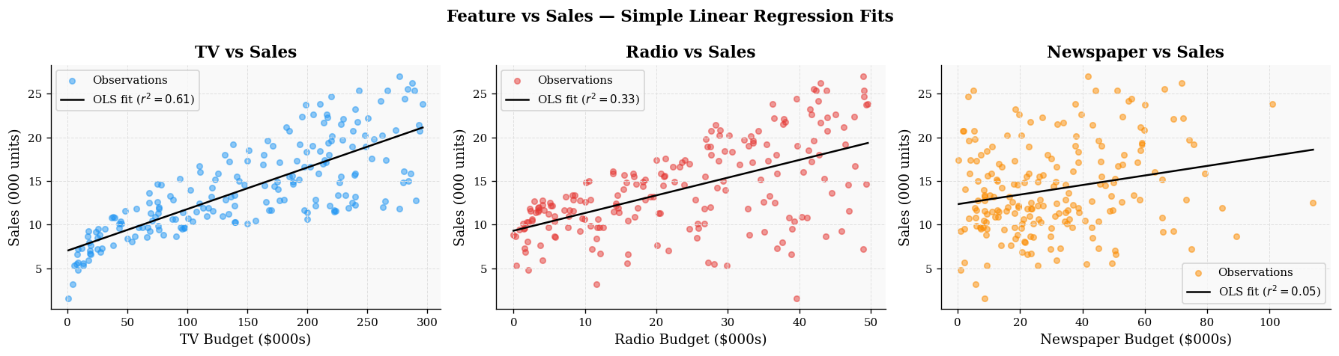
Scatter Plots: Predictors vs. Sales
Critical Observation
TV–Sales shows clear linear trend AND increasing variance. At low TV: tight scatter. At high TV: fans out. This funnelling is the signature of heteroscedasticity — motivating White's test and WLS in Part 4.
Figure 8. Sales vs. each advertising channel. TV exhibits increasing variance — a visual cue for heteroscedasticity.
CIE 457 · MLE in Linear Regression · Zewail City · Spring 2026

Slide 23
§ 6 — Part 4: Real-Data Analysis
Heteroscedasticity detection · White's test · OLS vs. WLS on Advertising

Slide 24
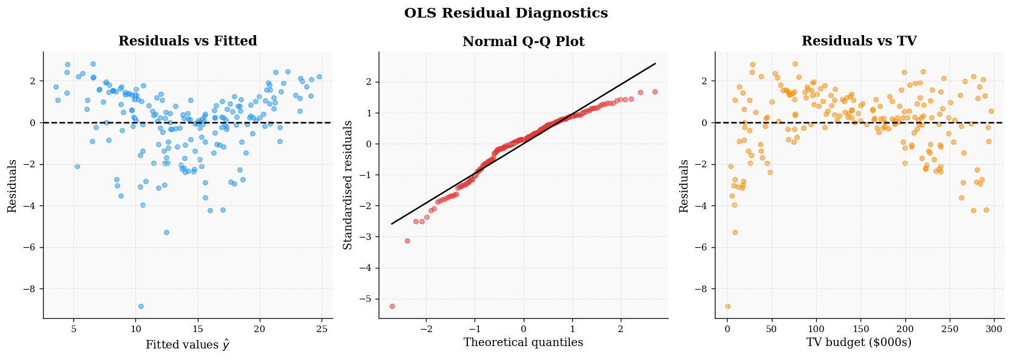
Residual Diagnostics
Part 4
Diagnosis
Funnel-shaped residuals vs. fitted → variance grows with fitted values. Upward scale-location trend → confirms non-constant variance. Q-Q plot: approximately normal errors (favourable for inference). OLS standard errors are therefore UNRELIABLE.
Figure 9. Three-panel residual analysis. Left: residuals vs. fitted (funnel). Centre: scale-location (upward trend). Right: normal Q-Q.
CIE 457 · MLE in Linear Regression · Zewail City · Spring 2026

Slide 25
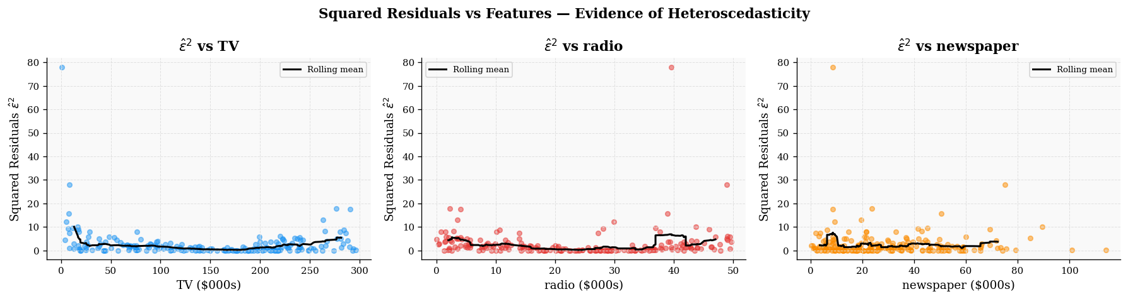
Formal Test: White's Heteroscedasticity Test
Part 4
Why White's Test — Not Breusch–Pagan?
Test Hypotheses
• Breusch–Pagan: regresses ε̂² on X — detects linear variance dependence only
H₀: σ₁² = σ₂² = ⋯ = σₙ² (homoscedasticity) H₁: at least one σᵢ² ≠ σⱼ²
• White's test: augments with X², cross-products — detects nonlinear patterns
• TV variance grows roughly quadratically → White's test is necessary
• Breusch–Pagan fails to reject on this dataset; White's strongly rejects
Result on Advertising Data
White's test statistic ≫ χ²₀.₀₅, df p-value < 0.001 → REJECT H₀ — strong evidence of heteroscedasticity
Figure 10. OLS squared residuals ε̂ᵢ² vs. each predictor. Positive trend with TV confirms variance grows with TV budget — nonlinear heteroscedasticity.
CIE 457 · MLE in Linear Regression · Zewail City · Spring 2026

Slide 26
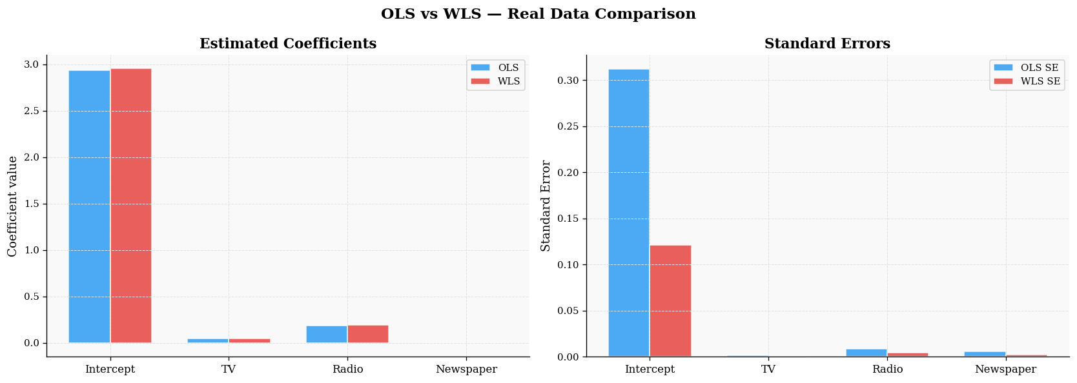
OLS vs. WLS Coefficients — Advertising Data
Part 4
Interpretation
Coefficient estimates differ slightly between OLS and WLS. More importantly: standard errors differ. OLS SEs computed under false homoscedasticity assumption → UNRELIABLE. WLS SEs correctly account for heteroscedastic structure → RELIABLE. Using OLS SEs would produce incorrect hypothesis tests and intervals.
Figure 11. Estimated coefficients ± SE for OLS (blue) and WLS (red) on Advertising data. Error bars represent one standard error.
CIE 457 · MLE in Linear Regression · Zewail City · Spring 2026

Slide 27
§ 7 — Bonus: Fisher Info & CRLB
Cramér–Rao Lower Bound · OLS as UMVUE

Slide 28


Fisher Information & Cramér–Rao Bound
The Fisher information matrix quantifies the information the data carry about β:
Cramér–Rao Lower Bound
For any unbiased estimator β̃ of β: Cov(β̃) ≥ I(β)⁻¹ = σ²(X'X)⁻¹ (in the positive semi-definite sense)
Main Result — OLS is UMVUE
Cov(β̂_OLS) = σ²(X'X)⁻¹ = I(β)⁻¹ OLS achieves the CRLB exactly. → No unbiased estimator of β can have smaller variance than OLS under Gaussian noise. → β̂_OLS is the Uniformly Minimum Variance Unbiased Estimator (UMVUE).
CIE 457 · MLE in Linear Regression · Zewail City · Spring 2026

Slide 29
Summary of Main Results
Part
Claim
Method
Status
Theory
β̂_OLS ~ N(β, σ²(X'X)⁻¹)
Analytical derivation
Proven
Part 1
Empirical distribution matches theory
Monte Carlo, M = 5 000
Confirmed
Part 2
WLS more efficient than OLS
MC + variance comparison
Confirmed
Part 3
95% CI achieves 95% coverage; PI > CI
MC coverage test
Confirmed
Part 4
Advertising data heteroscedastic
White's test + residuals
Confirmed
Bonus
OLS achieves CRLB → UMVUE
Fisher info + MC ratio ≈ 1
Confirmed
CIE 457 · MLE in Linear Regression · Zewail City · Spring 2026

Slide 30
Conclusions
Theoretical Takeaways
Practical Takeaways
• OLS is MLE under Gaussian errors — not merely geometric
• Always run residual diagnostics before trusting SEs
• β̂ inherits Gaussianity from ε via linearity
• Use White's test when nonlinear variance patterns are suspected
• Heteroscedasticity breaks OLS efficiency but not unbiasedness
• PI is always wider than CI — use the right one for the right question
• WLS is the correct MLE when Σ is known
• TV budget drives most explainable variance in sales
• OLS is UMVUE — provably optimal among unbiased estimators
• TV budget also drives the heteroscedasticity in the Advertising data
Connecting Theory and Practice
Simulation validated theorems. Real-data analysis demonstrated consequences of assumption violations. The project bridges statistical theory and applied regression methodology.
CIE 457 · MLE in Linear Regression · Zewail City · Spring 2026

Slide 31
Thank You
Questions & Discussion
Ibrahim Hanafy · Mai Ibrahim · Mohamed Alaa CIE 457 — Statistical Inference and Data Analysis · Zewail City · Spring 2026

