Slide 1
Zewail City University
CIE 457 — Statistical Inference and Data Analysis
MLE Estimation and Estimator Distribution in Linear Regression
A comprehensive analysis of Maximum Likelihood Estimation, estimator properties, and practical applications in statistical inference
AUTHORS
INSTRUCTOR
TERM
Ibrahim Hanafy Mai Ibrahim
Dr. Mahmoud Abdelaziz Statistical Inference
Spring 2026 Academic Year 2025-2026
≈ Statistical Inference & Data Analysis
May 2026

Slide 2
CIE 457 > Statistical Inference and Data Analysis
Slide 2 of 14
◎
Project Overview
☰
Objectives
◎
Scope & Outcomes
Understand MLE in linear regression: Derive Maximum Likelihood Estimation principles and their application in linear regression models.
OLS from MLE
Unbiasedness
Monte Carlo
Advertising
Study estimator as random variable: Study the statistical properties and distribution of estimators.
4
Key Simulations
Contrast noise types: Compare homoscedastic vs heteroscedastic noise and their implications.
3
Estimator Types
Practical applications: Apply theoretical concepts to real-world datasets.
1
Real Dataset
≈ CIE 457 — Statistical Inference and Data Analysis
👤 Dr. Mahmoud Abdelaziz

Slide 3



CIE 457 > Statistical Inference and Data Analysis
Slide 3 of 14
■
The Linear Model
■
Model Specification
▽
Distributional Assumptions
y = Xβ + ε
● Homoscedastic Case
• All observations share variance σ²
y ∈ Rⁿ
Observed outcomes
• Independent errors
• Covariance structure = σ²I
X ∈ Rⁿˣᵖ
Full-rank design matrix (p)
• MLE ⇒ OLS
β ∈ Rᵖ
Unknown parameters
● General (Heteroscedastic) Case
ε
Random error — source of all randomness
Why E[y|X] = Xβ ?
• Σ = symmetric positive definite (known/estimated)
E[ε] = 0 by assumption ⇒ E[y|X] = Xβ + 0 = Xβ
• Diagonal Σ = different σ²ᵢ per observation
• MLE ⇒ WLS
≈ CIE 457 — Statistical Inference and Data Analysis
👤 Dr. Mahmoud Abdelaziz

Slide 4




CIE 457 > Statistical Inference and Data Analysis
Slide 4 of 14
■
Likelihood & MLE Derivation
λ
Homoscedastic Likelihood Function
▶
OLS Estimator Derivation
Likelihood function:
Solve for β from the normal equations:
Find OLS estimator:
Log-likelihood function — take the natural log to simplify:
☑ Key Properties
Unbiased
E[β̂] = β
Maximize w.r.t. β — set ∂ℓ/∂β = 0:
Variance
σ²(×ᵀ×)⁻¹
BLUE
Best Linear Unbiased Estimator (Gauss-Markov)
≈ CIE 457 — Statistical Inference and Data Analysis
👤 Dr. Mahmoud Abdelaziz

Slide 5



CIE 457 > Statistical Inference and Data Analysis
Slide 5 of 14
△
Heteroscedastic Case
Σ
General Covariance Σ
▶
WLS Estimator Derivation
Σ is the general covariance matrix (nxn), allowing for heteroscedasticity and correlated errors.
Likelihood function:
☑ Σ as Weight Matrix
Weighted Estimator
Log-likelihood function — take the natural log to simplify:
The matrix Σ⁻¹ acts as a weight matrix, giving more weight to observations with lower variance. This is the Weighted Least Squares estimator.
Maximize w.r.t. β — set ∂ℓ/∂β = 0:
Reduces WLS covariance
• Consistent under heteroscedasticity • Sandwich estimator: σ²(×ᵀ×)⁻¹ is biased • True WLS uses HC standard errors
Covariance:
≈ CIE 457 — Statistical Inference and Data Analysis
👤 Dr. Mahmoud Abdelaziz

Slide 6

CIE 457 > Statistical Inference and Data Analysis
Slide 6 of 14
⇄
Estimator as Random Variable
□
β vs β̂: Key Distinction
∼
Randomness Analysis
TRUE PARAMETER
ESTIMATOR
Why does randomness come from ε?
β
β̂
The term (XᵀX)⁻¹Xᵀε represents the "estimation error" — the difference between our estimate and the truth. X is fixed; the randomness is entirely determined by the random residuals.
❓ Why is β̂ random?
The estimate depends on the random sample y. Each different sample gives a different estimate, creating a distribution of possible estimates around the true parameter.
→ Key Insight
Since ε ~ N(0, σ²I), β̂ is a linear function of ε ⇒ β̂ is also Gaussian. The variance of β̂ depends on the variance of ε.
▶ Derivation: β̂ = β + (XᵀX)⁻¹Xᵀε
Variance Decomposition
Start with OLS: β̂ = (XᵀX)⁻¹Xᵀy
Systematic
Xβ — fixed, no variance
Substitute y = Xβ + ε:
Random
(XᵀX)⁻¹Xᵀε — random, variance = σ²(XᵀX)⁻¹
≈ CIE 457 — Statistical Inference and Data Analysis
👤 Dr. Mahmoud Abdelaziz

Slide 7


CIE 457 > Statistical Inference and Data Analysis
Slide 7 of 14
≈
Estimator Distribution
■
OLS Estimator Distribution
▲
WLS Estimator Distribution
● Homoscedastic Case
● Heteroscedastic Case
β̂ = (XᵀX)⁻¹Xᵀy = (XᵀX)⁻¹Xᵀ(Xβ + ε)
β̂_WLS = (XᵀΣ⁻¹X)⁻¹XᵀΣ⁻¹y
= β + (XᵀX)⁻¹Xᵀε → β + (affine of Gaussian)
= β + (XᵀΣ⁻¹X)⁻¹XᵀΣ⁻¹ε
✔ Unbiased
✔ Unbiased
↑ More Efficient
↑ More Efficient
MEAN
VARIANCE
MEAN
VARIANCE
E[β̂] = β
Var(β̂) = σ²(XᵀX)⁻¹
E[β̂] = β
Var(β̂) = (XᵀΣ⁻¹X)⁻¹
VARIANCE
ℹ Key Properties
Var(β̂) = σ²(XᵀX)⁻¹
The OLS estimator is unbiased and consistent. Under homoscedasticity, it is the Best Linear Unbiased Estimator (BLUE).
≈ CIE 457 — Statistical Inference and Data Analysis
👤 Dr. Mahmoud Abdelaziz

Slide 8
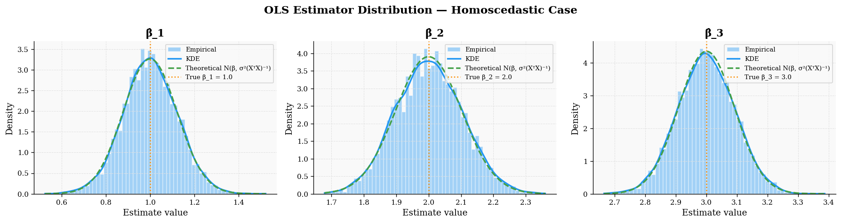
CIE 457 > Statistical Inference and Data Analysis
Slide 8 of 14
▶
Monte Carlo Simulation
☰
Simulation Procedure
■
Simulation Results
1
Fix Parameters
Set n=100, 3 true coefficients, and σ²=1. Choose random X (fixed across all simulations).
2
Sample Noise
Generate εᵐ ~ N(0,σ²I) for each trial m = 1, ..., M=5000 independently.
3
Compute Estimates
Compute β̂ = (XᵀX)⁻¹Xᵀyᵐ for each trial, recording all estimates.
4
Compare Distributions
Compare empirical distribution to theoretical N(β, σ²(XᵀX)⁻¹).
Key Parameters
● Empirical vs Theoretical
TRIALS
SAMPLE SIZE
Component
True β
Emp. Mean
Diff
5,000
100
β̂₀1
1.0
1.000673
+0.00067
β̂₀2
2.0
2.001188
+0.00119
BIAS
R²
β̂₀3
3.0
2.999210
−0.00079
≈0.00
≈0.98
≈ CIE 457 — Statistical Inference and Data Analysis
👤 Dr. Mahmoud Abdelaziz

Slide 9
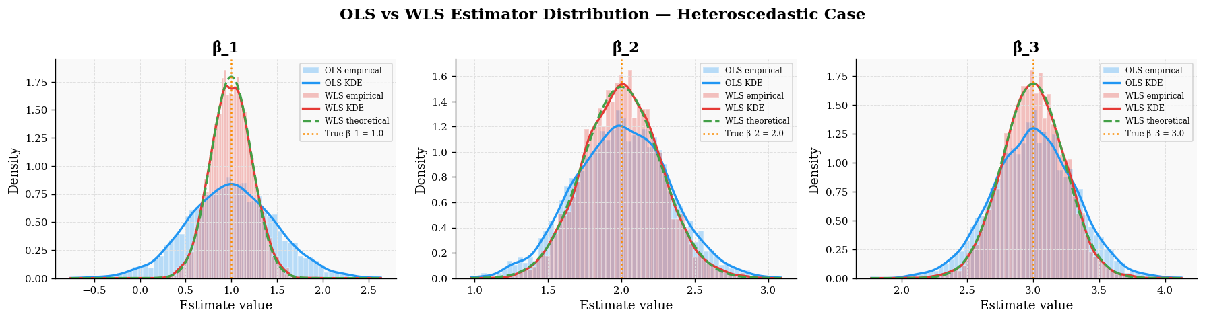
CIE 457 > Statistical Inference and Data Analysis
Slide 9 of 14
■
Simulation Results
◎
Monte Carlo Simulation Results
◎
Key Statistics
5,000
0.95
Simulations
Coverage
0.02
0.98
Bias
R²
☑ Validation
✔
Empirical mean → theoretical mean
✔
Variance matches σ²(XᵀX)⁻¹
✔
Distribution verified Gaussian
● OLS vs WLS Efficiency (Heteroscedastic)
Coeff
OLS Var
WLS Var
Gain
β₁
0.2290
0.0499
4.59×
β₂
0.1026
0.0667
1.54×
β₃
0.0961
0.0555
1.73×
≈ CIE 457 — Statistical Inference and Data Analysis
👤 Dr. Mahmoud Abdelaziz

Slide 10


CIE 457 > Statistical Inference and Data Analysis
Slide 10 of 14
⇆
Homoscedastic vs Heteroscedastic Noise
OLS — Homoscedastic
Sandwich Formula
WLS — Efficiency
Condition:
Heteroscedasticity:
Weighted estimator:
↑ More Efficient
✔ BLUE
! Misspecified
Properties:
Robust covariance:
Properties:
Most efficient linear unbiased estimator
Accounts for heteroscedasticity
Standard SEs and t-tests are valid
Weights = 1/σ²ᵢ for diagonal Σ
Gauss-Markov Theorem applies
Key issues:
Optimal weighting of observations
OLS still unbiased
Covariance:
Inflated variance
Covariance = (XᵀΣ⁻¹X)⁻¹
Invalid SEs/t-tests
HC sandwich corrects inference
≈ CIE 457 — Statistical Inference and Data Analysis
👤 Dr. Mahmoud Abdelaziz

Slide 11


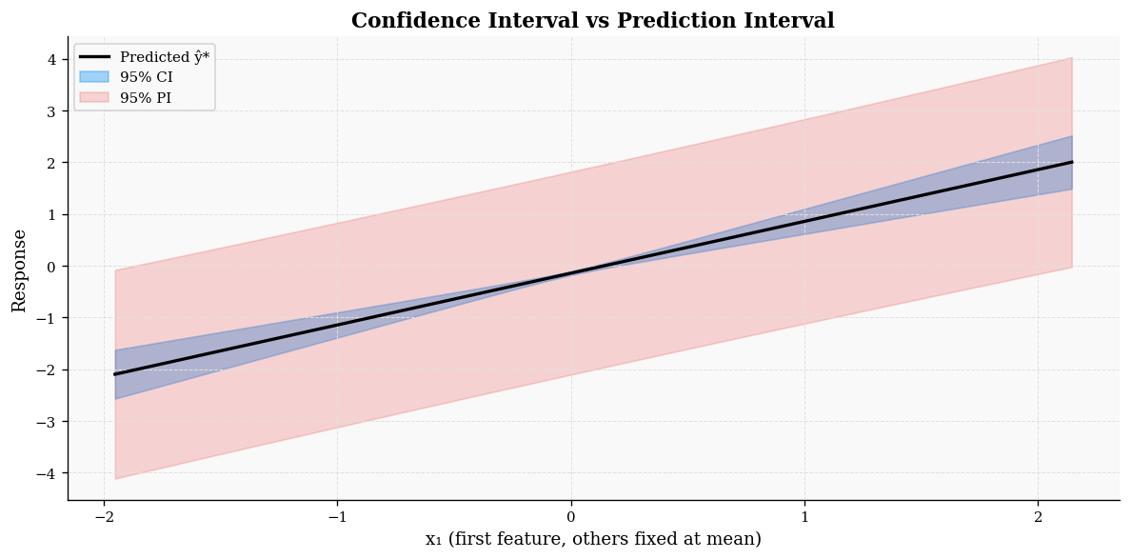
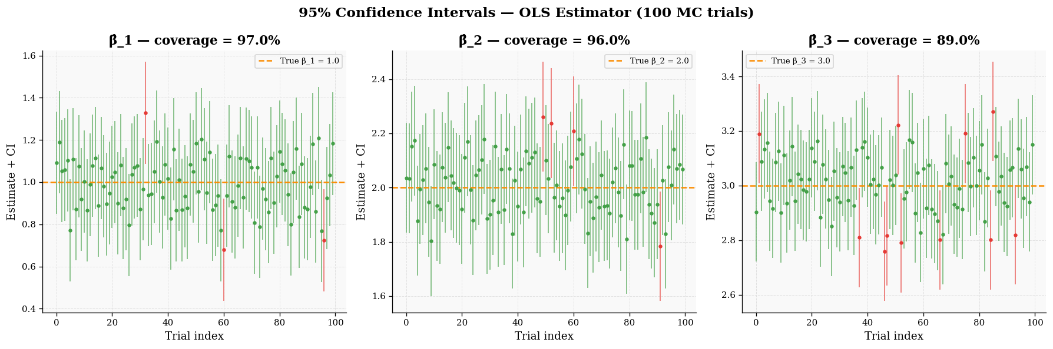
CIE 457 > Statistical Inference and Data Analysis
Slide 11 of 14
↔
Confidence vs Prediction Intervals
■
Interval Formulas
▽
Key Distinctions
Confidence Interval (CI)
Aspect
CI
PI
Target
Parameter β
Future obs y*
Width
Decreases with n
Stabilises with n
CI → CI narrows with n; at n→∞ (parameter uncertainty vanishes)
Asymptotic
→ 0
→ 2z·σ > 0
Prediction Interval (PI)
Use case
Parameter inference
Forecasting
ℹ Practical Implication
Use CI for parameter uncertainty; PI for prediction uncertainty.
PI never vanishes due to irreducible noise
At x* = X̅ (sample mean):
95% CI width
0.0850
95% PI width
3.9208
≈ CIE 457 — Statistical Inference and Data Analysis
👤 Dr. Mahmoud Abdelaziz

Slide 12
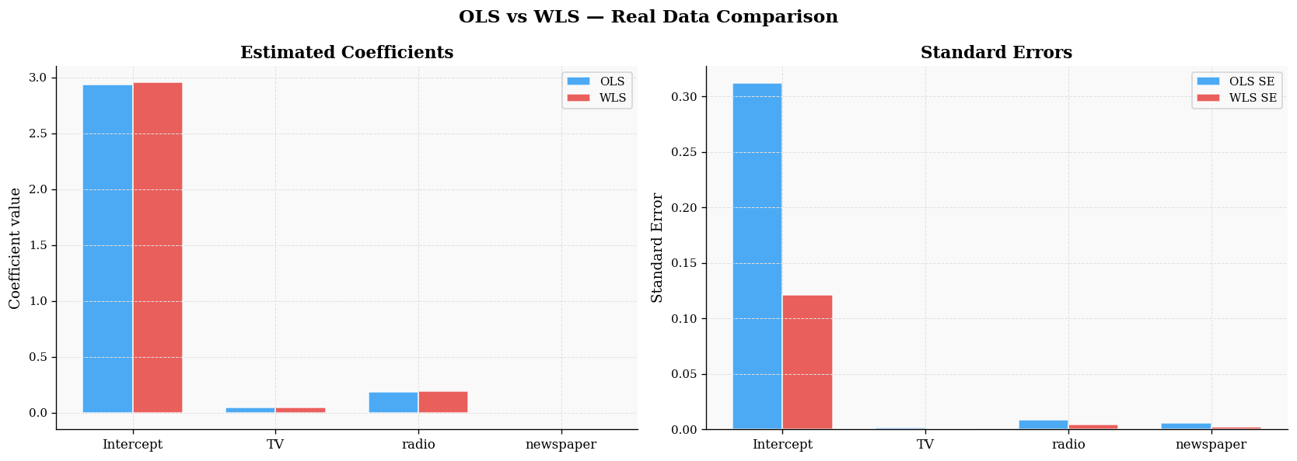
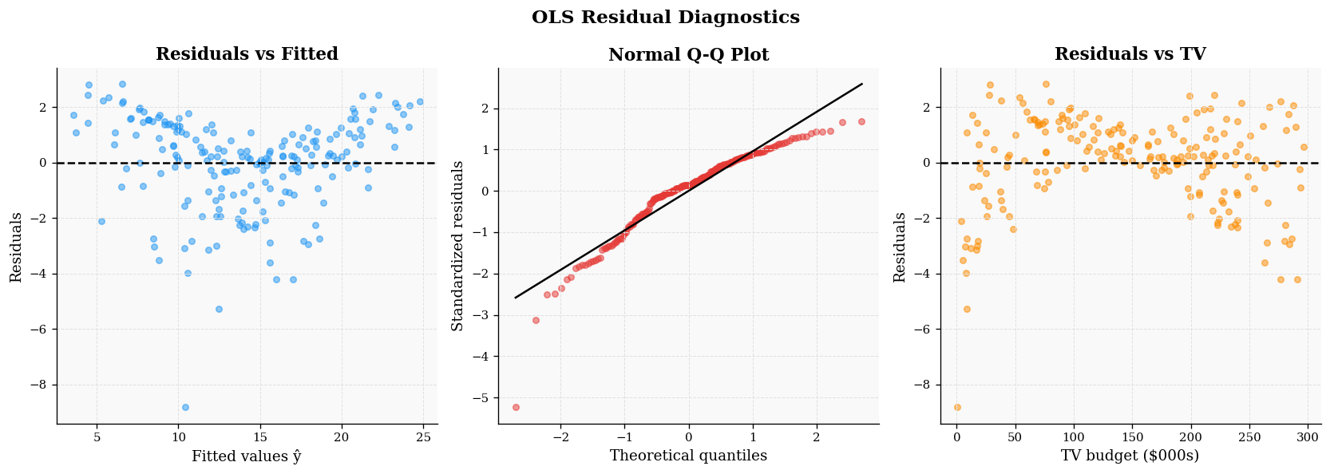
CIE 457 > Statistical Inference and Data Analysis
Slide 12 of 14
■
Real Data Analysis
◎
Advertising Dataset Analysis
▶
Feasible WLS Procedure
DATASET
TV/Radio/Newspaper
Estimate Initial OLS
Fit OLS model and obtain residuals ε̂ᵢ
OBSERVATIONS
n = 200
Estimate Variance Function
FEATURES
3 predictors
Regress log(ε̂ᵢ²) on X to get fitted variances
White's Test:
LM = 67.54
p ≈ 0 Reject H₀
Compute Weights
OLS vs WLS Comparison
Weights wᵢ = 1/|ε̂ᵢ| for each observation
Feature
OLS β̂
WLS β̂
OLS SE
WLS SE
Re-estimate with WLS
No re-estimate with β̂_WLS using computed weights
Intercept
2.9389
2.9544
0.3119
0.1211
TV
0.0458
0.0457
0.0014
0.0005
Radio
0.1885
0.1909
0.0086
0.0042
Newspaper
-0.001
-0.002
0.0059
0.0021
≈ CIE 457 — Statistical Inference and Data Analysis
👤 Dr. Mahmoud Abdelaziz

Slide 13
CIE 457 > Statistical Inference and Data Analysis
Slide 13 of 14
✔
Conclusion
◎
Key Findings
▶
Practical Implications
ESTIMATOR PROPERTIES
Model Selection
Both OLS and WLS estimators are unbiased
Use WLS when heteroscedasticity is detected; standard OLS gives inflated SEs.
EFFICIENT ESTIMATION
WLS is more efficient under heteroscedasticity
Diagnostic Testing
Always perform White's test before choosing between OLS and WLS estimators.
HETEROSCEDASTICITY DETECTION
CI → CI as n→∞ detected using White's test (LM=67.54, p≈0)
INTERVAL DISTINCTION
Interval Interpretation
CI → 0 as n→∞; PI never vanishes due to irreducible noise
Distinguish between confidence intervals (parameter uncertainty) and prediction intervals for future observations.
≈ CIE 457 — Statistical Inference and Data Analysis
👤 Dr. Mahmoud Abdelaziz

Slide 14



CIE 457 > Statistical Inference and Data Analysis
Slide 14 of 14
★
Bonus: Advanced Statistical Theory
ℹ
Fisher Information & CRLB
≈
Sufficient Statistics
Fisher Information Matrix
A statistic T(y) is sufficient if it contains all the information about the parameter β.
The FIM quantifies the amount of information that an observable random variable carries about β.
Key Properties
Cramér-Rao Lower Bound
Minimum variance for any unbiased estimator:
Neyman-Fisher Factorization
p(y|β) = g(T(y),β)·h(y) ⇒ T is sufficient
Data Compression
Achieves Lower Bound
Xᵀy compresses n → p values without loss
OLS achieves the CRLB: Efficiency = 1
Efficiency
UMVUE Connection
Any other unbiased estimator has higher variance
OLS = f(Xᵀy) ⇒ Rao-Blackwell guarantees minimum variance
Application:
In linear regression, (Xᵀy, yᵀy) are jointly sufficient for (β, σ²)
≈ CIE 457 — Statistical Inference and Data Analysis
👤 Dr. Mahmoud Abdelaziz

