Slide 1

UNIVERSITY OF DAR ES SALAAM COMPUTING CENTRE
FINAL YEAR PROJECT ASSESSMENT
AI-Enhanced Blood Supply Prediction
and Donor Notification System
Case Study: National Blood Transfusion Service (NBTS), Tanzania
Jackline Wilson
01-0924-02-86749
Sadiki L. Selemani
01-0924-02-87253
Bushiri A. Kwizombe
01-0924-02-88172
Ibrahim John
01-0922-02-72789
Joseph Masubugu
01-0924-02-87560
Zahoro M. Awadhi
01-0924-02-87427
Supervisor: Denis Kimaro
September 2026

Slide 2
INTRODUCTION
Blood is life-saving — and hard to plan for
1
Demand is unpredictable
Emergencies, accidents, surgeries and childbirth complications cause blood demand to spike without warning.
This project builds
a centralised, AI-assisted system to forecast demand, track inventory and notify eligible donors before a shortage becomes critical.
2
Blood is perishable
Poor coordination between collection and use can let one blood group expire while another runs short.
3
14
3
NBTS manages it nationally
user roles served
functional requirements
The National Blood Transfusion Service coordinates donor recruitment, collection, testing and distribution across Tanzania.
2

Slide 3
THE PROBLEM
Manual processes can't keep up with demand
No real-time view of blood-group availability across donation centres
Shortages are discovered only after stock is already critically low
✕
✕
Manually phoning donors during a shortage is slow and unreliable
Weak tracking of expiry dates risks wastage of collected units
✕
✕
Limited analytics — no way to forecast demand or spot trends
Weak audit trail makes it hard to trace who recorded what
✕
✕
3

Slide 4
OBJECTIVES
What the project set out to build
General objective: Design and implement an AI-enhanced system to predict blood demand, manage inventory, and notify donors — reducing shortages and wastage at NBTS.
1
2
3
4
Analyse existing collection & donor-communication processes
Design a centralised relational database
Build blood-group inventory management with expiry tracking
Develop an AI demand-forecasting component
5
6
7
8
Build shortage detection and donor-notification (SMS/email)
Provide real-time dashboards and reports
Implement role-based access control and audit logging
Test and evaluate the system end-to-end
4

Slide 5
SYSTEM DESIGN
Current application architecture
Hono API on Bun
MariaDB 11
Web application
React Router 7 and React 19
Tailwind CSS presentation
Session-aware API client
Authentication and HTTP-only sessions
Permission checks and facility scope
Business rules, Drizzle queries, audit records
AI and notification orchestration
21 relational tables
Foreign keys and indexed lookups
FastAPI AI service
Messaging providers
Training, evaluation and forecast generation
SMTP email and NextSMS or mock SMS
The API owns authorization, business decisions and database access. The AI service receives only the inputs needed for a forecast.
5
Notes:
Source: docs/02-system-architecture.md
Source: api/package.json and web/package.json
Source: docker-compose.yml
Current checkout reviewed on 24 September 2026.

Slide 6
SYSTEM DESIGN
Three roles with explicit access boundaries
Administrator
Blood Bank Staff
Hospital Staff
SYSTEM-WIDE
BLOOD-BANK OPERATIONS
ASSIGNED FACILITY
All 25 permissions. Manages users, roles and facilities, plus every operational, reporting and audit function.
Manages donors, donations, stock, requests, alerts, notifications and operational reports.
Views and updates facility inventory, creates and updates blood requests, and reads facility reports.
No facility restriction
No user, role or configuration administration
API forces the user facility on every scoped operation
Session
User roles
Permissions
API route
Facility filter
Authorization runs in the API before business logic and database queries.
6
Notes:
Source: api/src/db/seed/permission-codes.ts
Source: api/src/db/seed/roles-permissions-data.ts
Source: api/src/middleware/require-permission.ts
Source: api/src/modules/auth/access-scope.ts
The current worktree seeds Administrator, Blood Bank Staff and Hospital Staff.

Slide 7
SYSTEM DESIGN
Database architecture: 21 relational tables
Identity and access
6
Donor and collection
4
Inventory and demand
4
users, sessions
roles, permissions
user_roles, role_permissions
blood_groups
donors, donations
donation_centres
healthcare_facilities
blood_inventory
blood_requests, demand_records
Forecasting and alerts
5
Notifications and audit
2
ai_predictions
ai_analysis_runs, ai_analysis_settings
shortage_alerts, inventory_alerts
notifications
activity_logs
Foreign keys preserve the path from users, donors and facility requests to inventory, forecasts, alerts, messages and audit history.
7
Notes:
Source: api/src/db/schema/index.ts and every schema module exported from it.
The current schema contains 21 mysqlTable declarations.
Core foreign keys link donors to users and blood groups, donations to donors and centres, inventory to donations and facilities, requests and demand to facilities, predictions to blood groups and facilities, alerts to predictions, and notifications to donors and alerts.

Slide 8
SYSTEM DESIGN
Operational data flow
1 Capture events
2 Persist records
3 Generate forecast
4 Evaluate supply
5 Act and report
Donations, hospital requests and inventory status changes
MariaDB stores inventory units, demand history and user activity
The API sends selected demand data to the FastAPI service
The API compares forecast demand with available, valid stock
Alerts, donor messages, dashboards and reports use stored results
Controls applied throughout
Permission checks and facility scope
Expiry and status rules
Activity logs and notification history
The AI service predicts demand. The API decides what the system stores, exposes and sends.
8
Notes:
Source: docs/02-system-architecture.md
Source: api/src/modules and api/src/db/schema
The API remains authoritative for authorization, stock rules, alert creation, donor matching, notifications and persistence.

Slide 9
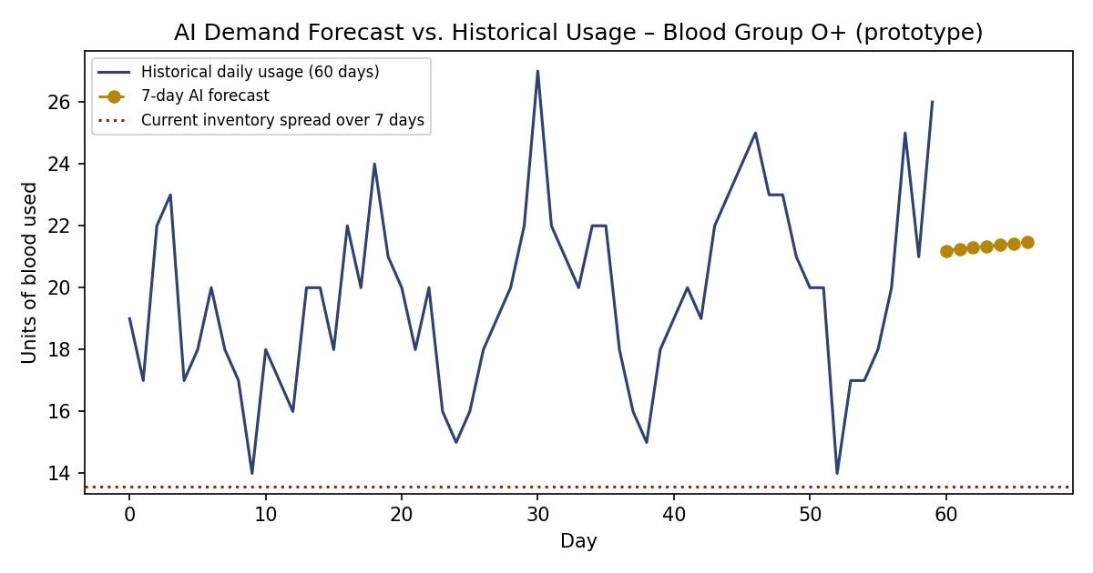
ARTIFICIAL INTELLIGENCE
The AI forecasting pipeline actually runs
Prototype trained on an illustrative 60-day usage series for blood group O+ (pending authorised NBTS historical data), then backtested and used to forecast 7 days forward.
2.95
units/day backtest MAE
149
units forecast, next 7 days
TRUE
shortage alert triggered
Figure: AI demand forecast vs. historical usage — Blood Group O+
9

Slide 10
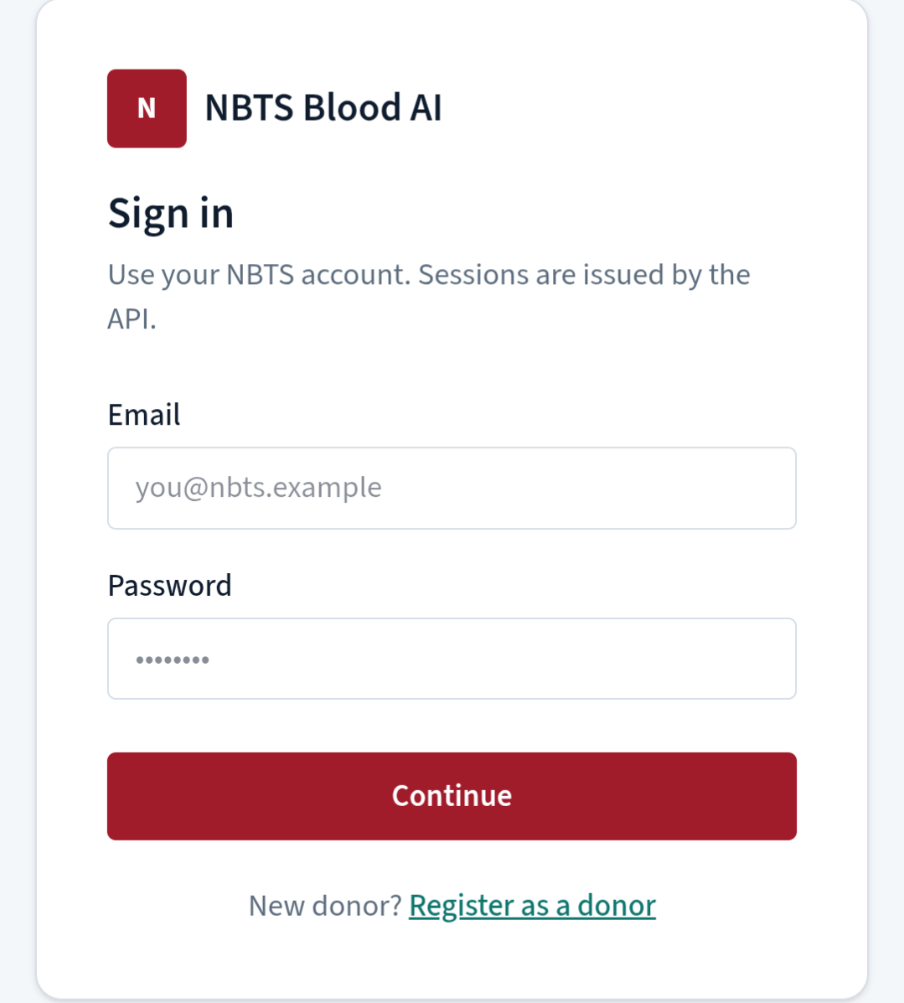
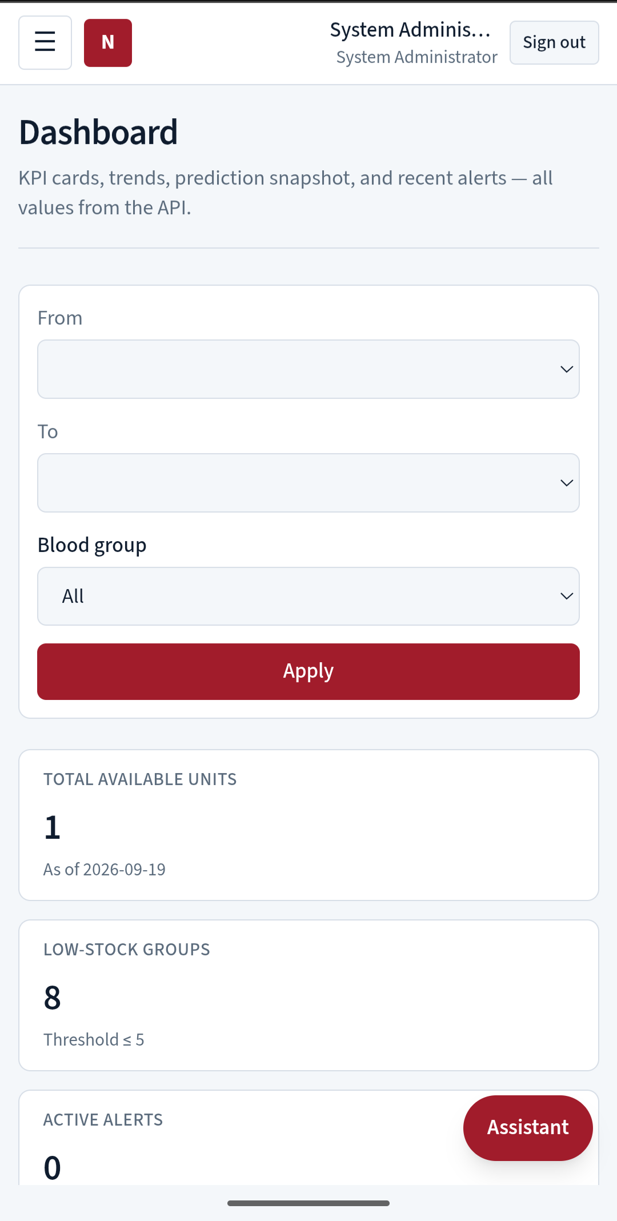
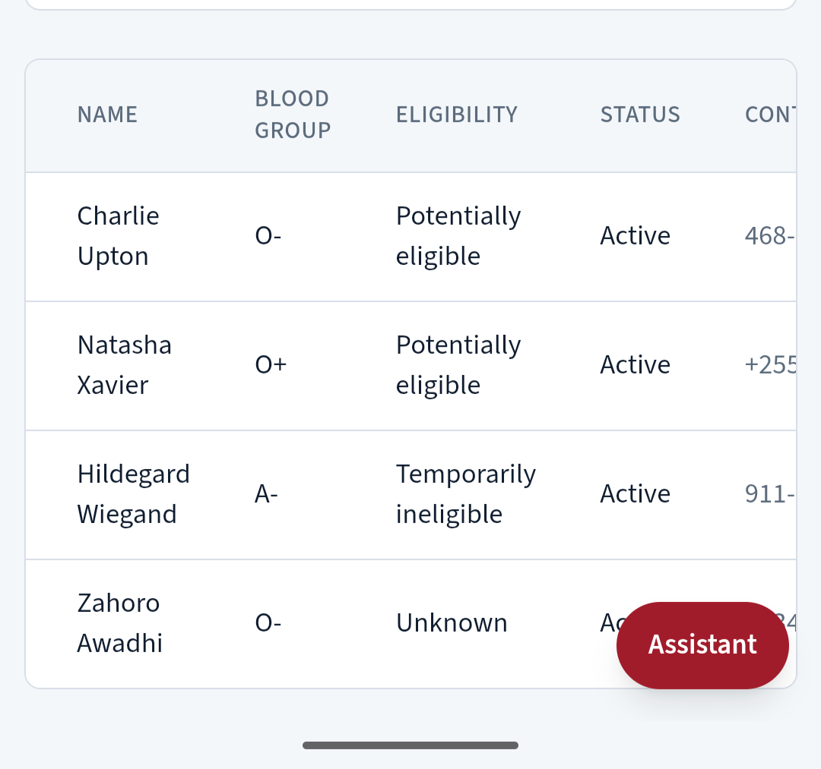
LIVE DEPLOYMENT
Deployed and working
web-production-1149.up.railway.app — branded “NBTS Blood AI”
Sign-in screen
Donor list with eligibility labels
Administrator dashboard
10

Slide 11
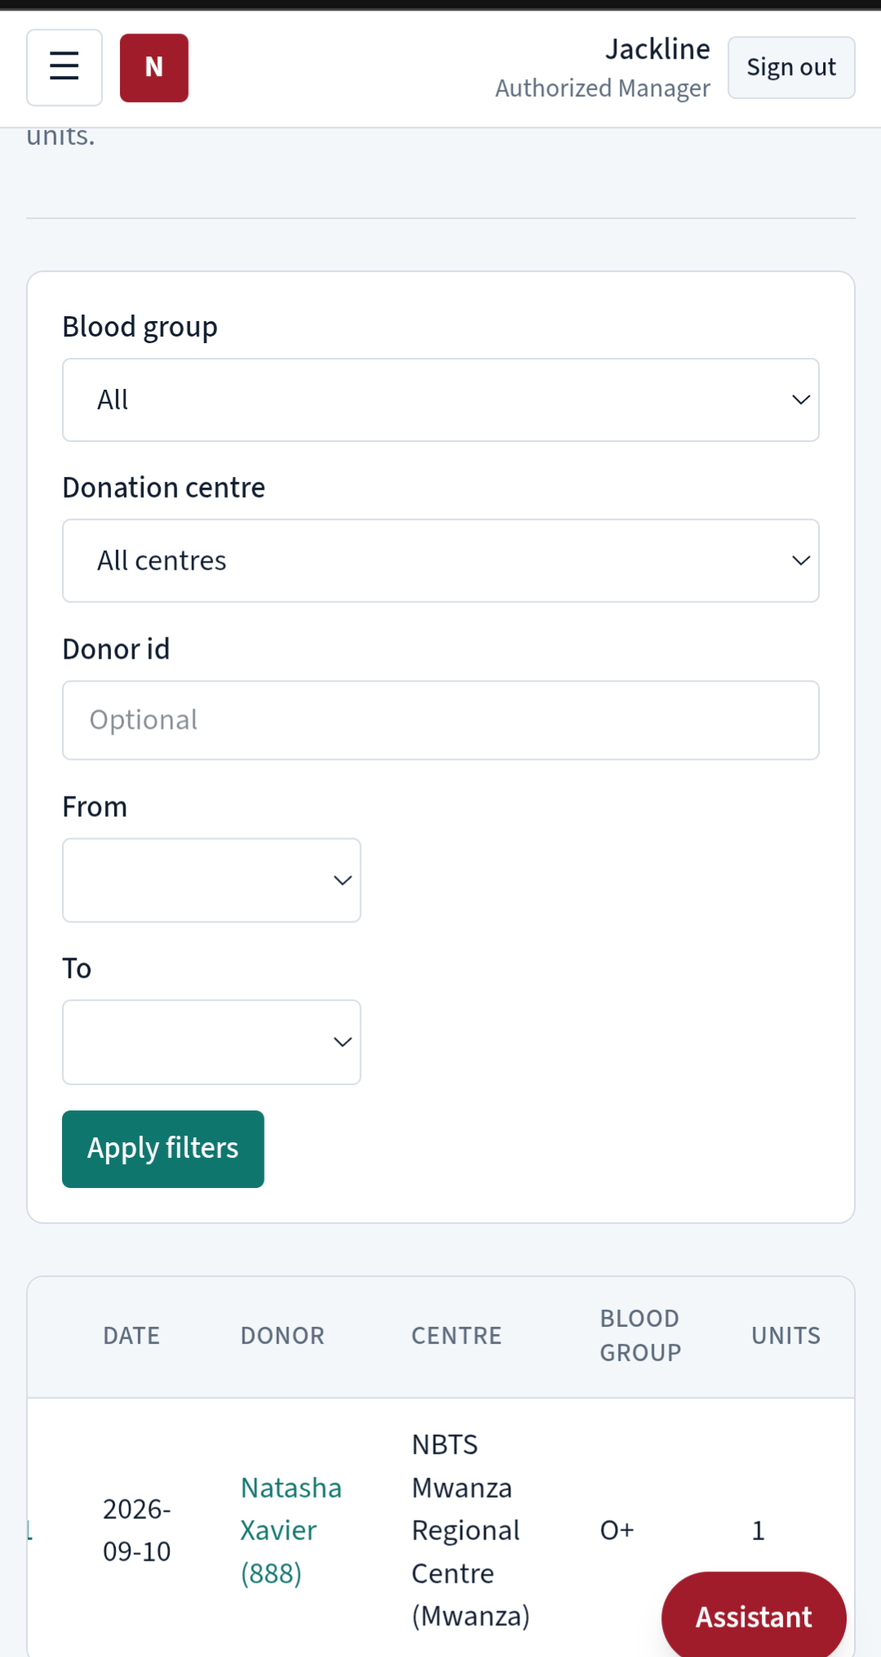
VERIFICATION
Tested against the live system
TC01
Authentication
✓
Pass
Evidence captured
TC02
Donor registration
✓
Pass
TC03
Donation recording
✓
Pass
TC04
Expiry monitoring
✓
Pass
TC05 / TC06
AI forecast & shortage logic
✓
Pass (prototype)
TC07 / TC08
Notification dispatch & role restriction
…
Follow-up planned
Recorded donation — Natasha Xavier, O+
11

Slide 12
WRAPPING UP
Conclusion & recommendations
Conclusion
Recommendations
Combining structured inventory management with AI-based demand forecasting and automated donor notification gives NBTS earlier visibility of shortages and a faster way to reach eligible donors — while medical screening stays with qualified staff.
Authorise access to full historical data to retrain & validate the forecast model
Pilot at a limited number of donation centres before wider rollout
Complete Hospital Staff facility-scope and live notification-provider testing
Provide staff training on interpreting AI forecasts as decision support
12

Slide 13
Thank You
Questions & Discussion
AI-Enhanced Blood Supply Prediction and Donor Notification System — NBTS, Tanzania

