Slide 1
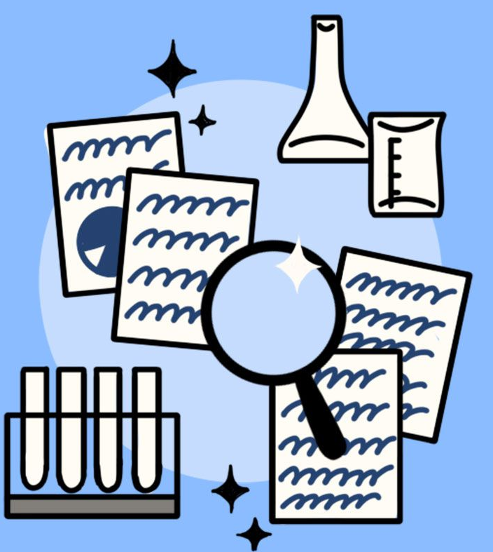






Insights into the Current State of Developer Skills and Trends
Ibrahim Parkar
April 9, 2023

Slide 2



OUTLINE
Executive Summary
Introduction
Methodology
Results
Visualization – Charts
Dashboard
Discussion
Findings & Implications
Conclusion
Appendix

Slide 3

EXECUTIVE SUMMARY
Popular languages 1. Python 2. java 3. R
Most desirable Databases 1. PostgreSQL 2. MongoDB 3. Redis 4. MySQL 5. Elasticsearch
Gender Gap in IT industry

Slide 4

INTRODUCTION
About: Analyzing the trends in software development
Purpose:
Identify skill requirements for future
What are the top programming languages in demand?
What are the top database skills in demand?
What are the popular IDEs?
Audience: Human Resource and IT Head

Slide 5

METHODOLOGY
Data Preparation 1. Found duplicates 2. Removed duplicates 3. Found missing values 4. Imputed missing values 5. Normalized data
Data Exploration 1. Found data distribution 2. Found outliers 3. Found correlation
III. Data Visualization 1. Distribution of data 2. Relationship of data 3. Composition of data 4. Comparison of data
IV. Dashboard 1. Built a dashboard

Slide 6

RESULTS

Slide 7
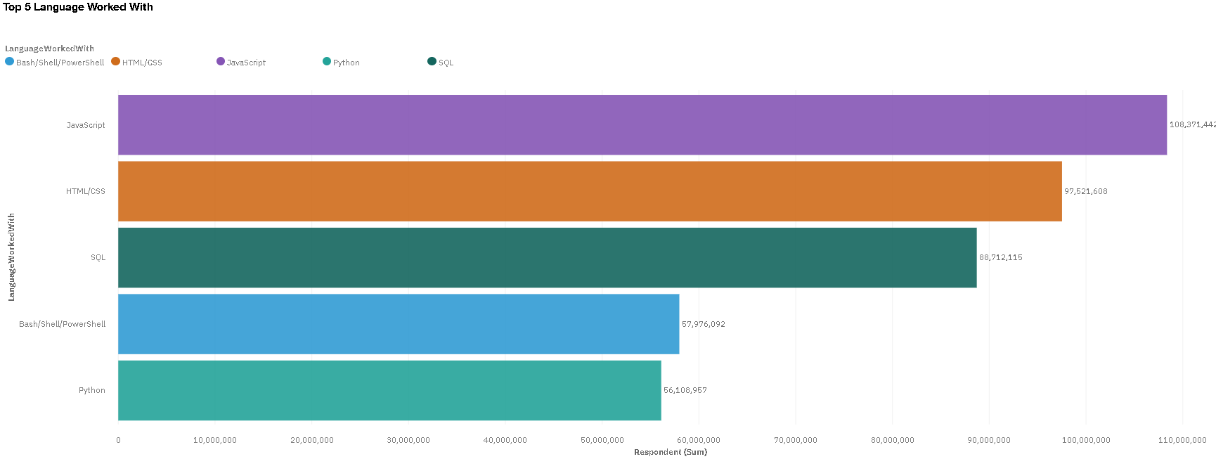
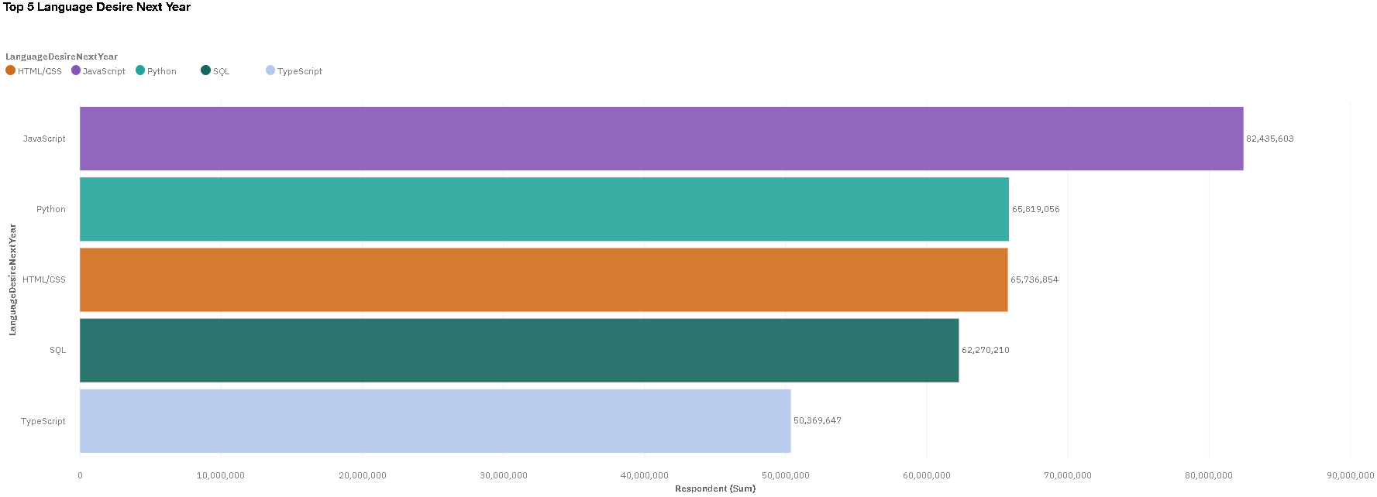
PROGRAMMING LANGUAGE TRENDS
Current Year
Next Year

Slide 8
PROGRAMMING LANGUAGE TRENDS - FINDINGS & IMPLICATIONS
Findings
JavaScript, HTML/CSS, SQL are top 3 this year
Python and Typescript becoming popular next year
PowerShell edged out in next year
Implications
High demand for Web Development
Consistent demand for HTML/CSS, Java, SQL, and Python.
With AI and ML in rising demand, Python is best choice

Slide 9
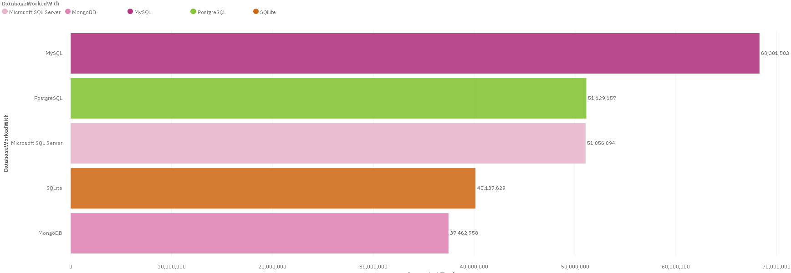
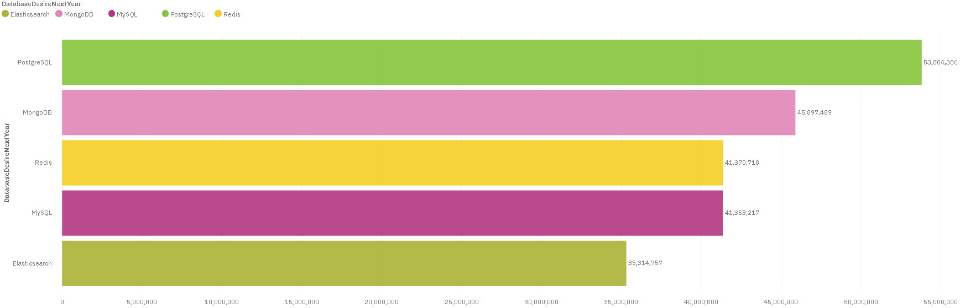
DATABASE TRENDS
Current Year
Next Year

Slide 10
DATABASE TRENDS - FINDINGS & IMPLICATIONS
Findings
Demand decreased for MySQL, SQlite and Microsoft SQL server.
Demand increasing for PostgreSQL and MongoDB
New language in top 5 Elasticsearch and Redis
Implications
Open-source databases are still preferable in companies
NoSQL databases will make an impact for storing non-relational data
Consistent Demand for PostgreSQL and MongoDB

Slide 11

DASHBOARD
https://dataplatform.cloud.ibm.com/dashboards/522a83f9-cbba-4c72-8efb-0939ad71e197/view/7b34d73c239537fc70c7cce4079c2d057a32740eb4bbd70584d67b490c697797f0691a96c87e4a598b190264fbb8415898

Slide 12
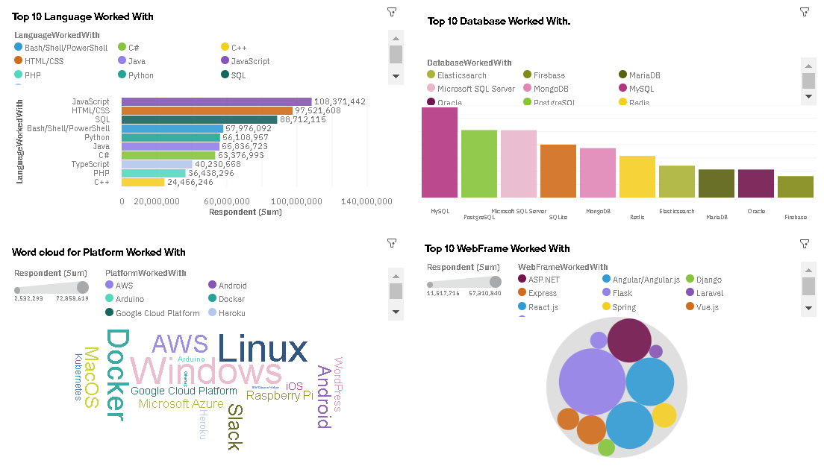
DASHBOARD TAB 1

Slide 13
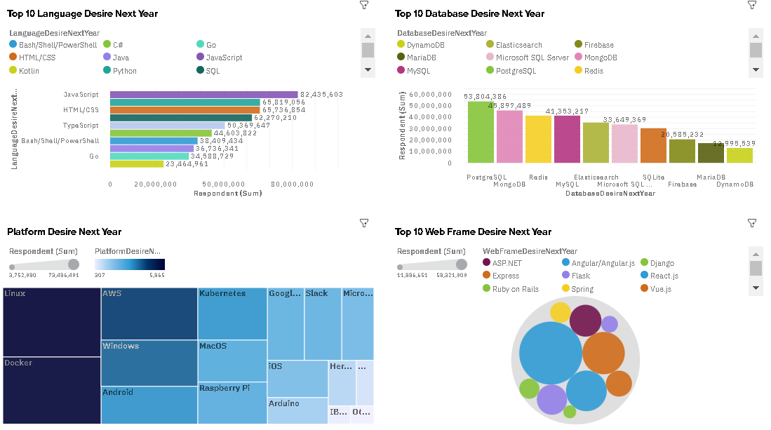
DASHBOARD TAB 2

Slide 14
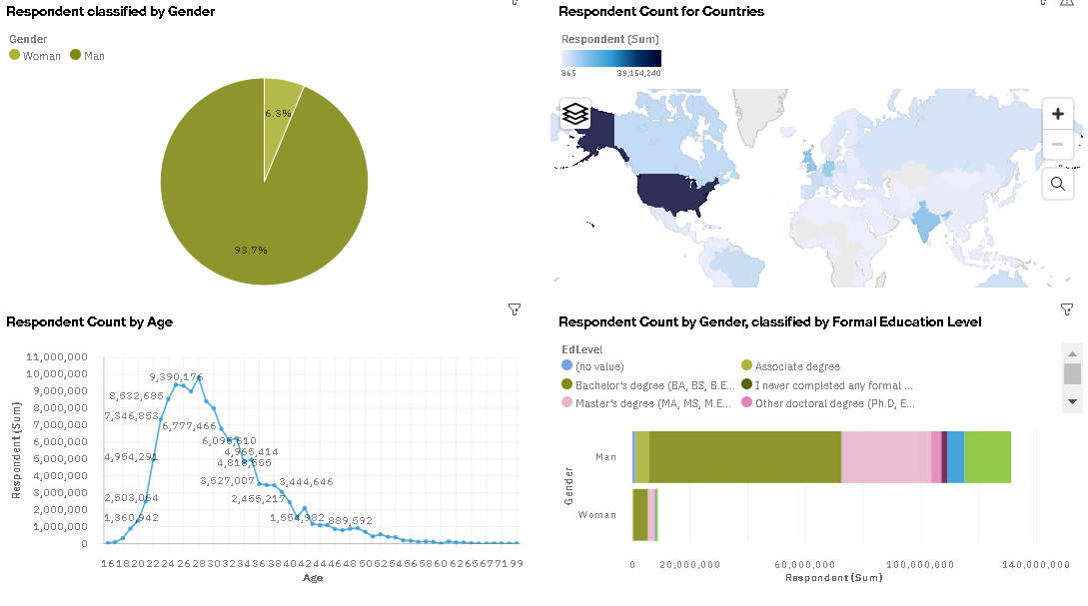
DASHBOARD TAB 3

Slide 15
DISCUSSION
Technology Trends now and future
Training and Reskilling workers
The IT industry needs to diversify in order to eliminate gender gap.
Bridge divide of technology gaps in developing countries

Slide 16
OVERALL FINDINGS & IMPLICATIONS
Findings
Popular Languages: JavaScript and Python
Popular Databases: PostgreSQL
Fast changing technology every year.
Gender gap in technology jobs
Platforms like Docker and AWS are growing
Implications
Proficiency in higher demand skills can lead to more opportunities.
Companies need to be flexible and adjust to rapid changes
Need to spread technology out to lagging countries
Shift to faster app deployments and cloud services in future

Slide 17

CONCLUSION
New technologies lead to varied trends and demands.
Most popular programming Languages: JavaScript - Python
Most popular database: PostgreSQL
In future, incorporate Machine Learning to predict trends and salaries
The Information Technology field needs diversity.

Slide 18

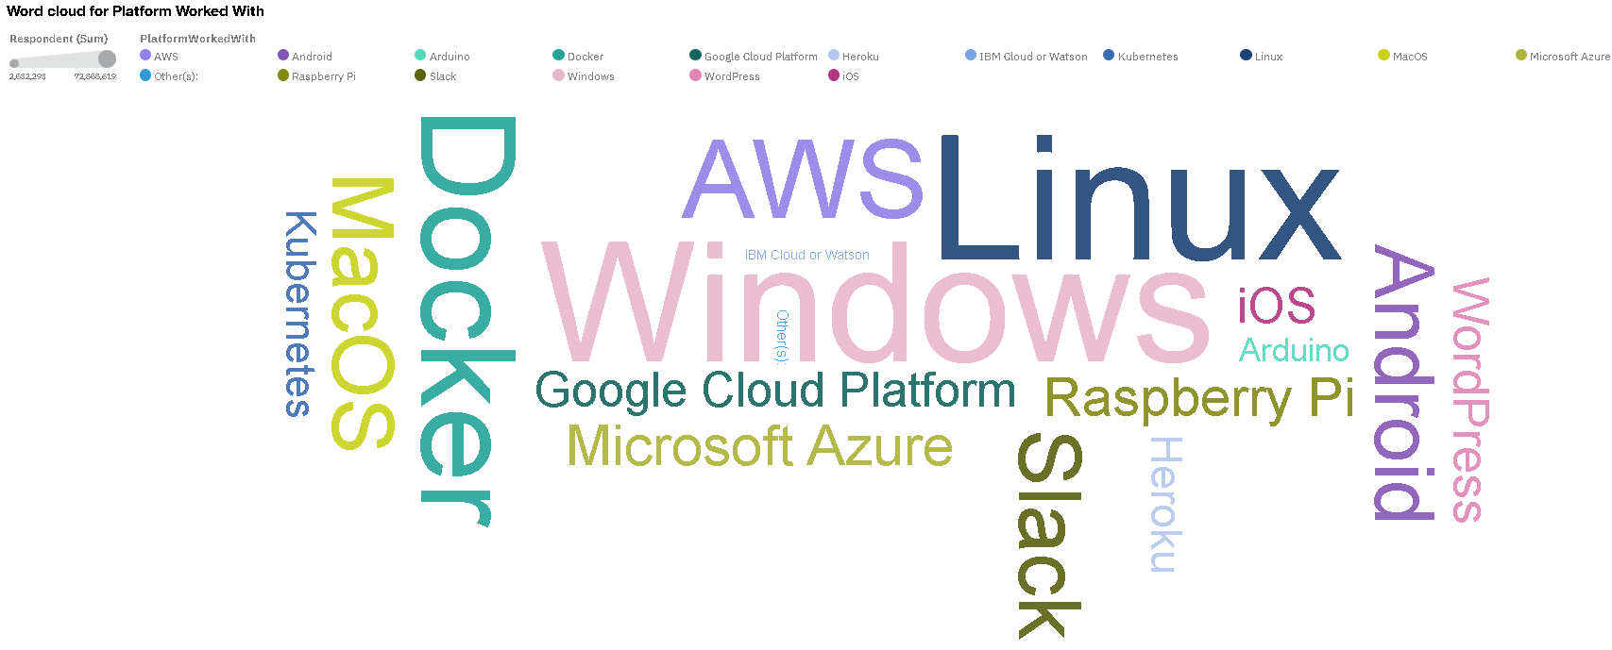
APPENDIX

Slide 19
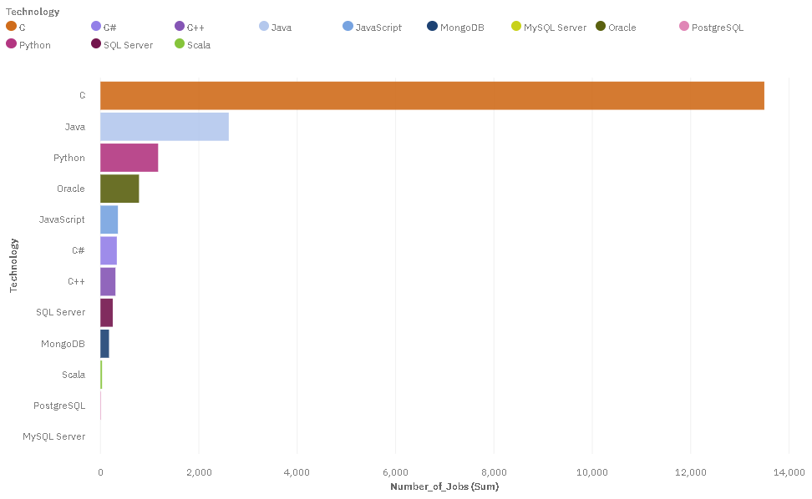
JOB POSTINGS

Slide 20
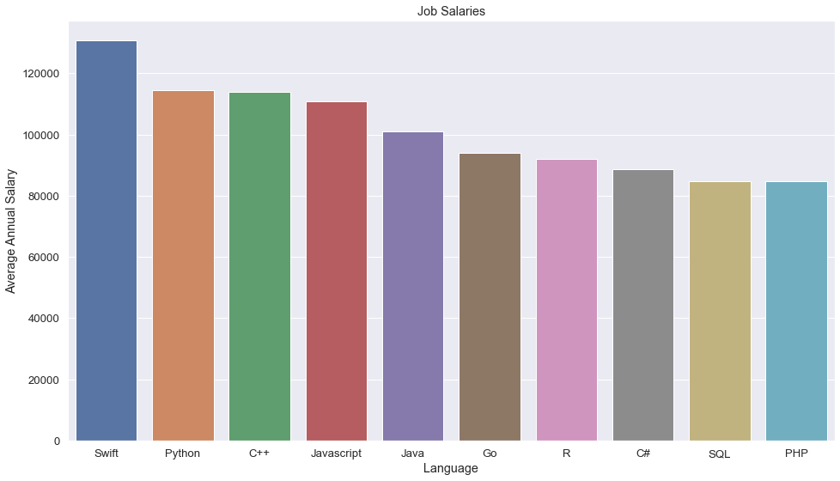
POPULAR LANGUAGES

