Slide 1
Electro-Optical Nose for Indoor Air Quality Monitoring
ID: 19201083
Section: 01

Slide 2
Introduction:
Indoor air pollution is a major problem for human health.
Electronic noses are low cost instruments.
This device combines NDIR and MOX to measure gases.
Capable of recognizing simple and complex odors.

Slide 3
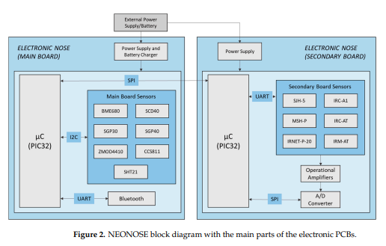
Methods:
Mixing gas to generate different concentration and humidity levels.
NEONOSE is built using two boards containing NDIR and MOX sensors.
Uses an Android app and LabView app in Windows to control.
Uses PCA and PLS to analyze datas.

Slide 4
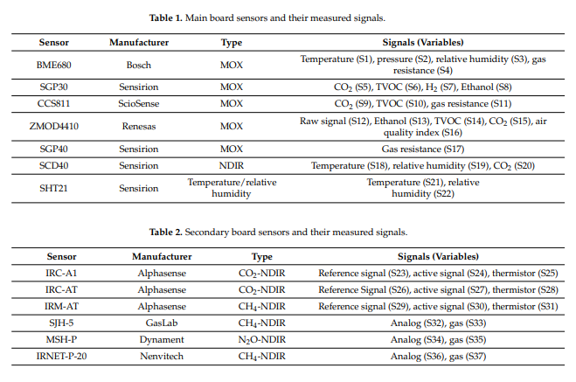
Measurements:

Slide 5
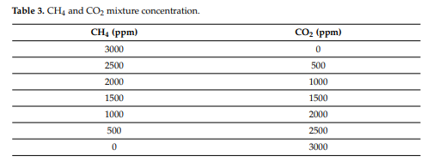
Tested in variations of humidity and effect of drift.
Validated system values from the legislation on indoor air quality and exposure limits.

Slide 6
Data Analysis:
Total of 37 variable from all sensors are measured.
Analyzed data using PCA and PLS
Used PCA to reduce the dimensionality and redundancy of the data.
Used PLS to generate prediction model

Slide 7
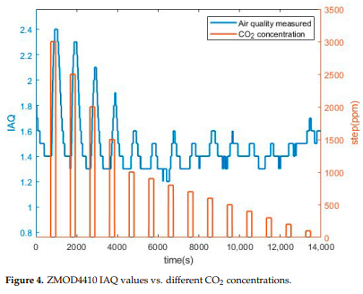
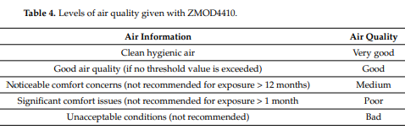
Results:

Slide 8
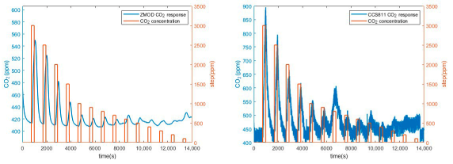
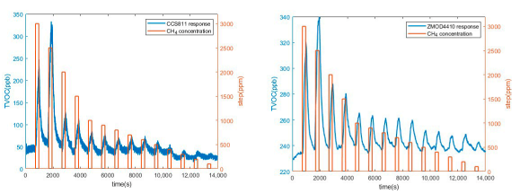
MOX Sensor

Slide 9
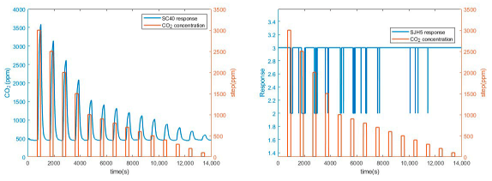
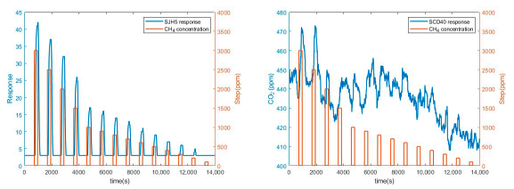
NDIR Sensor

Slide 10
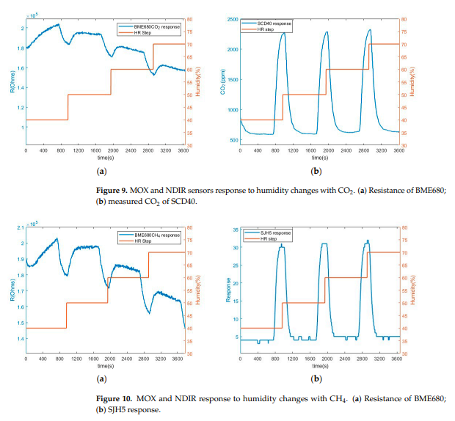

Slide 11
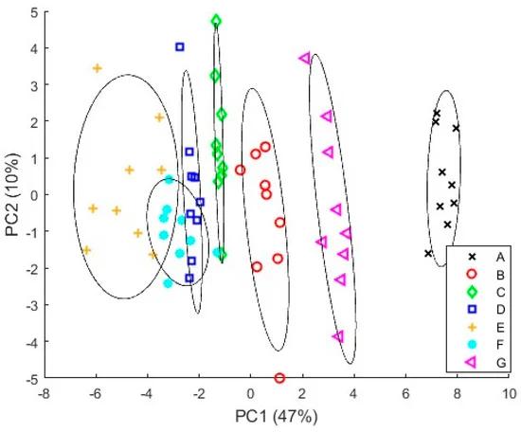
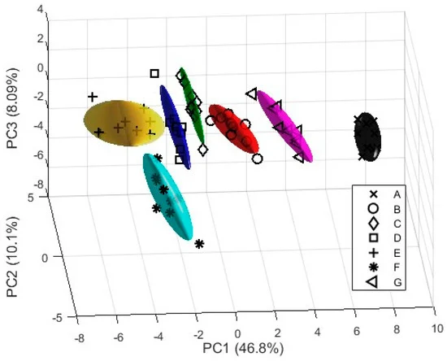
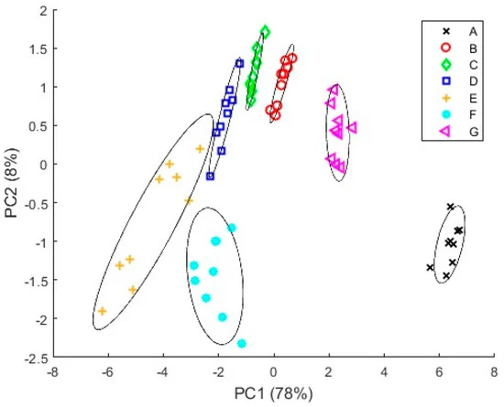
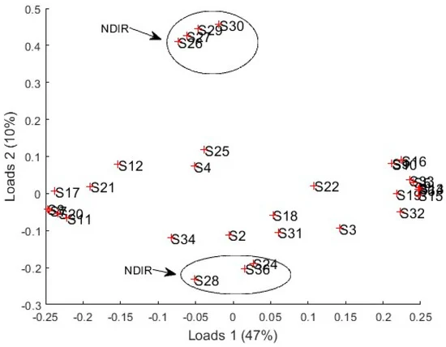
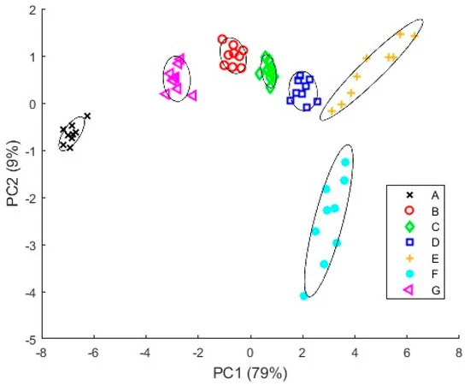

Slide 12
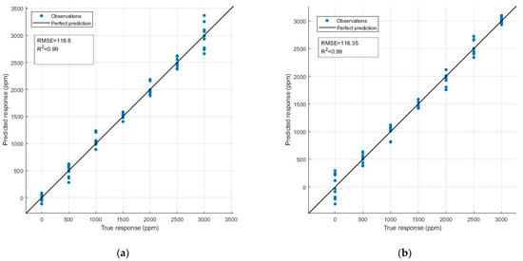
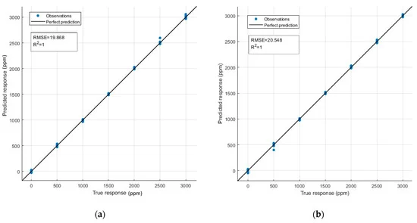

Slide 13
Conclusion:
Electro-optical nose is a low cost effective device.
Combination of NDIR and MOX better than only using MOX.
Has potential in different fields.

Slide 14
Improvements:
Increasing number of sensors and types of gases.
Improving calibration and compensation model to reduce drift and influence of humidity.
Testing in real scenario to compare with reference methods.

