Slide 1
Comparative Analysis of Machine Learning Techniques for Predicting Air Quality in Smart Cities
ID: 19201083
Section: 01

Slide 2
Introduction:
Air pollution one of the main detriment to human health.
Causes asthma, skin infections, heart issues, eye diseases etc.
Poses a serious threat to our planet earth.
Real-time monitoring of pollution data.
Smart city is to provide better health, transport etc using monitored datas.

Slide 3
Proposed Architecture:
Data gathering: Collecting datas using devices connected in smart city.
Communication: Transferring datas from collection layer to further layers.
Data Management: Will store and analyze those datas.
Application: This layer is connected to real-time time devices to give meaning full informations.

Slide 4
Methodology:
Decision Tree Regression
Random Forest Regression
Gradient Boosting Regression
ANN Multilayer Perceptron Regression

Slide 5
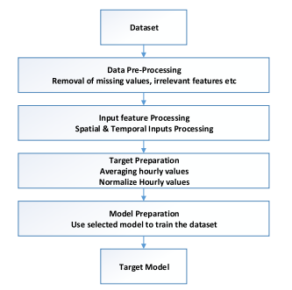
Implementation:

Slide 6
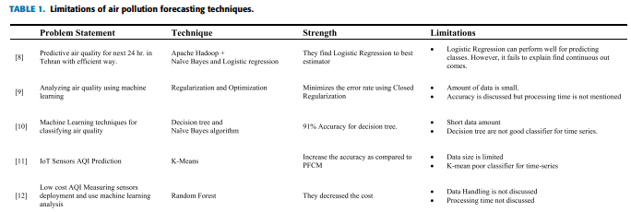
Datasets:

Slide 7

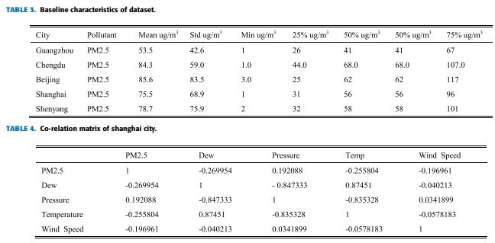

Slide 8
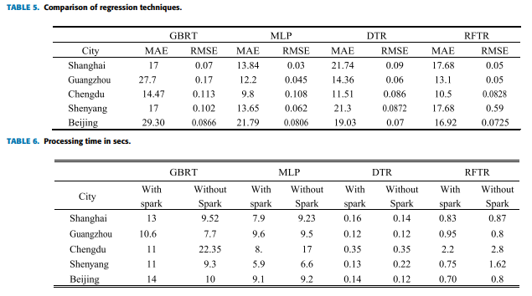
System Evaluation:

Slide 9
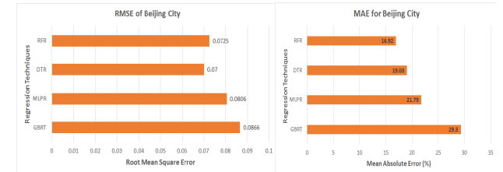
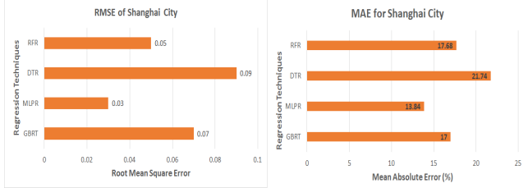
Results and Discussion:

Slide 10
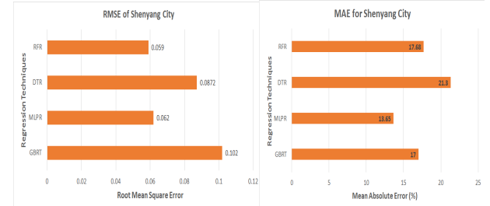
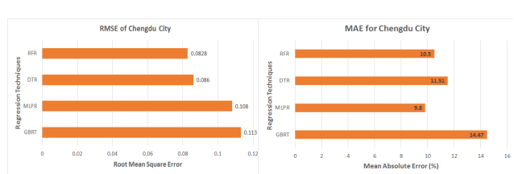
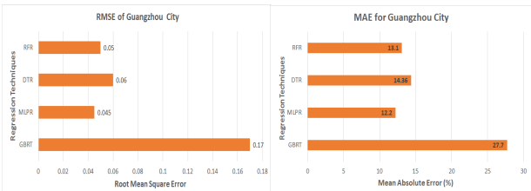

Slide 11
Conclusion:
Analyzed and compared four existing schemes.
Random Forest Regression was best.
Gradient Boosting Regression was worst.

Slide 12
Improvements:
Using more data to provide a more comprehensive analysis.
Using other regression techniques.
Using other factors which can create air pollution.
Providing more detailed information on techniques and results.

