Slide 1
Tic Tac Toe
Game
IBRAHIM TUNCER
240ADB016

Slide 2
Step 1: Description
Step 2: Software Requirement
Step 3: Testing
Step 4: Demonstration
Steps

Slide 3
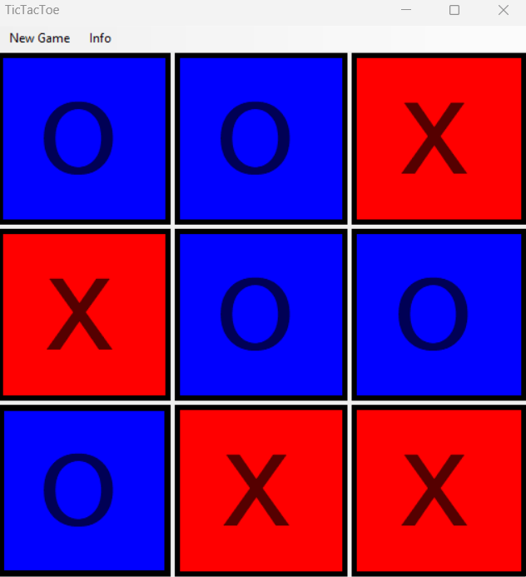
Tic Tac Toe is a
two-player game
on a 3x3 grid.
Players take turns
marking X or O, aiming
to get three in a row
horizontally, vertically,
or diagonally. The
game ends in a win
or a draw when the
grid is filled.
Description

Slide 4
1. Introduction
Purpose: The purpose of this document is to outline the requirements for developing a Tic Tac Toe game software application.
Scope: The software will allow users to play the classic Tic Tac Toe game against another human player
2. General Description
Product perspective: The software will be a standalone application running on various platforms, including desktop and mobile devices.
Product functions:
Allow users to start a new game.
Enable users to make moves by selecting empty cells on the game board.
Implement game logic to determine win, loss, or draw conditions.
Provide an option for users to play against another human.
User classes and characteristics:
Casual players of all ages.
Operating environment:
Desktop computers (Windows, macOS, Linux), VS2022
Design and implementation constraints:
The game should be developed using a suitable programming language and platform.
User interface should be intuitive and easy to navigate.
Assumptions and dependencies:
Availability of development tools and libraries for implementing game logic and user interface.
Software Requirements

Slide 5
3. Specific Requirements
External interface requirements:
User interfaces:
Main menu: Start new game, choose opponent (AI or human).
Game board: Grid layout for Tic Tac Toe board.
End game screen: Display winner or draw message, option to start a new game.
Functional requirements:
Allow users to start a new game.
Validate user moves to ensure they are legal (empty cell).
Implement game logic to determine win or draw conditions.
Performance requirements:
Smooth gameplay experience without noticeable lag.
AI opponent should respond to user moves within a reasonable time frame.
Logical database requirements:
No database requirements for this application.
Design constraints:
Ensure the user interface is responsive and works well on different screen sizes.
Software system attributes:
Reliability: The game should handle user inputs and game state changes reliably.
Maintainability: Code should be well-structured and documented for future updates and maintenance.
Usability: The user interface should be intuitive and easy to understand.
4. Other Nonfunctional Requirements
Documentation requirements:
User manual explaining game rules and controls.
Quality attributes:
Testability: The software should be thoroughly tested to ensure all game scenarios are handled correctly.
Usability: The game should be enjoyable and easy to play for users of all skill levels.
Software Requirements

Slide 6
Monolithic Architecture: All components reside in a single project. Changing one component may require recompiling the entire application. Less flexibility and maintenance difficulty.
Modular Architecture: Components such as business logic and user interface are organized into separate modules. Each module can be developed, tested, and updated independently. Provides higher flexibility and ease of maintenance.
This project suitable for monolithic architecture.
Because:
Single Project File
Unified Structure
No Independent Modules
Architecture

Slide 7
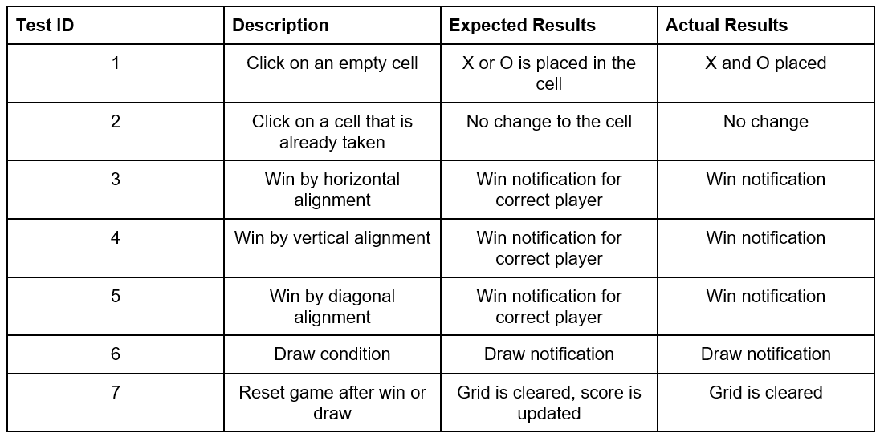
Because of We do not enter some values, I just implemented black-box tests.
Testing

Slide 8
In this section, I am going to explain the code and,
do the demonstration of application also.
Demonstration

