Slide 1

Hospital management system
Ibrahima Ndao
15-12-2022
Final project
Technology used:
MYSQL
ANGULAR
SPRING BOOT JPA
SPRING SECURITY

Slide 2
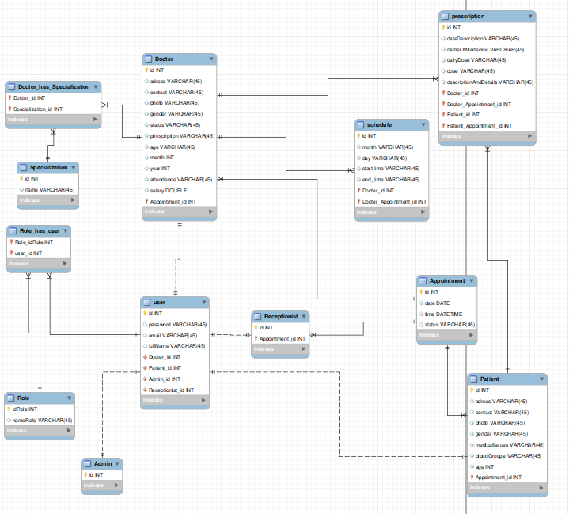
Database modeling

Slide 3



Home Page

Slide 4
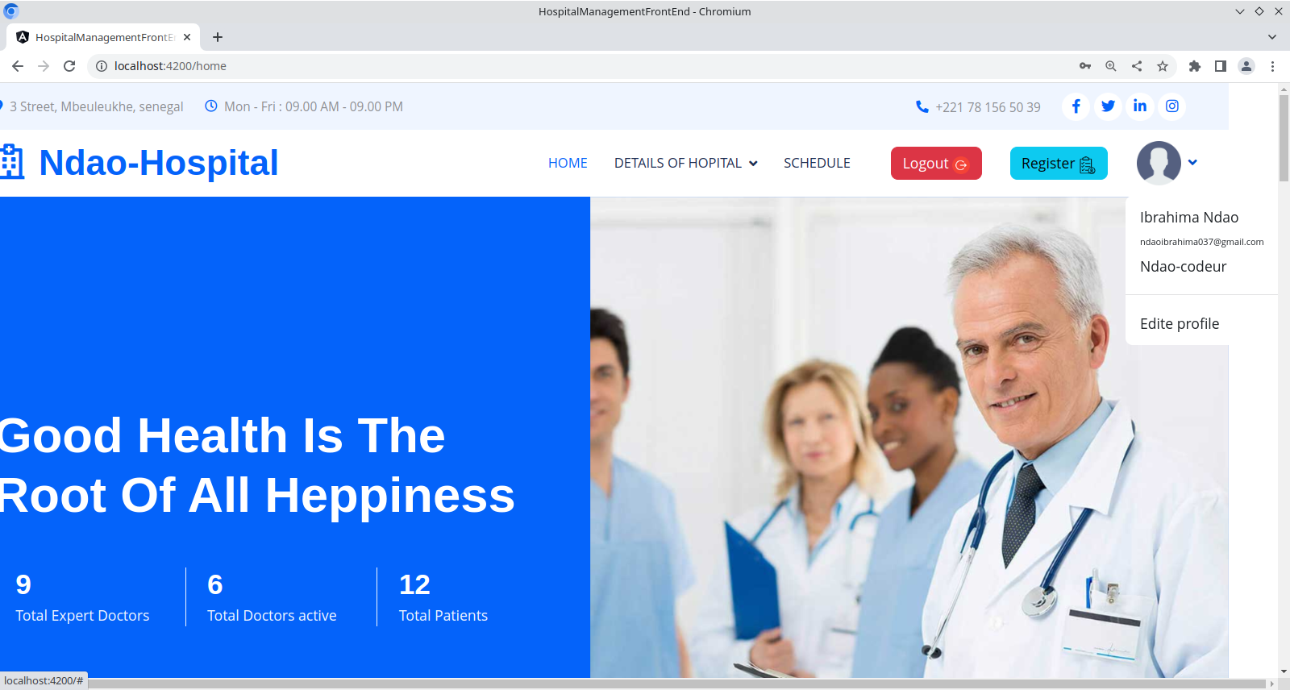
When I connect as a admin

Slide 5

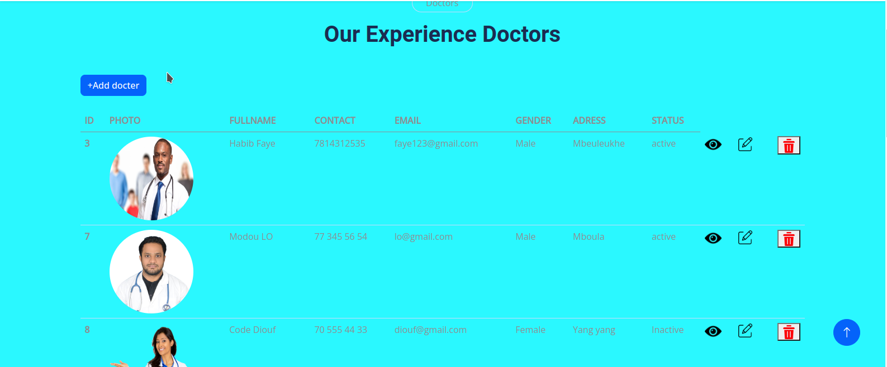
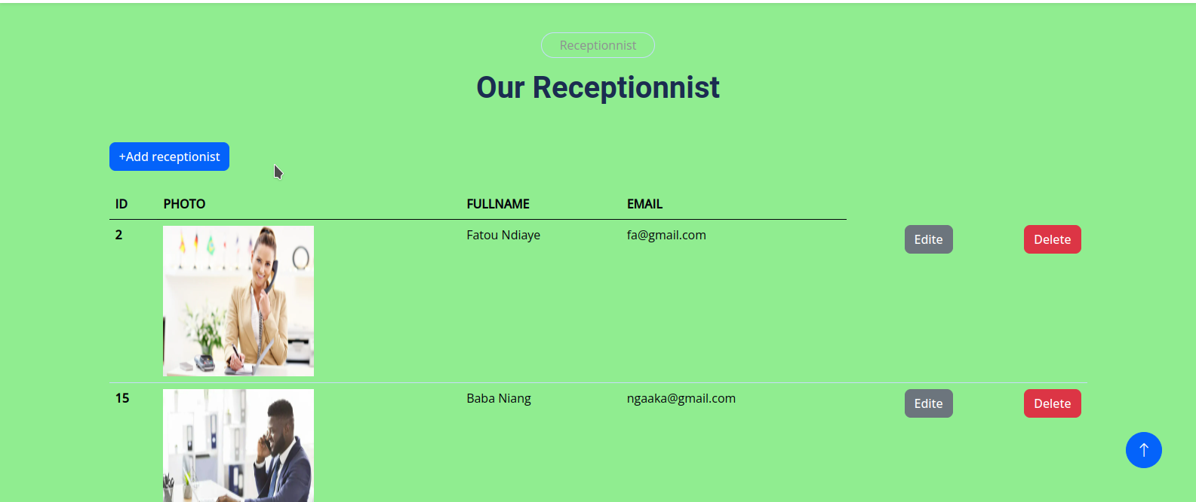
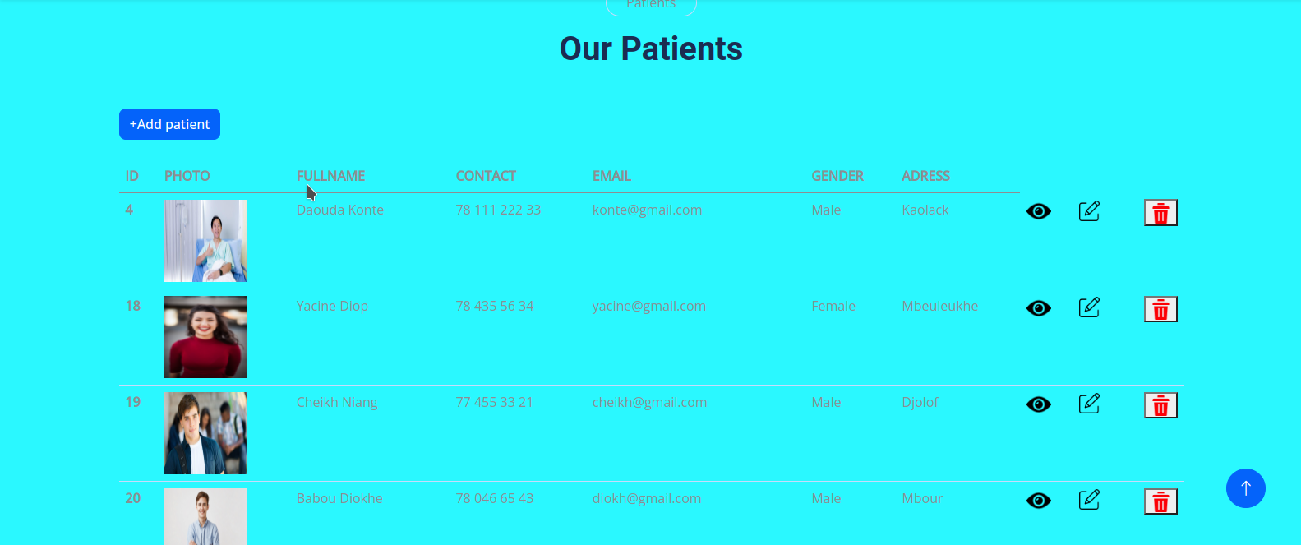


Slide 6
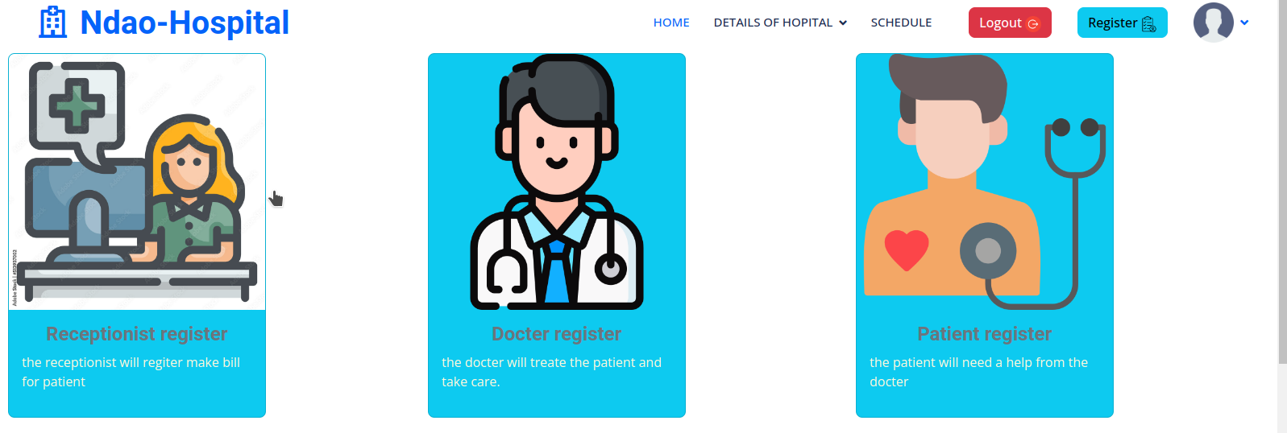
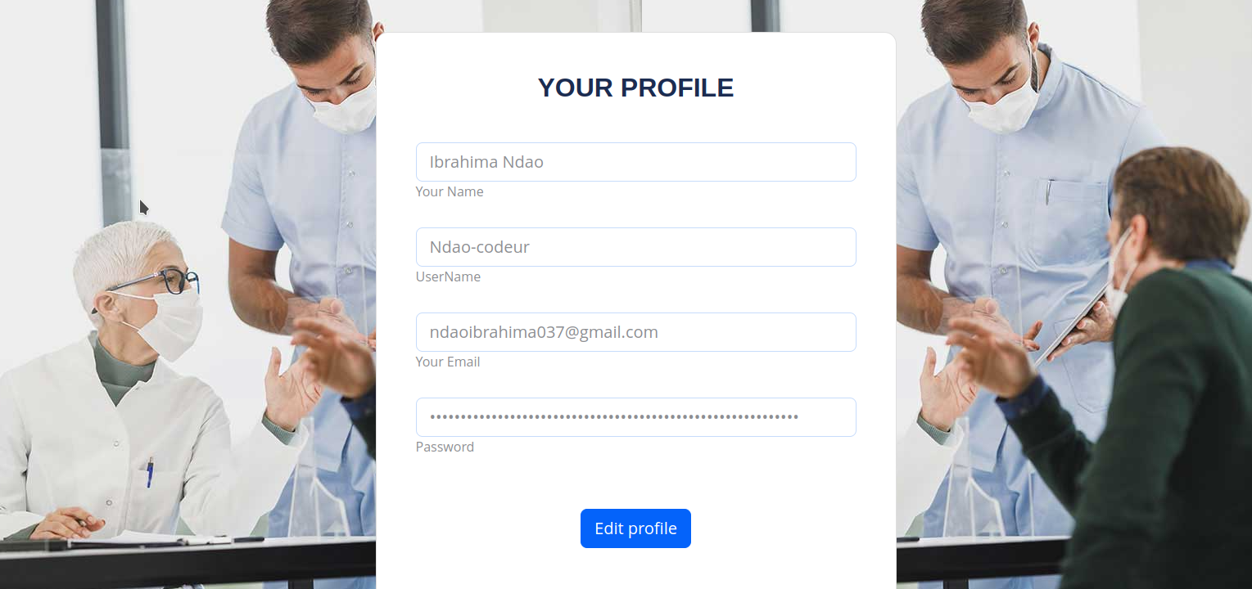

Slide 7
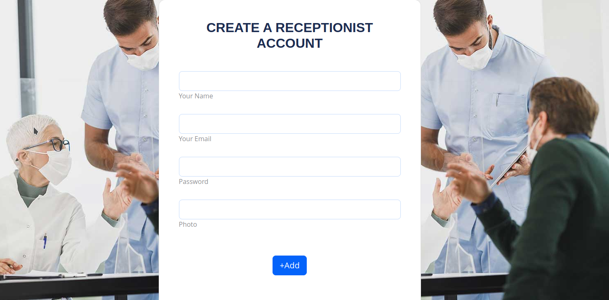
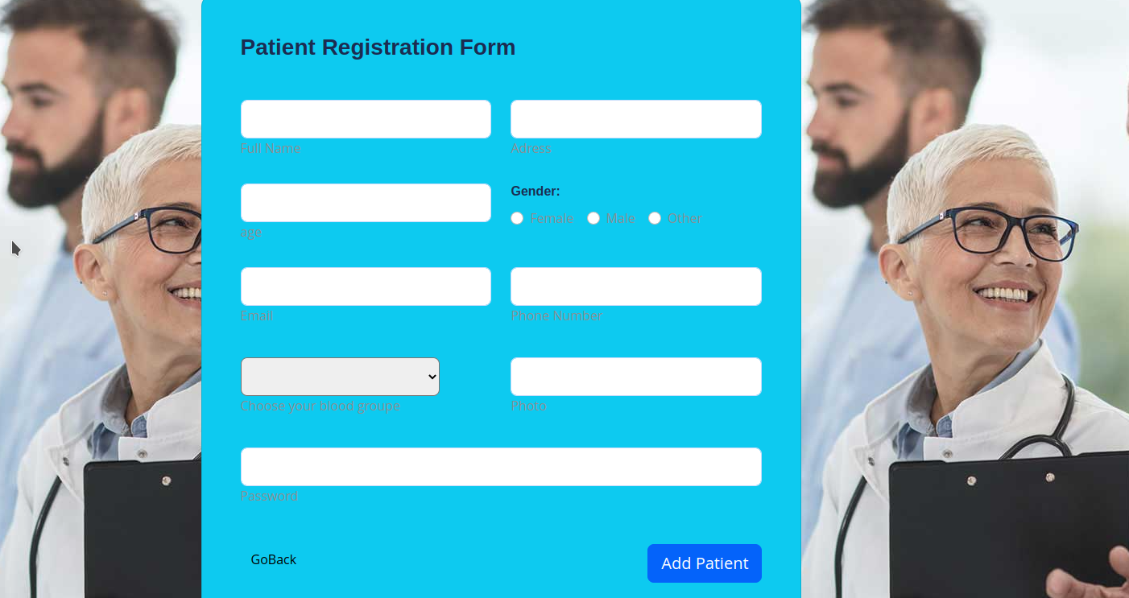
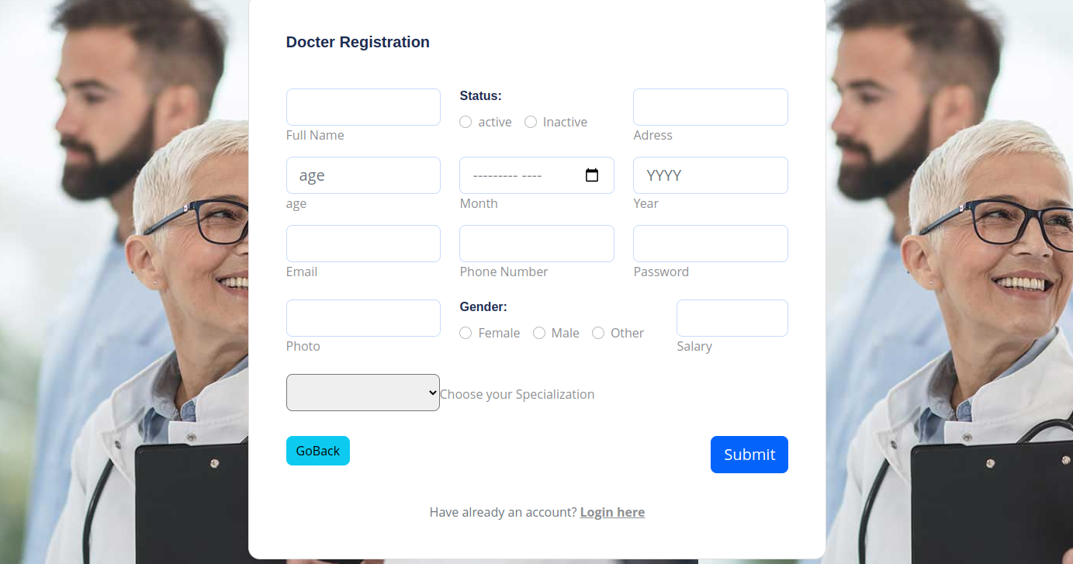
Users register

Slide 8
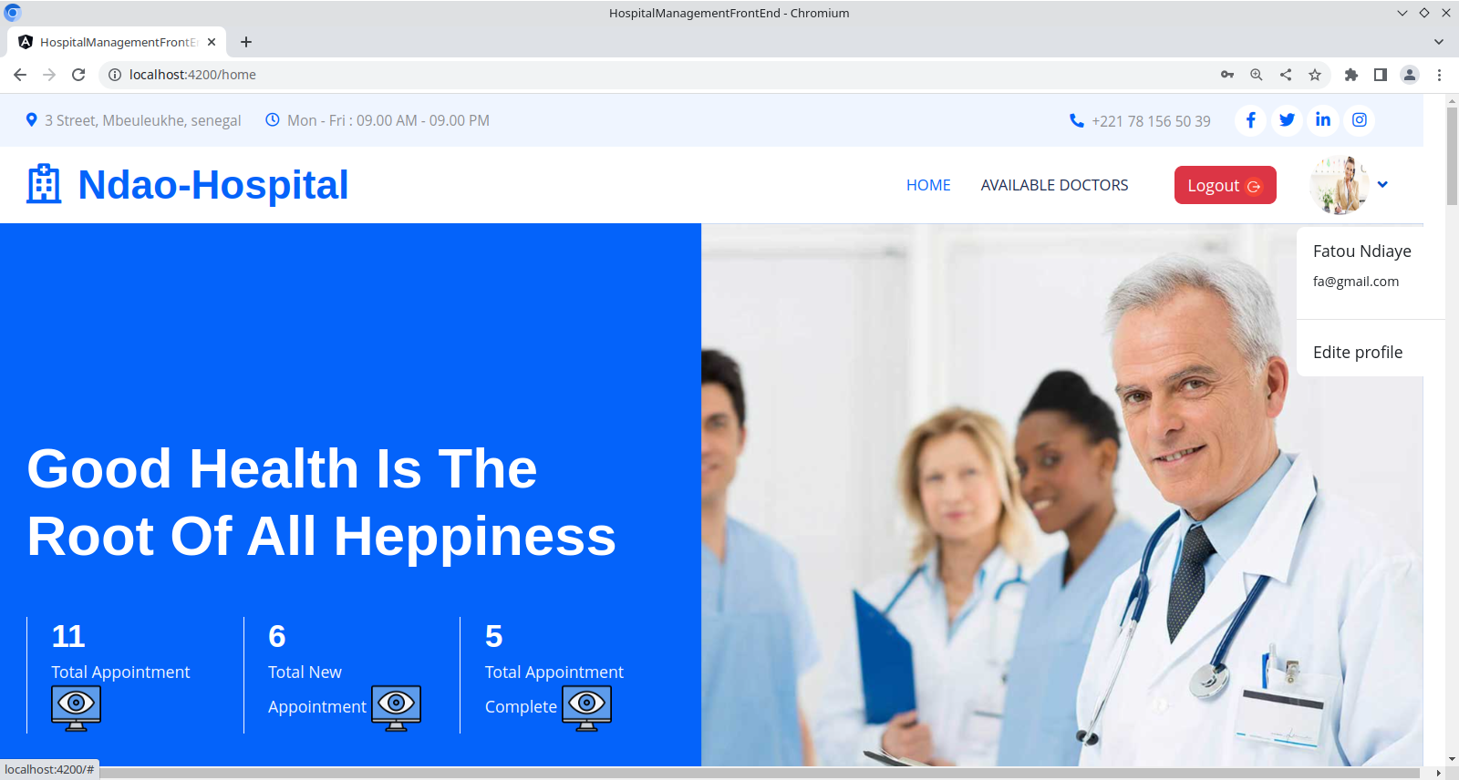
When I connect as a receptionist

Slide 9

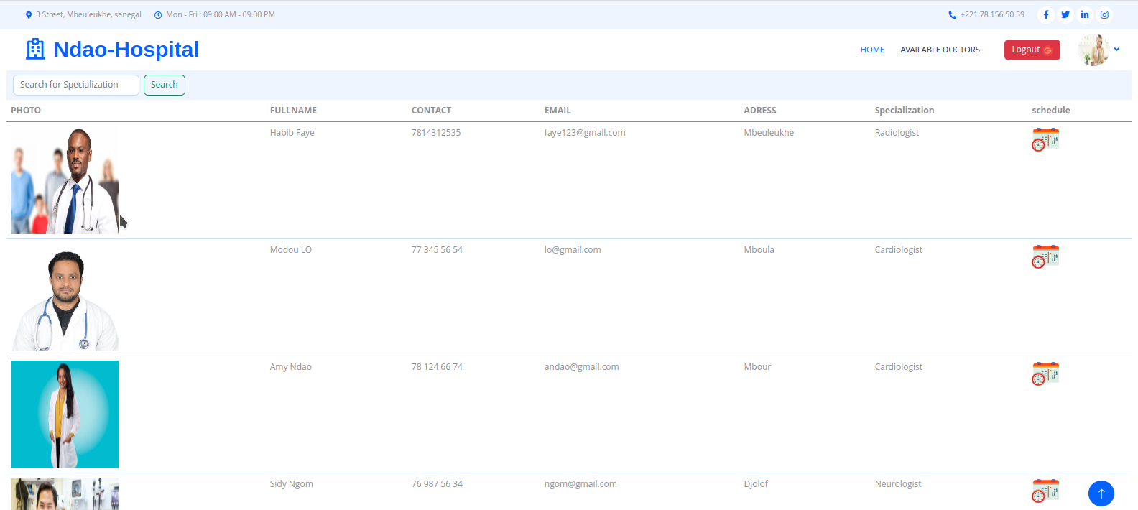
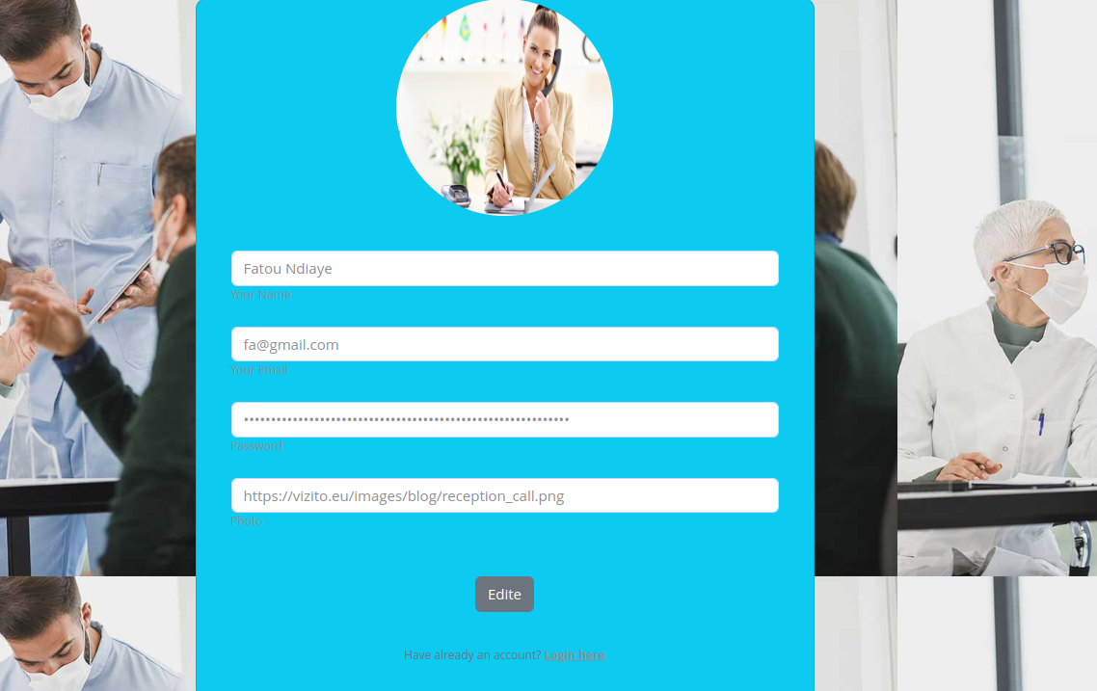

Slide 10

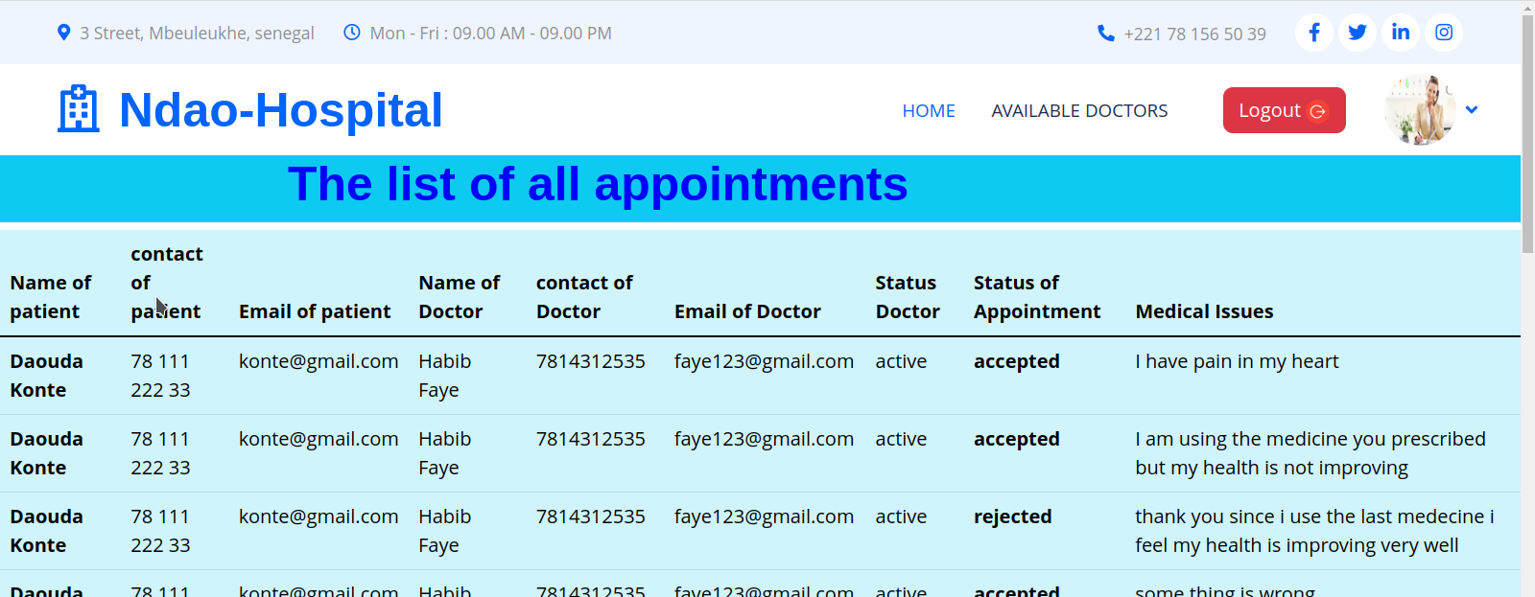

The receptionist dashboard

Slide 11
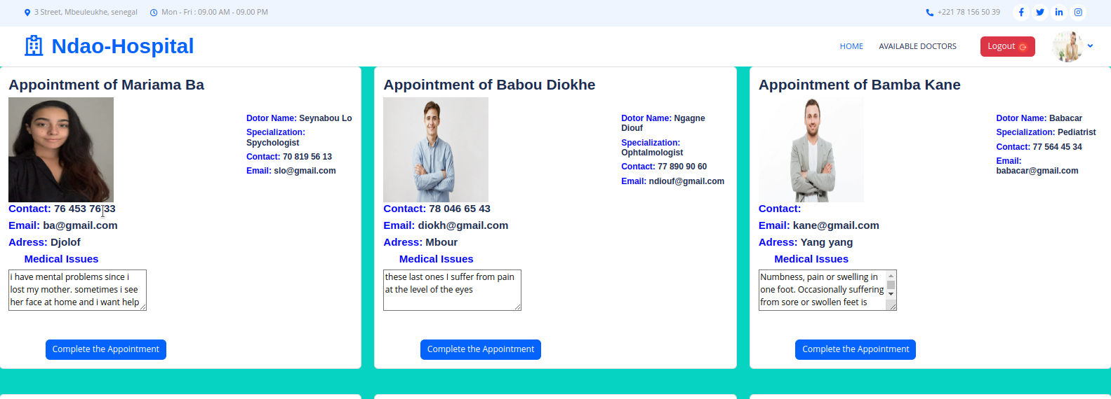

Slide 12
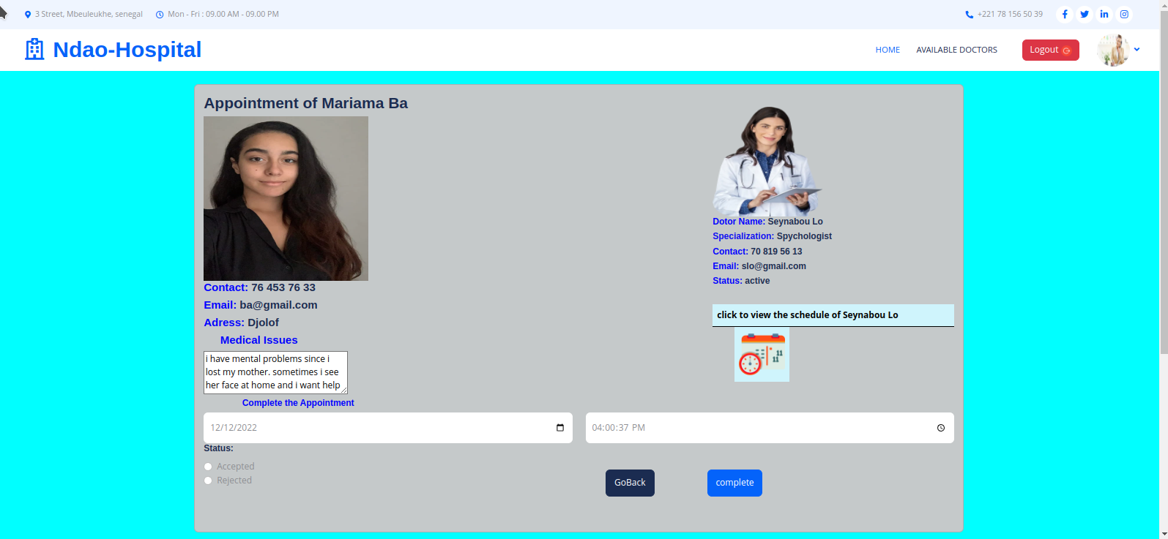
The appointment will be complete by the receptio

Slide 13


Slide 14


Slide 15
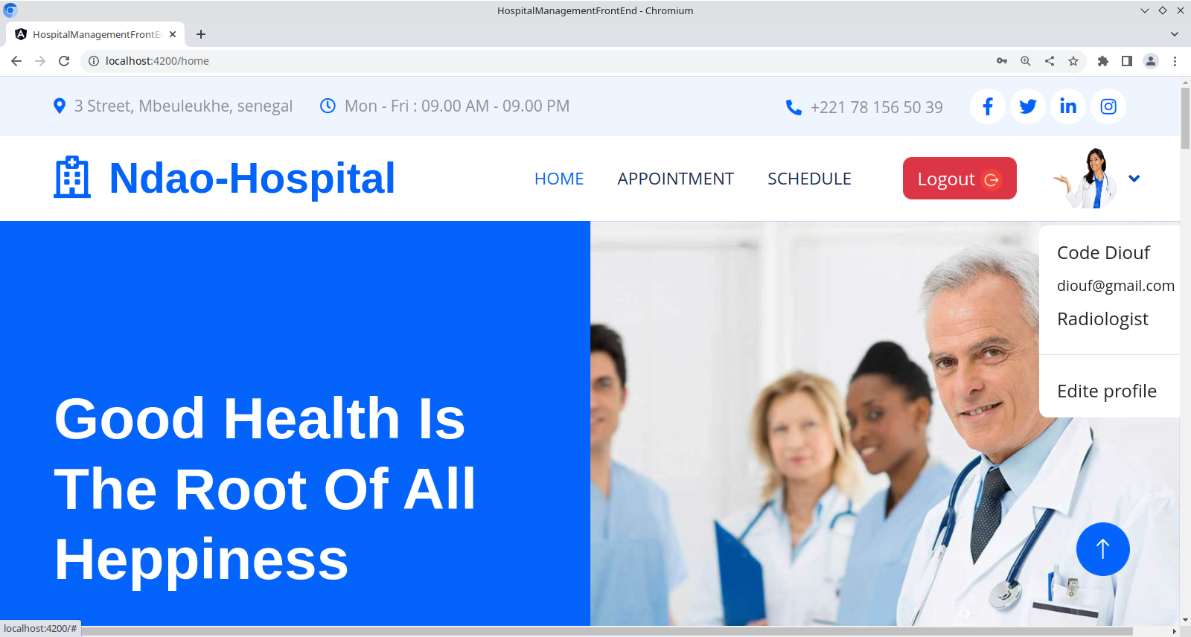
When I connect as a doctor

Slide 16


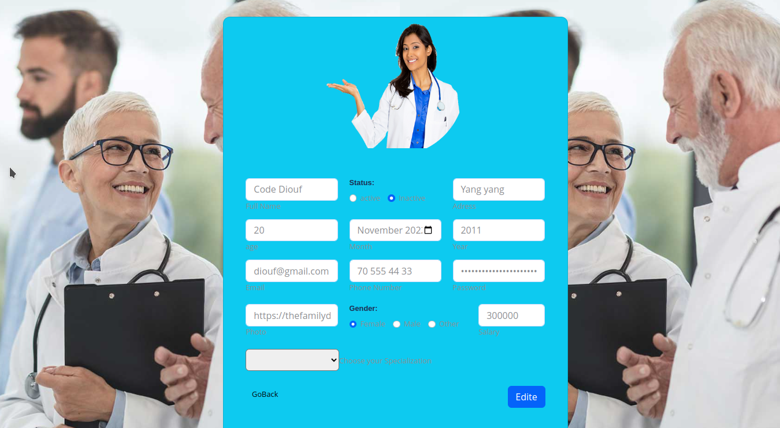
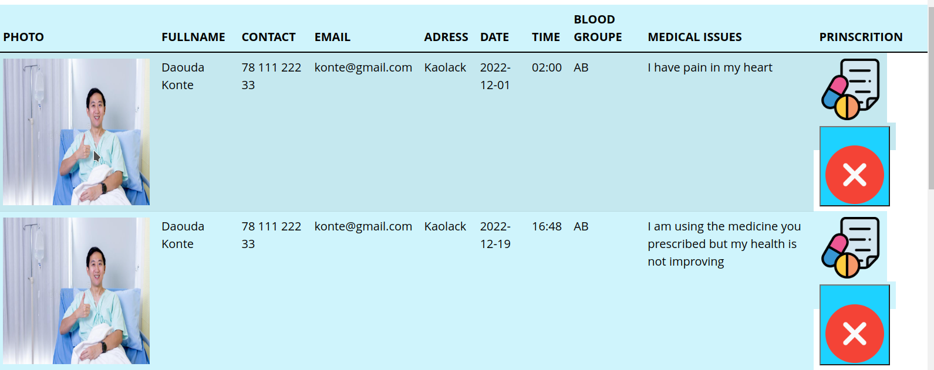

Slide 17
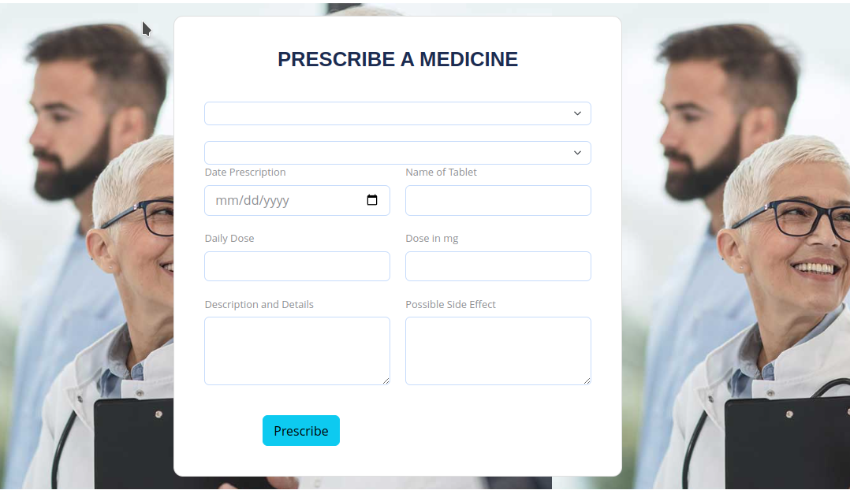
The doctor can see the appointment from the patient and add prescription and dele

Slide 18
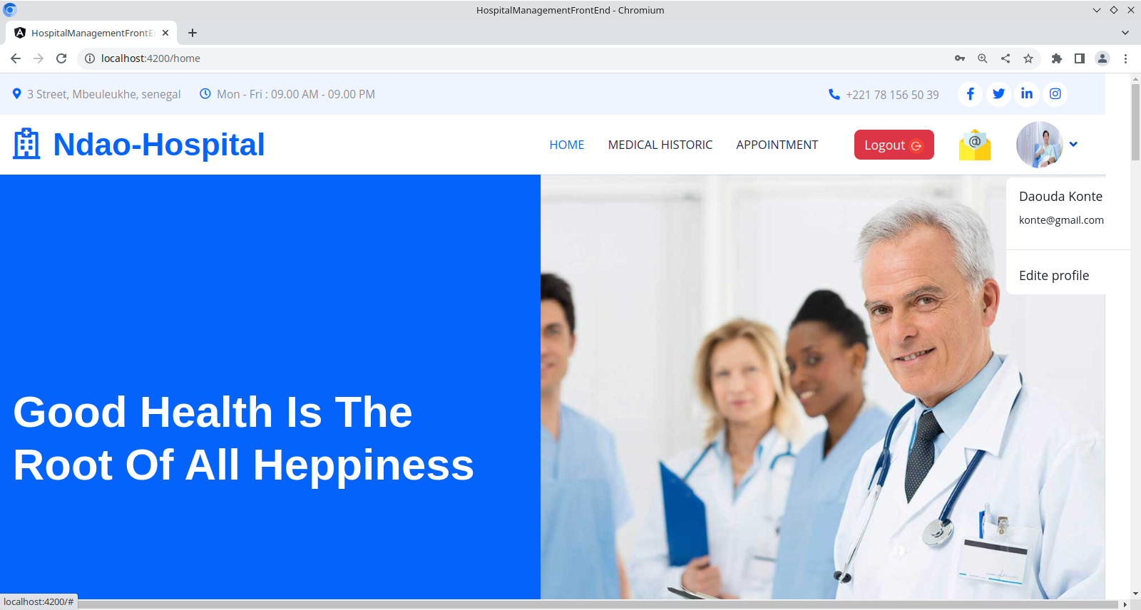
When I connect as a patient

Slide 19

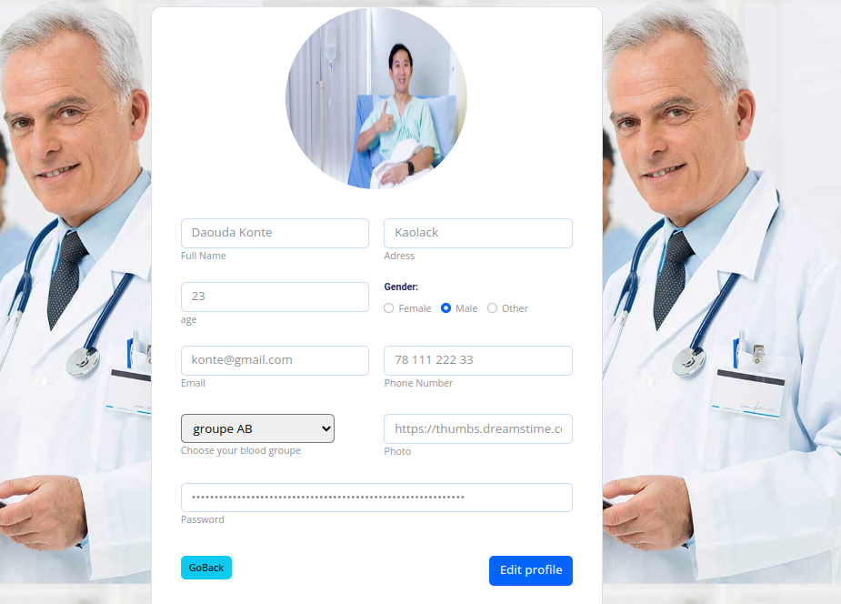
PROFILE

Slide 20
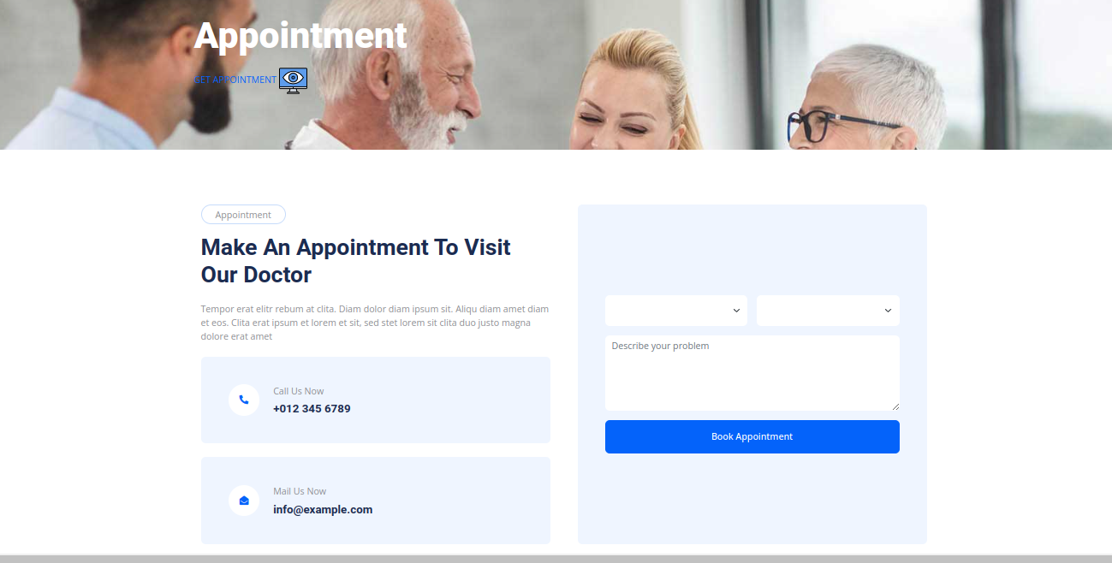

Slide 21
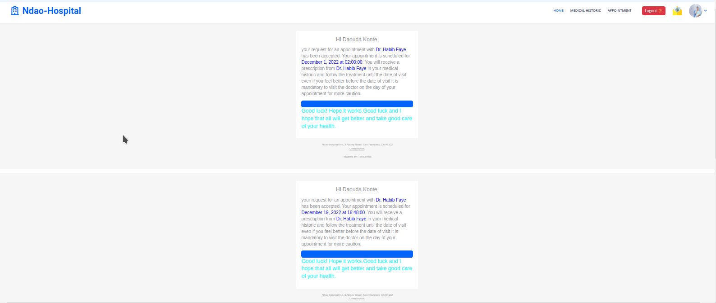
When the appointment is accepted by the receptionist, a notification will be sent to the
Patient to let them know that their request for an appointment has been accepted.

Slide 22
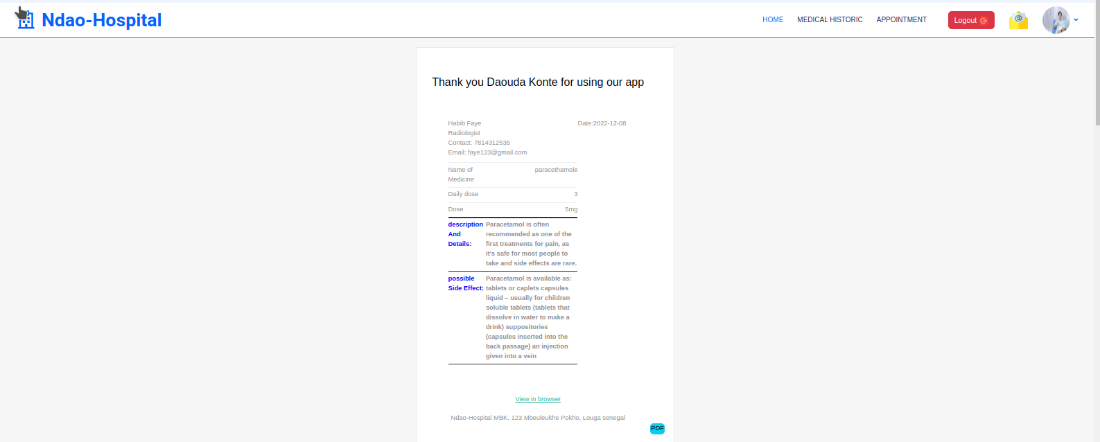
When the patient click to the option medical historic he will see the
prescription sent by the doctor .

Slide 23
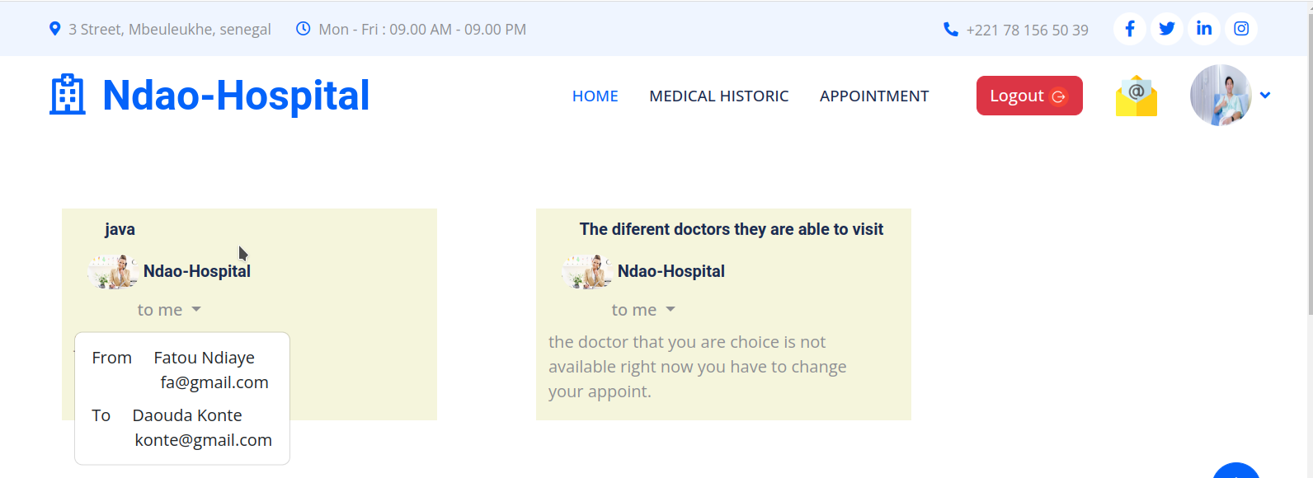
When the appointment is rejected by the receptionist. An email message will be sent to the patient
To explain the reason why the appointment is rejected and help him to do another appointment with an available doctor.

Slide 24


