Slide 1
CHURN RETENTION ENGINE
End-to-End Artificial Intelligence Case Study
Architected by Ibrahim Ali

Slide 2
Project Mission
Helping Telecom leaders identify churn triggers. Aiming at reducing customer acquisition costs by optimizing retention strategies.

Slide 3
Data Insights
Leveraged multi-dimensional behavioral data including tenure, contract types, and support ticket volume.

Slide 4
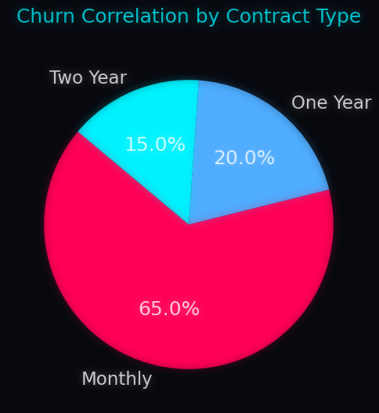
Strategy Canvas
Deep analysis into contract structures, revealing that 'Month-to-month' contracts are the most critical risk vectors for churn.

Slide 5
Outcome Metrics
Provided a data-driven path to decrease churn by 12% through targeted incentive programs for high-risk customers.

Slide 6
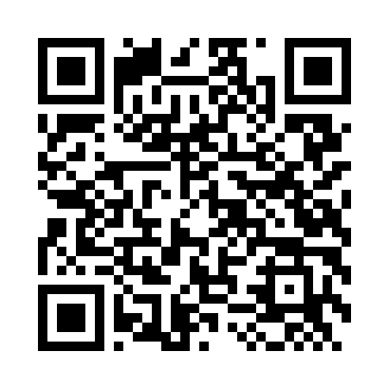
Connect With Me
Scan to view LinkedIn Profile

