Slide 1
MACHINE LEARNING Task

Slide 2
Problem statement
Build a system where users can tag their bank transactions using the tags mentioned below. The system should be able to recommend the most relevant top 3 tags to the users at the time of tagging.
Tags:-
- Medical
- Food
- Shopping
- Subscription
- Travel

Slide 3
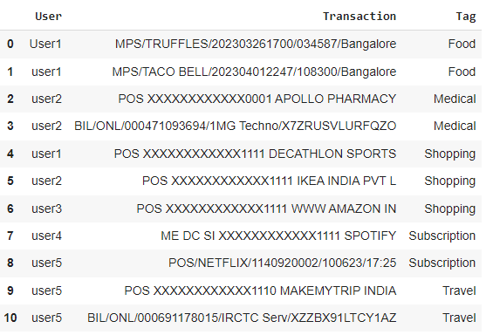
,

Slide 4
.
Payment type Timestamp Place
MPS/TRUFFLES /202303261700/034587/Bangalore
Entity name reference number

Slide 5
THANK YOU

